Slide 1
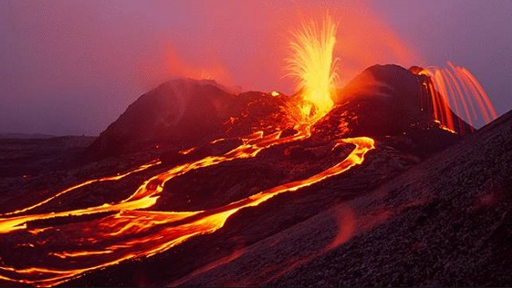
WHY DO THE IMPACTS OF TECTONIC HAZARDS VARY?

Slide 2
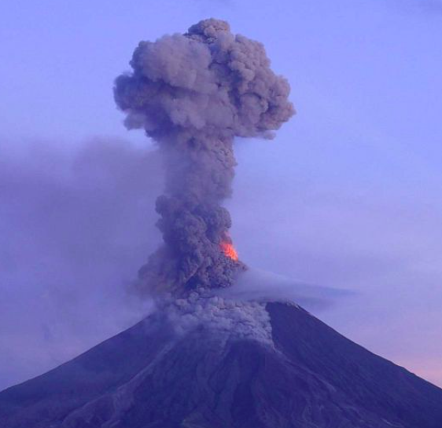
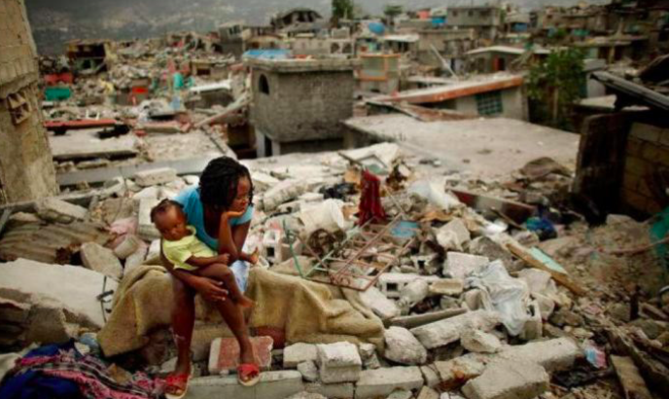
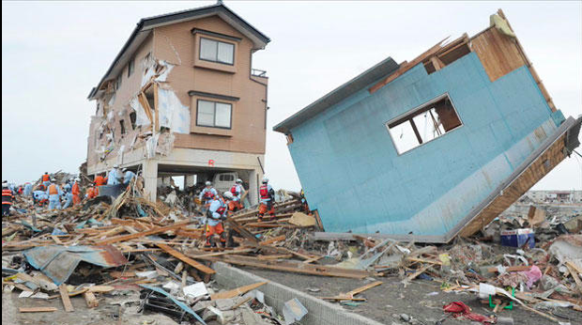
WHY DO THE IMPACTS OF TECTONIC HAZARDS VARY?
Essential questions - What are the causes of tectonic activity? (Causality) - What are the effects of tectonic hazards and how do these vary in different locations? (﻿Time, place and sp﻿ace) - What are the responses to tectonic hazards and do these vary by place? (﻿Innovation, power﻿)

Slide 3
Objectives
WHY DO THE IMPACTS OF TECTONIC HAZARDS VARY?
What: The location of earthquakes/volcanoes
Why: To understand that different types of plate margins cause different types of tectonic hazards
How: To explore maps of the main tectonic plates and plate tectonic theory

Slide 4
Can you name the places where earthquakes and volcanoes occur?

Slide 5
Where are the world’s deadliest volcanoes?
Volcanoes are one of the most beautiful and the most dangerous geological features on the face of the planet Earth.
However, not all volcanoes are the same.
However, some volcanoes are located quite close to densely populated areas, and in the past, they have erupted ferociously, spewing lava and pyroclastic flows that destroyed vast areas.
These volcanoes have been named the "Decade Sixteen” and are considered the most threatening volcanoes on earth to human populations.

Slide 6
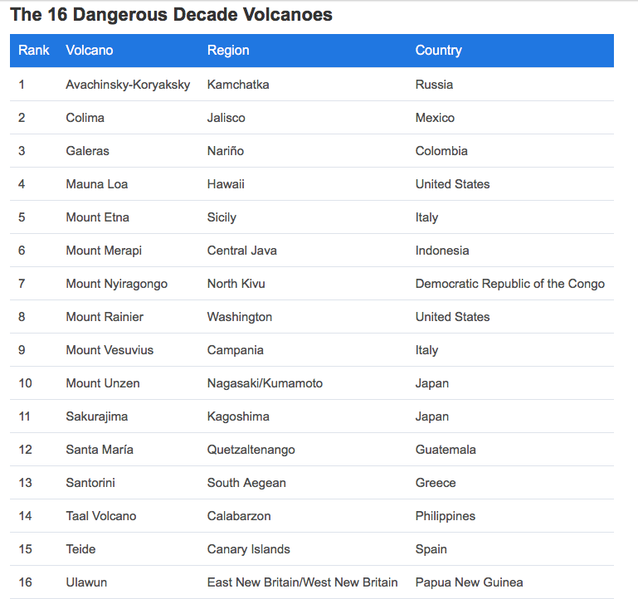
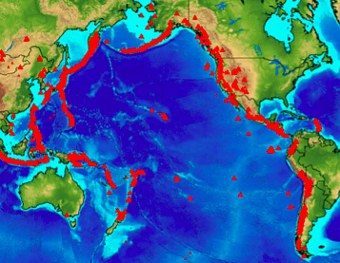
The location of volcanoes
https://www.worldatlas.com/articles/the-16-dangerous-decade-volcanoes.html
https://listverse.com/2020/01/18/16-most-dangerous-volcanoes-in-the-world/
Task:
1. Use the atlas, google maps or google earth to locate these volcanoes.
2. Mark them on your map.
3. How can you describe the location of these volcanoes in the world? (write a short paragraph)
Extension: Choose one of the decade volcanoes and undertake some research to explain: Where it is, the type of volcano it is, the plate boundary this volcano is found at, when it last erupted, what the worst eruption was, how the volcano tends to erupt, fun facts

Slide 7
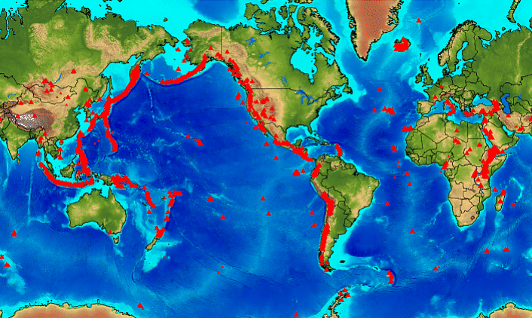

Slide 8
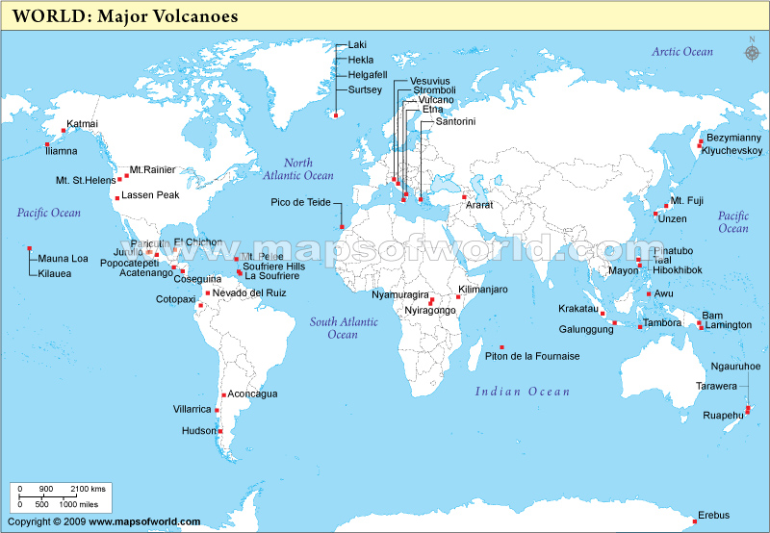

Slide 9
True or false?
Volcanoes happen all over the world.
Volcanoes are found in narrow belts.
Volcanoes are found along the East Coast of North and South America.
Volcanoes are found along the West Coast of North and South America.

Slide 10
Write your own description of the location of volcanoes in the world.
Think about:
The patterns you notice about where volcanoes are found and any odd things out (anomalies)
The areas of continents where there are many volcanoes
The areas of continents where there are few volcanoes

Slide 11
The location of volcanoes
There are not many volcanoes in (Asia/Africa) or (Europe/Antarctica).
Many of the volcanoes stretch along lines like the one down the western side of (Africa/North America) and the middle of the Atlantic (Ocean/Continent).
Many of the volcanoes are found in a big circle around the edge of the (Pacific/Atlantic) Ocean in countries such as the (UK/Japan). This is called the (Pacific Ring of Fire/Atlantic Ring of Fire)

Slide 12
Copy the paragraph below. Select the correct answers from the brackets.
There are not many volcanoes in (Asia/Africa) or (Europe/Antarctica).
Many of the volcanoes stretch along lines like the one down the side of (Africa/North America) and the middle of the Atlantic (Ocean/Continent).
Many of the volcanoes are found in a big circle around the edge of the (Pacific/Atlantic) Ocean in countries such as the (UK/Japan). This is called the (Pacific Ring of Fire/Atlantic Ring of Fire)

Slide 13
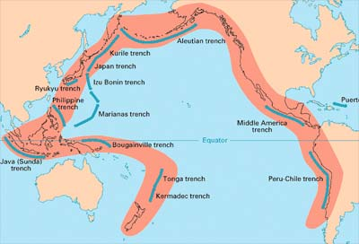

Slide 14
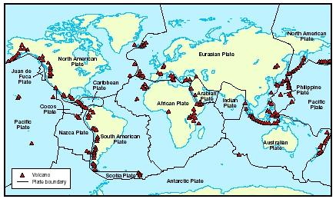

Slide 15
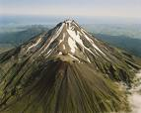
Homework:
Research the names of the 5 largest Volcanoes. Explain what criteria you have used to decide which are the biggest.
Due:

Slide 16
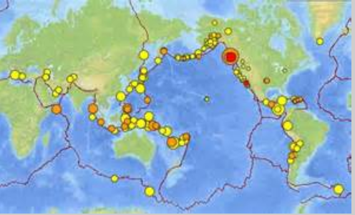
The location of earthquakes
WHY DO THE IMPACTS OF TECTONIC HAZARDS VARY?
LO: I can use atlas maps and GIS to locate tectonic plates and earthquake zones.

Slide 17
Post it note challenge
Where are some of the main earthquake zones?

Slide 18
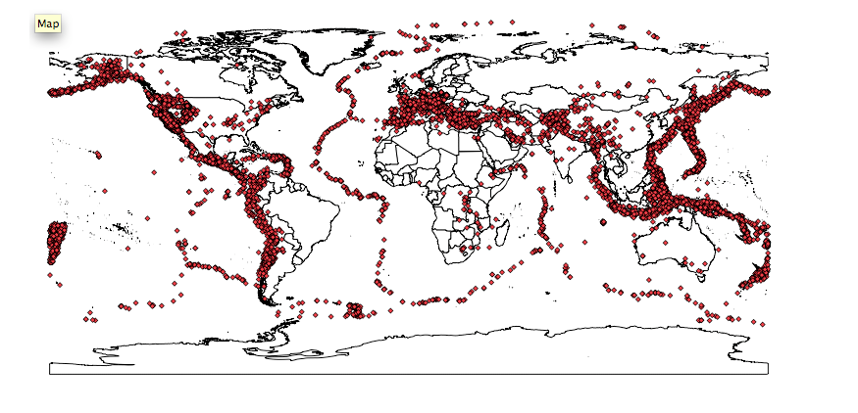
A map of the worlds major earthquakes
How does this compare to the map of volcanic activity?

Slide 19
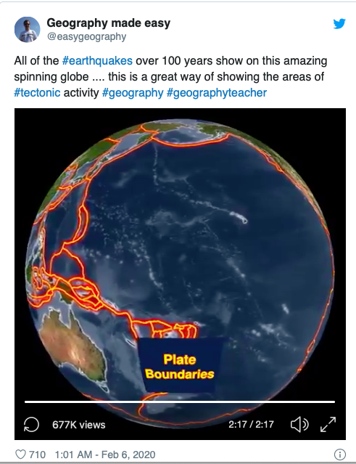

Slide 20
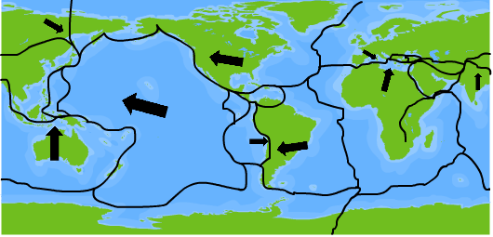
The location of earthquakes
Do the USGS map and the plate boundary map relate?
Recent earthquakes from the USGS:
http://earthquake.usgs.gov/earthquakes/map/

Slide 21
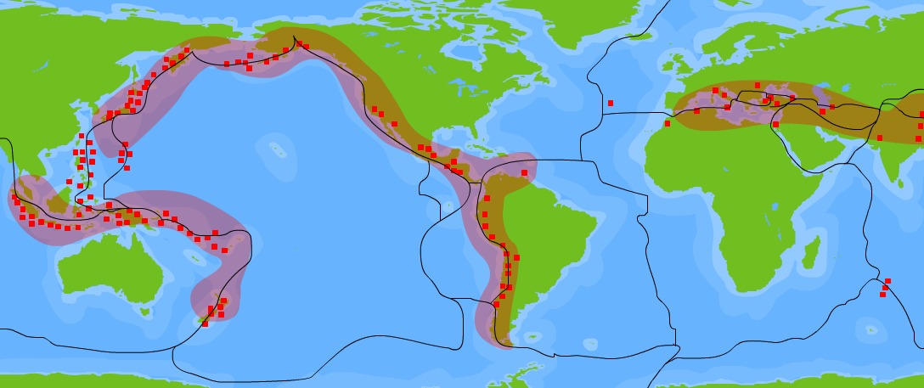
Where do earthquakes occur?
Earthquakes are vibrations of the earth’s crust caused by movement at plate boundaries and major fault lines. The red areas on the map are where earthquakes are most common.
North American Plate
Eurasian Plate
Pacific Plate
African Plate
South American Plate
Indo-Australian Plate
Nazca Plate
Do the location of earthquakes form a pattern?
Notes:
Teacher’s note:
Students should be encouraged to describe the patterns of earthquake activity on a global scale as shown on the map. Most earthquakes are felt on or near plate boundaries. This could be extended through discussion of the movement of the world’s major tectonic plates (the presentation ‘Plate Tectonics’ could be used here). Students could be encouraged to ‘build’ maps similar to the one shown here. Students could mark ‘active zones’ on world map showing population distribution and label where densely settled populations overlap with earthquake zones.
The worksheet Plates accompanies this slide.

Slide 22
Geographical presentation skills
LO: I can use atlas maps and GIS to locate tectonic plates and earthquake zones.
Using internet research complete the tasks showing the locations of recent earthquakes on the map.
Add these to your volcanoes map.
Include a key to differentiate between the volcanoes and earthquakes

Slide 23
Plenary
How may what we have learnt already feed into our main enquiry question?
WHY DO THE IMPACTS OF TECTONIC HAZARDS VARY?

