Slide 1
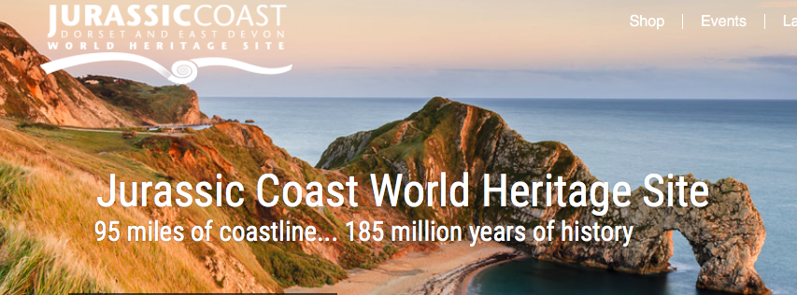
Case study: The Jurassic coastline, Dorset
https://www.youtube.com/watch?v=iTuZCiOLLtk
Learning Objectives:
I can describe the location of the Jurassic Coast and the erosional processes that shape the coastline.
I can explain the formation of landforms found along the Jurassic coast and investigate why some areas are eroding more quickly than others.
http://jurassiccoast.org

Slide 2
https://www.youtube.com/watch?v=ZWEJq03NBao&t=249s

Slide 3
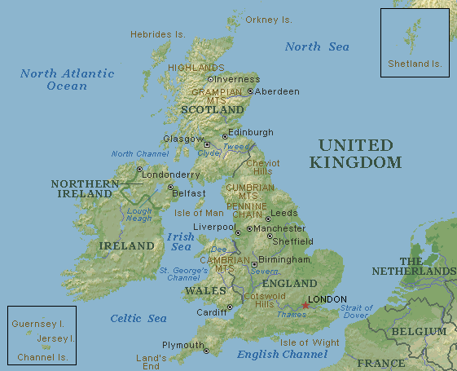
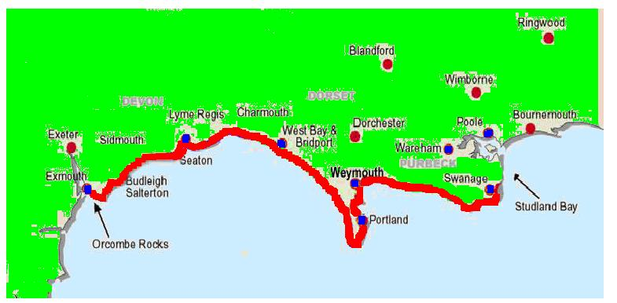
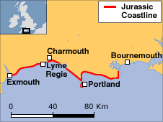
How could you describe the location of the Jurassic Coast?

Slide 4
Where is the Jurassic Coast?
Describe where the Jurassic Coast is located
HINTS: Use compass directions, towns located on the coastline, scale etc…

Slide 5
6
4
5
2
3
1

Slide 6
1. Chesil Beach
Chesil beach stretches for 18km and is made of pebbles and shingle.
It is Britain’s longest tombolo. A tombolo is a spit that connects to an island – in this case, the Isle of Portland.

Slide 7
2. Durdle Door
Durdle Door is an excellent example of a sea arch. The sea has broken through the outer wall of Porland Stone and rapidly eroded the Purbeck Bed behind.

Slide 8
3. Lulworth Cove
Lulworth Cove is a small circular bay with a narrow seaward opening. It is thought that the weak point that produced the opening was due to a river. Marine erosion exploited the line of weakness produced by the river and eroded the weaker rocks behind the Portland Stone until the more resistant chalk cliffs were reached.

Slide 9
4. Studland Bay
Studland Bay was voted the fourth top beach in the UK by Which Magazine.
Glorious sandy beaches stretch for three miles and includes a designated naturist (nudist) area!

Slide 10
5. Studland Heath
The heathland behind Studland Beach is a haven for many rare birds and wildlife.
Rare heathland plants grow here and it is home to all six British reptiles – 3 species of lizard and 3 species of snake.

Slide 11
6. Old Harry Rocks
Old Harry Rocks are chalk sea stacks that have been eroded by the power of the sea.

Slide 12
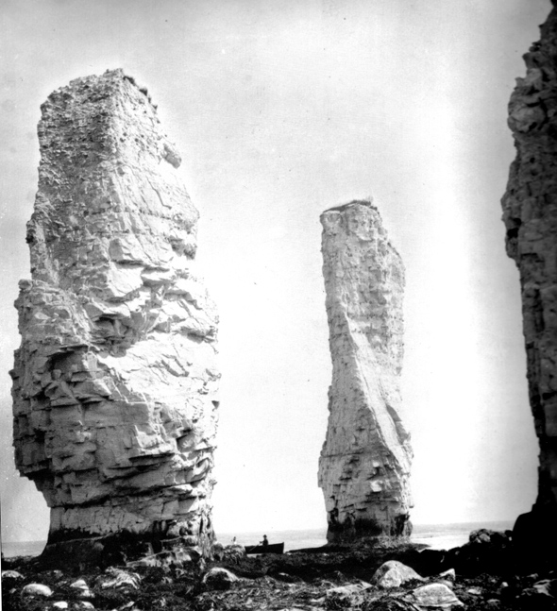

Slide 13
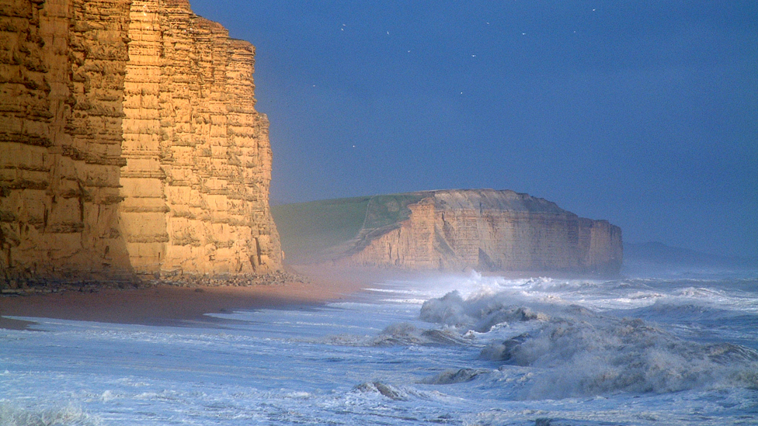
What: A case study of landforms on the Jurassic coast, Dorset, UK
How: - Using the resources internet, produce a overview of the processes and resulting landforms on the Jurassic coast (poster, PPT, revision sheet)
Success criteria:
Where is the Jurassic Coast? (Include map and description)
What erosion processes are happening at Lulworth Cove? (name the processes)
What landforms can be found at the Jurassic Coast?
Include pictures and labels for ‘hard’ landforms e.g. arches, caves.
TIP: Look at Lulworth Cove, Durdle Door, Swanage, Old Harry Rocks.
What depositional landforms can be found?
4. Why are some areas eroding more quickly than others? (think of the geology)
Good overview websites from RGS:
https://www.rgs.org/schools/teaching-resources/jurassic-coast-of-dorset-and-east-devon/
https://www.dorsetwildlifetrust.org.uk/hres/TheFormationofChesilBeach.pdf
EXTENSION- How do people use this area?:

Slide 14
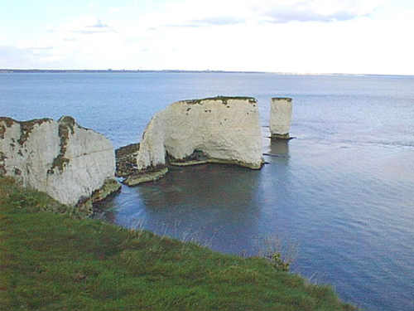
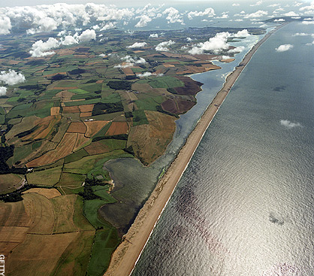
Landforms along the Jurassic Coast
What landforms are pictured below? How did they form?
Lulworth Cove
Durdle Door
Explain how each of the following features form. Include pictures and labels
Old Harry Rocks
Chesil beach

Slide 15
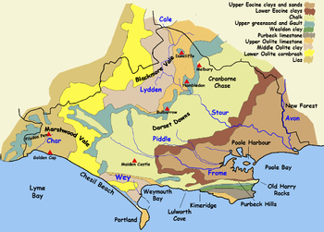
Why are some areas eroding more quickly than others?
Think about the rock type (geology) of the area. Use the map and found out which rocks are harder and which ones are softer.

Slide 16
EXTENSION- How do people use the Jurassic Coastline?
Consider how people use the coastline for economic and environmental reasons.
Carry out your own research!

Slide 17
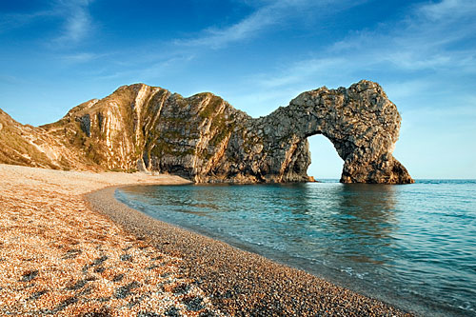
Geographical skill: Draw an annotated sketch of Durdle Door sea arch

Slide 19
