Slide 1
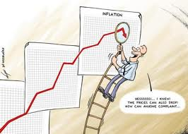
The inflation game
To understand the causes and consequences of inflation

Slide 2
Workers
Start with wages of $20,000 a year
Work out the Purchasing Power for each year
You may demand higher wages as a group at anytime though this will lead to an additional 2% next round, firms will of course need to agree to this
You have savings of $5000
Calculate what happens to these
Assume an interest rate of 5%

Slide 3
Large Firm – Industrial Factory
You export and sell aircraft to the Vulgarians
Orders are worth $100 million a year
The exchange rate is $1 to 5 Vulgars
Assume that the rate of inflation is 5% in Vulgaria
For every 1 percentage point of inflation above the Vulgarian Inflation rate your exports become more expensive and you lose $5million of revenue
The Vulgarians will buy from countries with lower rates of inflation
If you can get the inflation rate below 5% your exports will actually be cheaper!!

Slide 4
Small firm – shoe shop
You have sales of $500,000 a year.
You must decide at the beginning of each year how much to put your prices up during the game.
For every 1% point above inflation to a maximum of 3% you increase revenue by $50,000
For every year you put up prices at below the rate of inflation you lose $50,000

Slide 5
Small firm – chocolate shop
You have sales of $200,000 a year.
You must decide at the beginning of each year how much to put your prices up during the game.
For every 1% point above inflation to a maximum of 3% you increase revenue by $50,000
For every year you put up prices at below the rate of inflation you lose $50,000

Slide 6
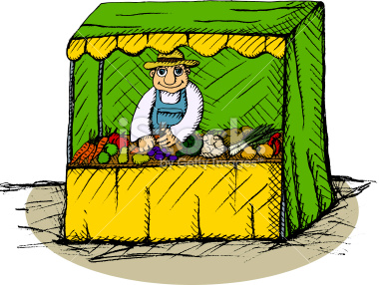
Small firm – green grocer
You have sales of $50,000 a year.
You must decide at the beginning of each year how much to put your prices up during the game.
For every 1% point above inflation to a maximum of 3% you increase revenue by $5,000
For every point you
For every year you put up prices at below the rate of inflation you lose $5,000

