Slide 1
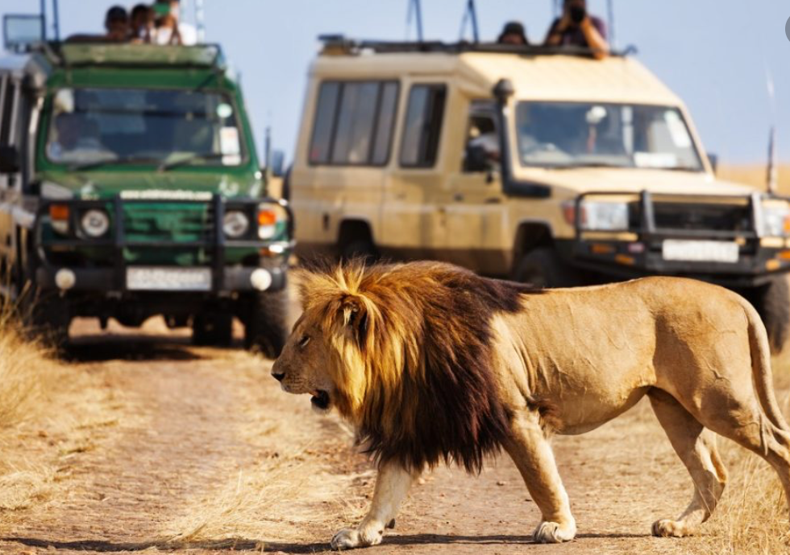
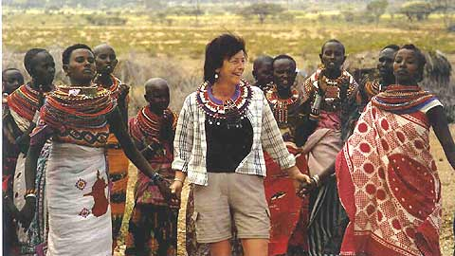
3.4 Tourism
Learning objectives;
Why has tourism grown?
What are the impacts of growth?
How can it be managed sustianbly?

Slide 2
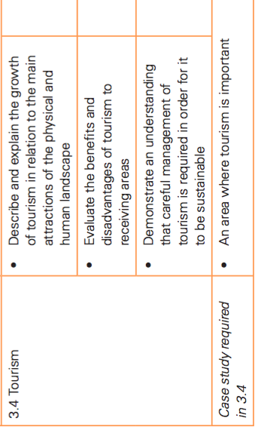

Slide 3
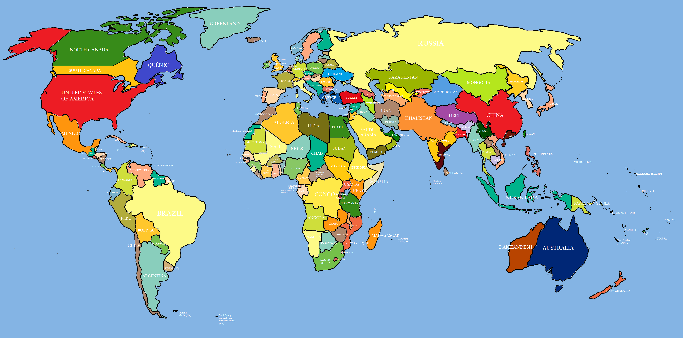
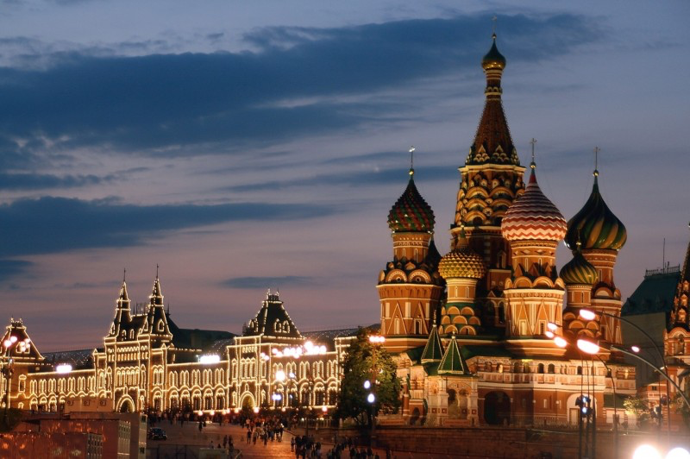
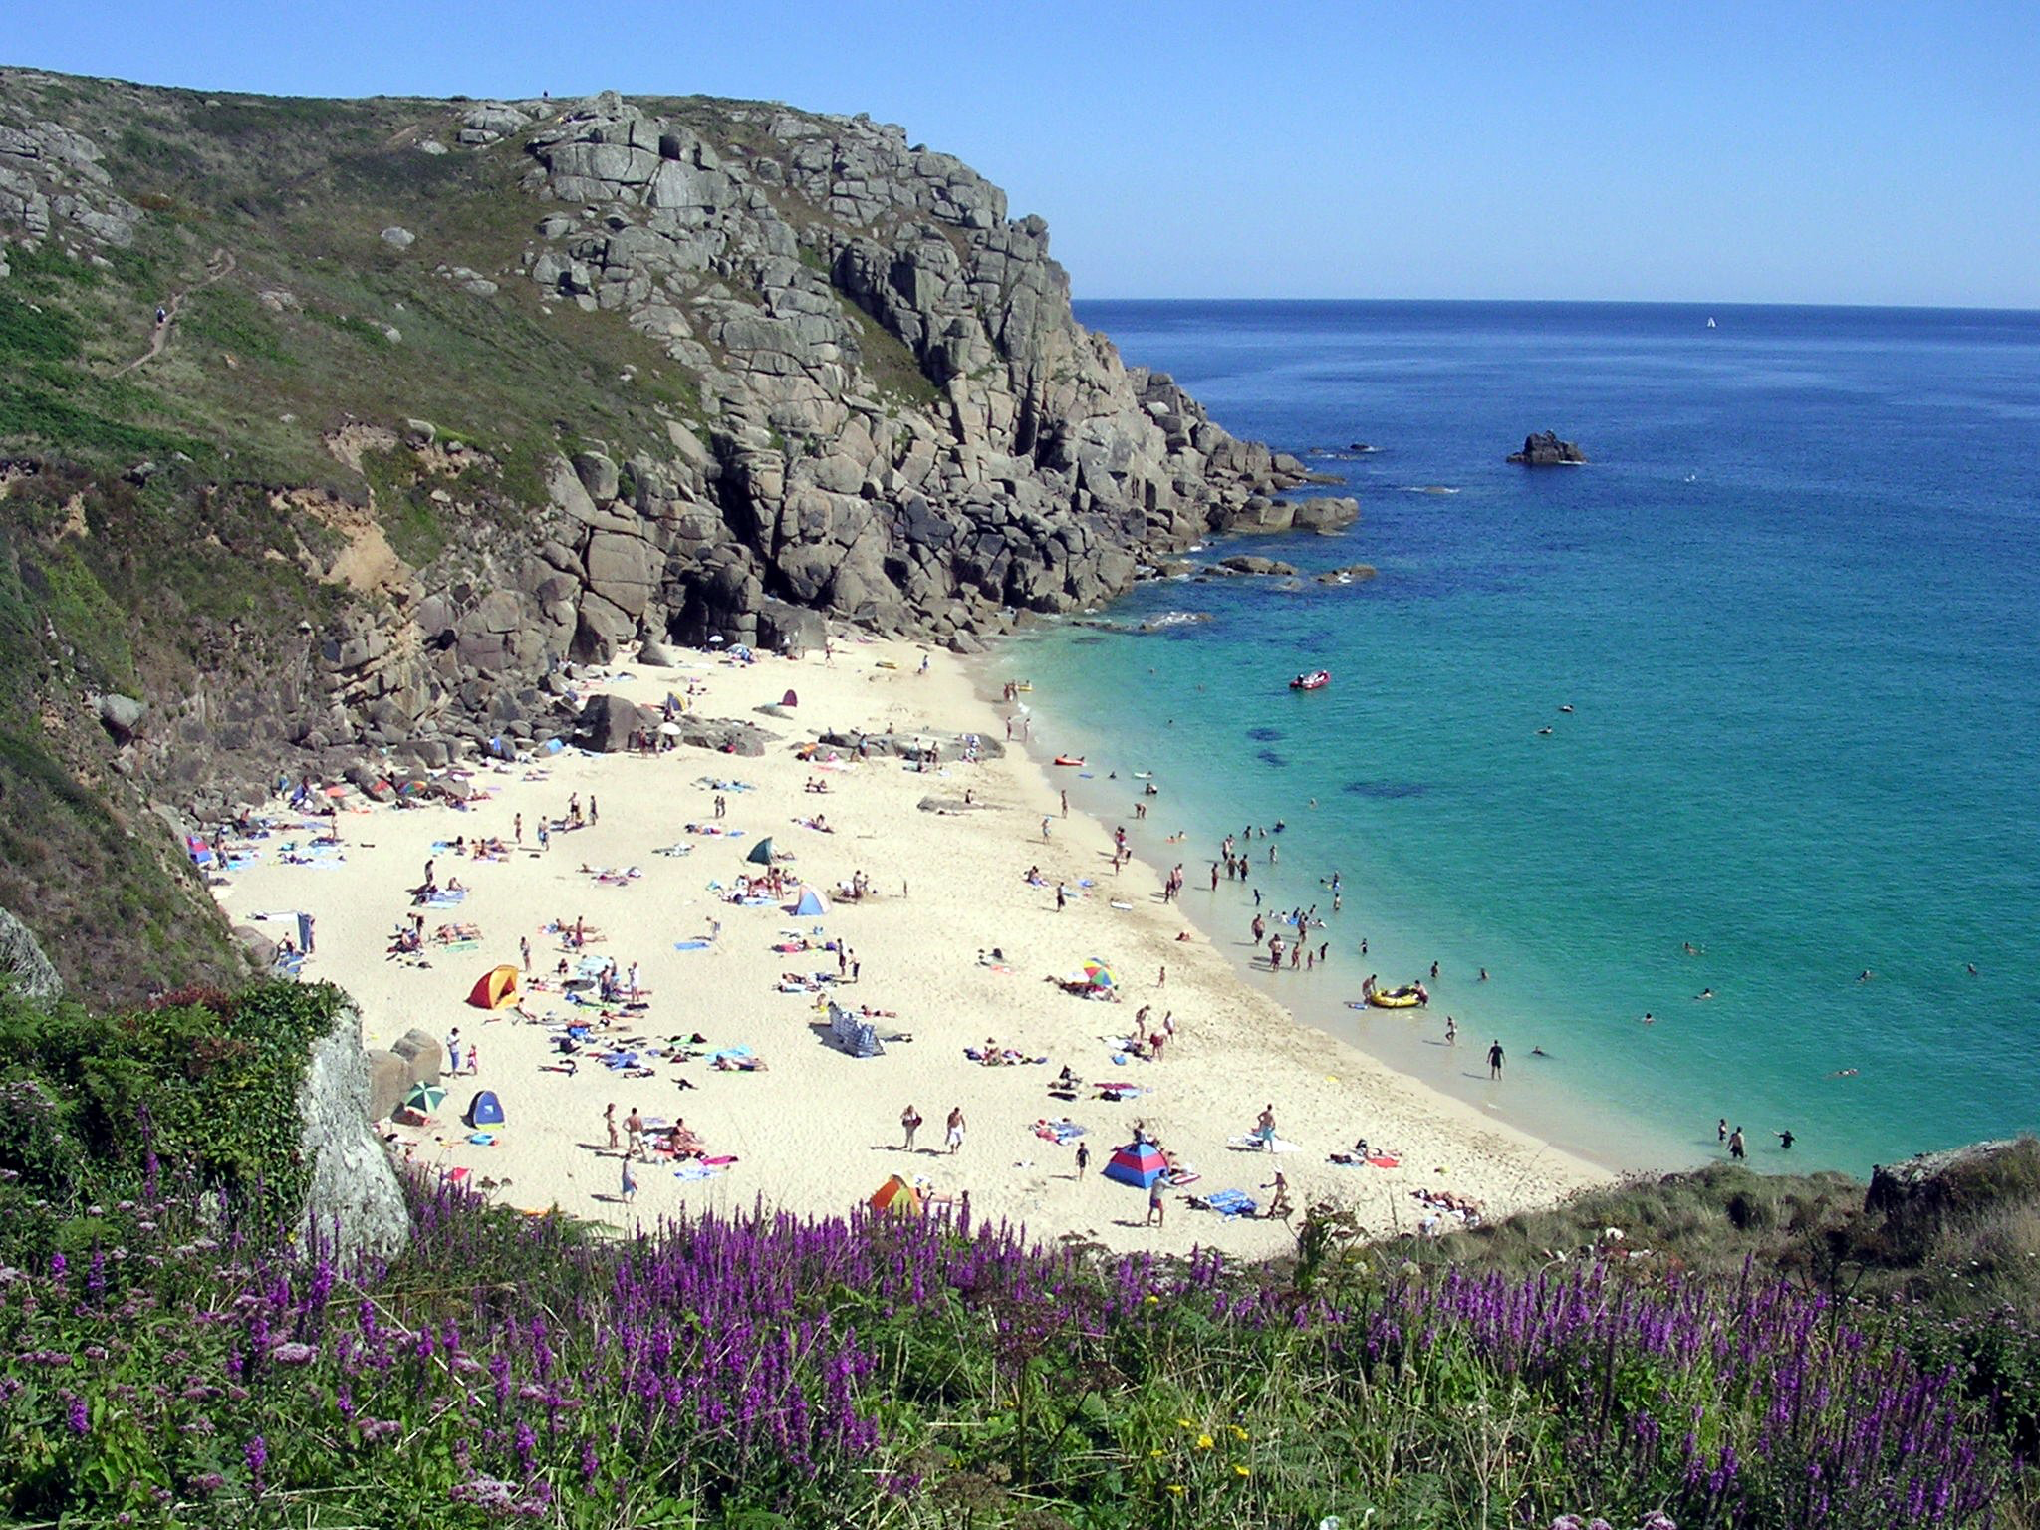
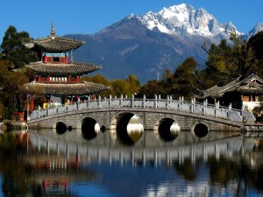
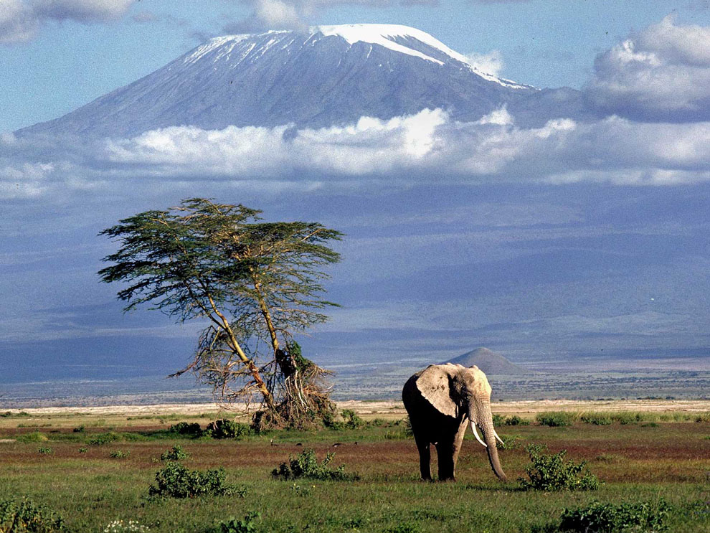
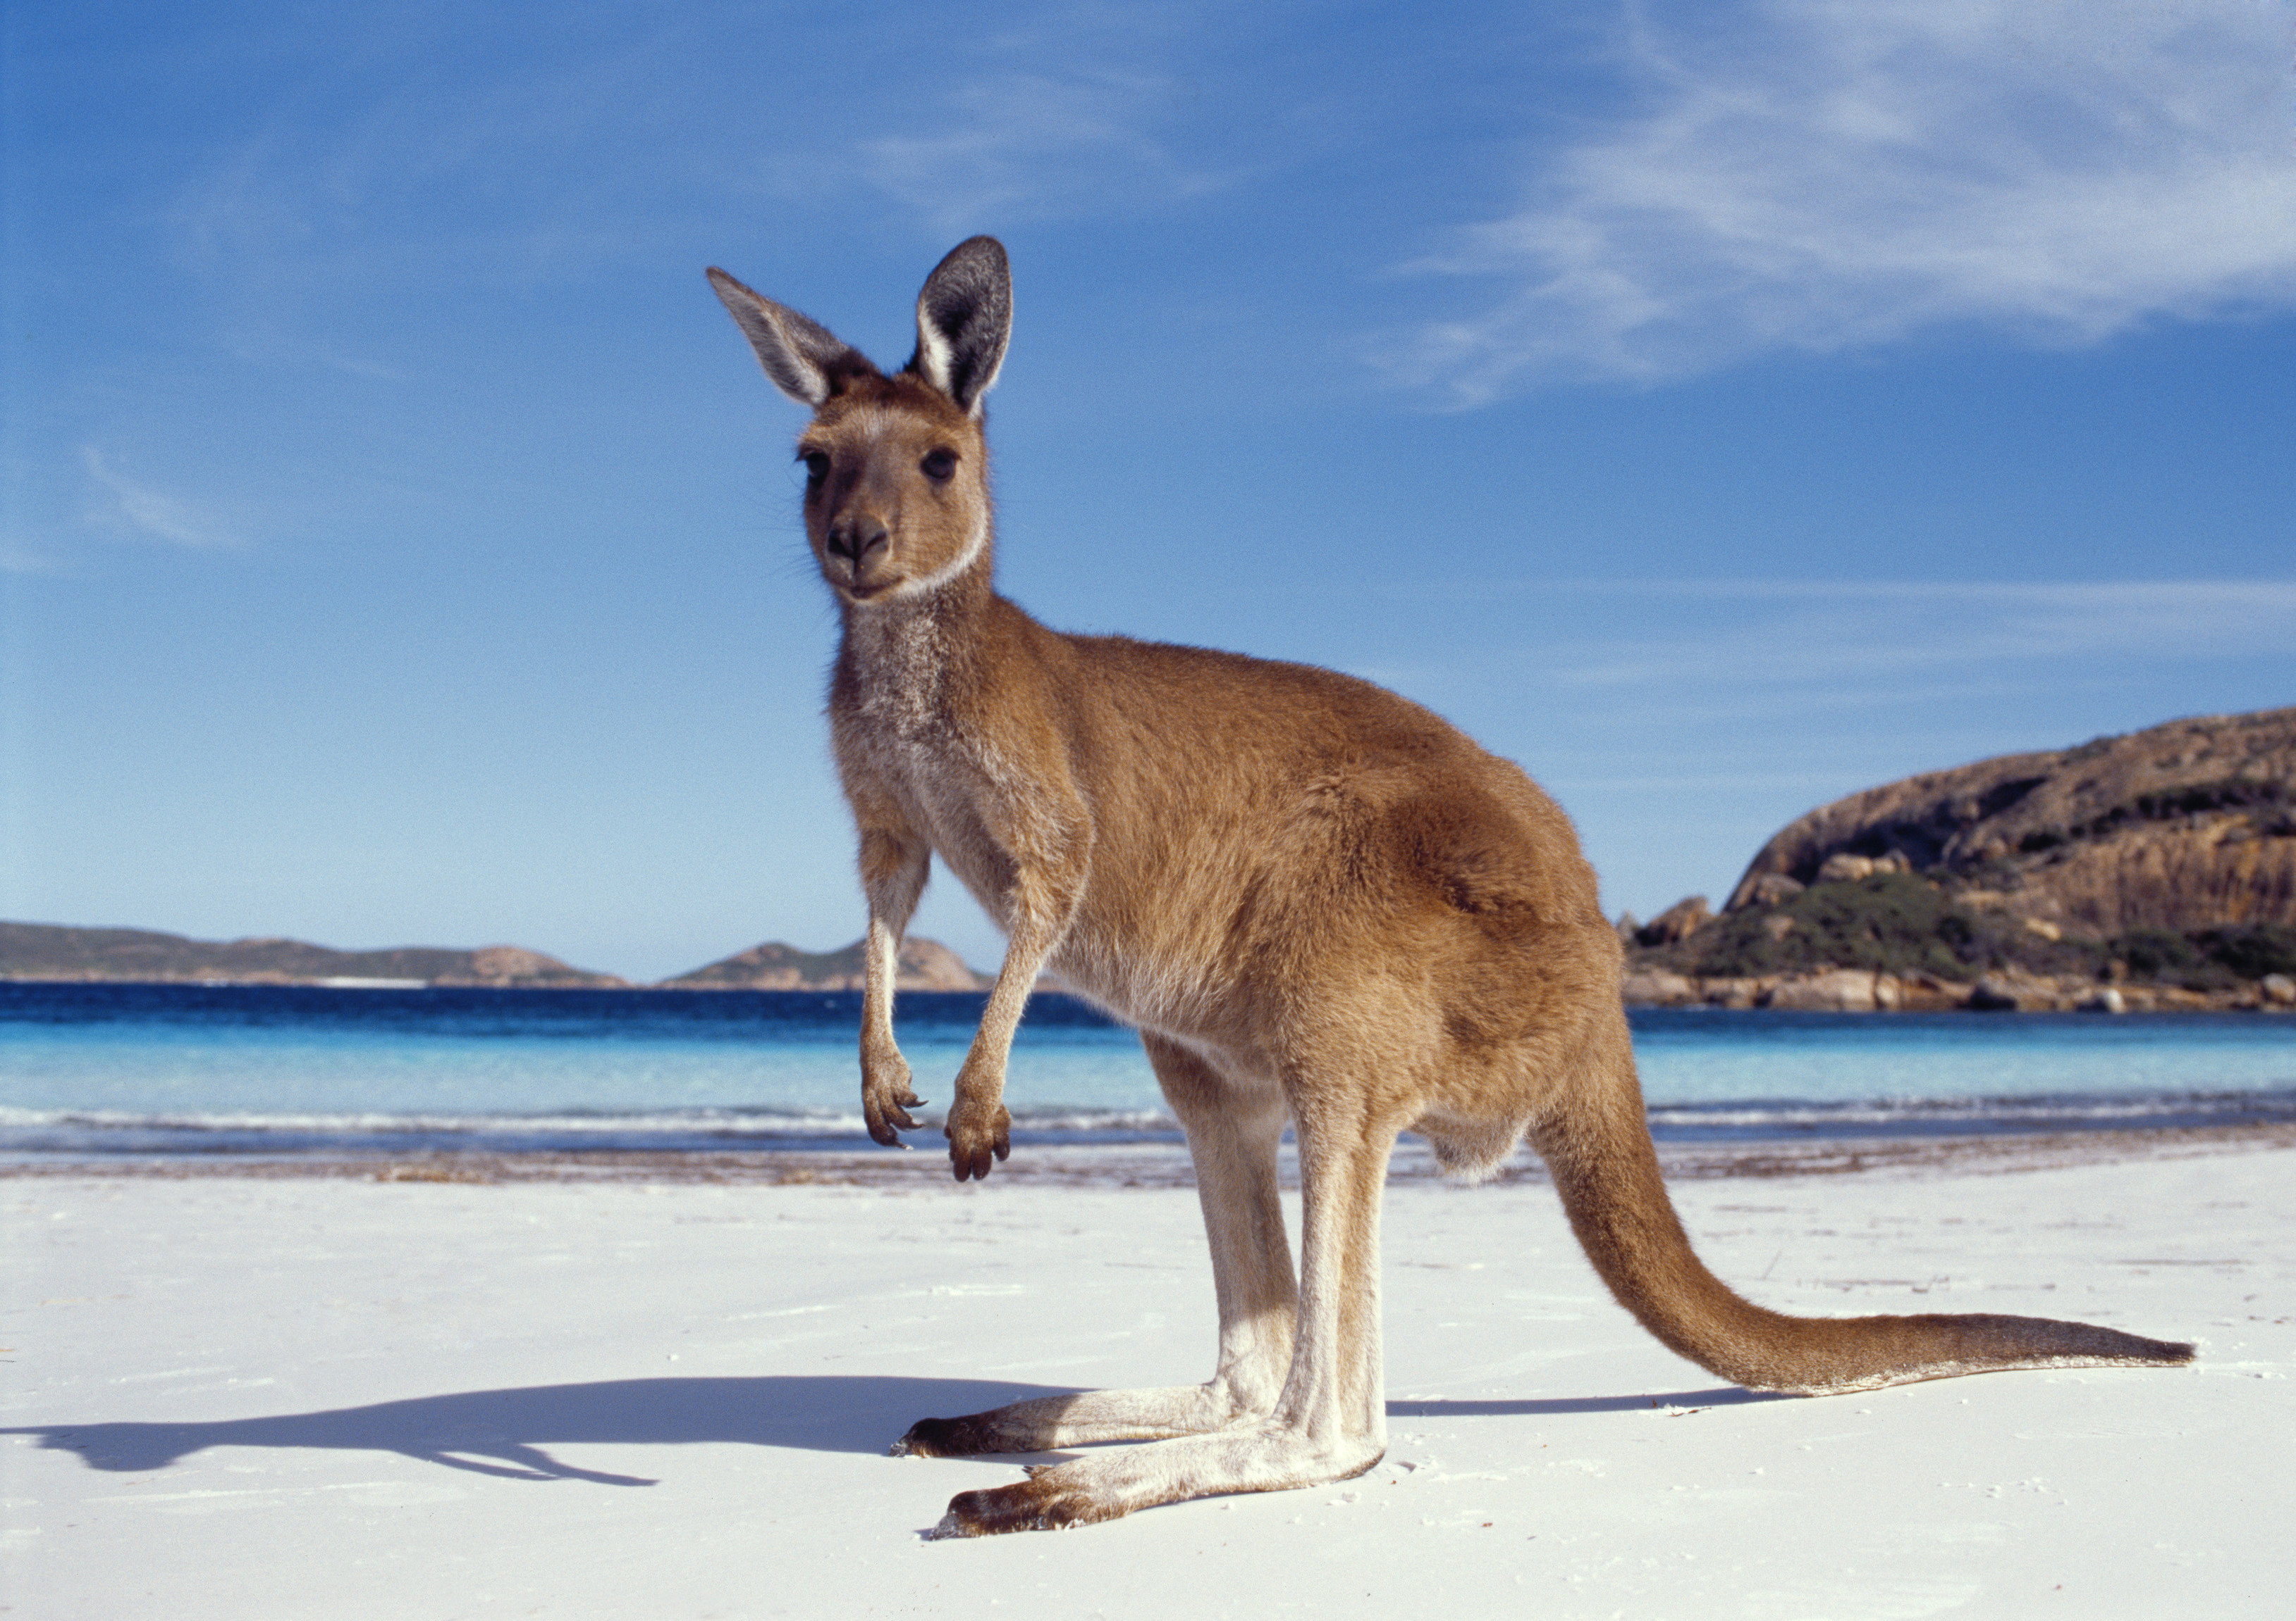
Where have you been on holiday?
What’s the favorite place you have visited and why?
What’s the worst place you have visited and why?
A tourist is defined as a person who is travelling or visiting a place for pleasure.
Tourism is defined as the travel for recreation, leisure, religious, family business purposes, usually of a limited duration.
Starter: holidays; home and abroad…...

Slide 4
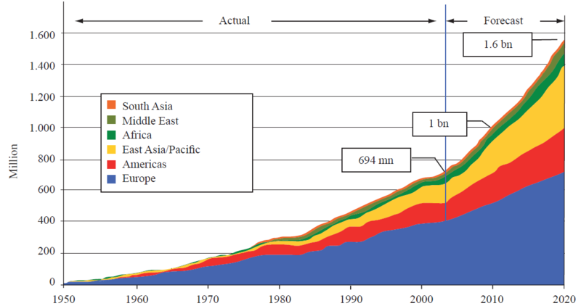
How has tourism grown?
Describe the trend in international tourist arrivals between 1950 and 2000 (4 marks)
Increase
Decrease
Upward trend
694 mn
Fluctuates
Forecast
Drastic
1.6 bn

Slide 5


Why are tourist numbers increasing?
There are three main reasons for an increase in tourism numbers:
Social and economic factors
Improvements in technology
Expansion in holiday choice
Sort the factors that have increased tourism under these three categories. You can sort them into a table or create a mind map for revision.

Slide 6
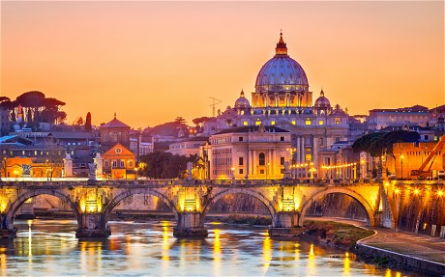
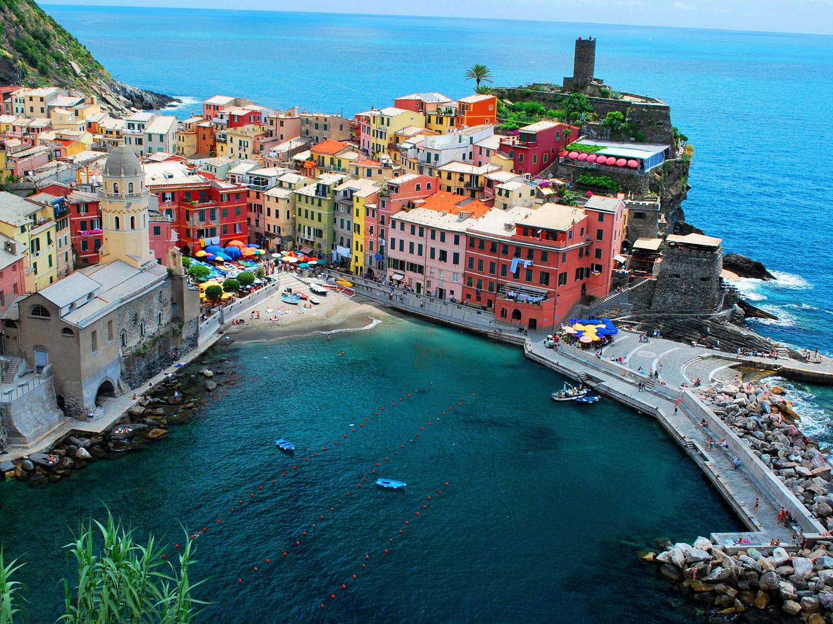
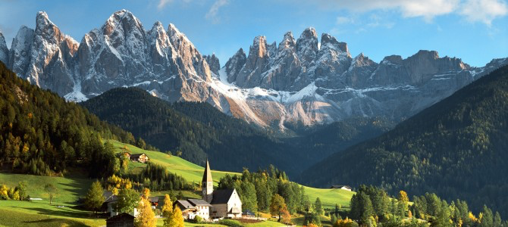
Where do all the tourists go?
For each of the images annotate the physical and human features which are causing the growth in tourism.
The factors which attract tourists in certain places are known as the ‘pull’ factors. These can be physical or human.
Cities- Rome
Coasts- Vernazza
Extension:
What types of tourists will be attracted to each area?
What would happen to Rome if people stopped visiting the history and shopping more? Explain your answer.
Mountains- Alps
Notes:
Extension: What would happen to Paris if people stopped visiting the Effiel tower and shopped more- tourist industry grows and adapts to supply what the market demands.

Slide 7
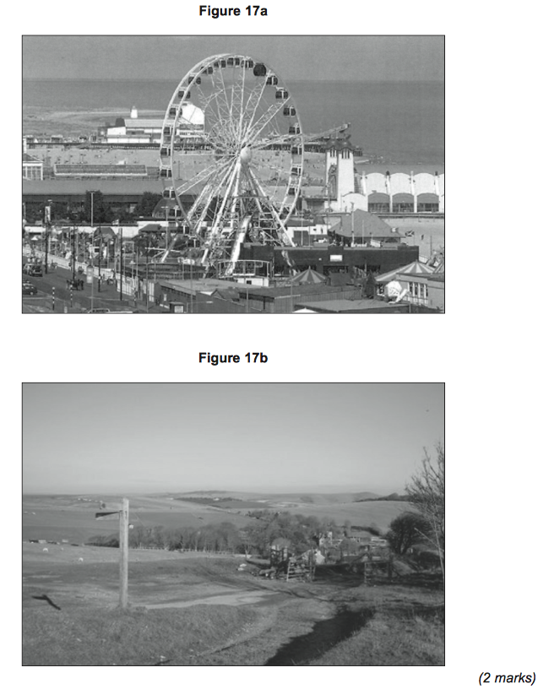
Exam practise
On EITHER Figure 17a OR Figure 17b, label one physical feature and one human feature tourists would visit the area to see.

Slide 8
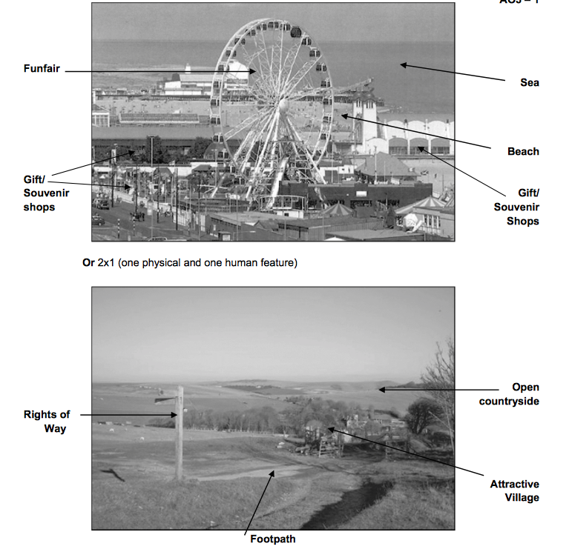
Mark scheme

Slide 9
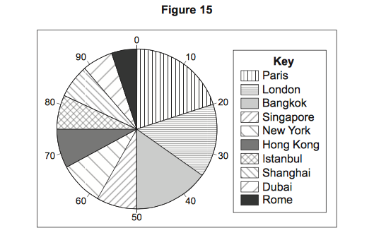
Exam practise
Work out the difference between 20 and 35.
What percentage of tourists visited London in 2009? (1 mark)
2. Outline why some cities attract many tourists.(2 marks)

Slide 10
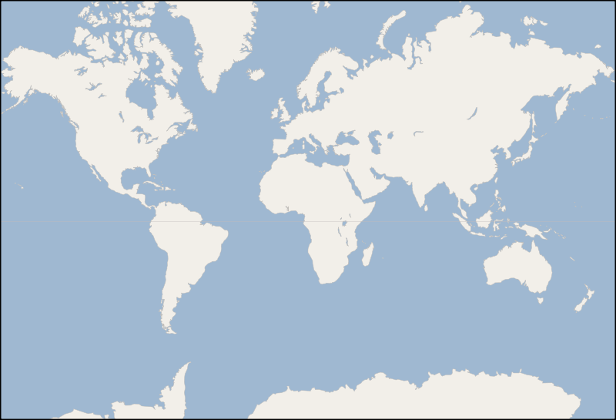
Research
Choose two of the countries and research the following:
Why they make good tourism destinations
Why tourism is important for them.
Europe (Spain OR France)
The economic importance of tourism varies here.
The Caribbean (St Lucia)
The islands of the Caribbean include some of the world’s poorest countries.
The Maldives
Tourism is vey important to these islands making up almost 30% of their GDP.
Gambia
Tourism provides 17% of Gambia’s GDP, this is very high for Africa.

Slide 11
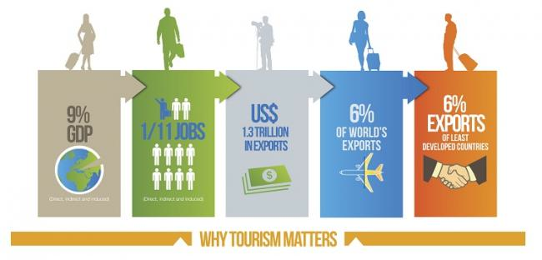
Why is tourism important?
Tourism is an important part of the __________ of many richer countries, especially those in Western Europe and North America. Today it is increasingly seen by __________ countries as one of the best ways to earn ________ income, provide jobs and improve _______ of living. Countries want to take advantage of the _________ numbers of tourists and the money they have to _________.
developing standards spend growing foreign economies

Slide 12
The economic importance of tourism
Country | Annual tourist income ($ millions)
USA | 66,547
Spain | 33,609
France | 32,329
Italy | 26,915
China | 20,385
Germany | 19,158
UK | 17,591
Austria | 11,237
Hong Kong | 10.117
Greece | 9,741
Country | Number of tourists ( millions)
France | 76.0
Spain | 55.6
USA | 46.1
China | 41.8
Italy | 36.5
UK | 30.0
Germany | 21.5
Mexico | 20.6
Turkey | 20.2
Austria | 20.0
Countries with largest tourist receipts 2005
Countries with the most tourist arrivals 2005
Compare the two tables by discussing and answering the questions.

Slide 13
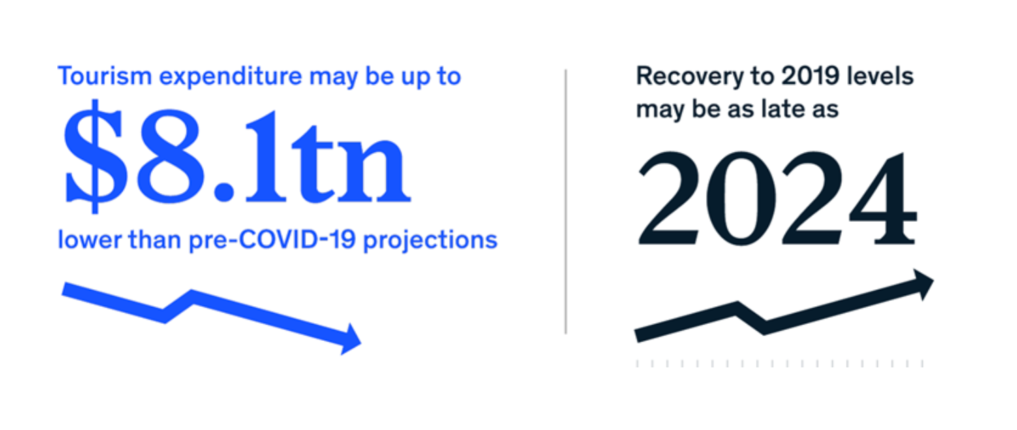
The impact of covid 19 on tourism
A total of 330 million jobs are supported by this industry around the world, and it contributes 10%, or $8.9 trillion to global GDP each year.

Slide 14
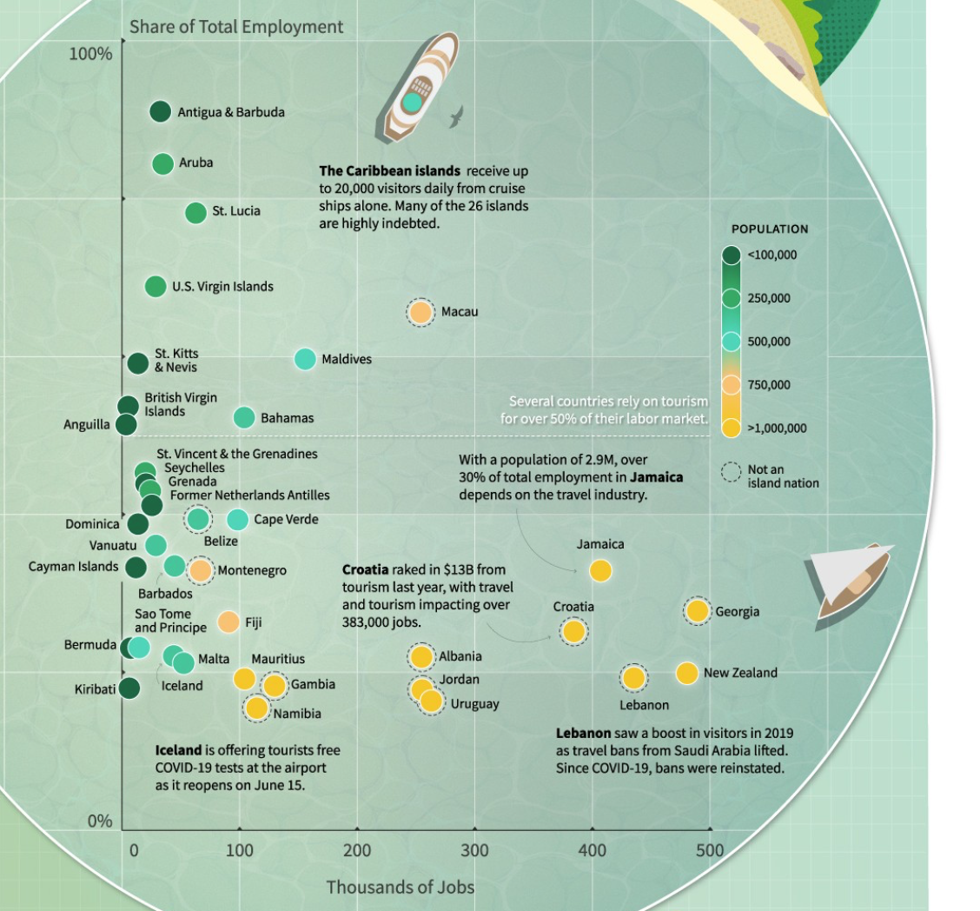
https://www.smarttravellab.org/post/the-countries-most-reliant-on-tourism

Slide 15
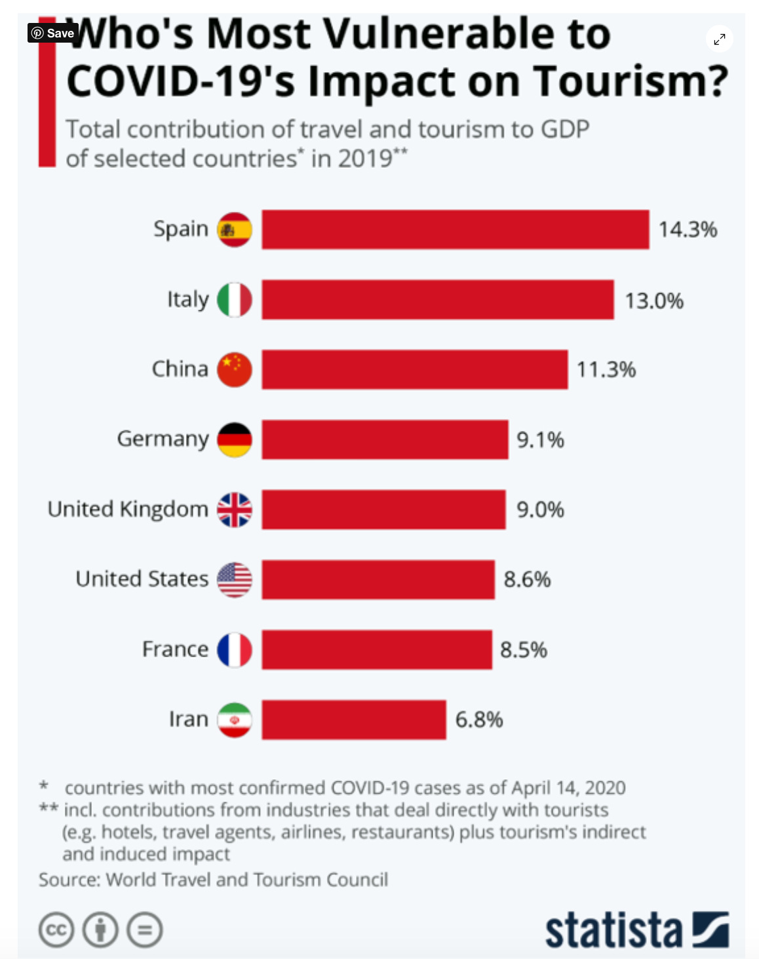

Slide 16
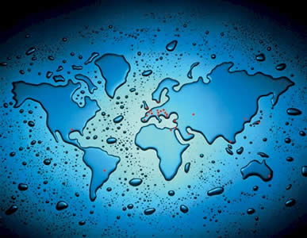
Write down 1 IMPACT
of tourism

Slide 17
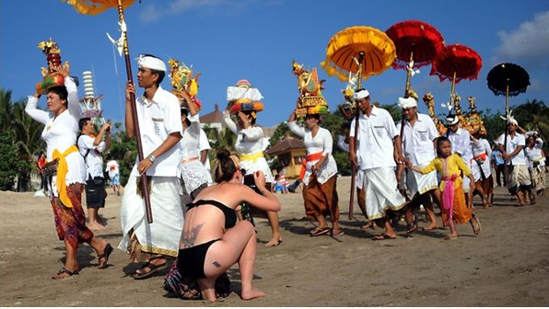
Is this impact social, economic or environmental
Write it on a post it note:
Economic
Social
Environmental

Slide 18
To what extent does tourism have a positive impact on the development of an area?
Place your post it note on the Continuum

Slide 19
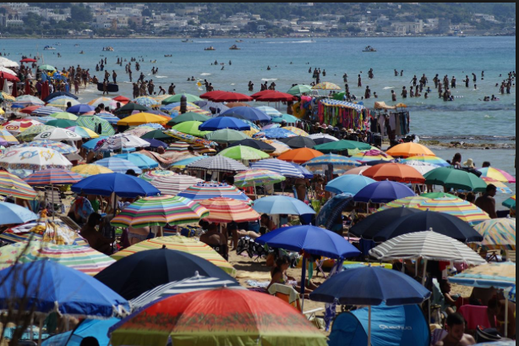
To what extent does tourism have a positive impact on the development of an area?
Learning Objective – To investigate the impacts from tourism.
What are your initial thoughts?

Slide 20
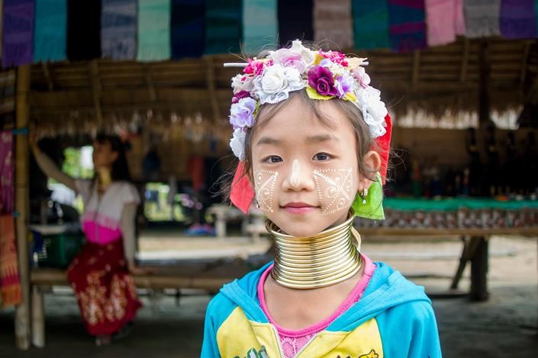
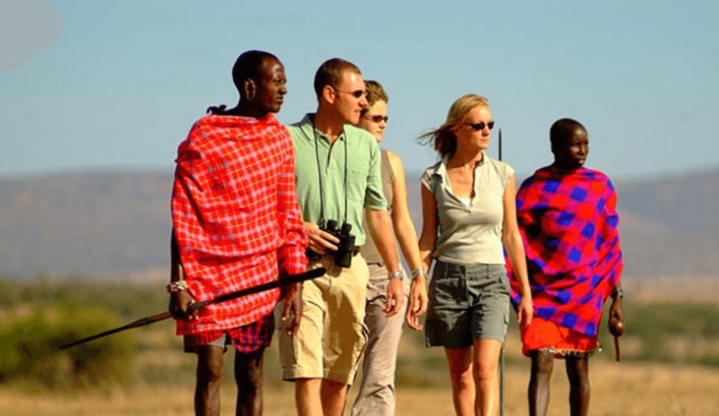
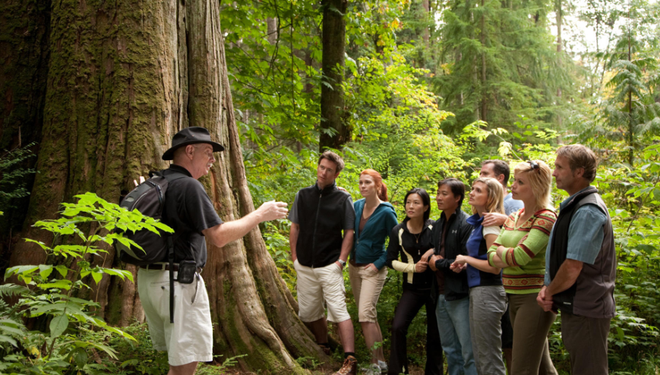
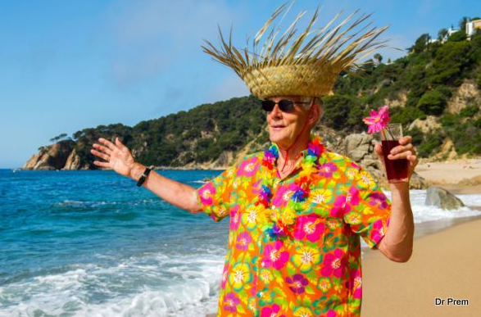
Success criteria 1: To be able to explain the social, economic and environmental impacts of tourism:
Key concept: Consequences

Slide 21
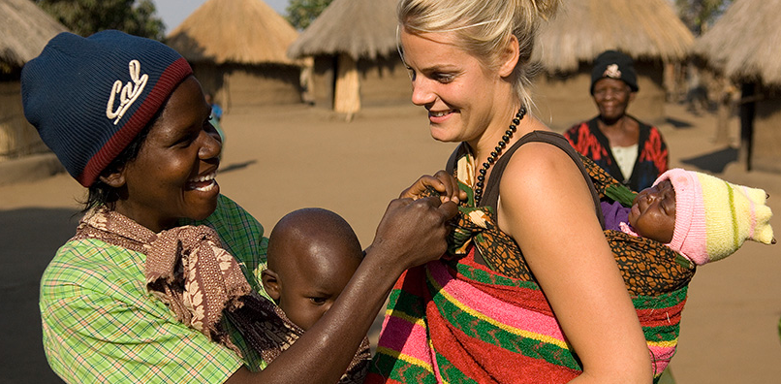
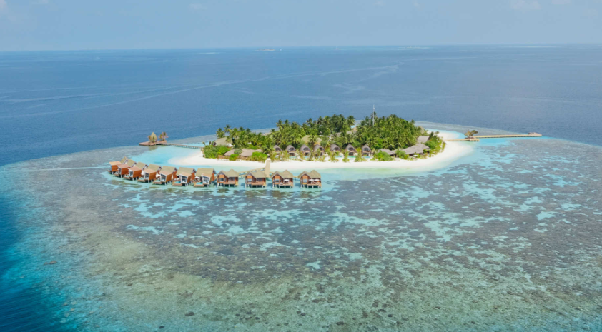
Success criteria 2: Include a range of key terms
Multiplier effect
Leakage
Mass tourism
Sustainable Tourism/ Ecotourism
Zooification of culture
Enclave resort
Package holiday

Slide 22
Mass tourism: is what happens when there are large numbers of people who go on holiday to the same resort, usually at the same time of year.
Usually, tourists will have purchased a package deal that includes flights, transfers and accommodation.
Leakage: the phenomenon where the vast majority of tourism revenue leaks out of the local economy and into the pockets of big international companies.
Multiplier effect: the phenomenon where the vast majority of tourism revenue leaks out of the local economy and into the pockets of big international companies.

Slide 23
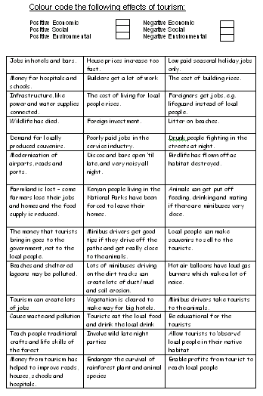
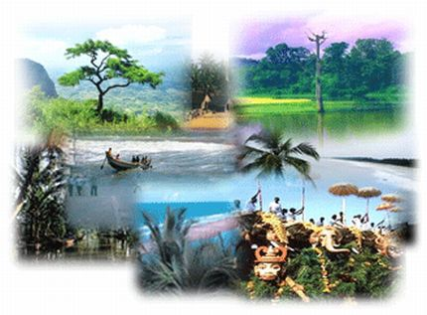
SEE impacts from tourism
Colour code the impacts from tourism into positive SEE impacts and negative SEE impacts
L/O - To investigate the impacts from tourism.

Slide 24
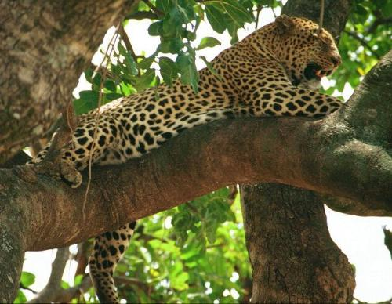
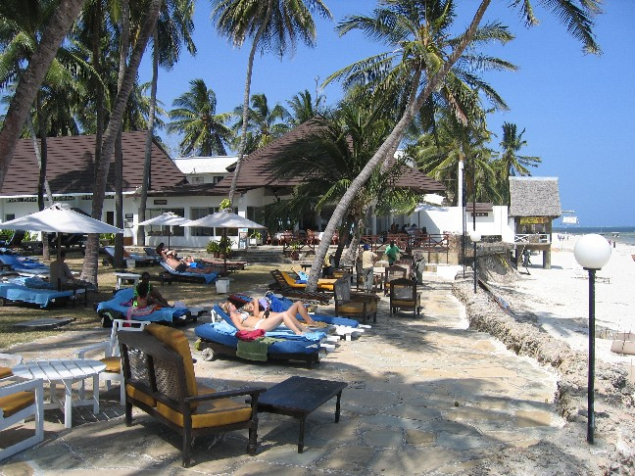
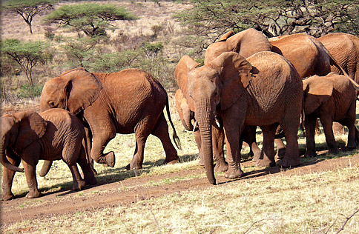
Tourism in Kenya
What are the attractions of a holiday in Kenya?

Slide 25
What is this woman doing?
Why is she there?

Slide 26
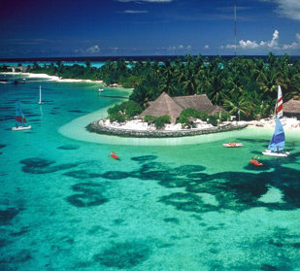
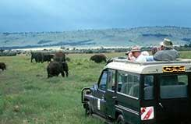
Types of tourism in Kenya
1. Beach holidays
2. Safari holidays

Slide 27
Ecotourism/sustainable tourism
"Tourism that respects both local people and the traveller, cultural heritage and the environment" Source: www.unesco.org

Slide 28
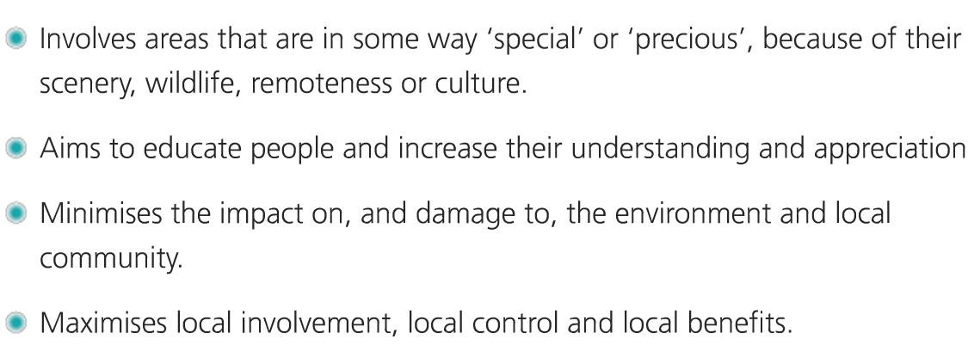
What should ecotourism involve?

Slide 29
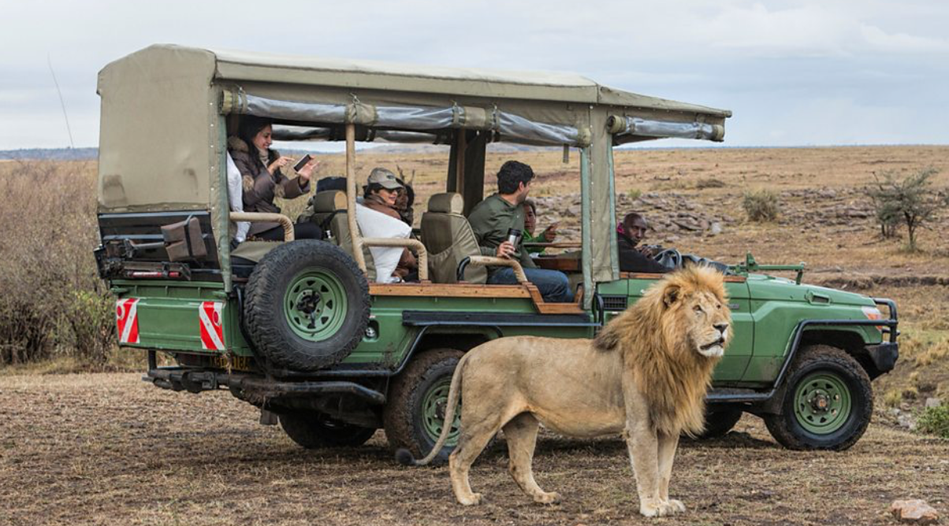
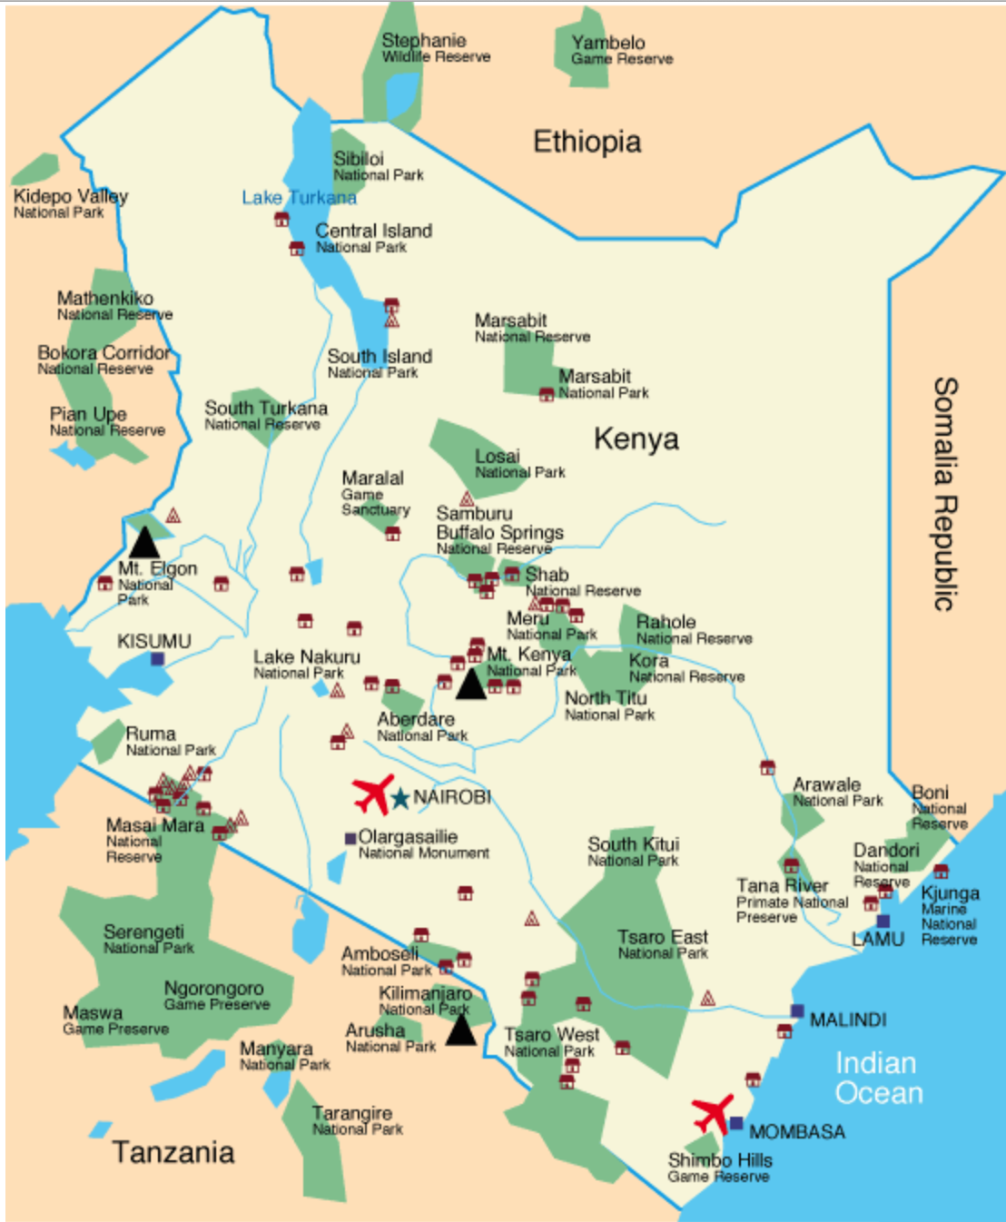
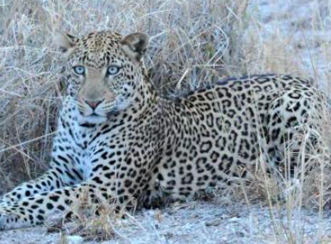
Sustainable tourism in Kenya: Masai Mara
Social/ economic benefits
Providing well-paid, stable jobs for the local population
High quality education and staff training
‘Community Development Projects’
Education
Environmental
Supporting local conservation efforts
Sustainable building
Water management
Electricity- from a sustainable source such as solar
Waste- encouragement of recycling
https://www.bbc.co.uk/bitesize/guides/zpfd4qt/revision/5

Slide 30
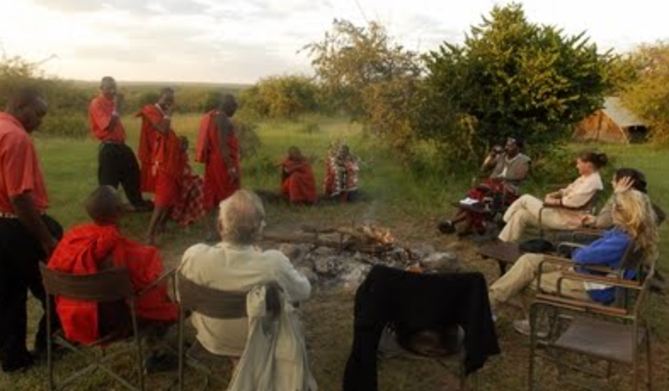
Ecotourism/sustainable tourism in Kenya - Basecamp Explorer
Case Study of Sustainable Tourism
Basecamp Explorer Masai Mara Reserve - Kenya
You should write up this case study report using the following structure;
A map showing the natural features and key tourist attractions of Kenya. Include the Masai Mara National Reserve.
Brief description of the climate and ecosystem of the Masai Mara National Reserve, with examples of flora and fauna.
Definition of ecotourism / sustainable tourism.
Describe the features of Basecamp Explorer which make it a good example of ecotourism.
Your evaluation of Basecamp Explorer as an example of sustainable tourism. What social, economic and environmental benefits does it provide? Can you think of any problems or limitations?
Advantages and disadvantages for a LIC of using tourism as a development strategy?

Slide 31
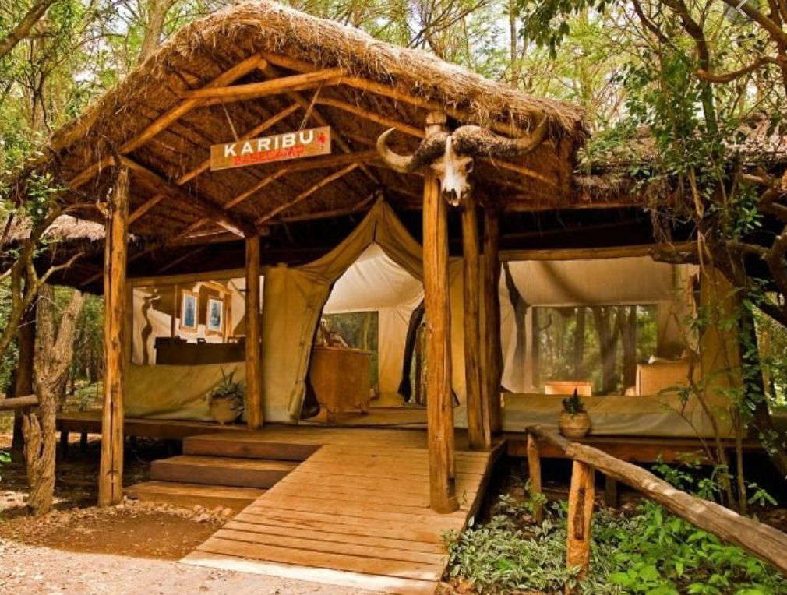
Case Study - Basecamp Masai Mara
Set up in 1998 - The main camp has 16 tents (consisting of 32 beds). The camp activities include; Day game drives, nature walks, tree-planting
Use of “Maasai grammar” to explain culture.
In guest rooms furniture is made of Maasai designs, to encourage visitors to learn more about the Maasai culture
Extensive use of local material, including deadwood, and labour for construction. Buildings can be dismantled and taken away safely – no permanent damage.
Use of a tree-top wildlife viewing post has reduced the need for game drives
Extensive use of solar energy and use of energy saving LED bulbs. The solar water heaters and communication systems are powered by solar energy.
Have a solar cooker at the kitchen area, as a demonstration to the local community on efficient technologies available
Garbage is sorted & composted. Has clean and well-fenced garbage disposal and composting areas.
Waste (grey) water is collected and re-used to water plants in the compound
Use of dry toilets uses less water
Have planted an estimated 25,000 trees since 2000, as part of restoring vegetation along the river near Basecamp. Done jointly with the local community.
A percentage of bed night goes to an education fund that mainly supports girl-child education.
Of the 43 staff, 95% are local, including 10 women – promotes gender equality.

Slide 32
7 mark questions
For a named area you have studied where tourism is important, explain how it has both positive and negative impacts on local people.
For a named area you have studied, describe the problems caused by tourism for local people and the local natural environment.
For a named area you have studied, state an economic activity which takes place which threatens the natural environment and explain how these threats are being managed.

Slide 33
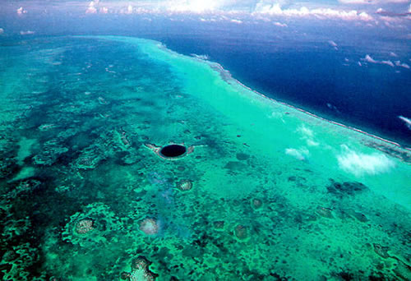
The positive and negative impacts of tourism
Explain the attractions of the destination shown on the picture (3)
What impacts may tourism have on a destination such as that shown on the photo (4)

Slide 34
Answer: What impacts may tourism have on a destination such as that shown on the photo (4)
Impact is direct and indirect both from tourist usage (1) and from servicing that tourist economy (1).
Fragility is a feature of coral reefs (1) boats and swimmers can cause walking can cause breakage and pollution (1).
Could be a loss in the traditions and culture of the area as locals are exposed to western tourists (1)
The development of tourist infrastructure will loose the natural look of the area (1)
Can also bring employment (1) jobs for locals (1).
Better infrastructure (1) easier to travel in and out
(1).
Better services (1), e.g. education/health facilities.

Slide 35
Other 7 mark questions
Explain the social impacts of tourism (7)
Explain the economic impacts of tourism (7)
For both of these questions you should refer to case study examples and consider both negative and positive examples

Slide 36
Exam practise
Annotate the parts of the question which have been boxed or underlined.
Decide what your three points will be.
Using examples you have studied, assess the advantages that tourism can bring (7)
Basic (1-4)
Clear (5-7)
You describe three basic impacts of tourism in poorer countries.
You use because and this means that to explain three impacts of tourism. You use specific case study detail
Use exam modelling sheet

