Slide 1
Task 1: Storyboard Restoration to Revolution 1660-1688
You have a blank storyboard that covers the period 1660 (the restoration of the monarchy)-1688 (the Glorious Revolution).Draw an image to summarise each part of the story. Add colour.
When it is completed your storyboard should tell you how it was that PARLIAMENT came to chose the monarch by 1688.
Higher thinking: Why had monarchs failed to regain the power they had held? How did the events of 1688 give more power to parliament?

Slide 2
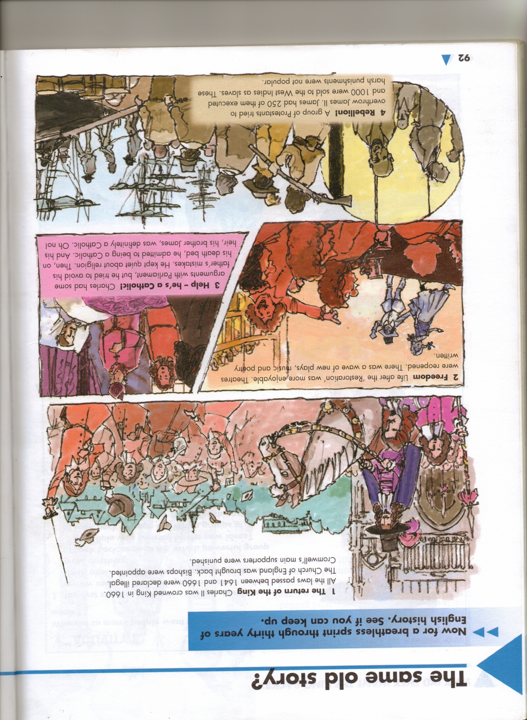
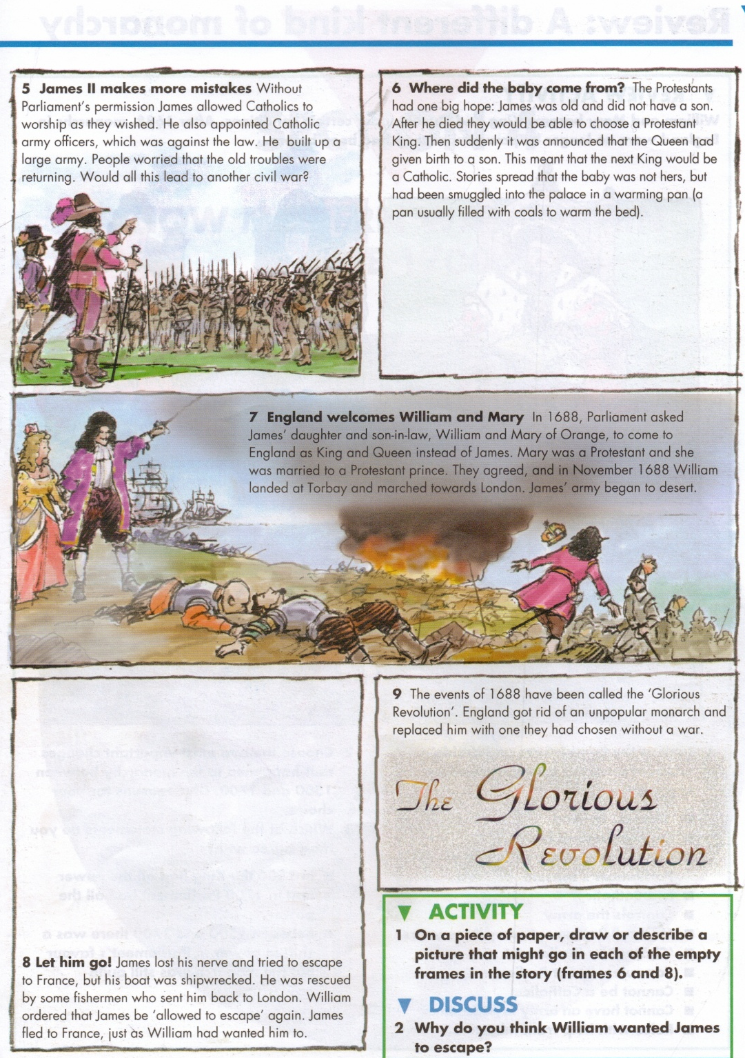
Stuck for inspiration? Here’s one from the textbook!

Slide 3
From Restoration to Glorious Revolution

