Slide 1
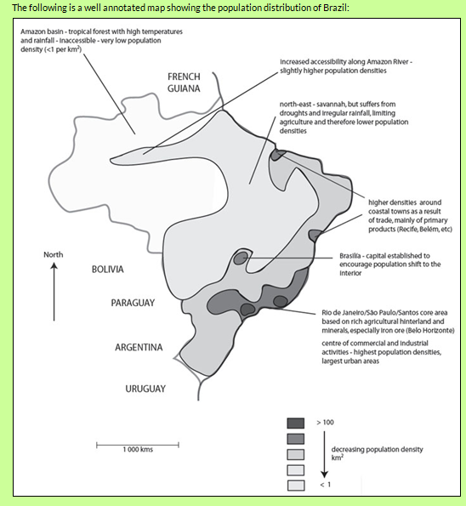
Key geographic skill- annotating maps
Annotating maps requires you to include comments on the map itself and to place these comments in the relevant locations. Comments added after the maps are not acceptable. Common problems tend to be that students produce small, untidy, inaccurate maps that are not located and lack orientation.

Slide 2
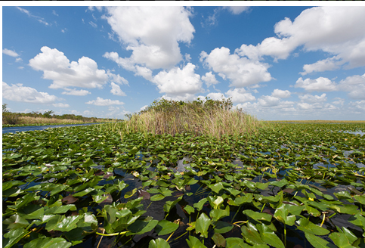
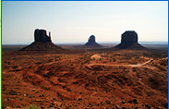
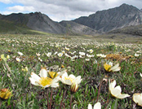
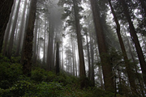
Natural Environment of the USA

Slide 3
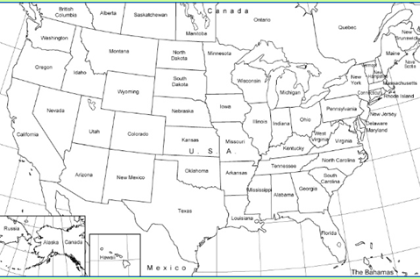
Map of the USA

Slide 4
What is the pattern of population/distribution/density in the USA?

Slide 5
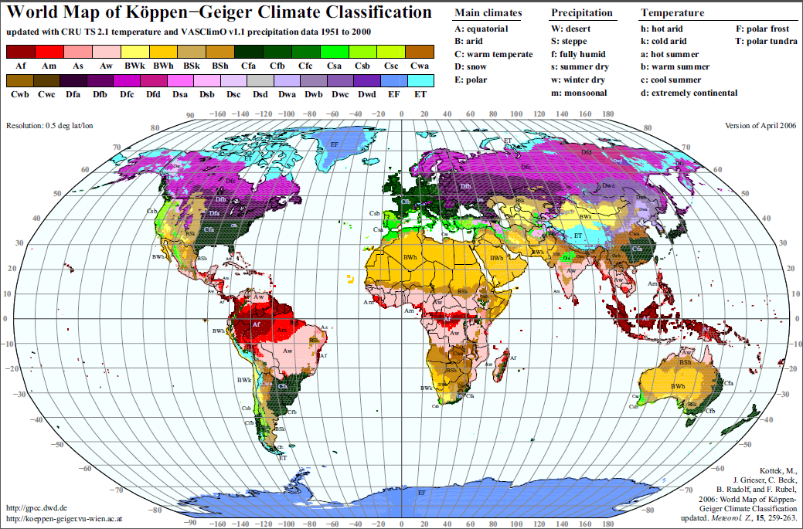
A biome is a major regional group of distinctive plant and animal communities best adapted to the region's physical natural environment, latitude, altitude and terrain factor.

Slide 6
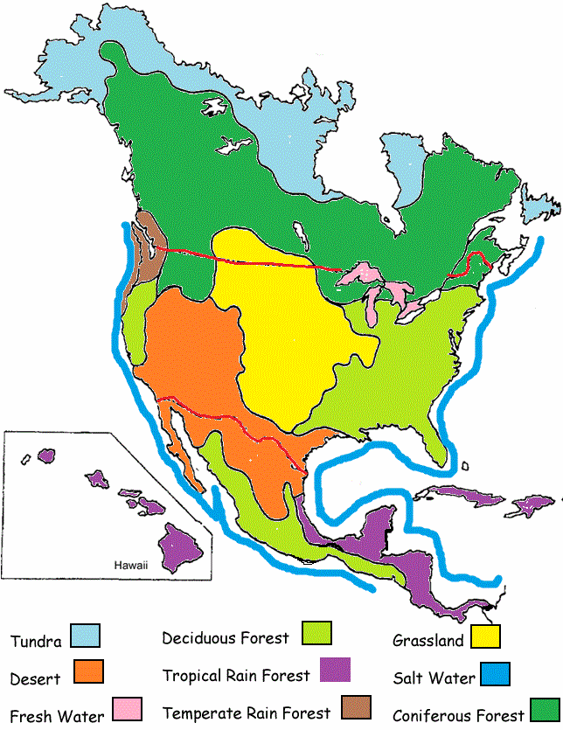
Task: natural environments of the USA mapping
All:
Map the biomes of the United States onto your base map.
Most:
Use annotations to explain why the biomes exist where they do. Use the Geog 2 textbook p 48-51 to help you.

Slide 7
Can you locate the four images used at the start of this lesson on your base map?

