Slide 1
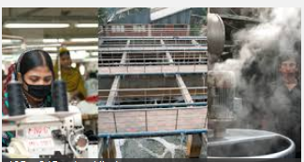
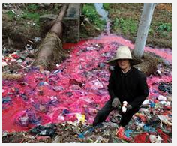
Environmental issues related with global shift of industry

Slide 2
Reasons for the global shift in industry
The cost of labour is much cheaper in Asian countries than in Europe and the USA thus making the cost of producing goods less per unit
The willingness of governments such as China and India to allow joint ventures of local groups and overseas companies
The quality of labour is also increasing as educational standards rise
Cheap and plentiful power supplies (although some is from the use of heavily polluting materials such as coal)
The desire of national governments such as those in India and China to modernise and provide a better lifestyle for their citizens
The liberalisation of capital markets, making money more available to entrepreneurs to undertake new projects
A liberal interpretation of copyright laws (discussed in Section 6.1.4) and copying of some industrial processes patented elsewhere
Fewer restrictions on companies to observe safety and emissions regulations.

Slide 4
AIR pollution
According to the dictionary, air pollution is the contamination of air by smoke and harmful gases, mainly oxides of carbon, sulfur, and nitrogen. Some examples of air pollution include: Exhaust fumes from vehicles
The burning of fossil fuels, such as coal, oil, or gas
Harmful off-gasing from things such as paint, plastic production, and so on
Radiation spills or nuclear accidents

Slide 5
WATER pollution
Water pollution is the contamination of any body of water (lakes, groundwater, oceans, etc). Some examples of water pollution: Raw sewage running into lake or streams
Industrial waste spills contaminating groundwater
Radiation spills or nuclear accidents
Illegal dumping of substances or items within bodies of water
Biological contamination, such as bacteria growth
Farm runoff into nearby bodies of water

Slide 6
Negative externalities usually affect poor people the most. Poor people tend to be people who are forced to live near polluting factories because they can't afford to live anywhere else. The old/young and sick are also vulnerable to pollution caused by industry. Many polluting industries also choose to locate in LEDCs for a number of reasons including: More relaxed environmental regulations
Less enforcement of environmental regulations (this might be because they can't afford to enforce, because they are being paid to overlook (corruption), or they are worried about losing FDI.
Access to a new potential marketplace
Access to raw materials (which again might be extracted using polluting methods)
Availability of cheap labour
Cheap land and building materials (possibly relaxed building regulations)

Slide 7
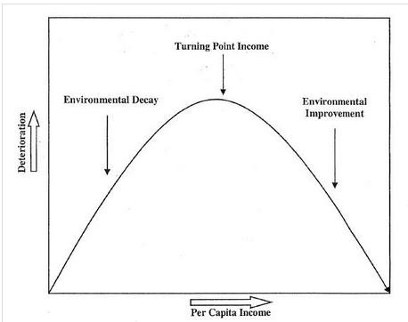
Kuznet Curve

Slide 8
Kuznet Curve
The Kuznets curve represents Simon Kuznets's theory. Initially the curve was developed to show how economic inequality changes as a country develops. However, the curve has also been applied to show how environmental degradation changes over time. It basically says in the early stage of development the main priority of any country is development. However, after a certain standard of living is reached (the tipping point) there is an increased emphasis on pollution, both by individuals, countries and companies. At this point the investment in the environment increases and the quality of the environment increases. The emphasis on the environment increases for a number of reasons including: People have a comfortable standard of living
People have increased leisure time and disposable income
People have increased awareness of environmental issues (news, education)
People spend more time enjoying the environment (holiday, sport, recreation, etc.

Slide 9
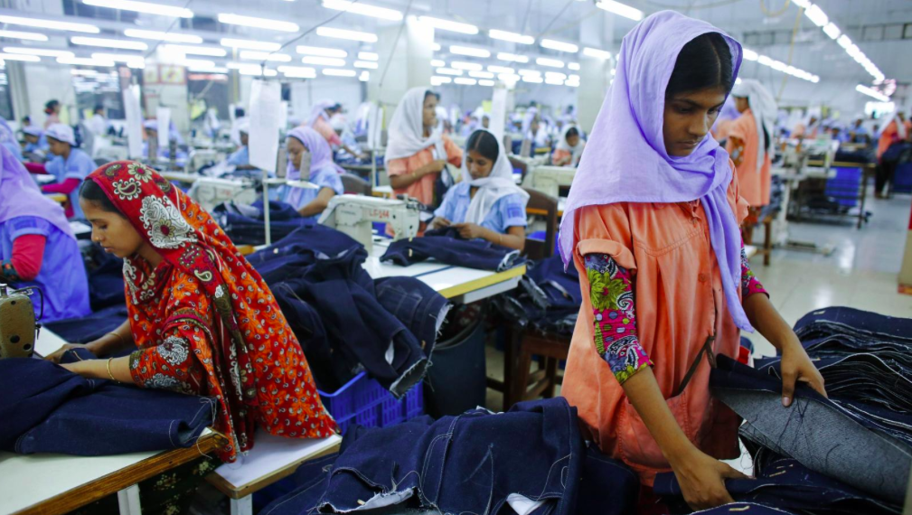
Garment manufacturing in Bangladesh

Slide 10
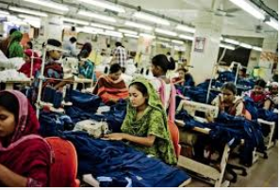
Case study: the textiles Industry in Bangladesh
Make notes on the negative (and positive?) externalities that occur in Bangladesh due to the relocation of manufacturing industries here.
How can the negative impacts be reduced?
Who should pay for the negative externalities?

Slide 11
Water pollution in Bangladesh
https://www.nytimes.com/2013/07/15/world/asia/bangladesh-pollution-told-in-colors-and-smells.html
Bangladesh’s garment and textile industries have contributed heavily to what experts describe as a water pollution disaster, especially in the large industrial areas of Dhaka, the capital. Many rice paddies are now inundated with toxic wastewater. Fish stocks are dying. And many smaller waterways are being filled with sand and garbage, as developers sell off plots for factories or housing.
Some factories treat their wastewater, but many do not have treatment plants or chose not to operate them to save on utility costs.
Task: Use ‘water pollution in Bangladesh’ and make notes on the causes and issues of water pollution

Slide 12
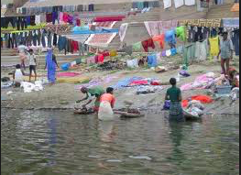
Is controlling pollution a simple matter?
Now explain in about 500 words whether further pollution controls in Bangladesh
would bring benefits or problems.

Slide 13
E-waste

Slide 15
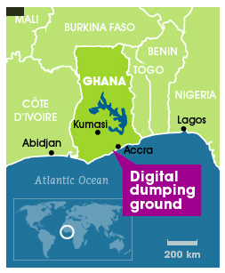
CASE STUDY: E WASTE DISPOSAL, AGBOGBLOSHIE, GHANA, WEST AFRICA

Slide 16
Carbon footprint of food

Slide 17
Food miles of a Christmas dinner

Slide 19
The growth of agribusiness
Global agribusiness: A transnational farming and/ or food production company.
Companies may specialize in food, seed and fertilizer production, as well as farm machinery, agrochemical production and food distribution.
E.Gs Dole, Kraft, Nestle

Slide 20
Global agribusiness
40% of Earth’s terrestrial ecosystems have been transformed into agricultural land- much at the hands of global agribusiness
Food chains and and nutrient cycles have been modified often brining habitat loss and severe biodiversity decline.
When measured in terms of land their controlling of local interests, the largest firms exhibit enormous size and power. Their impacts penetrate deeply into some of the world’s poorest societies such as East Africa and Southern Asia. Activities include cash crops and cattle ranching.

Slide 22
Why are Green beans (and flowers) for the UK being grown in Kenya?

Slide 23
Green beans in Kenya case study
Many less economically developed countries face an increasingly difficult moral dilemma - whether to use productive farmland to feed their own people or whether to use this land to boost their economies by growing commercial crops for trade with richer, Western nations.

Slide 24
Green beans in Kenya case study
Kenya sends out about 350 tonnes of vegetables and cut flowers each night ready to be sold next day in UK supermarkets. Leguminous vegetables (peas, beans, mange tout) constitute the largest proportion of Kenyan imports to the UK and this sector has shown strong growth. In 1988, the UK imported around 3,800 tonnes of legumes from Kenya. By 2005, this had increased to around 25,000 tonnes. Due to their high perishability and value, leguminous vegetables tend to be imported by air freight. Some people are concerned about the high carbon footprint of these vegetables.

Slide 26
16 mark question

