Slide 1
Development of Indian Nationalism and Independence

Slide 2
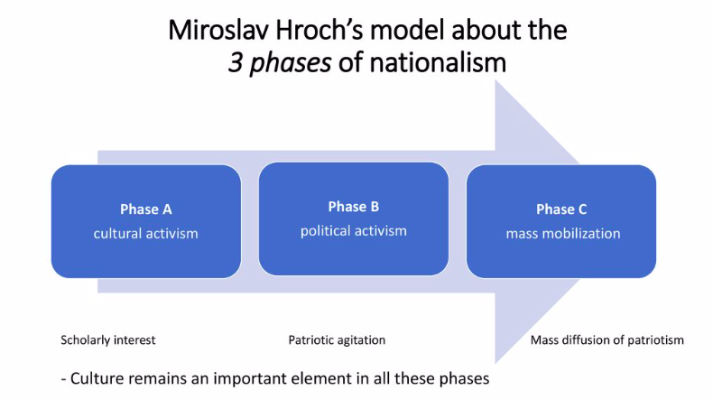

Slide 3
Nationalism is………………
[1]the desire to achieve political independence, especially by a country under foreign control or by a people with a separate identity and culture but no state of their own; [2]proud loyalty and devotion to a nation; [3]excessive or fanatical devotion to a nation and its interests, often associated with a belief that one country is superior to all others.

Slide 4
Causes of Indian Nationalism:
Discontent with British rule
India unified
Leadership
Common language
New print culture
Nationalist orgs.

Slide 5
Political Nationalism
Desire for ↑ political freedoms:
  suffrage
  ↑ Indians in government
  independence

Slide 6
Cultural Nationalism
Development of “Indian” cultural identity
Rewrite histories
  Hinduism
  math/sciences
  art

Slide 7
FACTORS ENABLING BRITAIN TO DOMINATE INDIA
By 1763 Britain had driven its chief European rival, France, from India and Britain expanded .
The British conquest was facilitated by India's backwardness and disunity.
1. Military Inferiority.
The Indians could not cope with the superior British military knowledge, training, and equipment.
2. Many Languages.
  The people of India were divided linguistically among more than a dozen main languages and over 200 dialects.
  Their many tongues reflected geographic and cultural separation.
3. Religious Divisions.
  Majority religion was Hindu, 20% of the nation was Muslim
  Hindu and Muslims constantly were fighting each other

Slide 8
FACTORS ENABLING BRITAIN TO DOMINATE INDIA
4 Economic Control. Britain profited greatly from India, called the "brightest jewel of the British Empire."
- British manufacturers and workers depended upon India to purchase their textiles and machines.
5. Social Control. The British had little respect for the native Indian culture, particularly the barbaric practices of
  slavery,
  suttee or sati(the Hindu custom of burning the widow on the funeral pyre of her deceased husband), and
  female infanticide (killing unwanted baby girls).

Slide 9
Beginnings of Indian Nationalism
Phase 1 – Cultural Nationalism

Slide 10
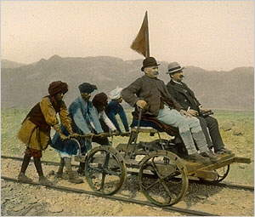
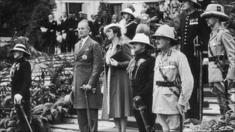
Nationalism in India began in the 1800s.
Indians did not like being under British colonial rule because:
  They were treated badly
  British got the best jobs
  British got the best education
  Indian craftsmen were not
  allowed to run traditional
  businesses because they
  would compete with
  British businesses.

Slide 11
First Indian Nationalists
Were upper class
Were English educated
Many of them from urban areas like Bombay, Madras, and Calcutta
Some were trained in British law
Some were members of the civil service
Many preferred reform to revolution

Slide 12
Beginnings of Indian Nationalism
The new Indian middle classes slowly grew tired of the injustice of British rule
The new nationalists wrote in both English and their regional languages and turned to aspects of Indian tradition, especially Hinduism, as a rallying ground for national pride
  Ignored or overlooked Muslim leaders
Notes:
12

Slide 13
Indian Nationalism
During the years of British rule, a class of western-educated Indians emerged who dreamed of ending imperial rule
In 1835, Thomas Macaulay articulated the goals of British colonial imperialism most succinctly: "We must do our best to form a class who may be interpreters between us and the millions whom we govern, a class of persons Indian in blood and colour, but English in taste, in opinions, words and intellect."

Slide 14
Preserving Indian Culture

Slide 15
Acts to Preserve Indian Culture
Indian teachers, writers, and journalists wanted to preserve their own culture.
In the early 1800s, when the British established a college in Calcutta, a publishing house was opened too.
It published Western books, but also books on India’s ancient language of Sanskrit and dictionaries and grammar books for many of the Indian languages.
This spread to other regions of India and led to writers searching for the Indian identity in modern novels and poetry.
Indians began writing historical romances and epics and usually in their own regional language.

Slide 16
Example of Preserving Culture: Tagore

Slide 17
Rabindranath Tagore
Most illustrious Indian author---great writer and poet
Was a social reformer, spiritual leader, educator, philosopher, and international spokesperson on morality
His life’s mission was to promote pride in Indian culture in the face of British domination
He wrote a widely popular novel in which he portrayed the love-hate relationship of Indians towards Britain.
Reflected how Indian people struggled with defining their identity as they admired and imitated the British, but lost some of their Indian traditions
Wanted world peace and a union of the East and West

Slide 18
Tagore
Strove to have a balance between Western influence and ancient customs
He was respected and followed by both British colonizers and Indians for his work
Friend of Gandhi
Preferred to stay out of politics

Slide 19
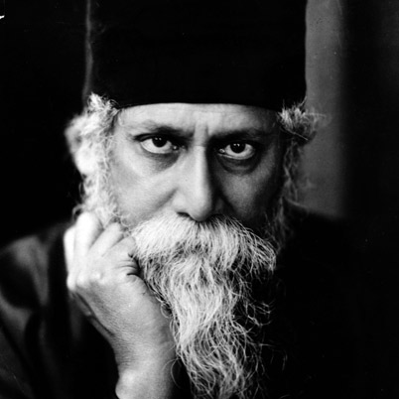
Rabindranath Tagore
“It is my conviction that my countrymen will truly gain their India by fighting against the education that teaches them that a country is greater than the ideals of humanity.”

Slide 20
Tagore
“Bigotry tries to keep truth safe in its hand with a grip that kills it.”

Slide 21
Preserving Indian Culture: Another Example ---Nationalist Newspapers

Slide 22
Nationalist Newspapers
Printed in various regional Indian languages
Common medium used to arouse mass support for the nationalist causes
The newspapers reached the lower middle class---tens of thousands of Indians who did not know English
Examples:
  Kesari or The Lion Newspaper---journalist Tilak used innuendo to convey negative feelings about the British without writing anything directly disloyal
  Swadeshamitram or The Friend of Our Nation---editor organized literary meetings to discuss poetry and politics

Slide 23
Print media
Tilak turned to the task of awakening the political consciousness of the people through two weekly newspapers that he owned and edited:
Kesari (“The Lion”), published in Marathi, and The Mahratta, published in English.
Through those newspapers Tilak became widely known for his bitter criticisms of British rule and of those moderate nationalists who advocated social reforms along Western lines and political reforms along constitutional lines. He thought that social reform would only divert energy away from the political struggle for independence.

Slide 24
Swadesamitran - Newspaper
Swadesamitran was a Tamil language newspaper that was published from the then Madras city from 1882 to 1985.
The name translated from Tamil to English literally means "friend of self rule". It was originally started as a weekly and became a daily by 1889. It was a chronicle of the Indian National Independence movement from its inception and it was used by Subramania Aiyer to rouse the nationalistic feelings of the Tamil people.
The Swadesamitran was the second vernacular newspaper published in India. The first was Kesari which was published in Hindi.
Editor, Subramania Aiyer, although more comfortable in English, was determined to take the discussion of the future of India's independence to the masses.
The paper was successful quite early in its life and quickly found readership wherever there was a significant Tamil population not only in India but also in Burma, Sri Lanka and Mauritius.
Subramania Aiyer was also a social reformer and sponsored the Madras Hindu Social Reform Association. During his tenure as editor he was also prosecuted and sentenced for sedition (1908) by the British due to his writings in the paper. He was never the same man after he went to prison.

Slide 25
Ram Mohun Roy and Indian Nationalism

Slide 26
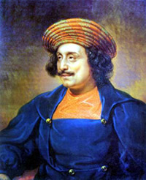
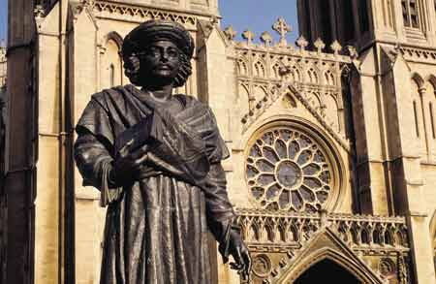
Combined Western and Indian Ideas:
Ram Mohun Roy combined both views and because of his influence, he is often hailed as the founder of Indian nationalism
This statue of Raja Rammohun Roy stands outside Bristol Cathedral.

Slide 27
The Rise of Indian Nationalism
Groups in India found British rule deeply disturbing
Indian elites and middle classes lacked opportunities
Indians had little power to influence decisions at higher levels of government
Nationalist Movement
Activating Movement
Nationalist movement did not take off until Indians saw themselves as having same rights as Europeans
Idea first expressed by reformer Ram Mohun Roy, 1820s
Felt British violating Indian’s rights, including free speech, religion
Roy wrote texts, opened schools to spread nationalist ideas
Despite his efforts, took several decades for movement to activate
1885, Indian National Congress, first nationalist group, founded by English-speaking Indians
Initial requests of the Congress to British were modest, such as more positions for Indians in the ICS, and better representation on government councils.

Slide 28
Bal Gangadhar Tilak – 1856 – 1920
"The father of the Indian unrest."
Also conferred with the title of "Lokmanya", which means "accepted by the people (as their leader)". Mahatma Gandhi called him "The Maker of Modern India"
Middle Class educated background from Bombay.
He obtained his Bachelor of Arts in first class in Mathematics in 1877. He left his M.A. course of study midway to pursue and obtain his LL.B degree in 1877.
After graduating, Tilak started teaching mathematics at a private school in Pune. Later, due to ideological differences with the colleagues in the new school, he withdrew and became a journalist.
Tilak actively participated in public affairs. He stated: "Religion and practical life are not different. The real spirit is to make the country your family instead of working only for your own. The step beyond is to serve humanity and the next step is to serve God.
He co-founded the New English school for secondary education in 1880 with a few of his college friends. Their goal was to improve the quality of education for India's youth. The success of the school led them to set up the Deccan Education Society in 1884 to create a new system of education that taught young Indians nationalist ideas through an emphasis on Indian culture.
The Society established the Fergusson College in 1885 for post-secondary studies. Tilak taught mathematics at Fergusson College. In 1890, Tilak left the Deccan Education Society for more openly political work.
He began a mass movement towards independence by an emphasis on a religious and cultural revival.

Slide 29
Political Career
When the British partitioned Bengal in 1905, Tilak demanded for the annulment of the partition and advocated a boycott of British goods, which soon became a movement that swept the nation. The following year he set forth a program of passive resistance, known as the Tenets of the New Party, that he hoped would destroy the hypnotic influence of British rule and prepare the people for sacrifice in order to gain independence.
Those forms of political action initiated by Tilak—the boycotting of goods and passive resistance—were later adopted by Mohandas (Mahatma) Gandhi in his program of nonviolent noncooperation with the British.
Tilak aimed at swarajya (independence), not piecemeal reforms, and attempted to persuade the Congress Party to adopt his militant program. On that issue, he clashed with the moderates during the party’s session (meeting) at Surat (now in Gujarat state) in 1907, and the party split. Taking advantage of the division in the nationalist forces, the government again prosecuted Tilak on a charge of sedition and inciting terrorism and deported him to Mandalay, Burma, to serve a six-year prison sentence.
Tilak had a long political career agitating for Indian autonomy from the British rule. Before Gandhi, he was the most widely known Indian political leader.
Tilak was considered a radical Nationalist but a Social conservative. He was imprisoned on a number of occasions that included a long stint at Mandalay.
Tilak sought to widen the popularity of the nationalist movement (which at that time was largely confined to the upper classes) by introducing Hindu religious symbolism and by invoking popular traditions of the Maratha struggle against Muslim rule.
He organized two important festivals, Ganesh in 1893 and Shivaji in 1895. Ganesha is the elephant-headed god worshipped by all Hindus, and Shivaji, the first Hindu hero to fight against Muslim power in India, was the founder of the Maratha state in the 17th century, which in the course of time overthrew Muslim power in India. But, though that symbolism made the nationalist movement more popular, it also made it more communal and thus alarmed the Muslims.
Tilak’s activities aroused the Indian populace, but they soon also brought him into conflict with the British government, which prosecuted him for sedition and sent him to jail in 1897. The trial and sentence earned him the title Lokamanya (“Beloved Leader of the People”). He was released after 18 months.

Slide 30
In the Mandalay jail, Tilak wrote his book (“Secret of the Bhagavadgita”)—also known as Bhagavad Gita or Gita Rahasya—an original exposition of the most-sacred book of the Hindus and published The Orion; or, Researches into the Antiquity of the Vedas, and, a decade later, The Arctic Home in the Vedas. The works were intended to promote Hindu culture.
On his release in 1914, on the eve of World War I, Tilak once more plunged into politics. He launched the Home Rule League with the rousing slogan “Swarajya is my birthright and I will have it.”
In 1916 he rejoined the Congress Party and signed the historic Lucknow Pact, a Hindu-Muslim accord, with Mohammed Ali Jinnah, the future founder of Pakistan. Tilak visited England in 1918 as president of the Indian Home Rule League. He realized that the Labour Party was a growing force in British politics, and he established firm relationships with its leaders. His foresight was justified: it was a Labour government that granted independence to India in 1947. Tilak was one of the first to maintain that Indians should cease to cooperate with foreign rule, but he always denied that he had ever encouraged the use of violence.
By the time Tilak returned home in late 1919 to attend the meeting of the Congress Party at Amritsar, he had mellowed sufficiently to oppose Gandhi’s policy of boycotting the elections to the legislative councils established as part of the reforms in 1918. Instead, Tilak advised the delegates to follow his policy of “responsive cooperation” in carrying out the reforms, which introduced a certain degree of Indian participation in regional government. He died, however, before he could give the new reforms a decisive direction.
In tributes, Gandhi called him “the Maker of Modern India,” and Jawaharlal Nehru, independent India’s first prime minister, described him as “the Father of the Indian Revolution.”

Slide 31
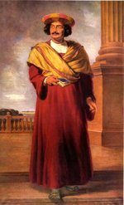
Nationalism Surfaces in India
Calls for Reforms
  In 1800s, Ram Mohun Roy leads modernization movement
  Many Indians adopt western ways and call for social reforms
  Indians resent being second-class citizens in their own country.

Slide 32
Raja Ram Mohan Roy
Sought to counter the criticisms of Hinduism made by the British missionaries
Founded the Brahmo Samaj in 1828 as a new religion with Christian-style services.
Encouraged Indians to be egalitarians----to move away from the caste system and accept that all people are equal
Encouraged Indians to do more social services for the poor and to reject the belief that their suffering was okay due to karma and dharma

Slide 33
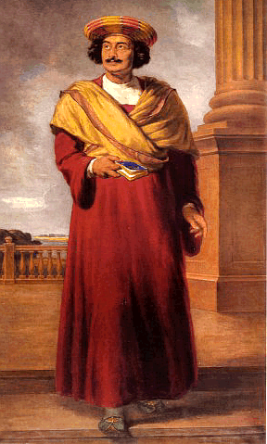
Ram Mohun Roy (1772-1833)
well-educated Indian who began a campaign to modernize India
he was opposed to India’s caste system (social class system that ties a person to the social class they are into for life: based on Hindu beliefs)
opposed to child marriages and widow suicides
believed these practices needed to be changed if India wanted to be free from rule by outsiders

Slide 34

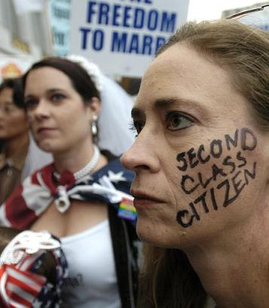

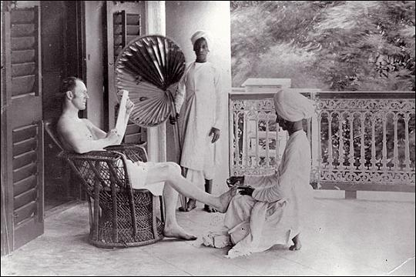
Ram Mohun Roy (1772-1833)
other Indian writers picked up on Roy’s ideas and called for changes
Indian resented being second-class citizens in their own country
Indians were paid 20 times less than British
Indians could not hold top jobs in government

Slide 35
Impact of Ram Roy: Independence Organizations Formed
Muslim League
Comprised of Middle Class professionals and lawyers educated in England
Members Muslim
Wanted independence for India and creation of 2 countries: India and Pakistan
Indian National Congress
Comprised of Middle Class professionals and lawyers educated in England
Majority of members Hindu
Wanted greater self-government for Indians in India

Slide 36
Indian National Congress
Phase 2 – Political Nationalism

Slide 37
Indian National Congress (INC)
Due to the slow pace of British reform in India, many of the nationalists became convinced that relying on British good will was a lost cause
1885---a small group of Indians met in Bombay and formed the Indian National Congress
It did not immediately call for independence, but for a share in the governing process

Slide 38
Indian National Congress
Had problems due to religious differences between Muslims and Hindus members
INC sought independence for all Indians regardless of class or religions
But its leaders were Hindus and not Muslims
INC reflected more Hindu concerns

Slide 39
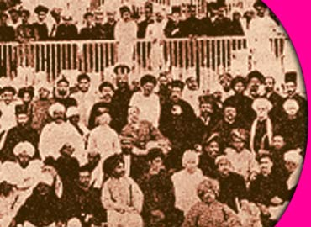

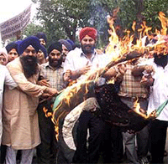

Indian National Congress 1885
Made up of Hindus; called for self-government
upset that Britain segregated Bengal (Indian city) into Muslim section and Hindu section in 1905
INC led acts of violence against British in Bengal
1911 Britain changed the order of segregation

Slide 40
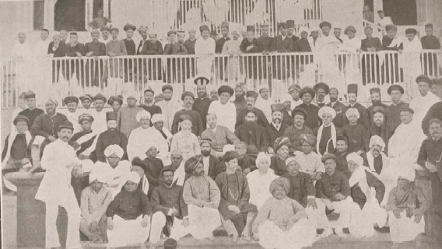
The Indian National Congress
1885 → The Indian National Congress
was founded in Bombay.
swaraj → “independence.”
* the goal of the movement.

Slide 41
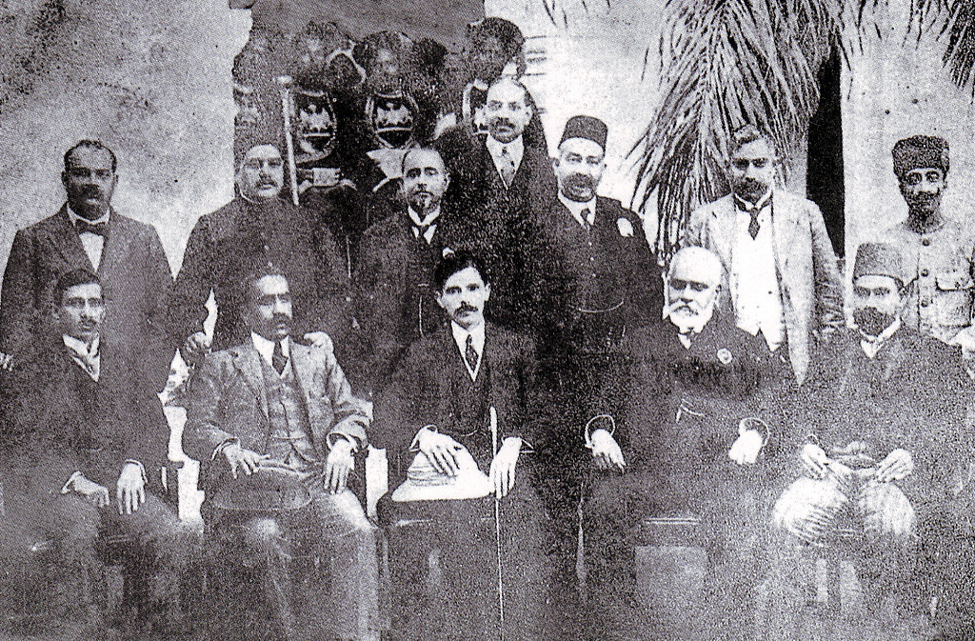
Indian National Congress
Goals: Democracy, Local Self-Rule, Prevent mass peasant uprising (like China) by keeping power centered on middle class leaders.
Notes:
Formed in 1885 - Claimed to represent all Indians.
Members were middle class professionals, western educated elite Indians. Growth of Indian nationalism - presented grievances to the British.

Slide 42
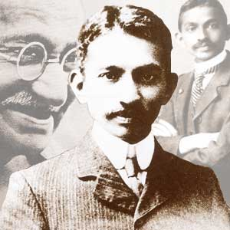
Mohandas Gandhi
Studied law in England, practiced in South Africa
Joined the INC before WWI
Became leader of the INC because he was better able to relate to the problems of the common people
Believed in the idea of non-violent resistance (Satyagraha)

Slide 43
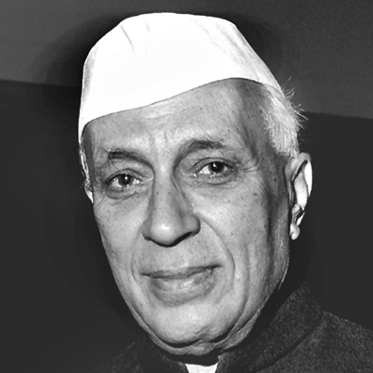
Nehru
Joined the INC in 1930s
New kind of Indian politician---upper class and intellectual
Differed from Gandhi who was more religious and traditional, while Nehru was secular, Western, and modern

Slide 44
Nehru
Jawaharlal Nehru. Also a high-caste Hindu educated in Britain,
- Nehru was a practical political leader with socialist leanings.
- He accepted Gandhi's ideas of passive resistance and aiding untouchables, but he rejected Gandhi's proposal for hand production.
- Instead, Nehru urged industrialization to develop India's economy and raise living standards.

Slide 45
Muslim League

Slide 46
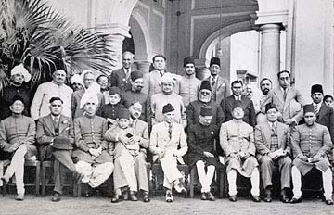
The Muslim League
1905 → partition of Bengal based on
religions and languages.
1906 → creation of the Muslim
League.

Slide 47
Muslim League
Strongest support came from Muslims who were frightened of Hindu domination
But many Muslims were also members of the Indian National Congress too
Initially the Muslim League focused on protesting Muslim rights and promoting understanding between the different religious groups
There was no notion of creating a separate state for Muslims until the 1920s when the religious differences developed

Slide 48
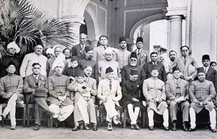

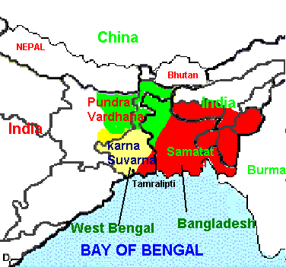
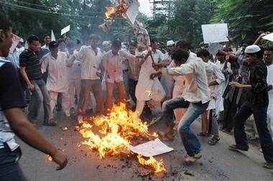
Muslim League 1906
Made up of Muslims
also called for self-government
also upset about segregation of Bengal in1905
also participated in acts of violence against British in India

Slide 49
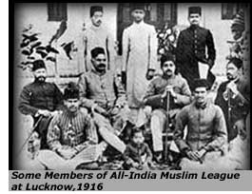
The Muslim League Forms
Goals:
Protect the interests, liberties and rights of Muslims
Promote an understanding between the Muslim community and other Indians - discourage violence.
Educating the Muslim and Indian community at large on the actions of the government
Notes:
Formed in 1906 – concerned about the future of Muslims, minority group in India; Muslims mistrust Hindu domination in the Congress Party

Slide 50
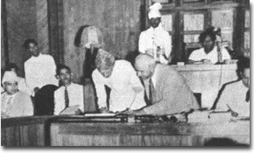
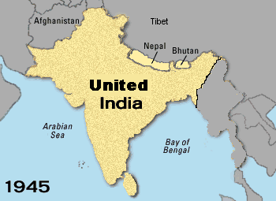
Indian Nationalism Grows
Indian National Congress (Hindus)/Muslim League (Muslims) Found Common Ground
Both worked together towards Indian Independence

