Slide 1
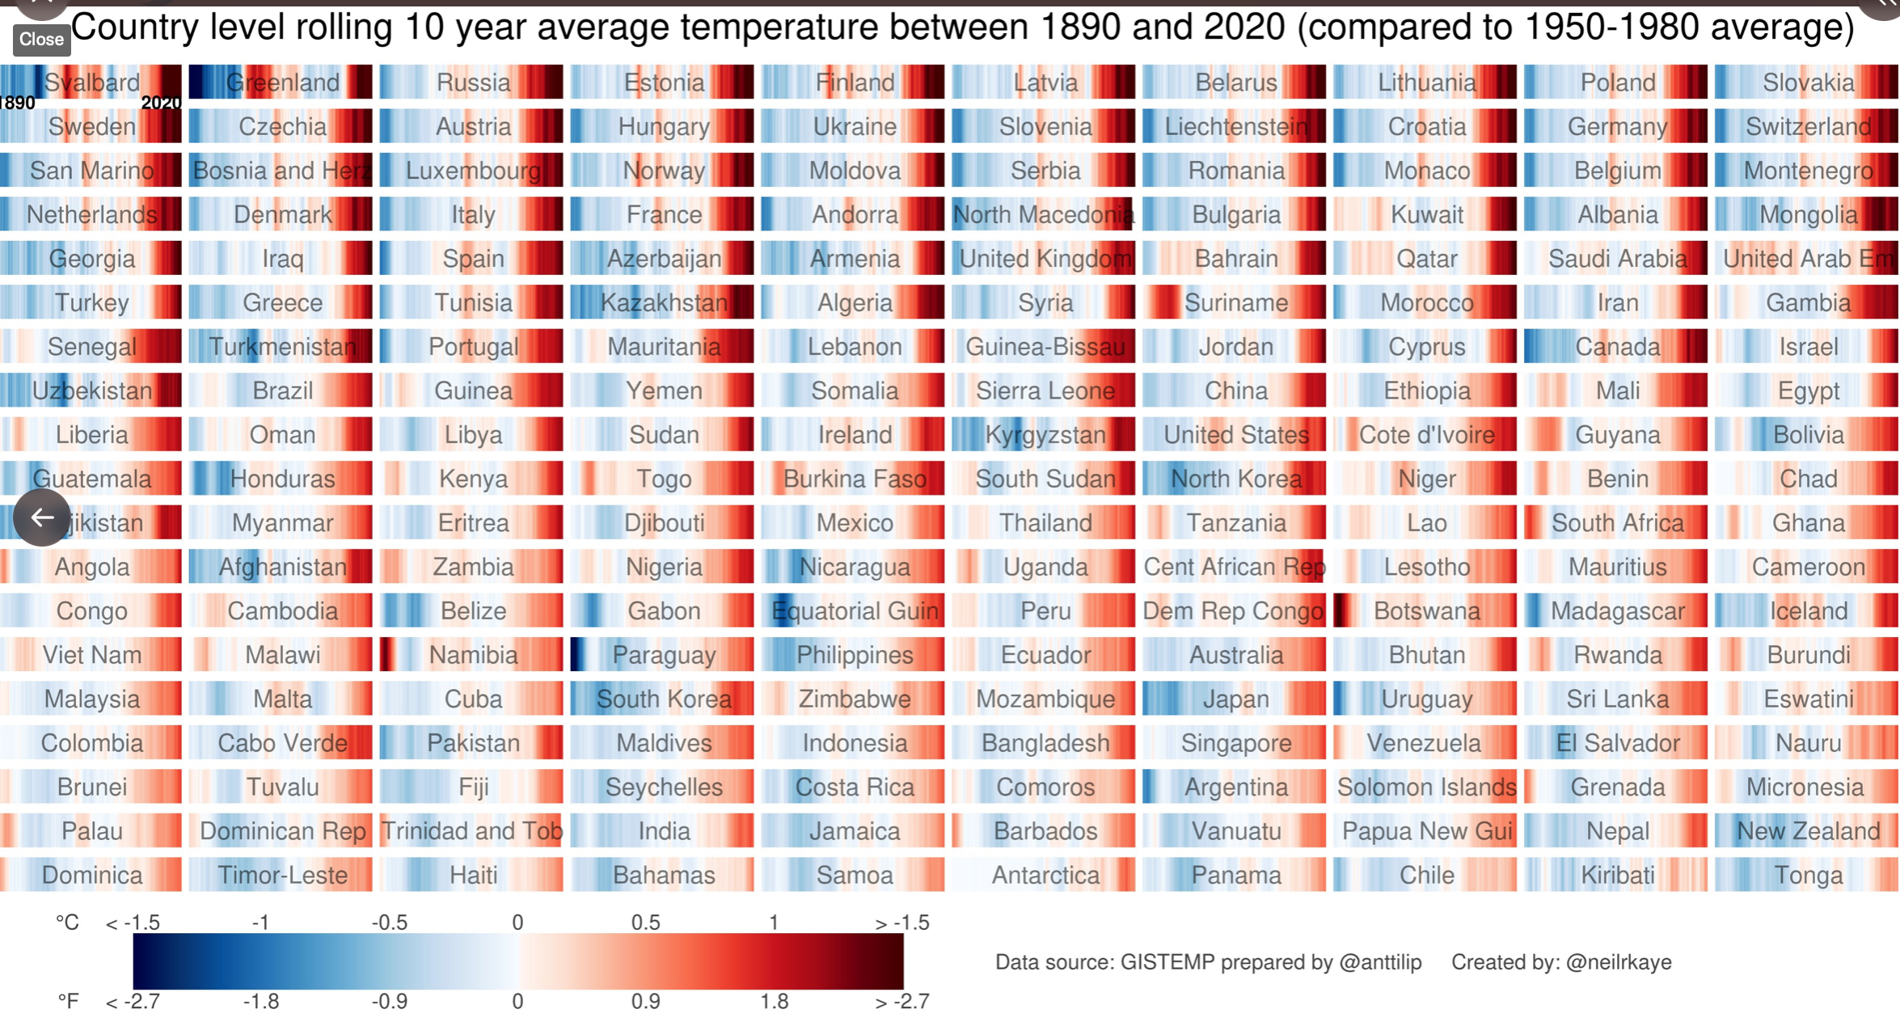
THE CONSEQUENCES OF CLIMATE CHANGE
What: The impact of global economic development on the Global Commons, including rainforest removal, biodiversity loss and ocean pollution.
Why: To investigate the concept of the Global Commons.
To recognise the main areas of concern.

Slide 2
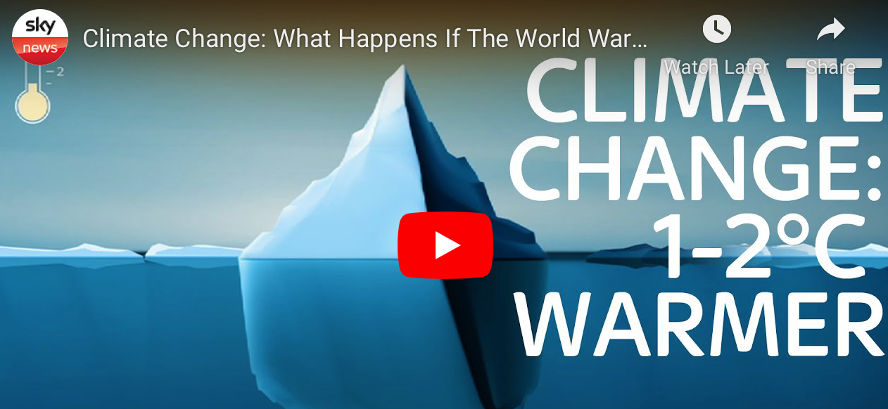
https://www.youtube.com/watch?v=9GjrS8QbHmY

Slide 3
COP26
Average global temperatures have increased by 1.2C since 1850.
So what?
This seemingly small increase in temperature has resulted
in serious climate change with impacts such as:
Melting Ice in Antarctica and sea-level rise | Intense heat waves, drought and famine | Increased storms and flooding | Loss of biodiversity and extinctions | Increased wildfires including in Siberia
The countries most at risk and those that are poorer (LICs)

Slide 4
Who Does Climate Change Affect?
In the long term, everyone will feel the effects of climate change. However, some people are currently more affected than others.
In most cases, the wealth of prosperous countries has come from activities which contribute to greenhouse gas emissions. This wealth allows these countries to protect themselves from the effects of climate change.
Poorer countries are less able to adapt to climate change and therefore suffer the most from its effects. They are also less able to develop because they need to focus on addressing the challenges caused by climate change.
The countries who have contributed the least to the climate crisis are the ones who are affected the most.
Is this fair?

Slide 5
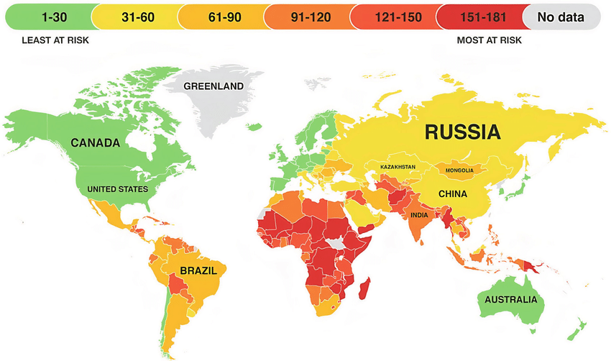
COP26
The countries most at risk and those that are poorer (LICs)

Slide 6
Highlighting the impacts: climate change
Highlight which continent you think the impact described may affect, or has affected. Colour in the thermometer according to the severity of that impact.
Severity scales
1. In which continent are the ice caps over 1km thick, the melting of which could raise sea levels by over 60 metres?
Severe
2. Which continent might experience greater future political tension over resources, despite the treaty that was signed in 1959?
Moderate
Low
3. On which continent will the Sub-Saharan areas likely experience over 30 days of ‘deadly heat’ a year by 2080?
Severe
4. On which continent could a 1. 5⁰C warming result in a 200% increase in population affected by floods in Colombia, Brazil and Argentina?
Moderate
Low
5. On which continent would you find the Maldives? The islands may be uninhabitable by 2030 due to sea level rise and submerged by 2070.
Severe
6. On which continent would a projected sea level rise of 82cm by 2100 flood important agricultural land in Bangladesh, India and Vietnam?
Moderate
Low
7. Which continent has experienced a greater frequency of category 4 and 5 hurricanes since 1980?
Severe
8. Which continent has the second largest body of ice on the planet, the melting of which could raise sea levels by 6 metres?
Moderate
Low
9. Which continent’s Great Barrier Reef has lost half its corals since 1995 due to coral bleaching caused by warmer sea temperatures?
Severe
10. Which continent’s shifting rainfall patterns may move the regions where malaria is prevalent into new humid areas to the south?
Moderate
Low
11. Which continent’s alpine glaciers may have vanished completely by 2050 causing economic losses from a lack of winter tourism?
Severe
12. Which continent may experience a current once-in-a-20 year extreme heat event in the southern states every 2-3 years by 2050?
Moderate
Low

Slide 7
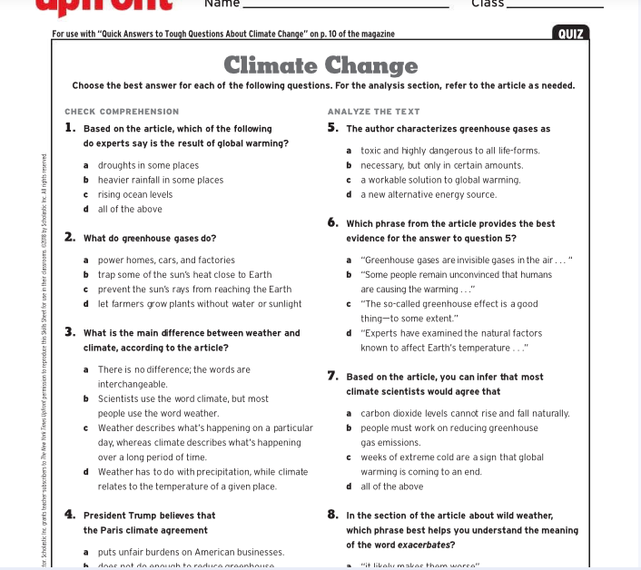
Read the resource and answer the questions

Slide 8
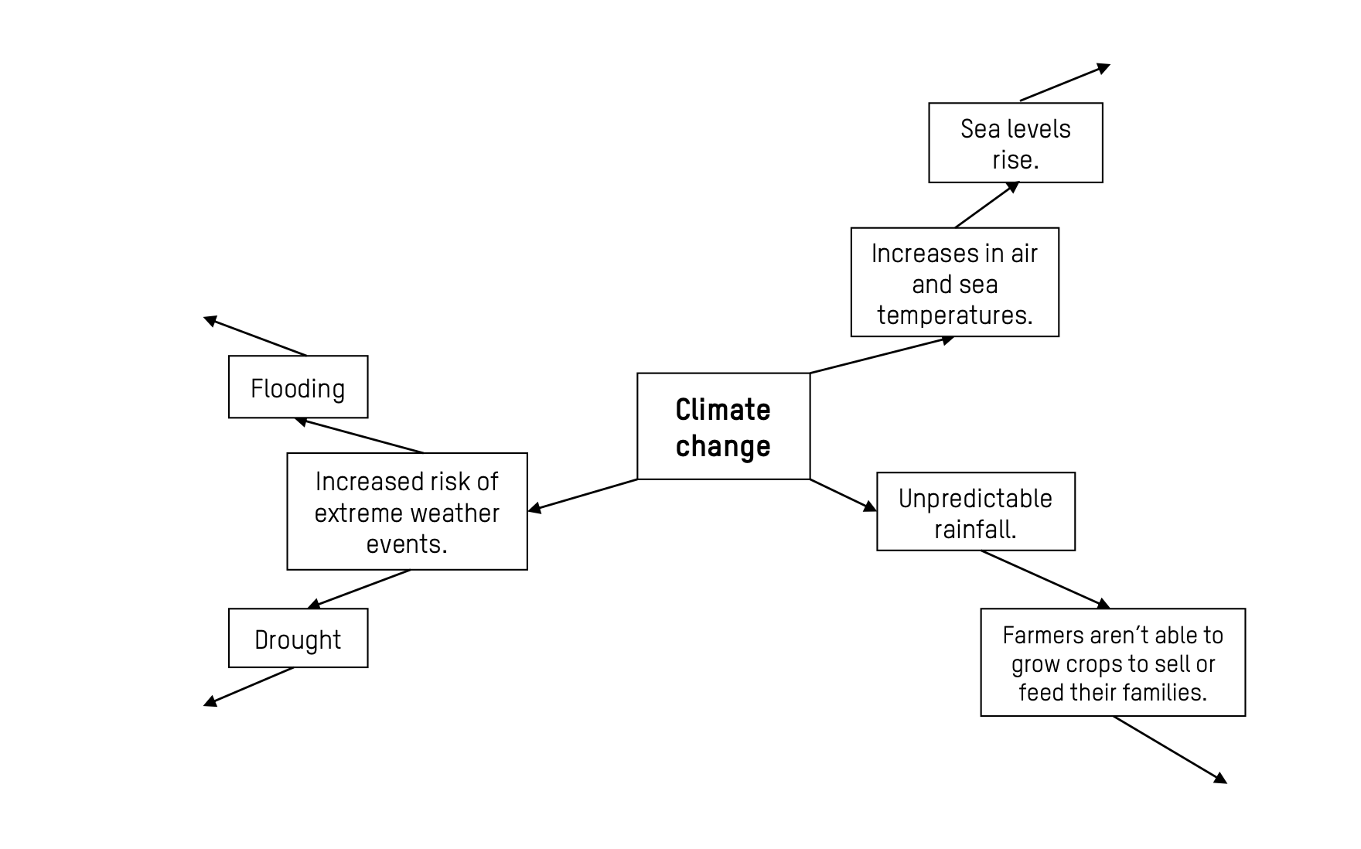
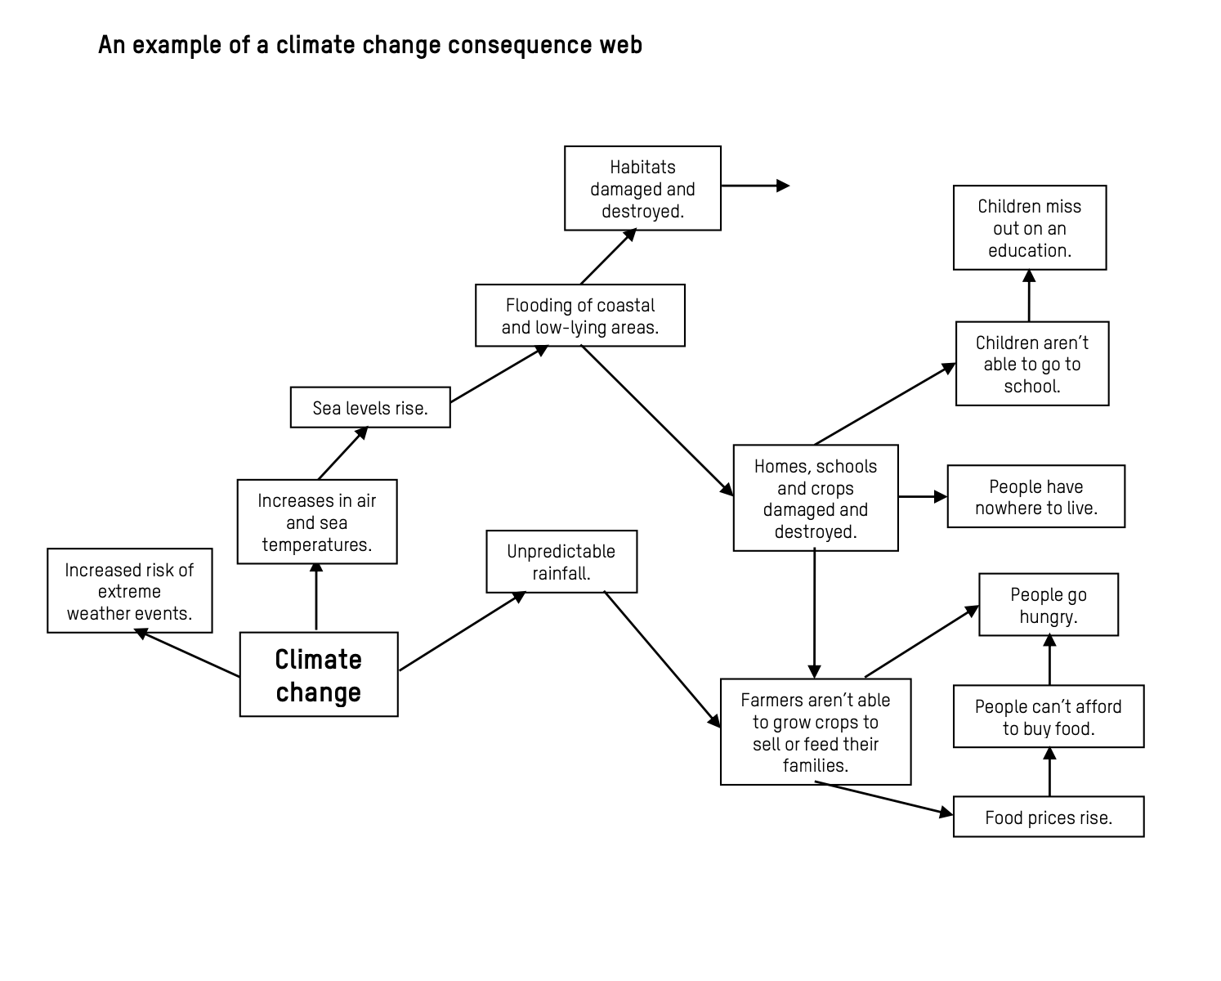
Use the sheet ‘climate change impacts’ to complete a climate change consequences web

Slide 9
Arrange these statements from the person who may be most vulnerable to least vulnerable to climate change.

Slide 10
