Slide 1
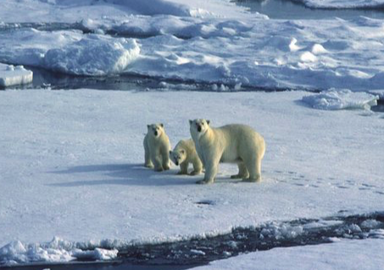
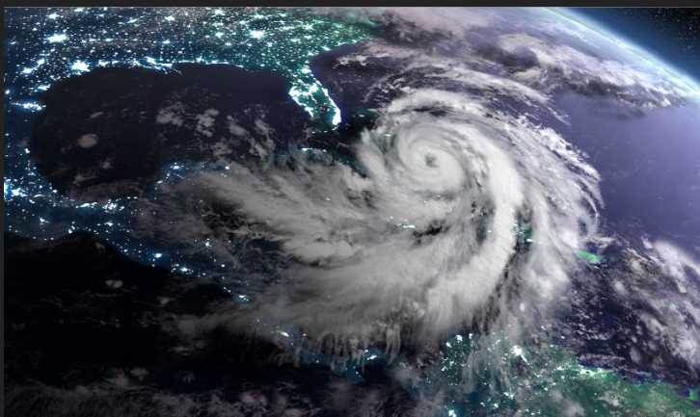
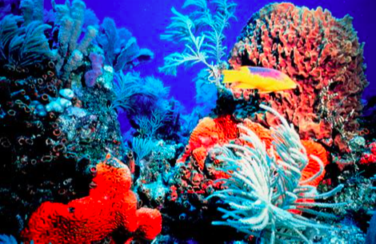
The consequences of climate change

Slide 2
Starter:
What is this? How was this brought about by climate change? What are the implications of this?

Slide 3
Objectives from the IB

Slide 4
2.2 Consequences of global climate change Key aims of this unit: | \
I know that global climate change will affect places, societies and environmental systems.
I can explain the terms hydrosphere, atmosphere and biosphere.
I can explain how water is stored in ice and oceans and how changes in this can lead to changing sea levels.
I can explain how carbon moves around the earth – and how it can be stored in ice, oceans and the biosphere.
I can discuss how changes is the hydrosphere and atmosphere can lead to extreme weather events, including drought.
I can explain how climate change can lead to spatial changes in where we find different biomes and habitats, and how this can affect animal migration patterns.
I can explain how climate change can lead to changes in agriculture by affecting crop yields, limiting where humans can cultivate certain species, and causing erosion in places it may not have occurred before.
I can discuss how the changes given above can impact on people’s lives and their environments, possibly leading to health hazards.
I can discuss how migration might occur as a result of climate change.
I can explain the opportunities that climate change might bring with regards to ocean transport routes, but that this comes at an environmental cost.
Synthesis, evaluation and skills opportunities I can explain the uneven distribution of effects and the uncertainty of the timing, scale, and impacts of these effects on individuals and societies.

Slide 6
Key terms:
Hydrosphere: Includes all the water in all the states/phases on the planet. Water may be stored in rocks or soil, or be on the surface of the Earth (rivers, lakes and oceans) or in the atmosphere. It may be a liquid, gas (vapour) or solid. Higher temperatures can and do affect all of these stores and flows.
Biosphere: The biosphere contains all living organisms, which includes plants, animals and microorganisms.
Atmosphere: The atmosphere is the mixture of gases that surrounds the Earth.
https://www.youtube.com/watch?v=5FooHD0atuc

Slide 7
List as many impacts of climate change as possible
Do these fall into hydrosphere, biosphere or atmosphere?

Slide 8
Hydrosphere
Changes in precipitation
Changes in ice stores
Sea level change
Changes in cycles such as carbon and water cycle

Slide 9
Biosphere
Migration of species
Sea ecosystems- change in ice/ Coral bleaching
Species extinction
Carbon cycles- i.e. trees carbon sinks

Slide 10
Atmosphere
Extreme temperatures
Changes in precipitation- drought/ flooding

Slide 11
Recent extreme weather events linked to climate change

Slide 12
Task: presentation/ infographic
In 2s/3s you will be given one of the following objectives
The impact of global climate change on
the hydrosphere, including water stored in ice and oceans, changing sea levels
the global carbon stores: ice, oceans and biosphere
weather: incidence and severity of extreme events such as drought, hurricanes, etc.
changing distribution of biomes and other impacts on the biosphere and its non-human inhabitants
agricultural productivity
human health, migration and transport.
Using the 4 textbooks and resources on the weebly explain the consequences of climate change linked to this objective
Success criteria:
Include examples of places- Include specific figures/ named examples- how does this vary spatially?
Explain the processes that cause the changes
Explain the scale of the effect- local/ global, long/ short term
Create a 10 minute presentation and an infographic for the rest of the class.

