Slide 1
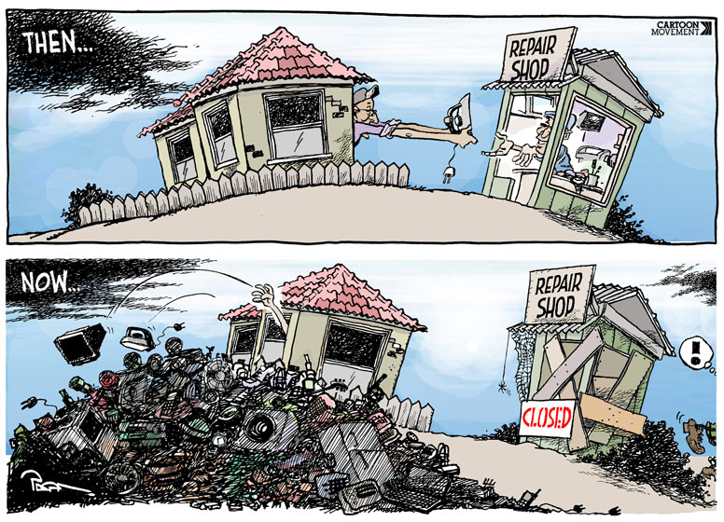
What do you think the message of this cartoon is?

Slide 2
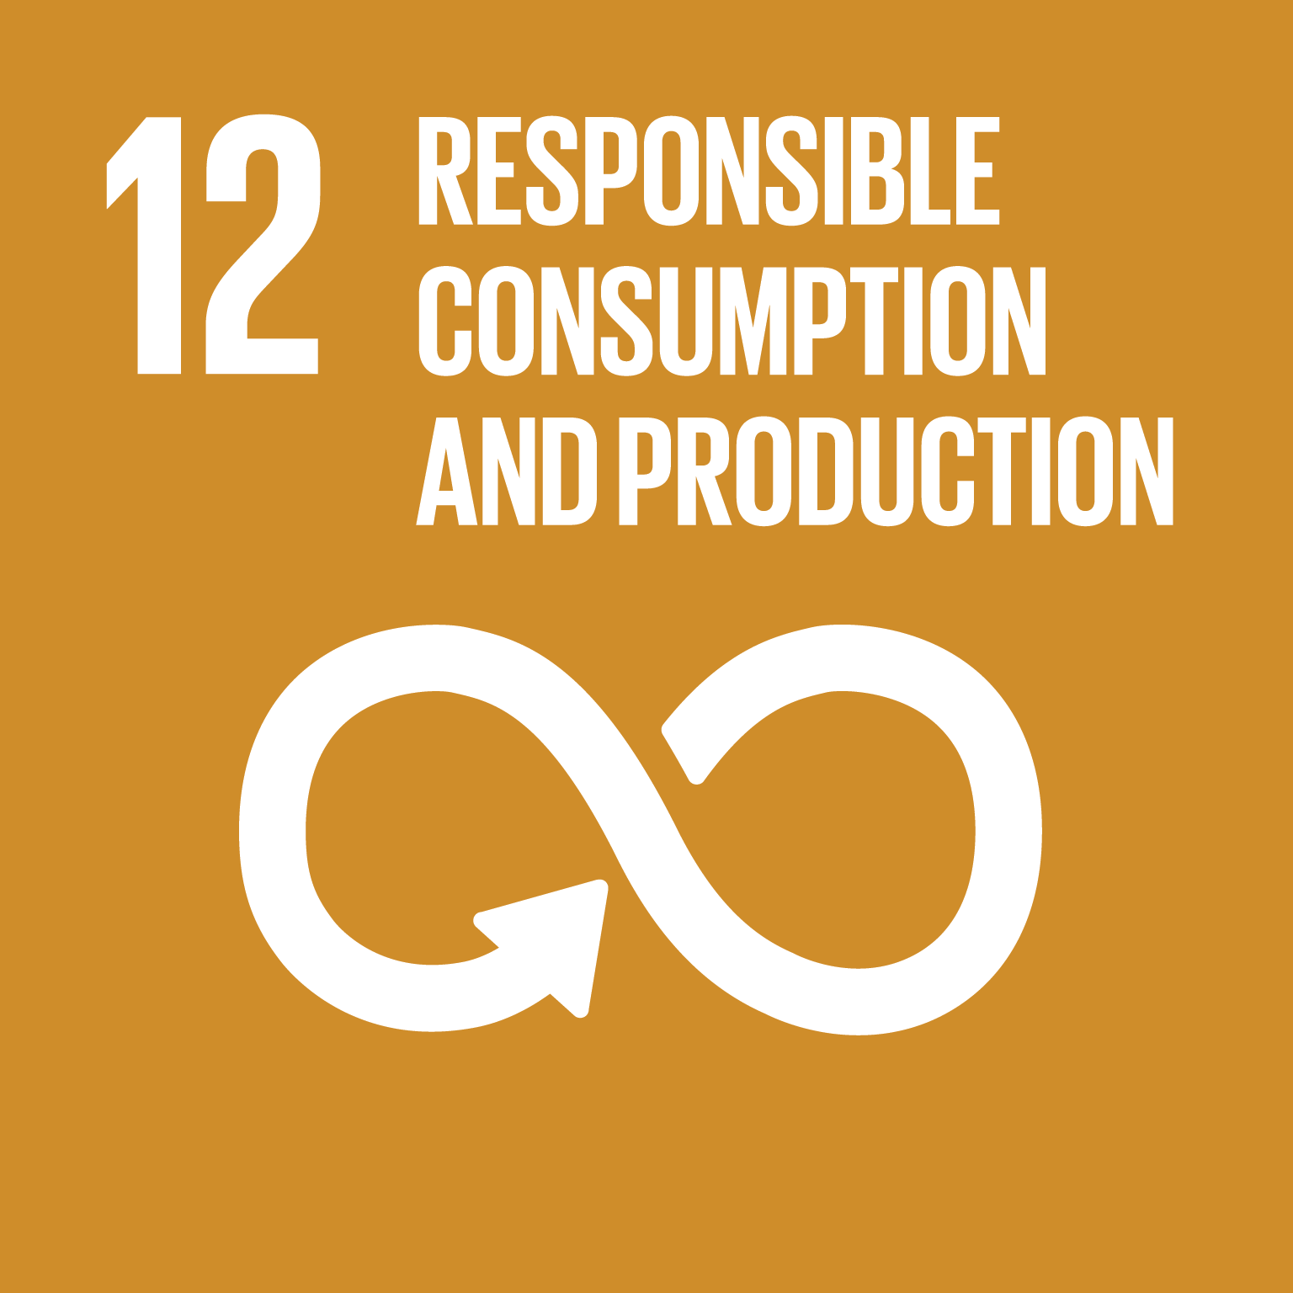
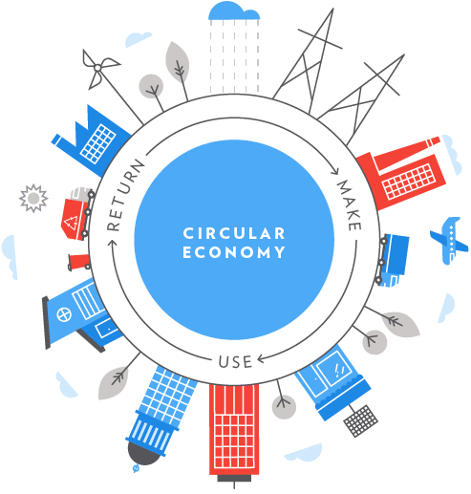
What: How can we be more responsible in our consumption and production?
Why: To understand how we could conserve our resources for the future
How: To research a variety of ways in which we can be more sustainable with our consumption practices and learning about how production can be made more sustainable through the circular economy

Slide 3
What goods do you use every day?
Task: Fill in your ‘goods wheel’ with items that you use on a normal school day.
Then: Categorise these items into items that you only use once and then throw away and items that you can reuse.
BONUS: Can you think of any items that you throw away after one use but that you could replace with one you reuse?
Toiletries
Digital devices
Drink
Fresh food
Goods Wheel
Packaged food
Machines
Furniture
Clothes
Challenge: Can you categorise these into products that you could source from the USA and those that you couldn’t?

Slide 4
Items that you use once and then throw away
Toiletries
Digital devices
Items that you can reuse
Items that you throw away after one use but could replace with an item you could reuse
Drink
Fresh food
Goods Wheel
Packaged food
Machines
Furniture
Clothes
Notes:
Model first, then allow students to work through their own examples.
During debrief, discussion of categories is key. Challenge all in the class to think of items they could replace with reusable ones.

Slide 5
Could you live a zero waste lifestyle?
https://www.youtube.com/watch?v=nYDQcBQUDpw

Slide 6
How can we manage our consumption sustainably? Is less more? L/O: To rank the options for more sustainable consumption
SUSTAINABILITY
Economic leg
Good jobs
Fair wages
Security
Infrastructure
Fair trade
Environmental leg
Zero pollution and waste
Renewable energy
Conservation
Restoration
Starter: Remind yourself of the meaning of sustainability by writing the three key elements of sustainability on the legs of the ‘stool of sustainability’ on your sheet.
Social leg
Good working conditions
Health services
Education services
Community & culture
Social justice
Challenge: Can you write a definition of ‘sustainable’?

Slide 7
3-legged sustainability stool
SUSTAINABILITY
Economic leg
Good jobs
Fair wages
Security
Infrastructure
Fair trade
Environmental leg
Zero pollution and waste
Renewable energy
Conservation
Restoration
Social leg
Good working conditions
Health services
Education services
Community & culture
Social justice
Notes:
Student copy

Slide 8
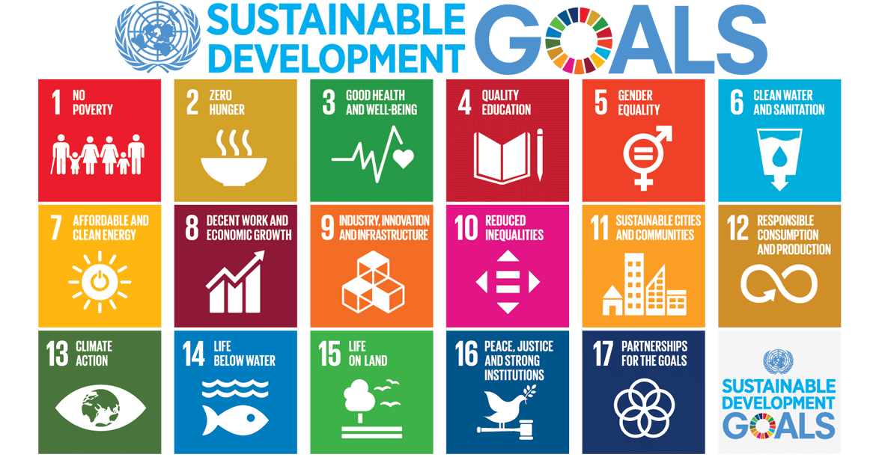
What can world leaders do?
Remember these?
Number 12 is all about responsible consumption!
Explore the interactive resource at the bottom of this web page: https://www.unenvironment.org/explore-topics/sustainable-development-goals/why-do-sustainable-development-goals-matter/goal-12

Slide 9
SDG 12: Responsible consumption and production
Paragraph 28 of the 2030 sustainable Development Goal Agenda reads: “We (Countries) commit to making fundamental changes in the way that our societies produce and consume goods and services. Governments, international organizations, the business sector and other non-state actors and individuals must contribute to changing unsustainable consumption and production patterns, including through the mobilization, from all sources, of financial and technical assistance to strengthen developing countries’ scientific, technological and innovative capacities to move towards more sustainable patterns of consumption and production.
We encourage the implementation of the 10-Year Framework of Programmes on Sustainable Consumption and Production. All countries take action, with developed countries taking the lead, taking into account the development and capabilities of developing countries”

Slide 10
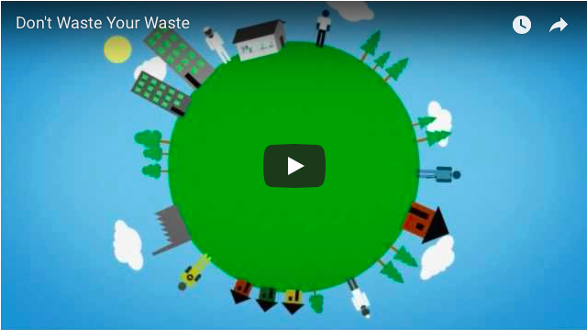
How waste is disposed of?
https://www.youtube.com/watch?time_continue=165&v=Kr_DGf77OhM

Slide 11
Study the cartoon below and discuss
1. The theme and message of the cartoon
2. The economic arguments which cause this
3. The arguments against this

Slide 12
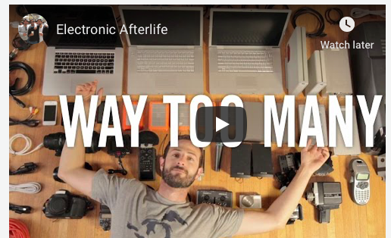

Slide 13
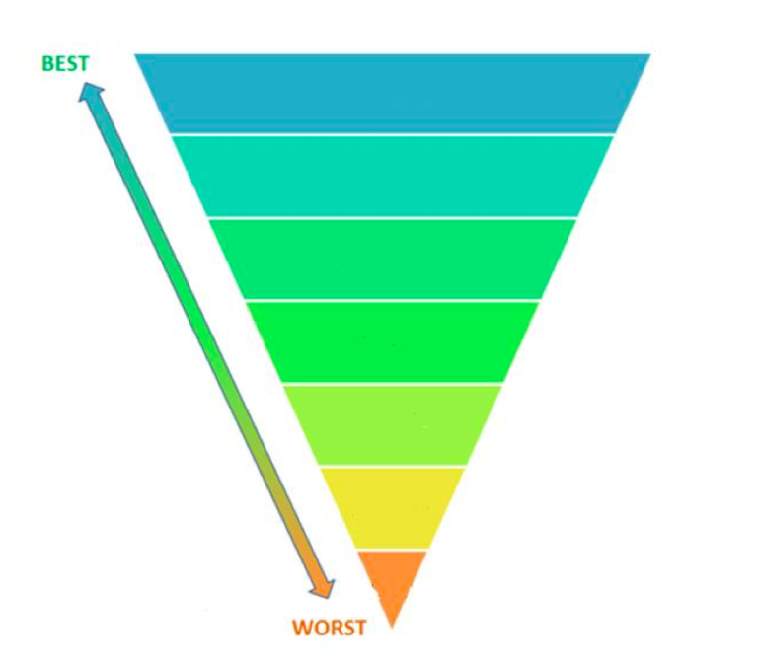
Study the list of strategies to manage waste and working with a partner (in pencil) rank the strategies from best to worst, placing the number in the correct level in the diagram.

Slide 15
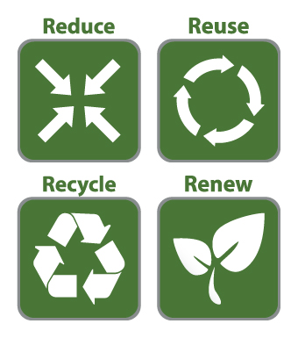
What can we all do to be more responsible consumers?
Remember the four Rs!
Reduce: Firstly, if we simply use less in the first place, then issues of consumption will also decrease
Reuse: Then, if you still want to consume, try to reuse what you already have
Recycle: If you must buy something new, make sure it is a) recycled and b) recyclable itself
Renew: As a last resort, if something cannot be recycled, can you give it an alternative use?

Slide 16
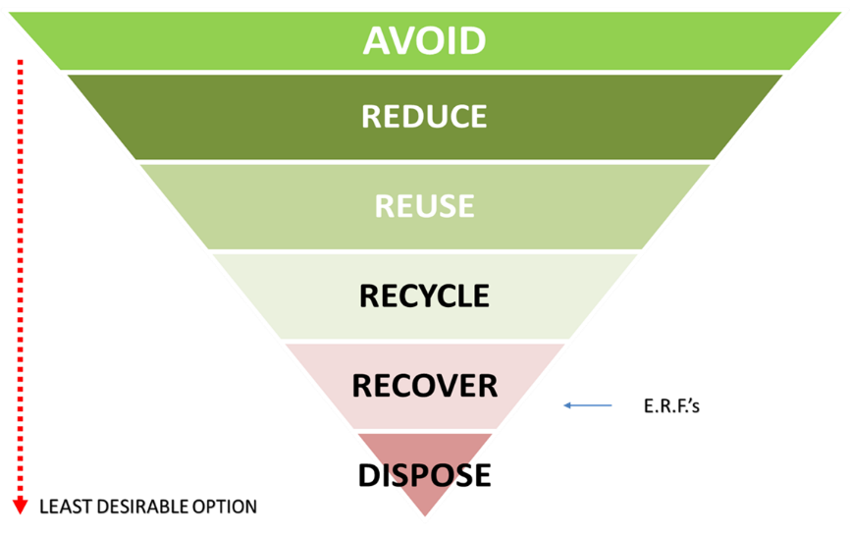
The Waste Hierarchy
CIRCULAR ECONOMY
Last option is to recycle, nothing goes to waste.

Slide 17
What can we all do to be more responsible consumers?
Task: You will be given some information about different methods you could use to be a more responsible consumer. You must then:
Summarise what this method is in your table in no more than 20 words per method
Decide which of the Four Rs this method is.

Slide 18
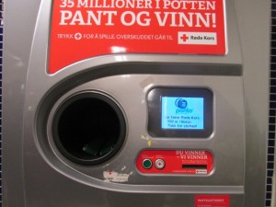
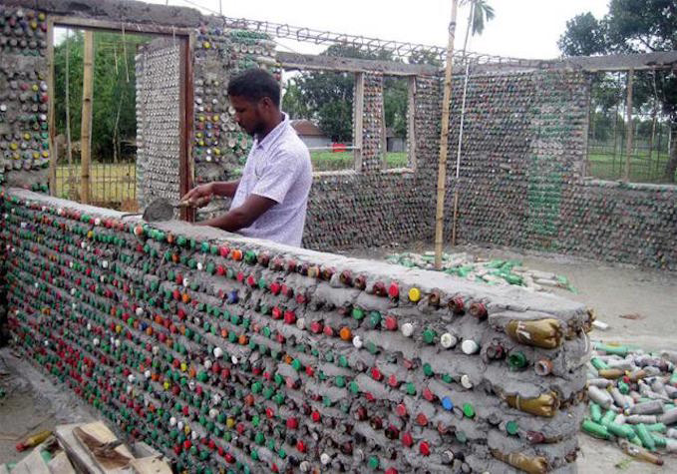
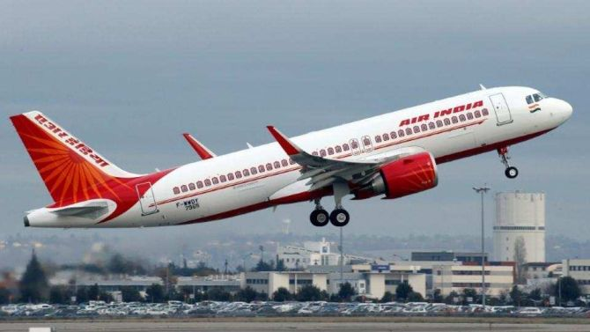
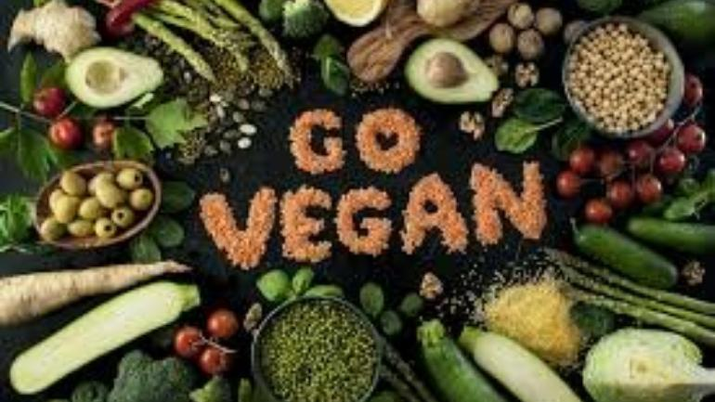
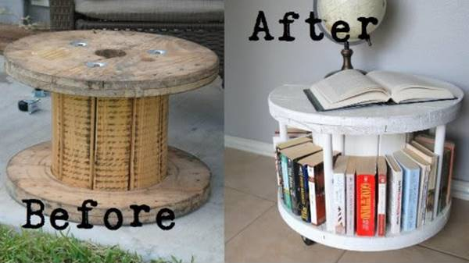
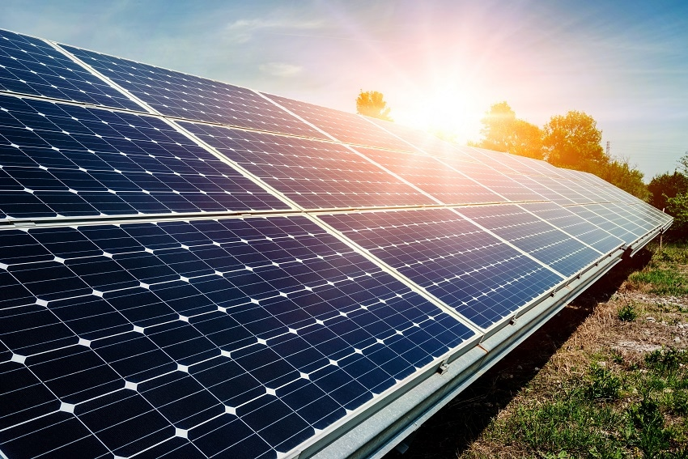
Method | Image | How does it work? | Reduce / Reuse / Recycle / Renew
Reverse vending machines
Zero waste shops
Ecobricks
Change one habit per month
Stop flying
Become a vegan
Try upcycling
Install solar panels on your roof

Slide 19
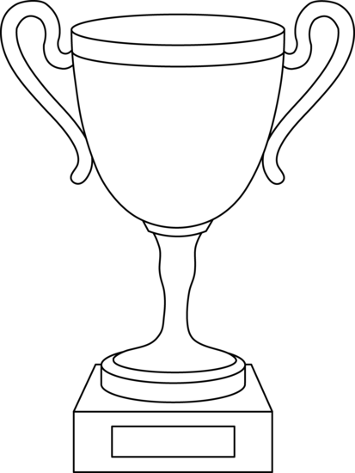
Which is the most important method of sustainable consumption?
ROUND ONE
SEMI-FINAL
FINAL
AND THE WINNER IS…
Reverse vending machines
Zero waste shops
Ecobricks
Change one habit per month
Stop flying
Become a vegan
Try upcycling
Install solar panels on your roof
Notes:
Students have their own copy but discuss their decisions in pairs

Slide 20
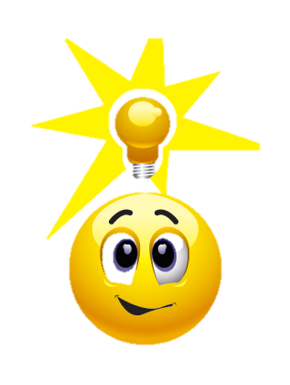
Which is the most important method of sustainable consumption?
Task: Using your chosen winner, answer this exam-style question in your book:
Justify one method of sustainable management of consumption. (6 marks)
AND THE WINNER IS…
TOP TIP
Think about the discussion you had with your partner when deciding who the winner of each round was going to be. Use those same arguments in your writing.

Slide 21
Resources

Slide 22
Reverse vending machines
What is a reverse vending machine?
A machine that accepts used beverage containers and returns money to the user. The containers are then sorted by the machine to be recycled. There are over 100,000 reverse vending machines installed throughout the globe.
How do reverse vending machines affect our consumption habits?
Since there is a financial incentive to recycle their waste, people are more likely to do so. This means that the number of recycled goods increases while the number of goods that end up in landfill sites decreases.

Slide 23
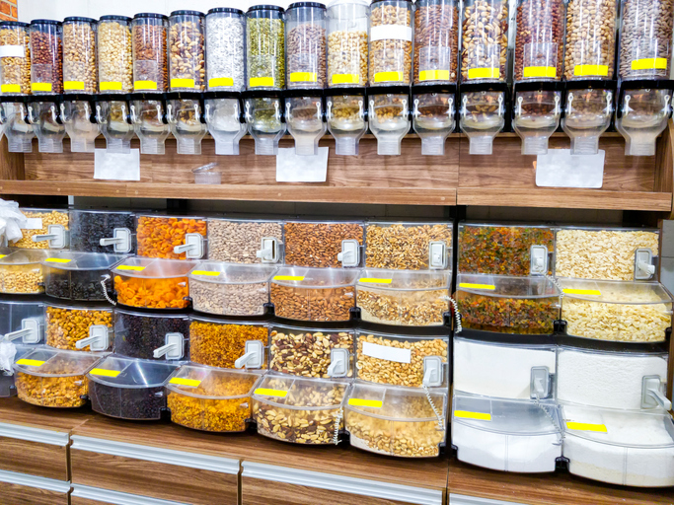
Zero-waste shops
What is a zero-waste shop?
Packaging-free refill shops where the shopper brings their own containers and fills them up with goods while in the shop. There is one in Tooting Market called BYO.
How does a zero-waste shop affect our consumption habits?
Much of what we buy in supermarkets comes packaged in non-recyclable plastic, which immediately gets thrown away after one use. This shop encourages people to reuse existing packaging. It is also a more time-consuming, less convenient process, which encourages consumers to think more about what they are buying.

Slide 24
Ecobricks
What is Ecobricks?
Ecobricks are reusable building blocks created by packing clean and dry used plastic into a plastic bottle. They can be used to make furniture, garden spaces, even full-scale buildings!
How does using Ecobricks affect our consumption habits?
Ecobricks give value to what was once value-less. They enable plastic to be kept out of the environment and create a reusable block that gives plastic waste a new lease of life.

Slide 25
Change one habit per month
What do we mean by ‘habits’?
The things you do every day that involve consumption. This could be getting a coffee, buying a newspaper, ordering something on Amazon; the list goes on!
How does changing one habit per month affect our consumption habits?
Like going on a diet, if people try to change parts of their life all in one go and too quickly, they will often fail. However, making one change to your consumption habits per month means that you only have to focus on making one change at a time. See the list on the left as an example.

Slide 26
Stop flying
What kind of flying are we talking about?
Aircraft, aeroplanes and helicopters. Basically, any way that humans can get around the world in the air.
How does stopping flying by aeroplane affect our consumption habits?
Aeroplanes are major emitters of greenhouse gases. If no one set foot on a plane again, it would undoubtedly make a difference to the rate of human-caused enhancement of climate change. One flight from New York to LA generates about 65 tonnes of carbon dioxide.

Slide 27
Become a vegan
What is a ‘vegan’?
A vegan is somebody that does not consume animal products. This can include not eating, wearing or using anything that is made with or by an animal.
How does veganism affect our consumption habits?
Researchers at the University of Oxford stated that eating a vegan diet could be the “single biggest way” to reduce your environmental impact on earth. This is because the meat industry is a huge emitter of carbon dioxide. The emissions created to produce one burger is equivalent to driving your car 320 miles. It also takes 2,400 gallons of water to produce a single pound of meat!
Many vegans also avoid consumption of animal products because many of these industries exploit the animals.

Slide 28
Try upcycling
What is upcycling?
Also known as creative reuse, upcycling is the process of transforming unwanted or waste materials into new products of better quality or for better environmental value.
How does upcycling affect our consumption habits?
By reusing waste without destroying it, our total volume of waste is reduced. It also reduces the need for production using new or raw materials, meaning a reduction in air pollution, water pollution and greenhouse gas emissions.

Slide 29
Install solar panels on your roof
What are solar panels?
Photovoltaic (PV) slabs which can be put on your roof to absorb sunlight as a source of energy to generate electricity.
How do solar panels affect our consumption habits?
Using solar panels means that you reduce the amount of energy you consume from the grid. This reduces the amount of pollutants being released every day, since energy from the grid has been sourced from non-renewable sources

Slide 30
Homework
Make your own plastic footprint!
We have explored what a carbon footprint is. Now you must create your own plastic footprint.
Save all the throwaway plastic items that you use in one week. These items will be used to create your plastic footprint. Only use items that you would use already – do not go out and buy anything to complete this project.
Draw around your foot onto a piece of (old and used!) card. Something like a cereal box would be good. Cut out the footprint.
Stick your plastic on to your footprint. Voila!

Slide 31
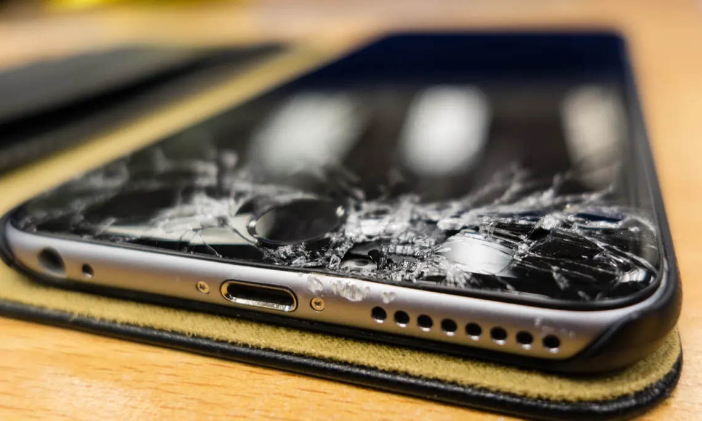
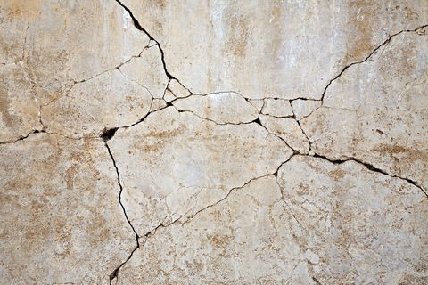
Title: What is the Circular Economy? L/O: To define types of economies and explain benefits of a circular economy
Welcome to the future, where your phone can fix its own smashed screen and concrete repairs its own cracks.
These are just two examples of something known as the ‘circular economy’.
https://www.theguardian.com/sustainable-business/2017/aug/30/phone-fix-its-own-smashed-screen-self-healing-materials-motorola-samsung
https://www.theguardian.com/sustainable-business/2015/jun/29/the-self-healing-concrete-that-can-fix-its-own-cracks

Slide 32
The Circular Economy
Task: Use ideas we have discussed in previous lessons, these images and the video to suggest what you think the circular economy is.
I think that the circular economy aims to … this means that …
https://www.youtube.com/watch?time_continue=125&v=zCRKvDyyHmI

Slide 33
Notes:
https://www.ellenmacarthurfoundation.org/circular-economy/concept

Slide 34
The Circular Economy
A circular economy aims to design out waste. This means that waste does not exist: the end-of-life concept is replaced with restoration.
Task: Use the definition on the right to improve your definition.
Raw materials
These are all the parts of the economy. Currently, we don’t have a circular economy.
Why not?
Production
Use
Non-recyclable waste
Recycling

Slide 35
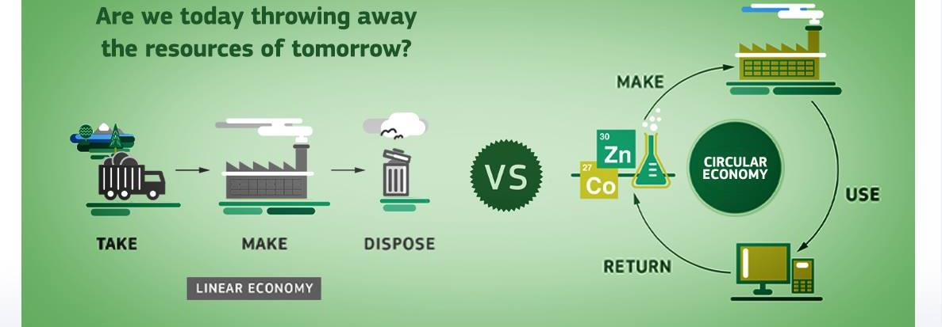
What is a circular economy?
A circular economy is an substitute to a linear economy, we can keep using our resources within our system for as long as possible.
Reuse as many times before disuse
Then recycle and regenerate products at the end of their life

Slide 36
The Circular Economy
Our economy looks something like this…
Or, at its best, this…
REMINDER: A circular economy aims to design out waste. This means that waste does not exist: the end-of-life concept is replaced with restoration.
But what if it could look more like this…?
Notes:
Give students copies of each of the economy types. Annotate with what each one is/how it works.

Slide 37
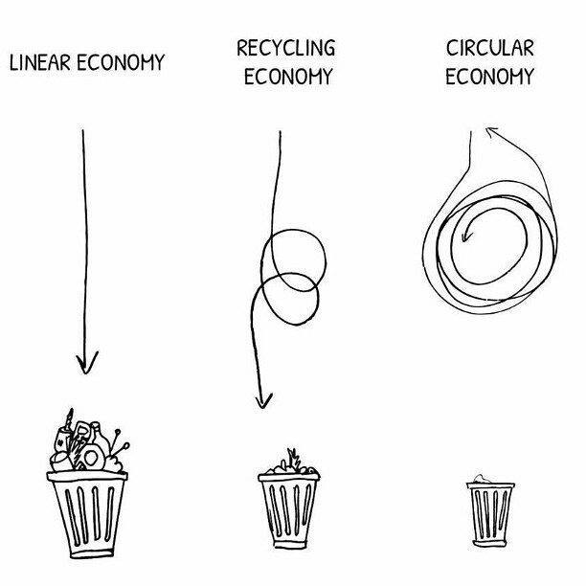

Slide 38
How did we previously manage waste?
In nature there isn’t any waste, in fact, we are the first species to produce “waste” which the planet cannot process
Just over 100 years ago materials and products became more abundant due to industrialisation that people didn’t think they needed to recycle
This meant everything no longer wanted ended up in the bin
This is called a linear economy

Slide 39
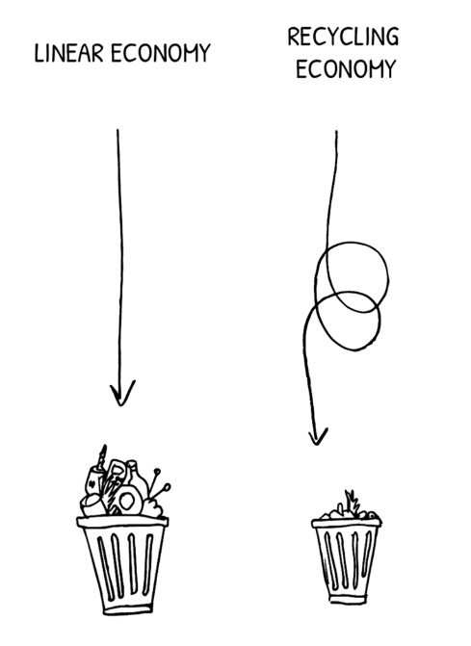
How do we currently manage waste?
It wasn’t until 1990 EU directives related to reducing our waste were introduced.
UK recycling has increased since 1990:
2000: 13,000 tonnes of plastic bottles recycled
2018: 350,000 tonnes of plastic bottles recycled.
We now live in a recycling economy- where less waste ends up in the bin.

Slide 40
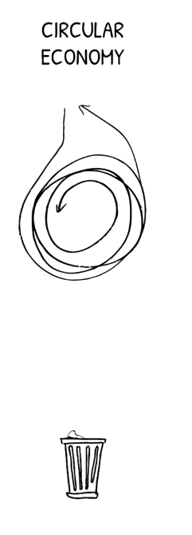
How is this changing?
Many countries are working towards achieving a circular economy- where nothing ends up in the bin.
Wales has committed to becoming a high recycling society by 2025 and circular by 2050.
Will other countries follow suit?

Slide 41
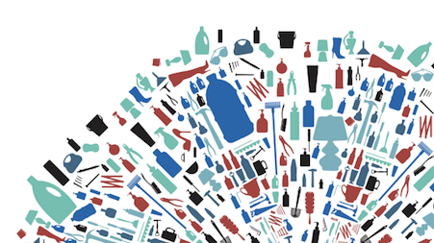
What are some benefits to a circular economy? (Discussion)
Reduces waste
Uses less energy and resources
Solution to the planet's resource shortage
Reduces pollution to our environment

Slide 42
The Circular Economy
https://www.youtube.com/watch?time_continue=76&v=9GorqroigqM

Slide 44
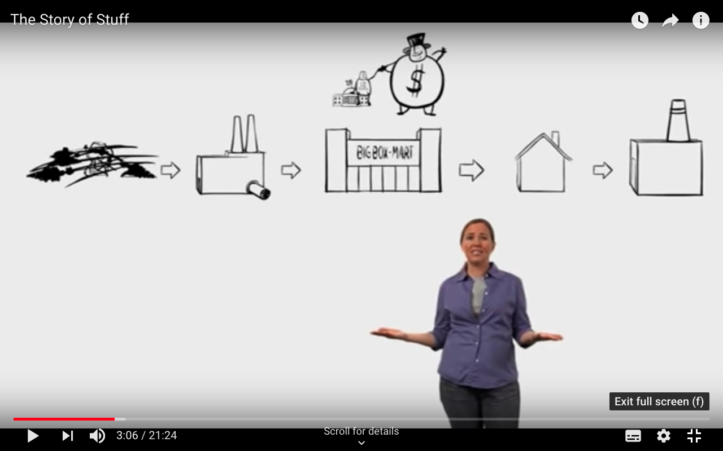
The story of stuff
Let’s explore the linear economy a little more…
As we watch the video, listen out for the answers that will help you to complete your sheet ‘The story of stuff questions’.
Challenge: Can you link any of the themes in this video to anything we have studied before in geography?

Slide 45
Topic focus: Blood, sweat & tears: can we be more responsible consumers?
Thinking back to our overall focus for this topic - write one sentence to summarise one thing you have learned from today that could help us to be more responsible consumers.

Slide 46
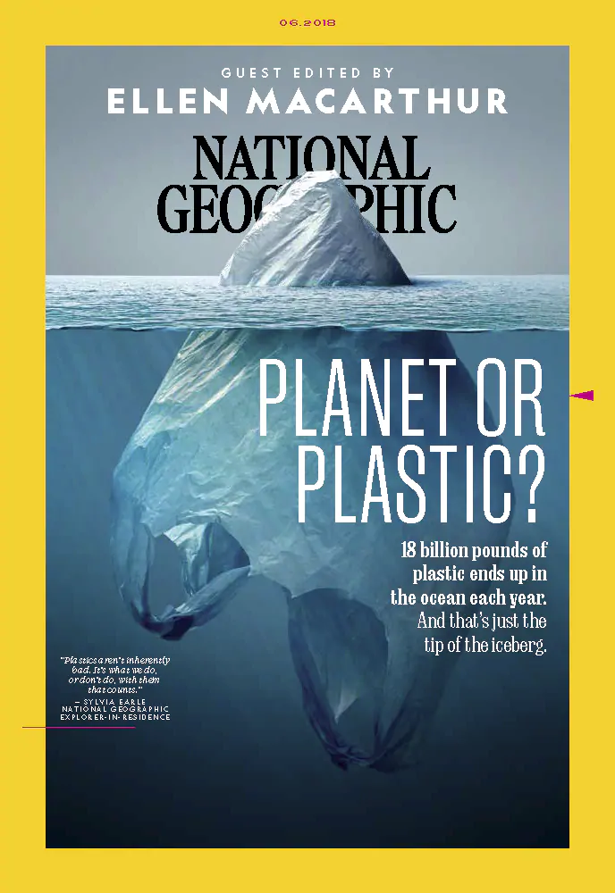
The Circular Economy
Further reading…
Dame Ellen MacArthur has launched a charity that works with business and education to encourage the movement towards a circular economy.
https://www.nationalgeographic.co.uk/environment-and-conservation/2018/06/why-our-throwaway-culture-has-end

Slide 47
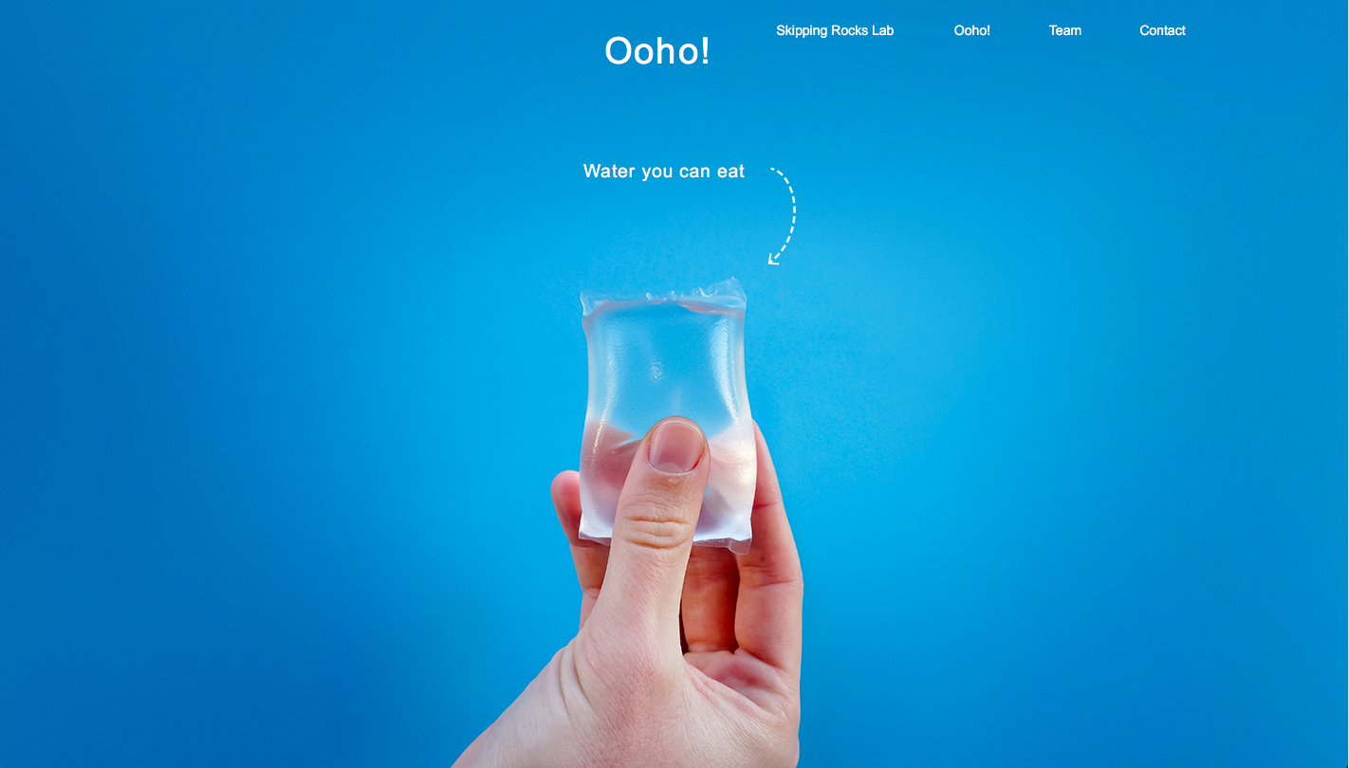
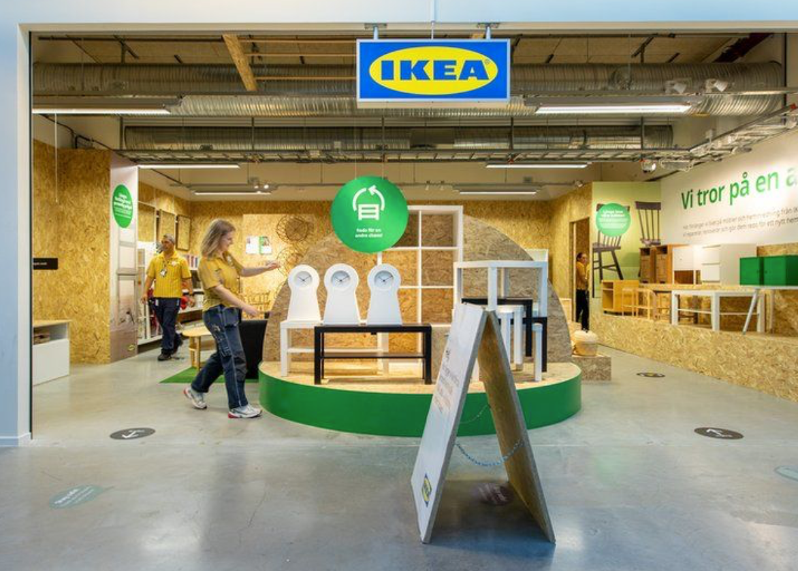
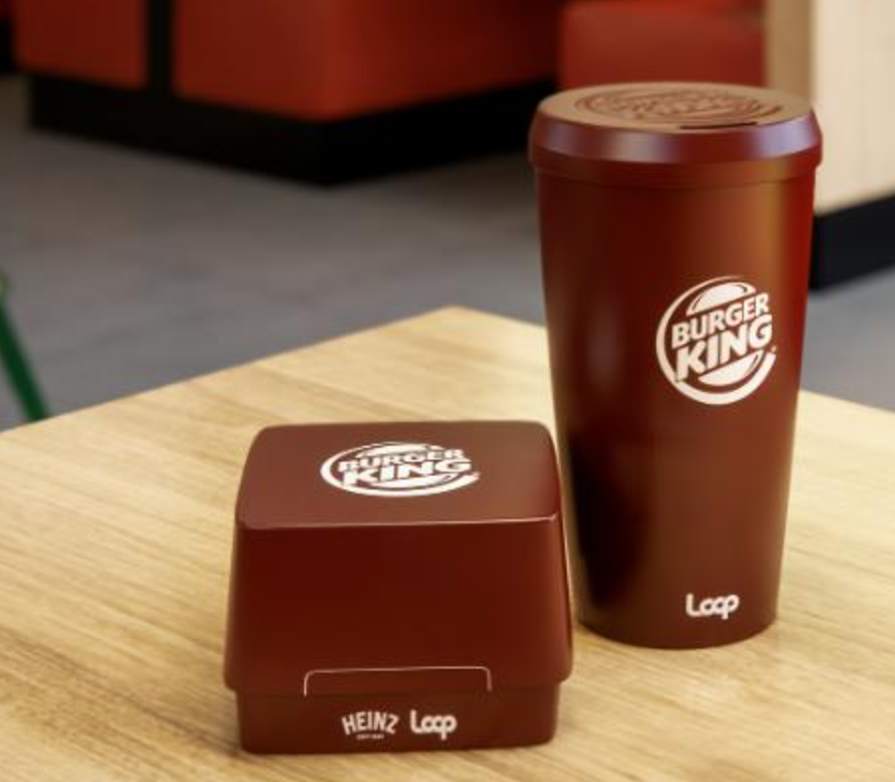
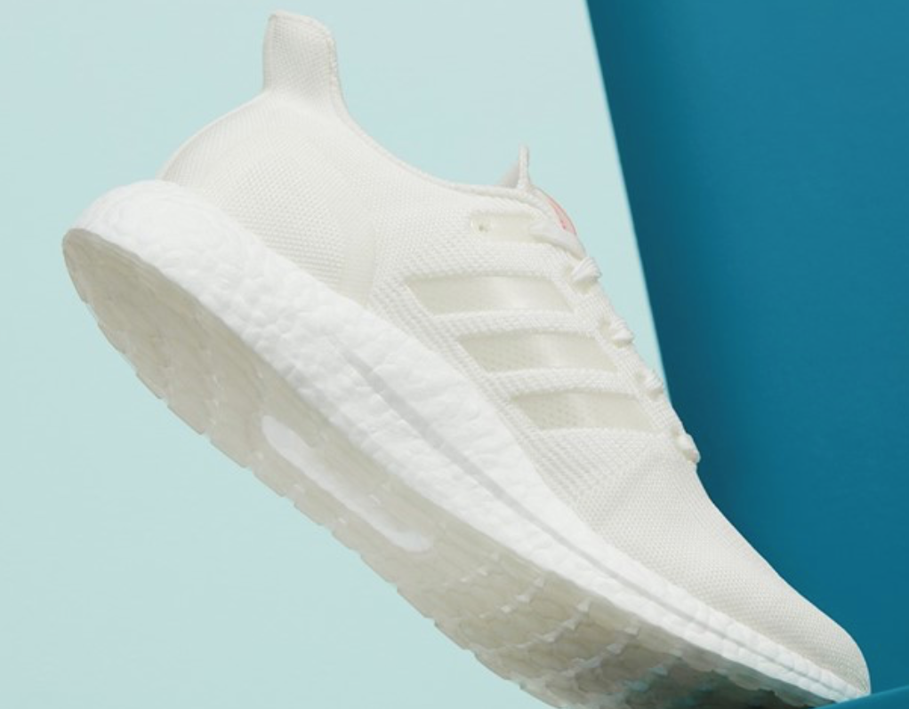
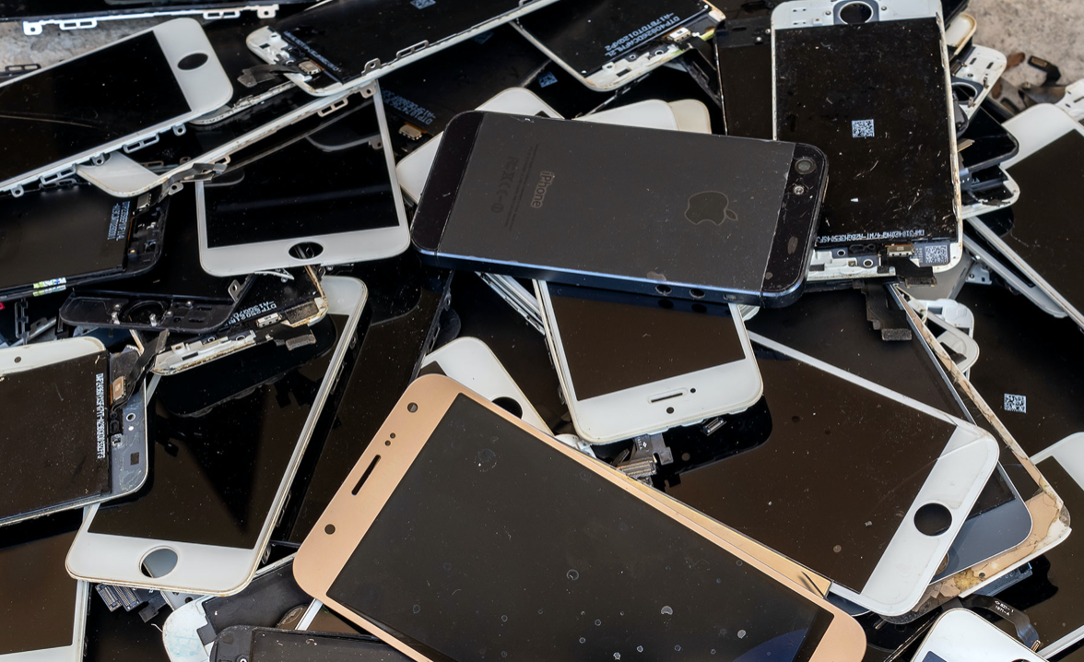
Research task: The Circular Economy
Ooho
Ikea
Research at least one of these companies
Write a description of what the company is doing to become more sustainable
How do these policies reduce the amount of resources being used?
How does this fit into the idea of the circular economy?
Nike grind
Burger king- re useable packaging
Adidas-
UltraBOOST DNA LOOP
Apple

Slide 48
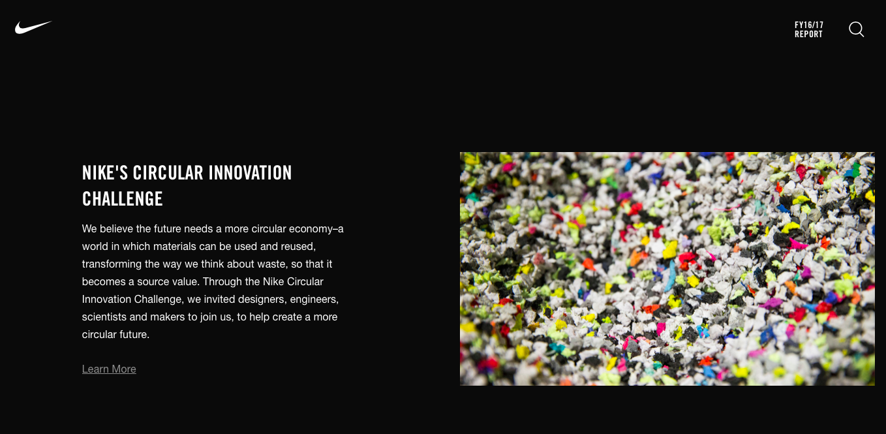
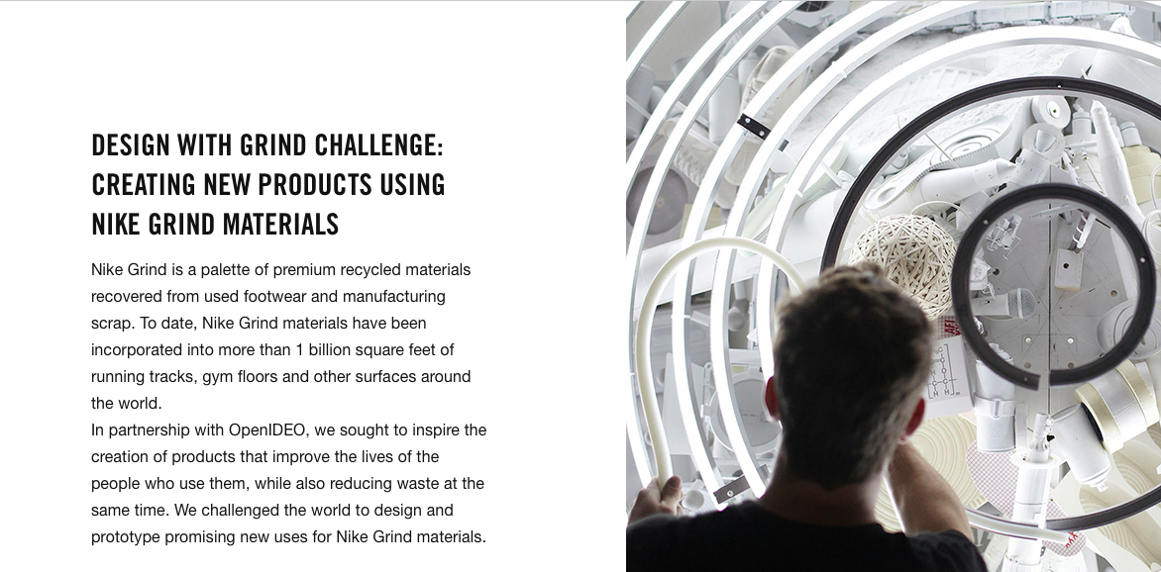
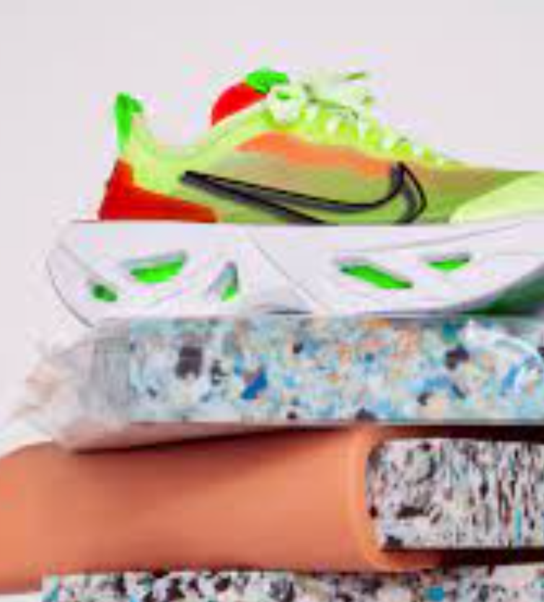
Nike Grind
https://www.youtube.com/watch?time_continue=105&v=AaV9nGyY-9A
https://sustainability.nike.com

Slide 49
Ooho
the ooho! edible water bubble gets set to replace plastic bottles
Is This Edible Blob The New Water Bottle?
This edible water bottle is how you will drink in the future
Ooho
These tiny edible water bottles are almost completely pointless

Slide 50
Ikea
https://www.ikea.com/us/en/this-is-ikea/sustainable-everyday/a-circular-ikea-making-the-things-we-love-last-longer-pub9750dd90
https://www.weforum.org/agenda/2020/10/ikea-opens-pilot-second-hand-store-sweden-circular-economy/
https://www.edie.net/news/5/Ikea-launches-circular-economy-strategic-partnership-with-Ellen-MacArthur-Foundation/
Swedish furniture giant Ikea says it aims to become a purely circular business by 2030. Last November it opened its first second hand-only store in a shopping centre in the Swedish city of Eskilstuna. The "pop-up" shop will be open until May.

Slide 51
Adidas utlraboost
https://news.adidas.com/boost/ultraboost-dna-loop-launches-to-public-as--made-to-be-remade--running-shoes-come-to-creators-club-we/s/38b4b53e-2343-4d9a-9c59-20feda458e2b
https://www.dezeen.com/2020/10/21/adidas-ultraboost-dna-loop-trainer-circular-economy/

Slide 52
Burger king- re useable packaging
https://www.cnn.com/2020/10/22/business/burger-king-reusable-packaging-sustainability/index.html
https://www.timeout.com/usa/news/gross-or-sustainable-burger-kings-new-eco-friendly-packaging-will-be-reusable-102220
https://www.plasticstoday.com/packaging/burger-king-partners-terracycle-pilot-reusable-packaging

Slide 53
Apple
https://www.apple.com/environment/
https://www.reutersevents.com/sustainability/apple-plants-seeds-sustainability
https://www.greenbiz.com/article/apple-dials-its-circular-materials-aspirations

