Slide 1
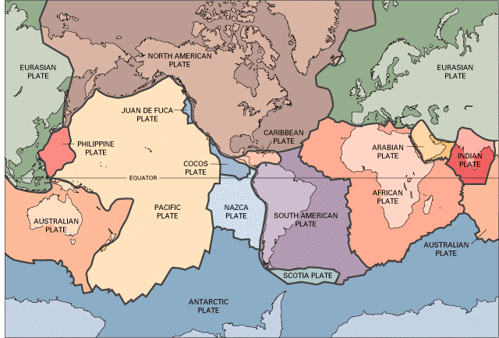
Plate boundaries
LO: to be able to explain what happens when plates meet

Slide 4
In what ways do the plates move?
3 types of plate movements we need to know:
Convergent: Plates move together. Can be split into destructive (oceanic and continental crust) and collision (continental and continental)
Divergent: Plates move apart from each other. Can also be called a constructive margin.
Conservative: Plates slide past each other.

Slide 5
Why do earthquakes and volcanoes happen?
A plate boundary is where two plates meet. Volcano and earthquake activity tends to occur in these locations.
There are 4 types of plate boundary:
DESTRUCTIVE, COLLISION ZONE, CONSTRUCTIVE, CONSERVATIVE
Volcanoes can also happen at HOTSPOTS
In groups, please produce a presentation to explain the following:
In what direction do plates move at your chosen boundary OR describe how tectonic activity at a hotspot works?
Include a map to show examples of this type of plate boundary OR to show the global distribution of hotspots
Include an annotated diagram to show how and why earthquake/volcanic activity happens
Describe what tectonic activity occurs at this plate boundary/hotspot e.g. earthquakes, volcanoes, tsunamis.
Can you give examples of any well known disasters that have occurred at this plate boundary or at particular hotspots?

Slide 6
Constructive/divergent boundaries
Where plates move apart

Slide 7
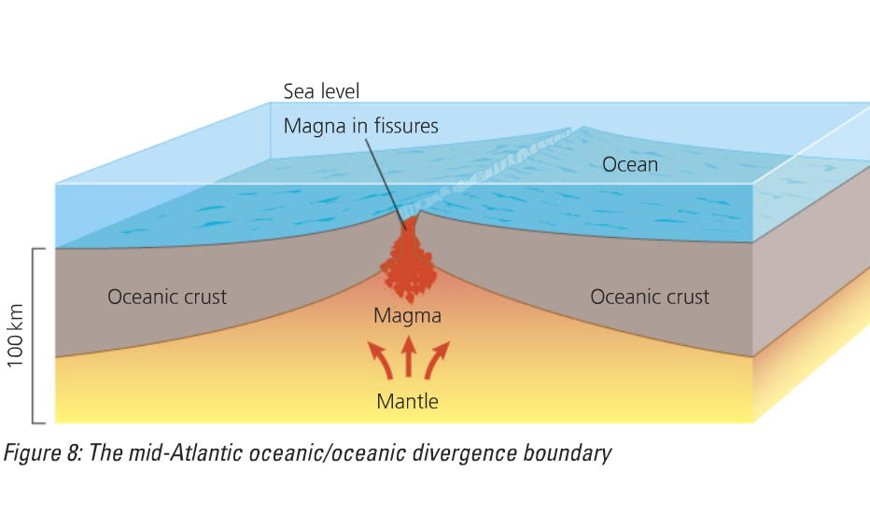
Divergent or constructive plate margin
https://www.youtube.com/watch?v=Djr4SugXEyw

Slide 8
How is it formed?
Convection currents cause the plates to move apart
As the plates move apart the magma wells up from the mantle to form new basaltic oceanic crust (new plate area is formed)
The Earth’s surface area increases due to the formation of new oceanic crust – sea floor spreading

Slide 9
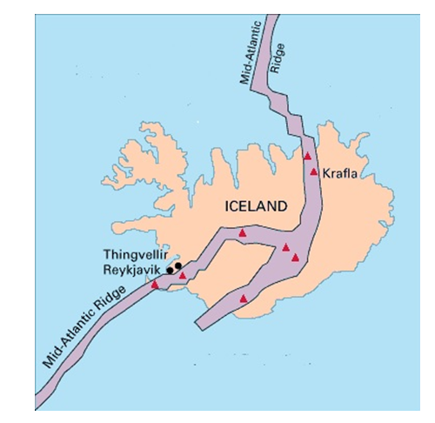
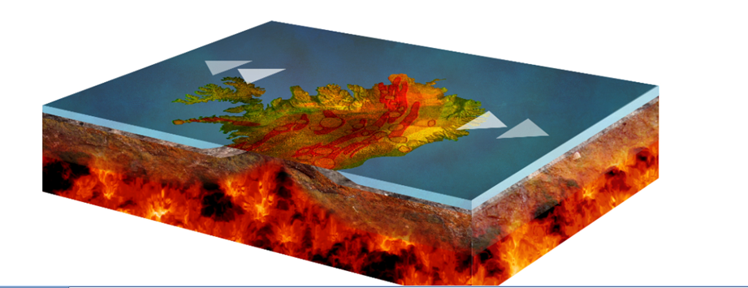
Divergent (constructive) plate margins in Iceland

Slide 10
Conservative/transform boundaries
Where plates slide past each other

Slide 11
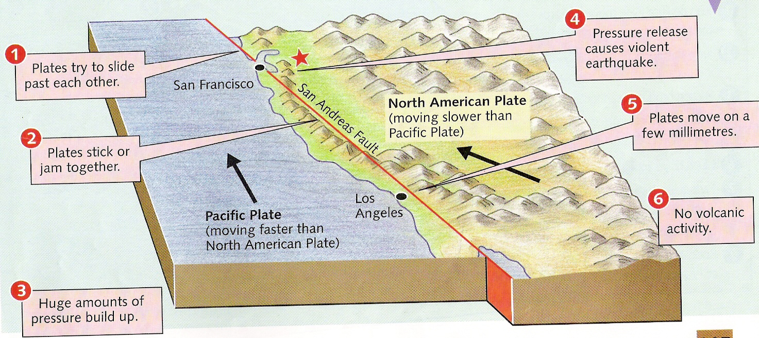
Conservative plate boundary
https://www.youtube.com/watch?v=qCBaBK8BxUU

Slide 12
What happens at conservative margins?
As the plates slide horizontally past each other pressure builds up in the rocks either side of the fault
Fault surface often rough – friction creates large strains along the faults
An earthquake happens when the built up pressure and energy are released in a sudden, jerky movement
Earthquakes do not occur at this margin as there is no opportunity for magma to escape

Slide 13
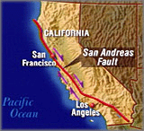
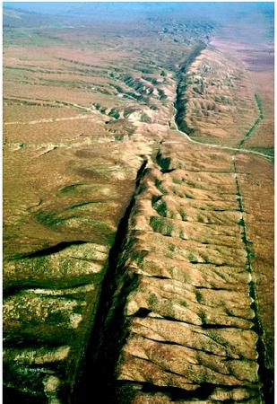
San Andreas Fault
The San Andreas Fault is the border between two tectonic plates — the North American Plate and Pacific (Nazca) Plate

Slide 14
Convergent/destructive plate margins
Where an oceanic and a continental plate move towards each other

Slide 15
Labels:
https://www.youtube.com/watch?v=kGzbhkLwL68
Neatly add these correct labels:
Generally explosive volcanic eruptions.
Magma rising to form volcanoes.
Plate being forced into the mantle
Deep, violent Earthquakes
One plate is denser than the other so sinks.
Plate melting.
Subduction zone
Oceanic plate
Continental plate
Ocean trench
Make sure you can explain how earthquakes and volcanoes occur at this plate boundary

Slide 16
Convergent (oceanic –continental)
Convection currents move plates towards each other.
The oceanic plate sinks down beneath the continental as it is heavier.
When the oceanic plate reaches the mantle the crust melts forming new magma.
Heated magma rises to the surface.
Violent volcanic eruptions result.

Slide 17
Collision plate margins
Where continental plates move towards each other

Slide 18
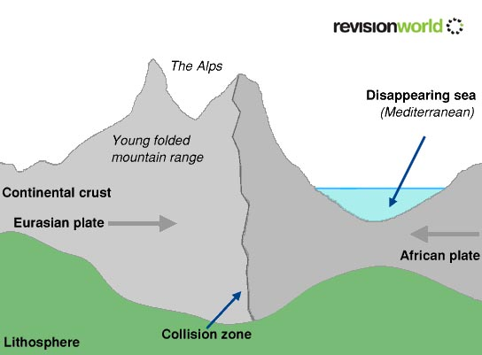
Collision margin Continental and continental
https://www.youtube.com/watch?v=i7ZUAi0B7DA

Slide 19
The Collision Zone
When continental plates collide head on with other continental plates, the result is upheaval!
Similar densities – neither plate is subducted
Gradual forward movement of each plate creates extreme pressures= earthquakes
Over time, the rock strata become folded, and rise to create mountain ranges

Slide 20
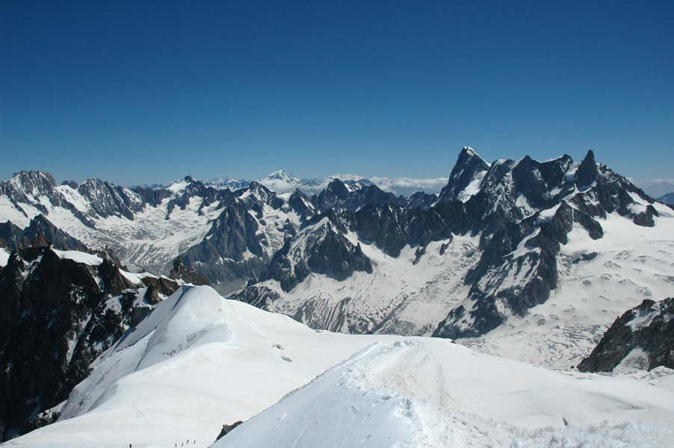
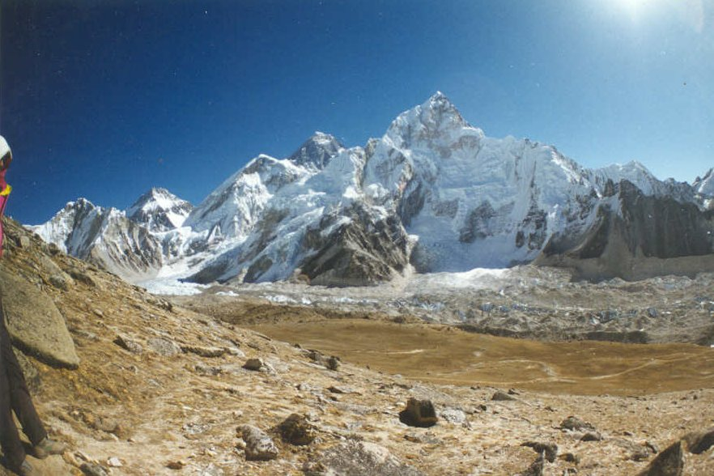
The Alps and the Himalayas
The Alps
The Himalayas

Slide 21
Hotspots
Where volcanoes occur, even with the absence of a plate boundary!

Slide 22
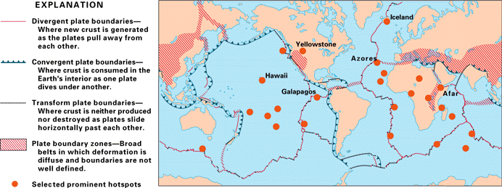
Main areas of hot spot activity globally

Slide 23
Hawaiian Hot Spots
Hotspots are areas in the lithosphere that are underlain by unusually hot magma. This heat causes partial melting of the lithosphere, eventually leading to volcanic activity. The Hawaiian Islands are a classic example of a volcanic grouping formed over one hot spot.
Over thousands of years, as the Pacific Plate inched its way in a northwest direction, the stationary hot spot underneath the plate successively created volcanoes above it. Several of these volcanoes reached the ocean’s surface, forming the Hawaiian Islands.
http://www.youtube.com/watch?v=bYv6V5EJAKc

