Slide 1
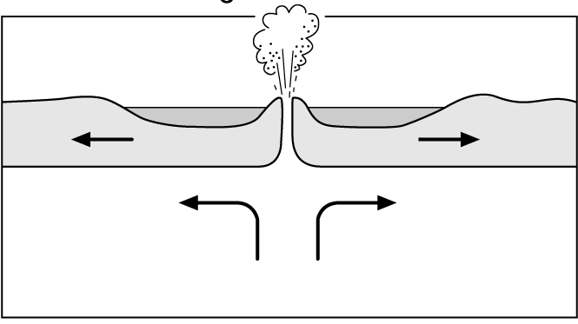
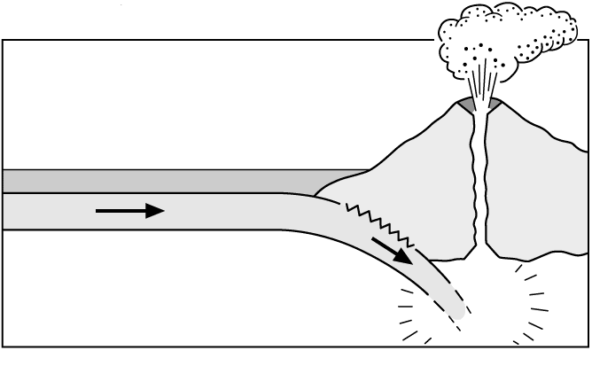
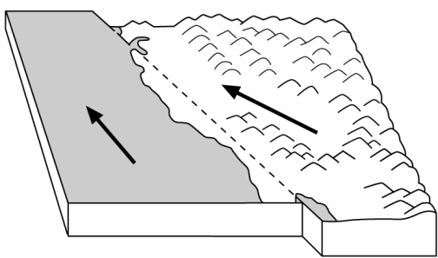
Types of plate boundary
Name:
Date:
Type of Boundary | Diagram (include labels and colour) | Information | Example | Eq, Volc, Both?
Both
Collision
Earthquakes
The San Andreas Fault

