Slide 1
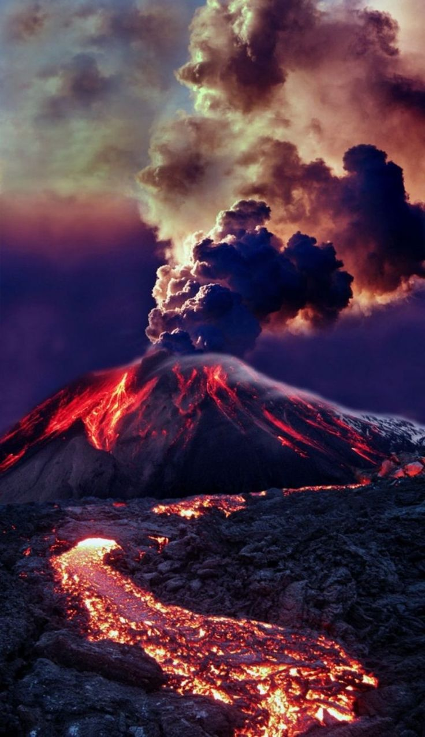
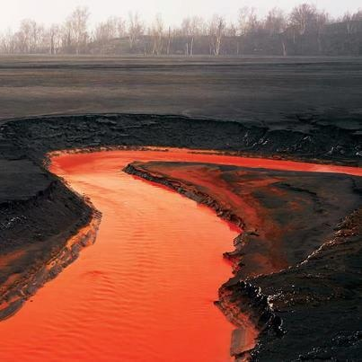
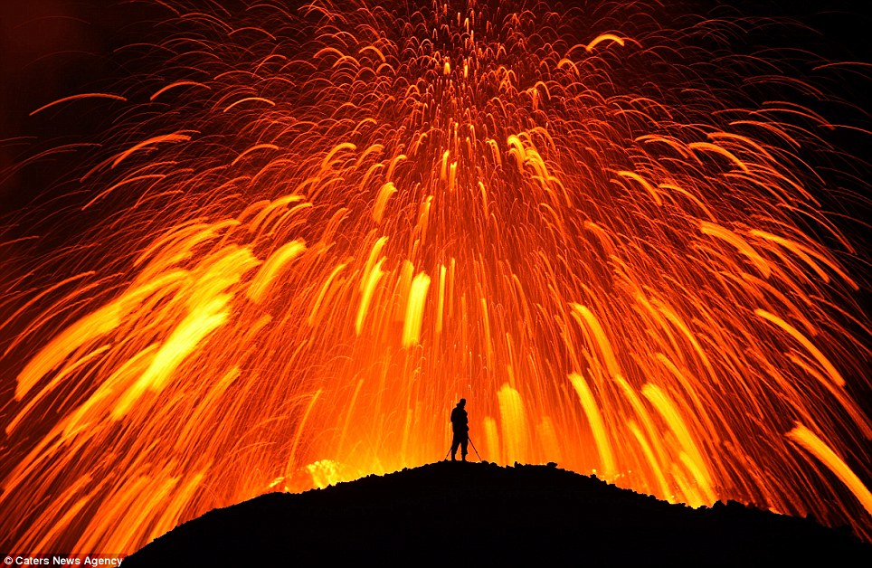
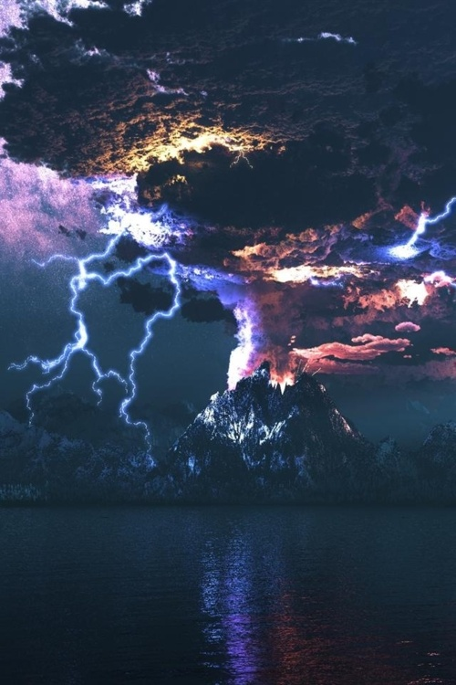
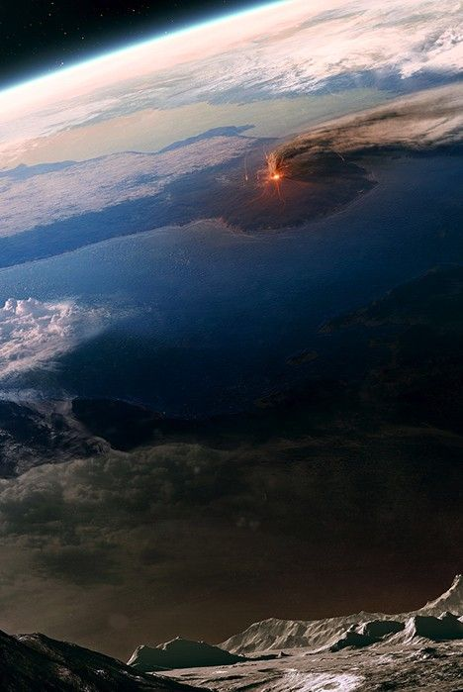
LO: To revise Plate Tectonics and Volcanoes and practice exam style questions.

Slide 2
Starter (3mins) (Match the term with its correct definition)
Parts of the earth crust which move/float.
Where earthquakes and volcanoes are located.
Where tectonic plates meet.
Volcanic regions fed by underlying mantle.
Series of oceanic trenches and volcanoes around the Pacific Ocean.
Distribution
Ring of Fire
Hotspot
Tectonic Plate
Plate Boundary

Slide 3
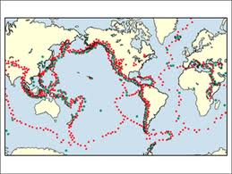
Map to show global distribution of earthquakes and volcanoes

Slide 4
In pairs explain where earthquakes and volcanoes are distributed
Knowledge of accurate information appropriately contextualised and/or at correct scale.
Detailed understanding, supported by relevant evidence and exemplars.
Well organised, demonstrating detailed linkages and the interrelationships between factors.
Range of ideas in a logical form; uses a range of specialist terms where appropriate.
Task 3 (7 min):
In pairs explain where earthquakes and volcanoes are distributed

Slide 5
This map shows the distribution of earthquakes around Japan
(1961-2004)

Slide 6
Task 4 – Individual Activity
Past Exam Question (January 2011)
Describe the distribution of earthquakes in and around Japan. (2 marks)
Explain why there are many earthquakes in and around Japan. (6 marks)
TIME – 10 Min

Slide 7
Example answer
Japan lies close to a destructive plate boundary. Here the Pacific/Philippine oceanic plate is subducted beneath the less dense Eurasian continental plate as convection currents in the mantle move the plates towards each other. As plates move, they snag and tension builds up, locking like a machine without oil. As the pressure builds up, it is suddenly released and causes a sudden movement that sends out shock waves, which causes earthquakes at the surface in Japan.

Slide 8
Plate margins: types of question
Characteristic features
Describe processes
Why do volcanoes happen?

Slide 9
Plate margins: types of question
Characteristic features
Describe processes
For each of the following 4 images identify the margin and answer these 3 questions
Why do volcanoes happen?

Slide 15
EXAMPLES
Do this for each plate boundary:
Describe the characteristic features of a ____________________ plate margin (4)
Explain the processes that take place at __________________ plate boundaries (4)
Draw an annotated diagram to illustrate the processes at a _________________ plate boundary.
Describe the characteristic features of a convergent plate margin. (4)
Volcanic trenches mark the point where a tectonic plate begins to be subducted beneath another tectonic plate. As the plate is pushed down a deep, narrow trench is formed on the seabed. For example, the Mariana Trench is the Pacific is the deepest trench in the world at 10.91km deep.
Steep sided volcanoes, such as strato-volcanoes, are also a feature at subduction zones. These volcanoes build up as a result of the thick and sticky lava that is characteristic of their eruptions.
Explain the processes that take place at divergent plate boundaries (4)
Divergent plate boundaries are when two plates move away from each other. The plates move due to convection currents in the mantle. The movement causes the breaking of the crust and this results in earthquake activity. Magma seeps out of the cracks causing volcanic activity. Eruptions of thin, viscous lava occur e.g. from fissures (cracks) in the rock.

Slide 16
Explain the processes that take place at convergent plate boundaries (collision – 4 marks)
At collision zones two plates of continental crust move towards each other. Since neither plate is heavier, the plates buckle and fold upwards. This process leads creates fold mountain ranges, such as the Himalayas, and large earthquakes can also occur. However, no volcanic activity happens here as magma is unable to escape.

Slide 17
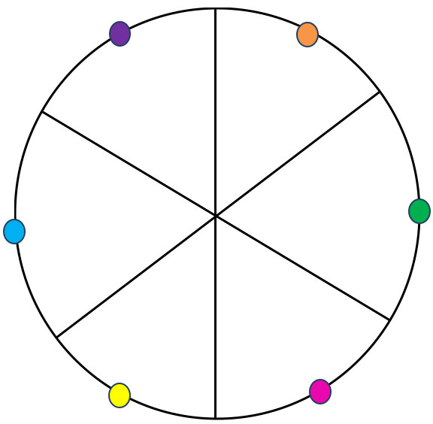
You are going to practice a timed exam question.
Choose a colour.
You will have 5 minutes to answer the question.
No talking or asking anyone for help.

Slide 18
Explain how volcanoes can be managed through prediction and prevention .
Explain why people live in earthquake zones
Explain the effects of a volcanic eruption or earthquake you have studied
Outline the characteristic features of a divergent plate boundary
Explain the processes at a convergent plate boundary
Explain why volcanoes are formed at a divergent plate boundary

Slide 19
Swap with another table.
Choose the colour clockwise to your colour to peer assess.
e.g. if you were green, you should mark pink.
If you were blue, you should mark purple.

Slide 20
Explain how volcanoes can be managed through prediction and prevention .
Explain why people live in earthquake zones
Explain the effects of a volcanic eruption or earthquake you have studied
Outline the characteristic features of a divergent plate boundary
Explain the processes at a convergent plate boundary
Explain why volcanoes are formed at a divergent plate boundary

