Slide 1
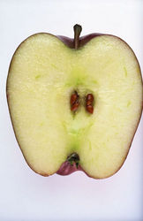
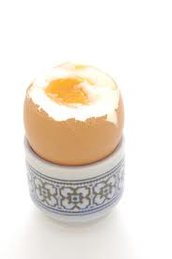
Lets get started...
Why is the Earth like an apple (or an egg?)
Learning objectives:
Be able to name the layers of the Earth
Be able to describe the characteristics of each of the Earth’s layers.
Think on your own for one minute, you will then be allowed to share your ideas with a partner before you share them with the class.

Slide 2
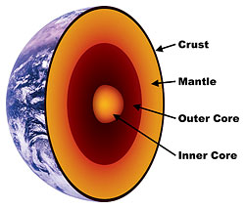
Current Learning Objective: Be able to name the layers of the Earth
Label and colour the diagram of the
Earth’s structure on your worksheet.

Slide 3
Current Learning Objective: Be able to describe the characteristics of each of the Earth’s layers.
The crust is the thinnest layer of the Earth (8-65km thick). It is the solid layer that we live on. It is divided into the heavy oceanic crust which is made of basalt and continental crust which is lighter and made of Granite.
The mantle is the thickest layer of the Earth (about 2900km). It is semi-molten rock and becomes more molten as you move towards the centre of the Earth.
The Outer Core is a liquid mixture of Iron and Nickel, whilst the Inner Core is a solid mixture of Iron and Nickel.
It is around 5,500km to the centre of the Earth. Temperature of the surface of the Earth vary from about -30ºC to 50ºC. The centre of the Earth is thought to be around 5500ºC.

Slide 4
Current Learning Objective: Be able to describe the characteristics of each of the Earth’s layers.
Match the definitions with the key terms below. Copy each definition into the correct box on your worksheet.
Inner Core Mantle Crust Outer Core
This is the outer layer of earth that we live on. It is a thin layer between 8-65km thick. It is cracked into pieces that we call tectonic plates. Under the oceans it is made of Basalt and under the continents it is made of granite.
This is the layer surrounding the inner core. It is liquid iron and nickel. It’s temperatures are similar to the inner core.
This is the widest section of Earth with a diameter of 2900km. It is soft molten rock that becomes more molten as you move towards the centre of the Earth, it is about 3800 degrees C.
This is the centre of the Earth – it’s solid Iron and Nickel. It is very hot, with temperatures up to 5500 degrees C.

Slide 5
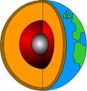
To Finish...
Trsuc
Rneni Oerc
Hrtea
Ptela Obndryau
Treou Orce
Tteocnci Lteap
Lnteam

Slide 6
Crust
Trsuc
Rneni Oerc
Hrtea
Ptela Obndryau
Treou Orce
Tteocnci Lteap
Lnteam
Inner Core
Earth
Plate Boundary
Outer Core
Tectonic Plate
Mantle

Slide 7
Learning Outcomes:
I am able to name the layers of the Earth
I am able to describe the characteristics of each of the Earth’s layers.
Show whether you have achieved each objective by placing a smile, sad face or straight face in the top left corner of your worksheet.

