Slide 1
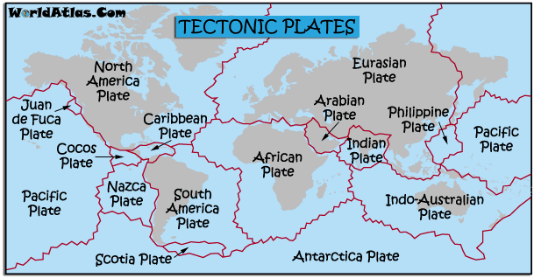

Slide 2
Plate Boundaries
Learning objectives;
Be able to recognise the four main types of plate boundary
Be able to explain what happens at each type of plate boundary

Slide 3
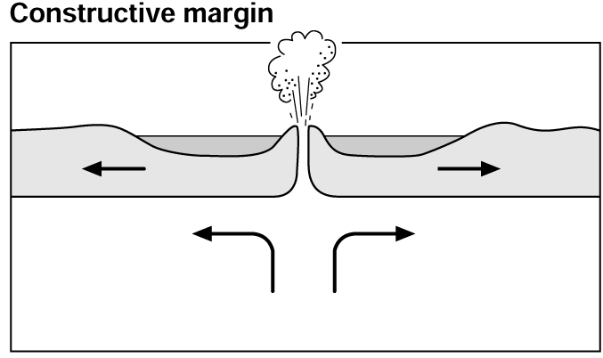
Constructive Plate Boundary
Current Learning Objective: Be able to explain what happens at each type of plate boundary.
A constructive plate boundary is one where the plates are moving apart because of convection currents in the upper mantle.
Liquid magma rises between the plates as they move apart, forming small volcanoes on the ocean floor. The magma hardens into basalt which forms new sea floor. It can eventually form islands, such as Iceland!
Volcano
Use this information to fill in your worksheet. Include colour and as much detail as possible!
Convection Currents
An example of a constructive plate boundary is the Mid-Atlantic Ridge where the North American plate and the Eurasian plate are moving apart at a rate of around 3cm/yr.

Slide 4
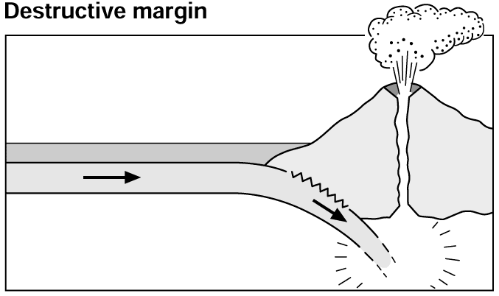
Current Learning Objective: Be able to explain what happens at each type of plate boundary.
Destructive Plate Boundary
There are two types of plate boundary where the plates push into each other. When a continental plate pushes against an oceanic plate a destructive plate boundary is formed.
The oceanic plate is heavier and so when the plates collide it is forced under the continental plate forming an ocean trench. Trenches are the deepest part of the Oceans. The oceanic plate melts as it sinks and molten rock forces its way to the surface to form a volcano. The collision of the rocks also causes earthquakes.
Use this information to fill in your worksheet. Include colour and as much detail as possible!
Ocean Trench
Magma rising
An example of this is the boundary between the Nazca oceanic plate and the South American continental plate.

Slide 5
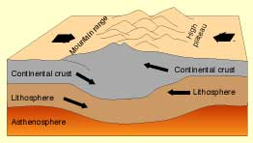
Current Learning Objective: Be able to explain what happens at each type of plate boundary.
Collision Plate Boundary
The other type of plate boundary formed when two plates push into each other is called a collision boundary. It occurs when two continental plates push against each other.
When two continental plates meet neither is pushed under because they are both relatively light. Instead the crust gets pushed and folded upwards and fold mountains are formed. There are a lot of earthquakes caused by the movement of the rock, but there are no volcanoes because no rock is being pushed down and melted.
An example is the boundary between the Indo-Australian plate and the Eurasian plate. This boundary has formed the Himalayas . The two plates are still pushing into each other and so the Himalayas are still growing higher.
Use this information to fill in your worksheet. Include colour and as much detail as possible!

Slide 6
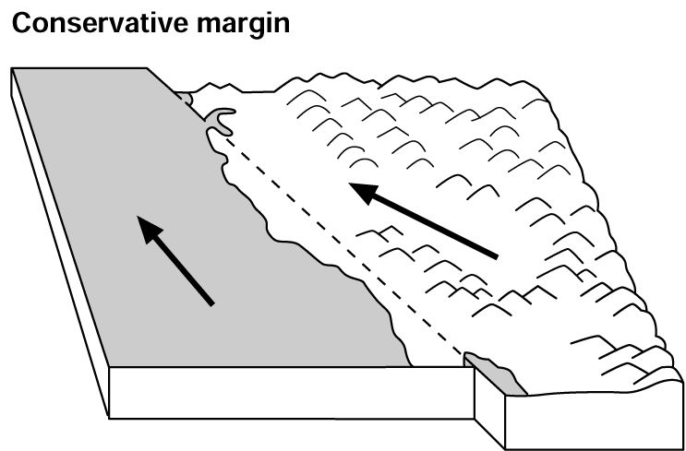
Conservative Plate Boundary
Current Learning Objective: Be able to explain what happens at each type of plate boundary.
A conservative plate boundary is formed when two plates are sliding past each other.
As the plates move alongside each other parts of the plates get stuck, then lurch free. This movement causes earthquakes. There are no volcanoes because no rock is being forced down and melted.
Use this information to fill in your worksheet. Include colour and as much detail as possible!
An example is the boundary between the Pacific plate and the North American plate. The Pacific plate is moving faster than the North American plate. This earthquake prone zone is known as the San Andreas Fault.

Slide 7
Learning Outcomes:
I am able to recognise the four main types of plate boundary
I am able to explain what happens at each type of plate boundary
Show whether you have achieved each objective by placing a smile, sad face or straight face in the top left corner of your worksheet.

