Slide 1
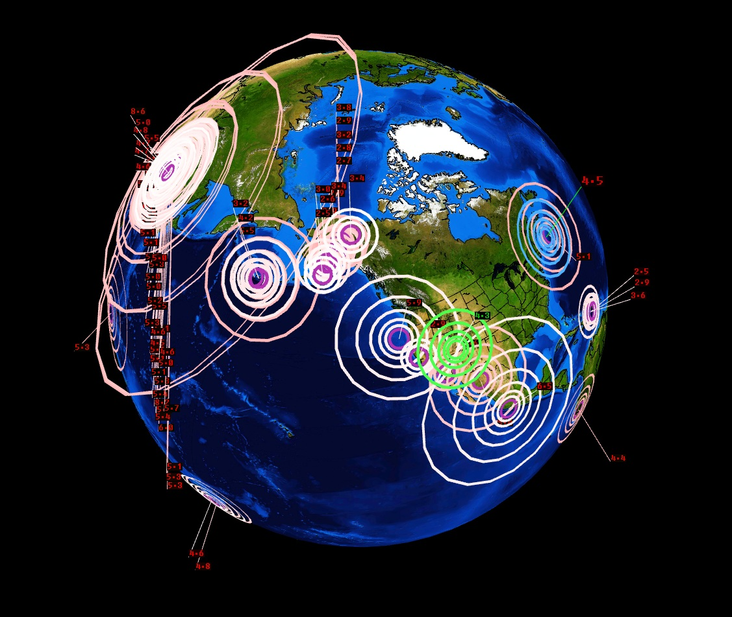
Tectonics in the USA
LO: Explain the threat posed by plate tectonics in the USA

Slide 2
How do plate tectonics impact the United States of America?

Slide 3
Objectives
What: Learning about where earthquake and volcano activity occurs in the USA and why it occurs in these areas.
Why: So that we can understand the pattern of risk for tectonic hazards in the USA.
How: Exploring tectonic patterns through discussion, mapping, creating diagrams.

Slide 4
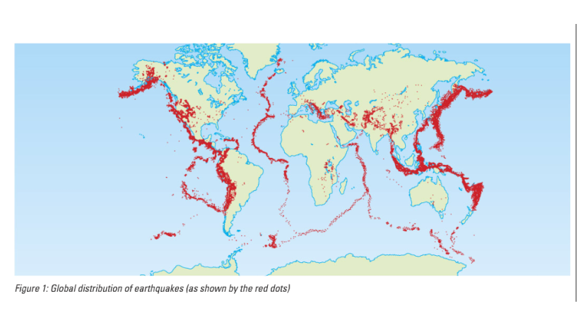
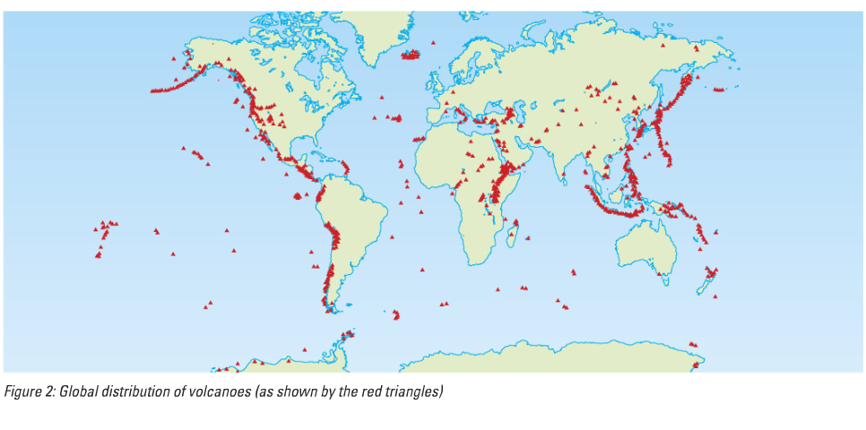
Global distribution
of tectonic activity
Where do earthquakes and volcanoes occur?
Why do they occur in these locations?

Slide 5
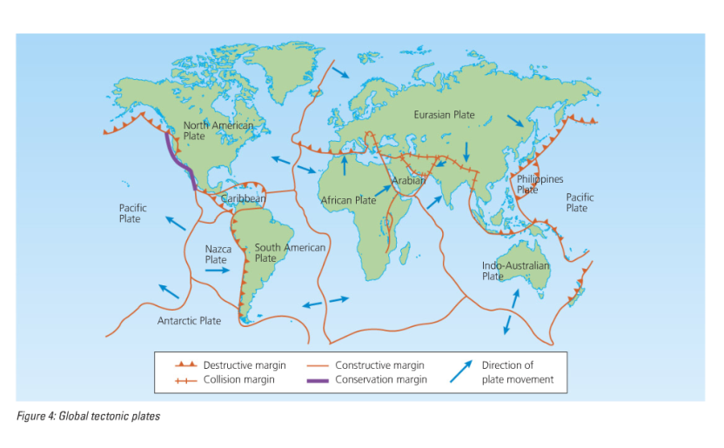
Global Tectonic Plates

Slide 6
What are the patterns in the USA?

Slide 7
Where do earthquakes happen?
http://earthquake.usgs.gov/earthquakes/

Slide 8
Earthquakes in the USA

Slide 9
Earthquake Risk USA

Slide 10
Earthquake Risk USA

Slide 11
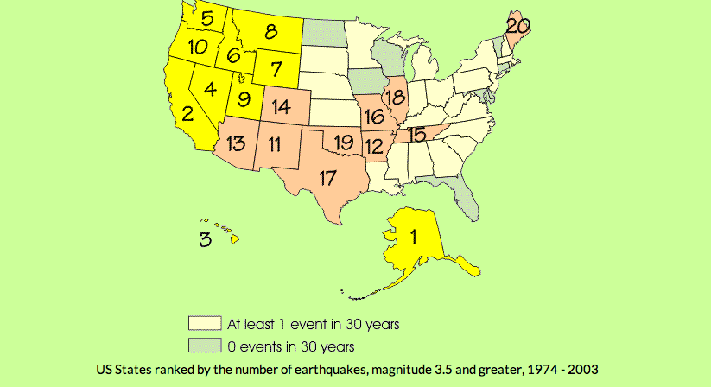
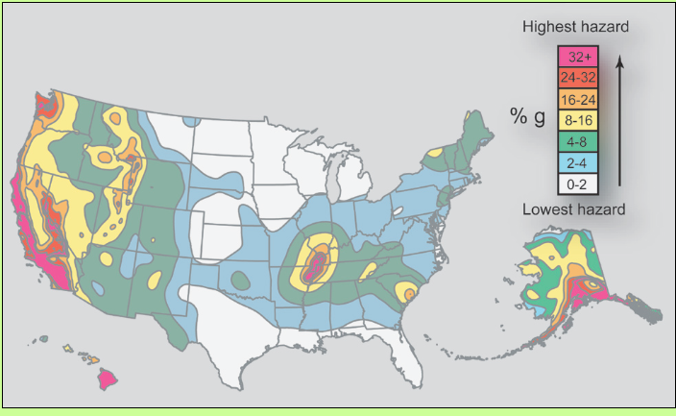
Earthquake Risk USA

Slide 12
World Volcano Risk

Slide 13
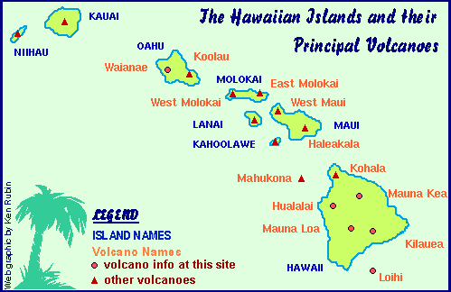
Volcano Risk USA

Slide 14
Super volcanoes!

