Slide 1
Case Study: The Tax Cuts and Jobs Act of 2017
Was the passage of the Tax Cuts and Jobs Act of 2017 a good ECONOMIC IDEA
What criteria will you use???

Slide 2
Research – Complete research using the following resources and then complete the enquiry - Was the passage of the Tax Cuts and Jobs Act of 2017 a good ECONOMIC IDEA?
Presentation will be in the form of a digital presentation and should use examples for all of the information in the PowerPoint.
Work in groups of no more than 3
REMEMBER THIS IS AN ECONOMIC NOT POLITICAL PRESENTATION. THOUGH OBVIOUSLY YOU ARE ENTERING AN AREA OF NORMATIVE ECONOMICS, ANY JUDGEMENTS SHOULD BE SUPORTED FOLLOWING EVALUATION OF THE ECONOMIC DATA AND APPROPRIATE ECONOMIC CRITERIA.

Slide 3
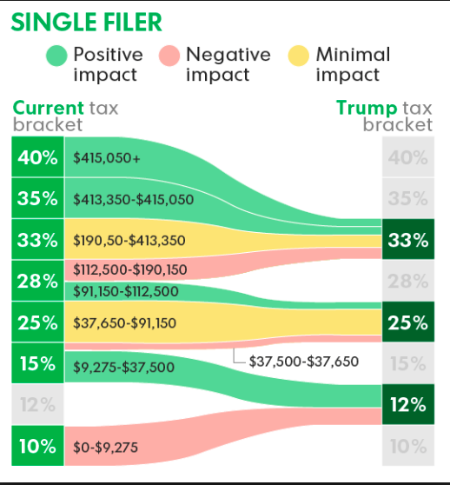
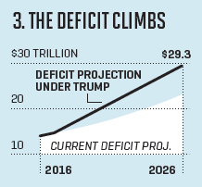
Resources
Make a not of the arguments for and against presented in the following resources:
https://www.economist.com/blogs/graphicdetail/2017/11/daily-chart-13
https://www.thebalance.com/trump-s-tax-plan-how-it-affects-you-4113968

Slide 4
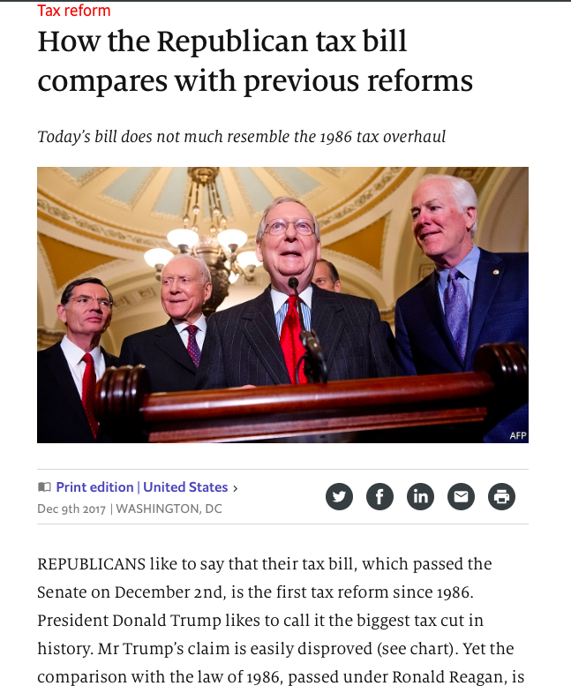
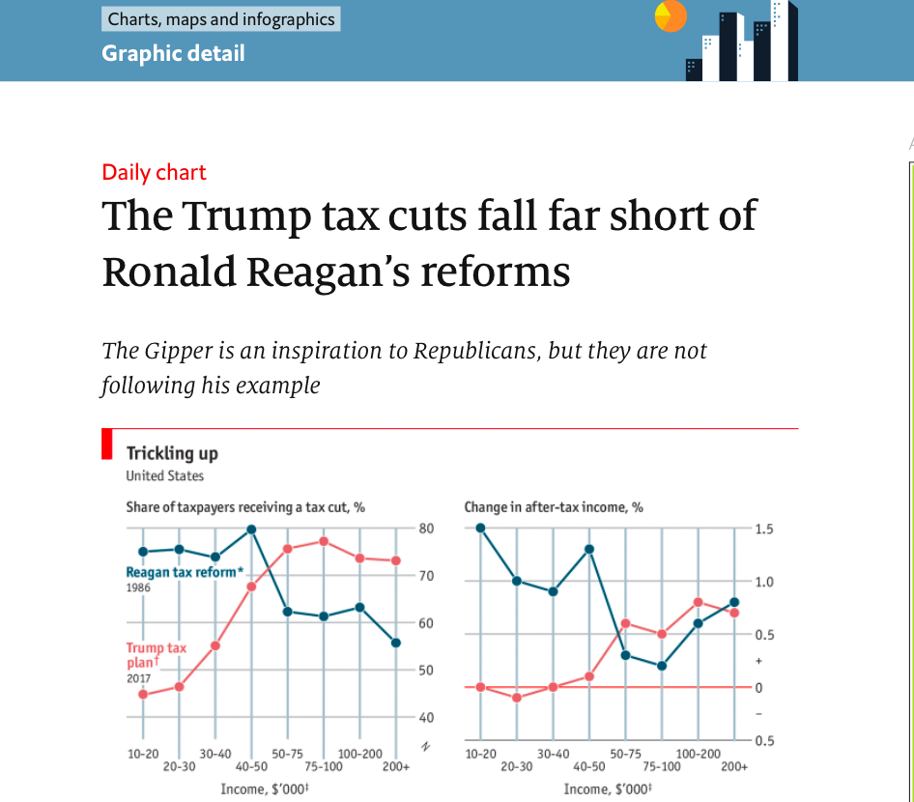

Slide 5
Adam Smith’s Maxims on Taxation
Among 9 canons of taxation discussed, Adam Smith propounded the following first four canons of taxation -
(1) Canon of Equity. It implies that tax should be Levied on citizens on the basis of equality. The sacrifice of all citizens must be equal. In the words of Adam Smith “The subjects of every state ought to contribute towards the support of the Government, as nearly as possible, in proportion to their respective abilities, that is, in proportion to their revenue which they respectively enjoy under the protection of the State“. In other words, this canon of taxation maintains that every person should pay to the State as tax according to Liability to pay. It implies taxing the people on the rate of taxation.
(2) Canon of Certainty: This canon of taxation suggests that the tax which an individual has to pay, should be certain and not arbitrary. It should be certain to the lax payer how much tax he has to pay, to whom and by what time the tax is to be paid. The place and other procedural information should also be clear. It would protect the tax payer from the exploitation of tax authorities in any way. It will enable the tax payer to manage his income and expenditure. The Government will also be benefited by this principle.
(3) Canon of Convenience or Ease: According to this canon of taxation, every tax should be levied in such a manner and at such a time that it affords to the maximum of convenience to the tax payer. According to Adam Smith, a good taxation policy must be convenient for the tax payer. The reason is that the tax payer for goes his purchasing power and makes a sacrifice at the time of payment of tax hence the Government should see that the tax payer suffers no inconvenience.
For example, in an agricultural country, tax should be collected only after the harvesting has been done.
(4) Canon of Economy. This principle suggests that the cost of collecting tax should be the minimum so that a major part of collections may bring to the Government treasury. If the administration expenses in the collection of taxes consume a major portion of tax revenue collected; it cannot be said to be a good tax system.
In the words of Adam Smith-“Every tax ought to be contrived as both to take out and keep out of pockets of the people as little as possible over and above what it brings, into the public treasury of the State”

Slide 6
The Tax Cuts and Jobs Act of 2017: The Details
Research the following:
What were the individual tax brackets (marginal rates of taxation for income tax) prior to the bill passing.
What were the individual tax brackets (marginal rates of taxation for income tax) following the passage of the bill.
What was the rate of taxation on corporate taxation before the passage of the bill? After?
What other major items were included in the Bill

Slide 7
How would the following households and firms be affected by the bill
Data on Household incomes: http://www.taxpolicycenter.org/statistics/household-income-quintiles
A single earner family with a household income of $59, 039
A joint filing family at the top end of the bottom quintile of household incomes
A single earner family at the top end of 4 quintile of household income
A single earner family at the median of the 5 quintile of household income
Can you find out their average tax rate before the passage of the bill and after?

Slide 8
How would the following firms be affected by the bill
An SME with profits of $1.2 million
An SME with profits of $4.5 million
A Large firm with profits of $120 million
An MNC with repatriated profits of $56 million

Slide 9
Impact on AD and AS
What are the projected growth forecasts for the US economy over the next 5 years? (be careful to use reputable data, office for budget responsibility has the most authoritative data)
What impact does this have on the deficit over the next 10 years
What would be the impact on AD, how would this be represented on an economic diagram?
How could you represent this on an LRAS diagram?
Given that we are talking about the future are there potentially several outcome that are possible? What are these – represent as diagrams.

Slide 10
Presentation – Feedback your findings, minimum of 3 minutes…

