Slide 1
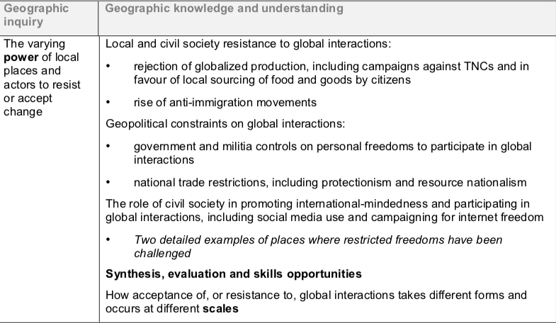
Local response to global interactions – task instructions

Slide 2
Resources: PPT, Weebly and Kognity
Part 1:
Describe local/civil society campaigns to encourage the growth of locally grown food/locally sourced goods
For and against sourcing of local food and goods by citizens
Describe local/civil society campaigns against TNCs
Campaigns against TNCs examples:
-Hindu Nationalist Groups Against McDonalds in India
-Rejection of McDonalds by Bolivia
-Glocalisation of McDonalds in India
-Greenpeace Vs APP & Mattel/KFC
Evaluation:
POWER - How powerful are the anti-globalisation movements you have focused upon?
PROCESS - Which processes (chain of events or similar) have been involved in the growth of the anti-globalisation movement?
PLACE - Can you state any of the key locations involved in the anti-globalisation movement’s growth? Has the anti-globalisation movement changed the nature of any places?
POSSIBILITIES - What is the likely future for the anti-globalisation movement you have focused upon?
Students:
Alannah
Sara

Slide 3
Part 2:
Resources: PPT, Weebly and Kognity
Students:
Milly
Zara
Jodie
Choose a country that has a visible anti-immigration movement e.g. USA/France
Describe the immigration situation in your chosen country.
Where are the majority of immigrants coming from?
Is the ‘issue’ with all immigrants or only a certain sub-set?
What is the name of the anti-immigration movement in the country you are focusing upon?
What is the history of the named movement?
How large is their following?
Have they had any successes in recent elections or similar?
What is the details of their stance on immigration?
Who is the ‘public face’ of the anti-immigration movement you are focused upon?
What is the ‘story’ of this public figure?
Find and detail a recent news report regarding an incident in the country you are focusing upon where the anti-immigration movement was involved - or expressed an opinion in the aftermath.
Evaluation:
POWER - How powerful is the anti-immigration movement you have focused upon?
PROCESS - Which processes (chain of events or similar) have been involved in the growth of the anti-immigration movement?
PLACE - Can you state any of the key locations involved in the anti-immigration movement’s growth? Has the anti-immigration changed the nature of any places?
POSSIBILITIES - What is the likely future for the anti-immigration movement you have focused upon?

Slide 4
Part 3:
Resources: PPT, Weebly and Kognity
A description of government & militia controls on personal freedoms e.g. Great Firewall of China, North Korean Government, Boko Harem in Nigeria.
Examples of national trade restrictions including protectionism e.g. the USA.
Examples of national trade restrictions including resource nationalism e.g. the Zimbabwe.
Evaluation:
POWER - How powerful are these movements in their ability to resist or accept change?
PROCESS - Which processes (chain of events or similar) have been involved in the growth of the anti-globalisation movement?
PLACE - Can you state any of the key locations involved in the anti-globalisation movement’s growth? Has the anti-globalisation movement changed the nature of any places?
POSSIBILITIES - What is the likely future for the anti-globalisation movement you have focused upon?
Students:
Theo
Ella
Ebony
Sol

Slide 5
Part 4:
Resources: PPT, Weebly and Kognity
Students:
Hannah
Oscar
Emmet
Define international mindedness
How have restrictions in internet freedoms been challenged by civil society action e.g. “GreatFire”, China.
How has social media use helped to challenge restricted freedoms e.g. The Arab Spring.
Evaluation:
POWER - How powerful are civil society/local movements in over-coming restricted freedoms?
PROCESS - Which processes (chain of events or similar) have been involved in the growth of the movements?
PLACE - Can you state any of the key locations involved in the movement’s growth? Has the movement changed the nature of any places?
POSSIBILITIES - What is the likely future for the movement you have focused upon?

