Slide 1
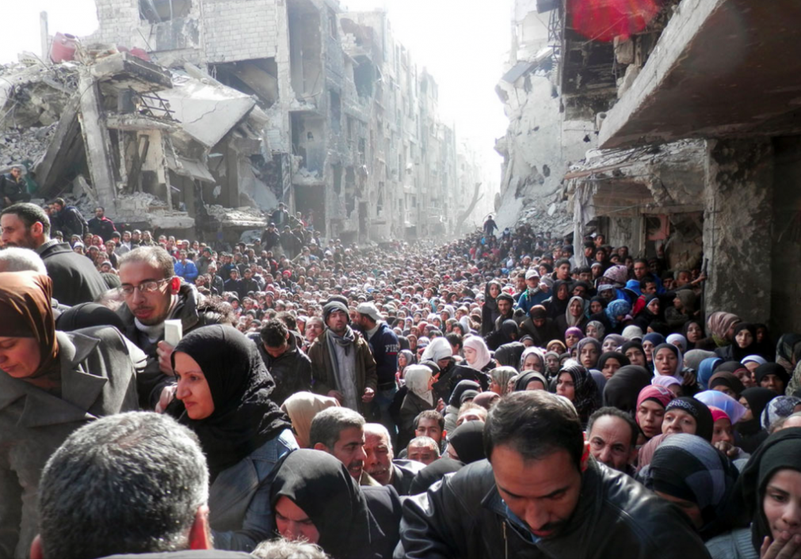
The causes and consequences of forced migration:
2. Political factors

Slide 2
IB Objectives
I can evaluate the causes and consequences of forced migration and internal displacement.
I can examine detailed examples of two or more forced movements, to include environmental and political push factors, and consequences for people and places.

Slide 3
Why, why, how???
What…. is forced migration?
Why: So that we can understand the concept of “refugee” and the impacts that refugee movements have on people and places
How: Analyse at least two examples of forced migration using case study evidence

Slide 4
Concepts in context
Why are we studying migration?
Population change is a dynamic process. Populations change due to variations in birth and death rates and migration. This may lead to a change in population structure, which in turn contributes to the process of population change.

Slide 5
Infographic practice
Source countries

Slide 6
A overview of the crisis

Slide 7
Syrian civil war causes and effects
The civil war started in 2011 as part of the Arab Spring. Non-violent anti-government protests were met with a violent crackdown by the Syrian government. Armed opposition formed as members of the army defected and were joined by armed civilians, creating the Free Syrian Army. The 'sides' were somewhat complicated owing to a mix of secular, religious and ethnic factions. Outside parties joined in with air strikes in 2015. Fighting intensified around Aleppo City in early 2016 and closed all roads.

Slide 8
The refugees
Syrians had no choice but to leave their homes because:
bombings destroyed cities and cut off all communication
human rights violations were prevalent
since 2011 nearly 500,000 people have been killed.
the infrastructure is non-existent: health care, clean water and schooling are severely limited, housing is mostly destroyed and the economy in severely depleted
children are used as human shields and forced to fight
the frontline is continually changing and civilians are caught in the crossfire.

Slide 9
Syrian Journey: Choose your own escape route
If you were fleeing Syria for Europe, what choices would you make for you and your family? Take our journey to understand the real dilemmas the refugees face.
Take the BBC interactive: http://www.bbc.com/news/world-middle-east-32057601

Slide 10
Destination of the refugees
https://www.youtube.com/watch?v=0_QrIapiNOw

Slide 11
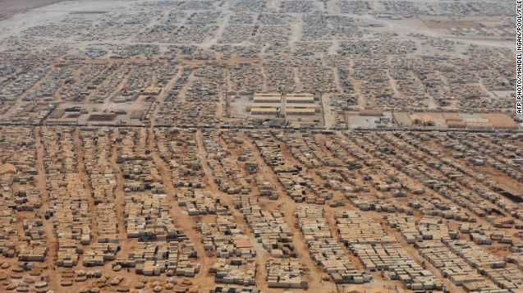
Life in a refugee camp: Zaatari refugee camp
https://reliefweb.int/sites/reliefweb.int/files/resources/FACTSHEET-ZaatariRefugeeCamp-Aug2017final.pdf
https://www.youtube.com/watch?v=tBNALXCMfjg
https://www.nytimes.com/video/world/middleeast/100000004844523/who-are-the-syrian-refugees.html?smid=pl-share

Slide 12
Link to theory

Slide 13
Refugees - Always two sides to the story?
Talk to your partner:

Slide 15
Task: Syrian refugee crisis case study
Using the resources in the textbooks, kognity and those embedded on the wiki complete a detailed case study using the following guidelines:
Place: Locations where the migrants are moving from and to, extent of the displacement
Process/ power: What are the poltical push factors (brief overview of the events in Syria- leadership, 2011 Arab Spring, response, civil war, ISIS and environmental factors.
What are the impacts of the refugee crisis on source and host countries and for the refugees?

Slide 16
Assessment (5+10 marks)
Complete an annotated map (5) showing the location of forced migration and the countries involved. Add as many numerical facts as you can regarding numbers, impacts and costs. Consider push and pull factors, impacts on the migrants and impacts on locations involved. (10)

Slide 17
Example exam question
Referring to a specific example, describe the positive | negative impacts that a forced migration has had at it's origins | destinations. [6 Marks]

Slide 18
Complete an annotated map showing the location of forced migration and the countries involved (5+10)

Slide 19
Essay question
Task:
Read through the 3 responses written under exam conditions and give each one a mark out of 15 using the IB markbands
What feedback would you give these students
Using what your advice and the IB markbands to re- write the essay

