Slide 1
Writing a synoptic essay- Population possibilities
Why: To learn how we can use the geographical concepts to write a synoptic essay
How: Plan an essay using the concepts
Write the essay: ‘The benefits of the demographic transition over time are greater than any costs.’ To what extent do you agree with this statement? (10)

Slide 2
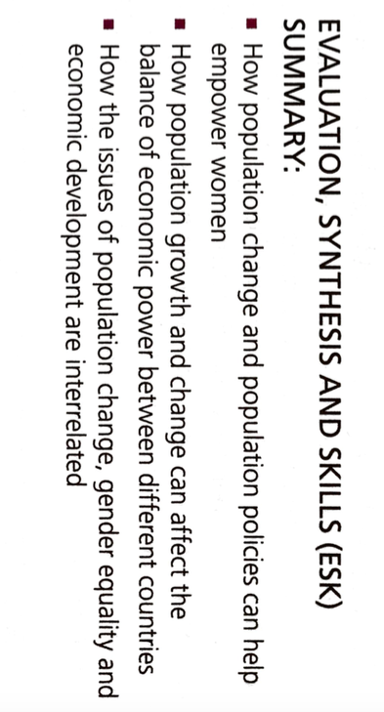
What you should know for the population possibilities section

Slide 3
Synoptic essay
To achieve an high grade in your synoptic essays you must show breadth of knowledge as well as depth.

Slide 4
‘The benefits of the demographic transition over time are greater than any costs. ‘To what extent do you agree with this statement? (10) Discuss what you understand by this essay title?

Slide 6
Mind mapping using the geography concepts
Spatial interactions
Place
Scale
Benefits and costs of the demographic transition
Place
Proccesses
Place

Slide 8
Introduction: What will be the relevant key terms? What will you be outlining in your essay?
Paragraphs 1-6: In each paragraph what will be the main point, concept and case study you will use? Ensure you link this point back to the essay title
Conclusion: Evaluate the overall balance of the benefits and costs of the demographic transition. Use different geographical criteria (i.e. concepts, scale, location or perspectives) to help weigh up the evaluation. .

