Slide 1
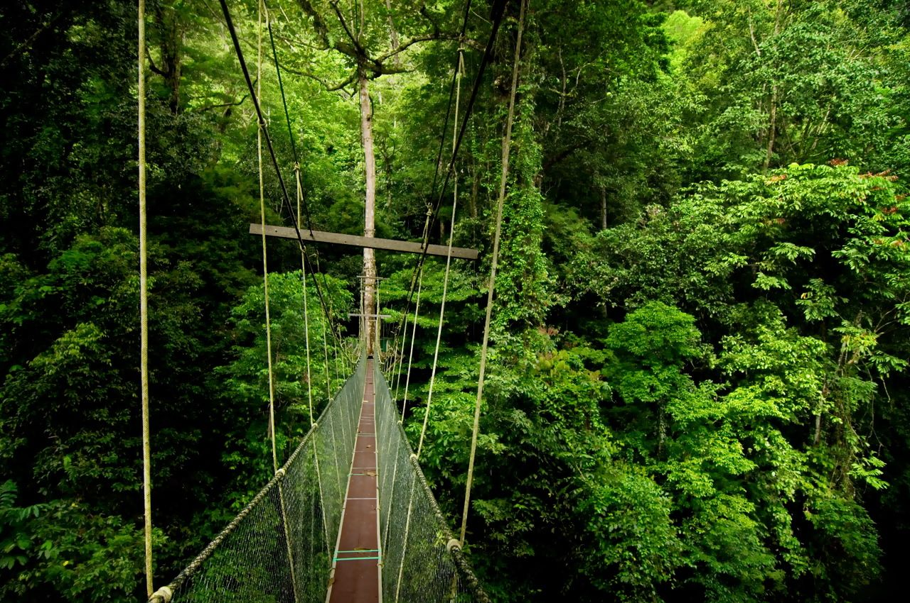
What options are there for sustainably managing a rainforest?
LO:
To know examples of sustainable management of rainforests

Slide 2
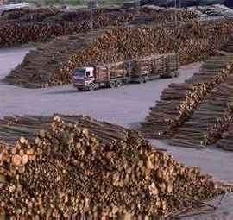
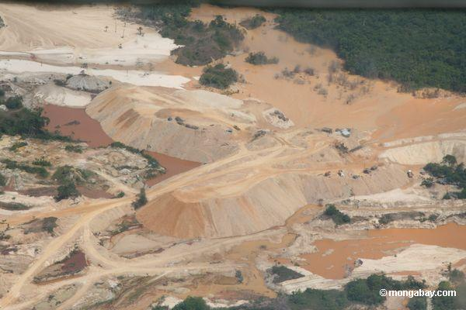
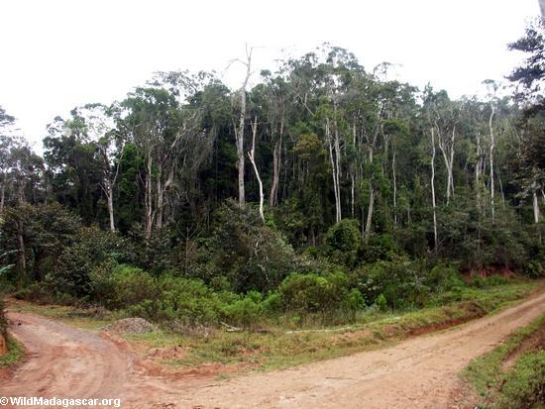
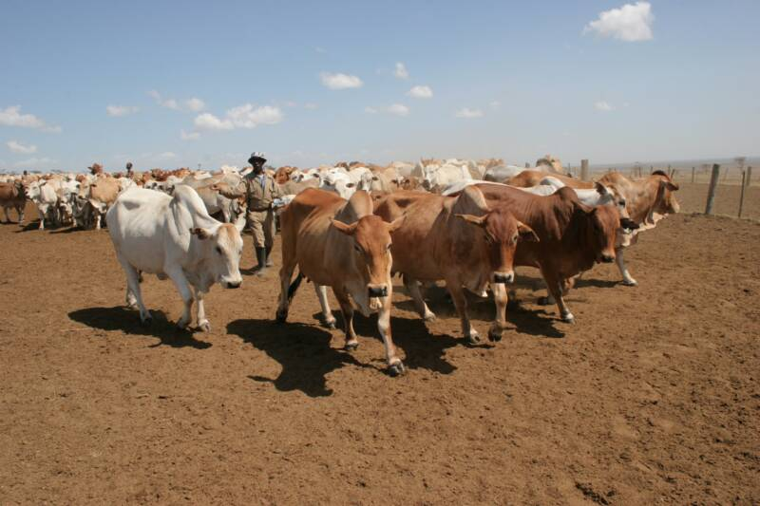
Rainforest Threats

Slide 3
Direct Causes…
Logging
Mining
Agriculture
Ranching
Oil companies
Dams

Slide 4
Sustainable Management
What is meant by the term sustainable management?
Meets the needs of the current population without compromising the needs of future generations.

Slide 5
Amazon Deforestation
We are losing 137 plant, animal and insect species every single day due to rainforest deforestation.
While 25% of Western pharmaceuticals are derived from rainforest ingredients, less that 1% of these tropical trees and plants have been tested by scientists.
European colonists have destroyed more than 90 indigenous tribes since the 1900's.

Slide 6
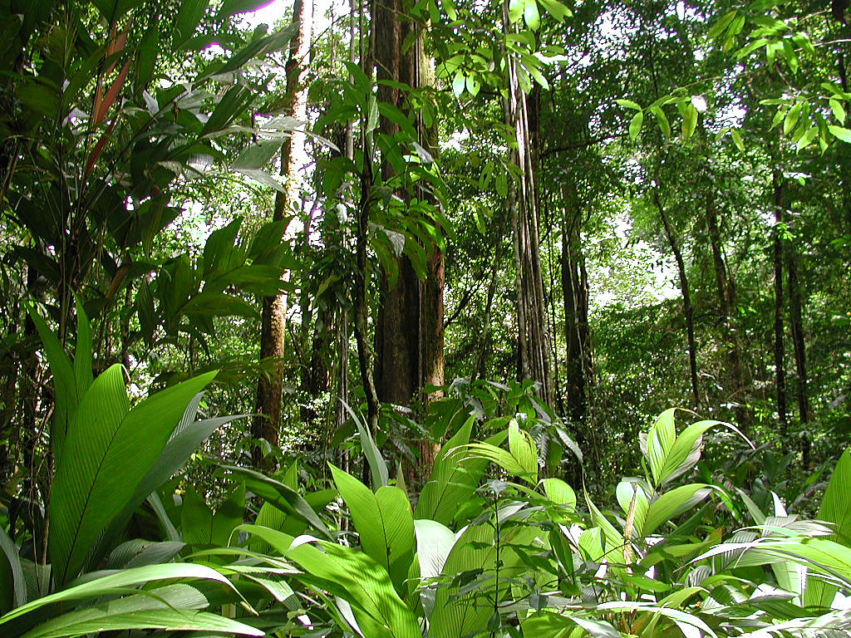
The future of rainforests
How can rainforests be managed sustainably?

Slide 7
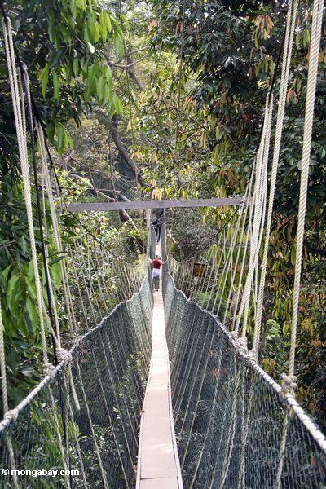
National Parks
These areas of the Amazon are protected, with no development or conversion of land use allowed. This land ensures the survival of the rainforest.

Slide 8
Rainforest Alliance Products

Slide 9
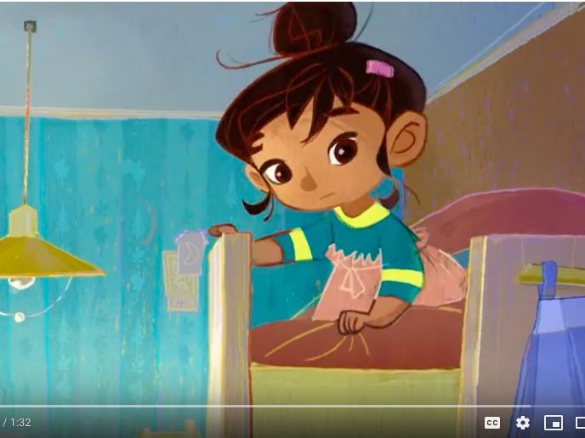
Corporate social responsibility

Slide 10
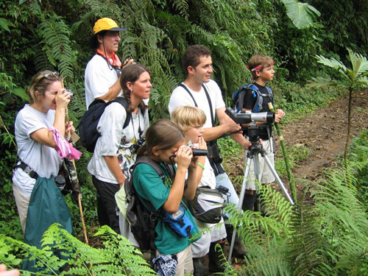
Eco Tourism
In recent years, Peru, Brazil and Ecuador have promoted their forests as destinations for ecotourism.
This aims to introduce people to the natural world without causing any environmental damage.
The great benefit of ecotourism is that it enables the undisturbed natural environment to create a source of income for local people without it being destroyed or damaged.
Watch the YouTube video
http://www.acegeography.com/tour---ecotourism.html

Slide 12
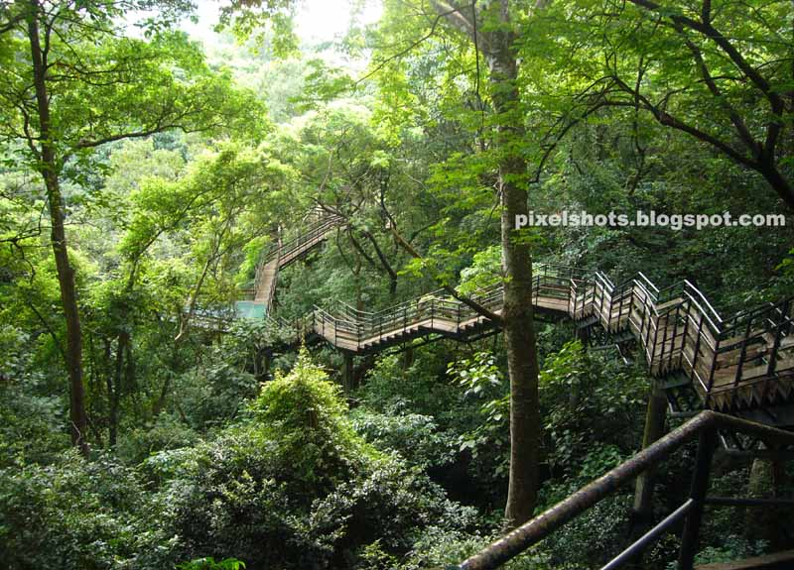
Usually involves small groups
Limited transport available
Local guides used
Mostly nature based experiences
Buildings are environmentally friendly

Slide 13
Sustainable management of the forest
Brazil needs to exploit the Amazon's resources to develop, so leaving it untouched is not an option.
Uncontrolled and unchecked exploitation can cause irreversible damage such as loss of biodiversity, soil erosion, flooding and climate change. So, sustainable use of the forest is essential. Sustainable development will meet the needs of Brazil's population without compromising the needs of future generations.
Possible strategies include:
Agro-forestry - growing trees and crops at the same time. This lets farmers take advantage of shelter from the canopy of trees. It prevents soil erosion and the crops benefit from the nutrients from the dead organic matter.
Selective logging - trees are only felled when they reach a particular height. This allows young trees a guaranteed life span and the forest will regain full maturity after around 30-50 years.
Education - ensuring those involved in exploitation and management of the forest understand the consequences behind their actions.
Afforestation - the opposite of deforestation. If trees are cut down, they are replaced to maintain the canopy.
Forest reserves - areas protected from exploitation.
Monitoring - use of satellite technology and photography to check that any activities taking place are legal and follow guidelines for sustainability.
Eco-tourism – low impact tourism that does minimal damage to the rainforest environment, whilst educating visitors about the importance of rainforest preservation.

Slide 14
Dragon’s Den: Development of the rainforest
Success criteria:
Explain what your industry/ development is
What would you do with the land
What benefits will occur – categorise as economic, environmental, social
How will your development be sustainable- short term and long term impacts, global and local impacts
Will your development link to any of the sustainable development goals?
How will it make money? How much (try to find out some information online)?
Presentation should be approx. 5 minutes long
Everyone in your group should be involved

Slide 15
Plenary
You have 60 seconds to summarise your learning from today’s lesson.

