Slide 1
Sustainable companies

Slide 2
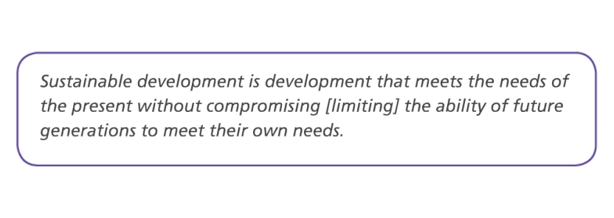
What is sustainable development?
The official UN/ Brundtland definition:

Slide 3
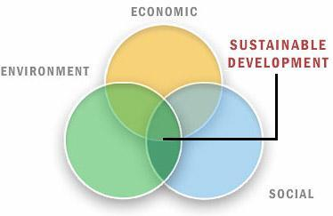

Slide 4
How do companies try to act sustainably?

Slide 5
Corporate social responsibility
Definition of corporate social responsibility: Recognizing that companies should behave in moral and ethical ways towards people and places as part of their business model.
Nike sustainability - https://sustainability.nike.com
Primark ethics - https://www.primark.com/en/our-ethics
Iceland “Our Power for Good” - http://about.iceland.co.uk/our-power-for-good/

Slide 6
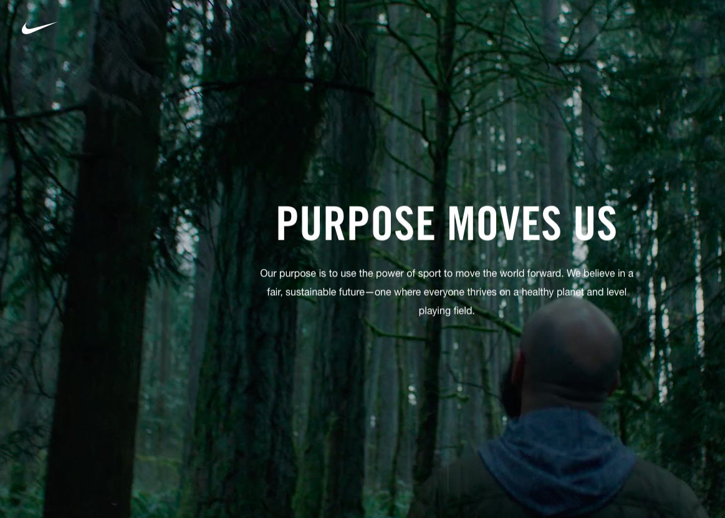
Nike’s definition: Our purpose is to use the power of sport to move the world forward. We believe in a fair, sustainable future – one where everyone thrives on a healthy plant and level playing field.

Slide 7
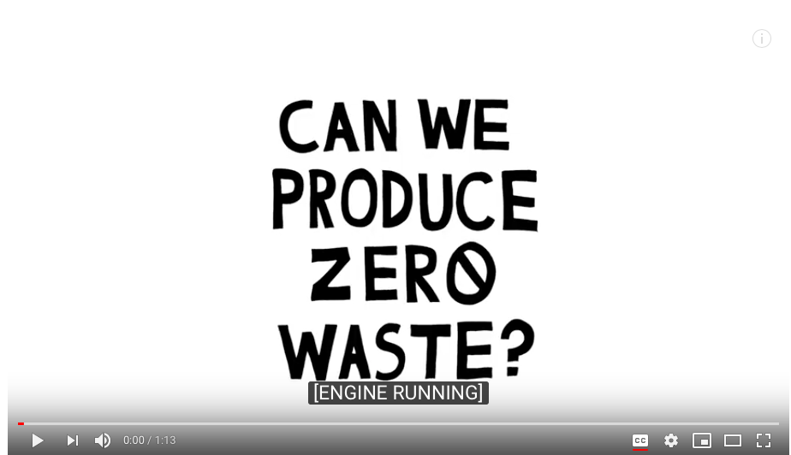
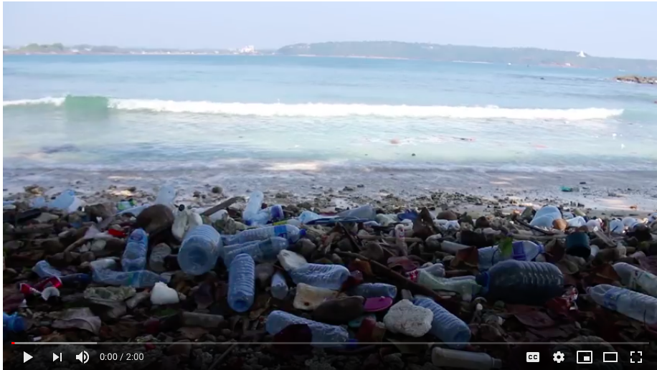
Corporate responsibility examples

Slide 8
Are large companies (TNCs) really sustainable?

Slide 9
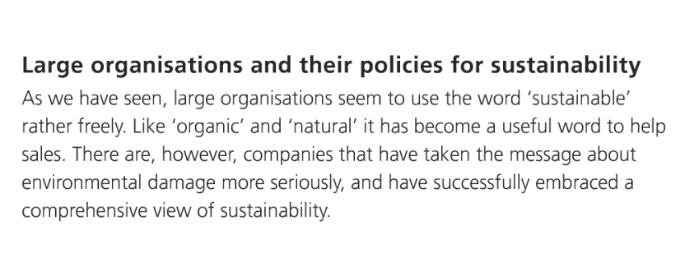
Are large companies really sustainable?

Slide 10
The Circular Economy

Slide 11
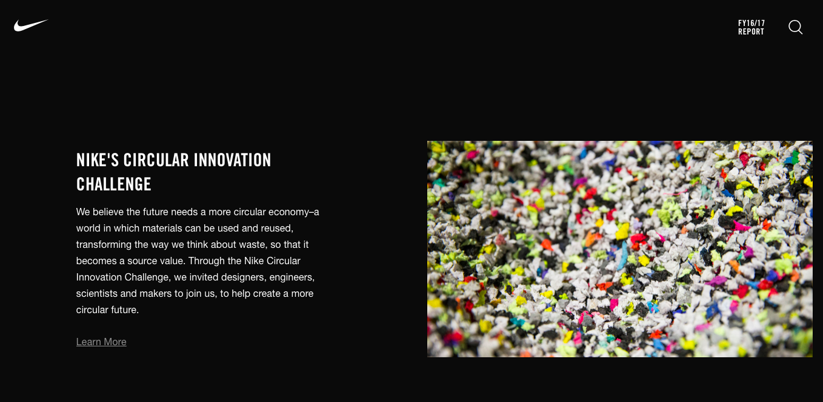
https://sustainability.nike.com

Slide 12
What is the circular economy?
A circular economy is an economic system where products and services are traded in closed loops or ‘cycles’.
A circular economy approach aims to retain as much value as possible in products, parts and materials.
This means that the aim should be to create a system that allows for the long life, optimal reuse, refurbishment, remanufacturing and recycling of products and materials.

Slide 14
https://www.youtube.com/watch?time_continue=105&v=AaV9nGyY-9A

Slide 15
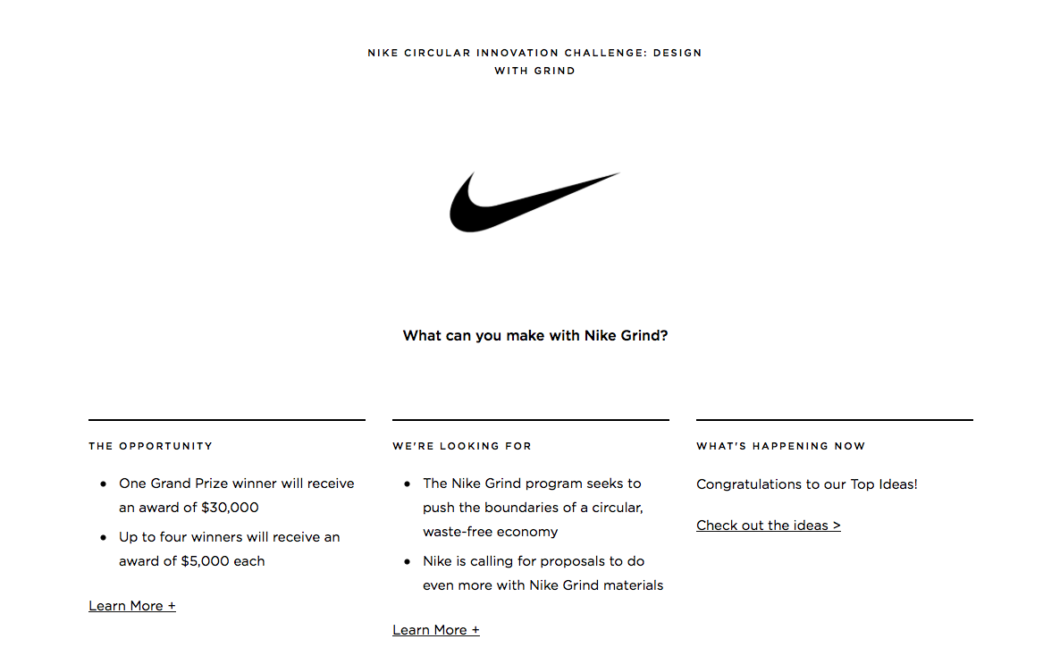

Slide 16
the ooho! edible water bubble gets set to replace plastic bottles
Is This Edible Blob The New Water Bottle?
This edible water bottle is how you will drink in the future
Ooho
These tiny edible water bottles are almost completely pointless

Slide 17
Why is TOMS sustainable?

Slide 18
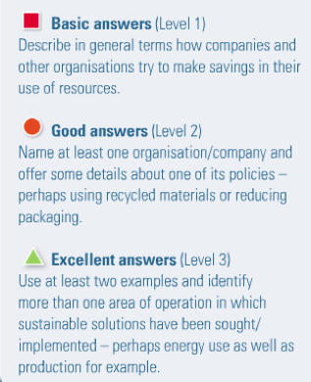
With use of examples explain how companies have made their operations more sustainable (7)
Plan ideas:
Introduction:
Definition of Sustainable development/corporate social responsibility
Outline of why it is important for companies to have sustainable policies
Outline the ways in which companies might aim to be more sustainable e.g. the social, economic and environmental aspects
Main part:
Explain the policies of two companies including why they are sustainable.
Conclusion:
In what different ways do companies aim to be sustainable?
To what extent can companies achieve sustainability?

