Slide 1
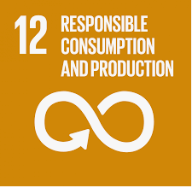
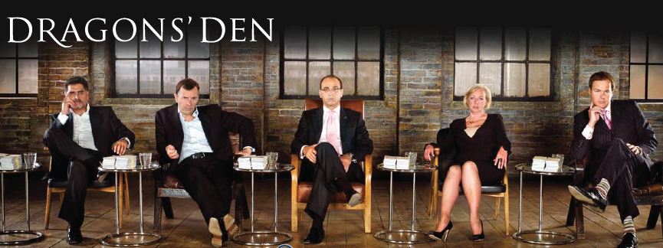
Designing a sustainable product

Slide 2
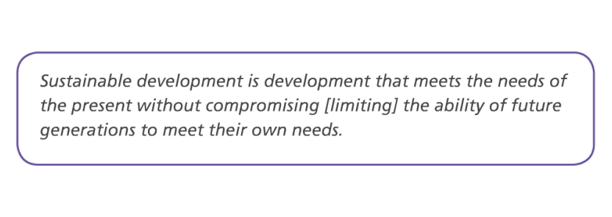
What is sustainable development?
The official UN/ Brundtland definition:

Slide 3
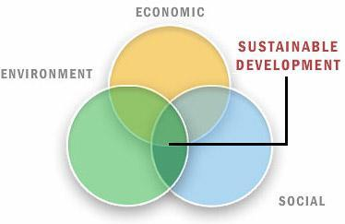

Slide 4
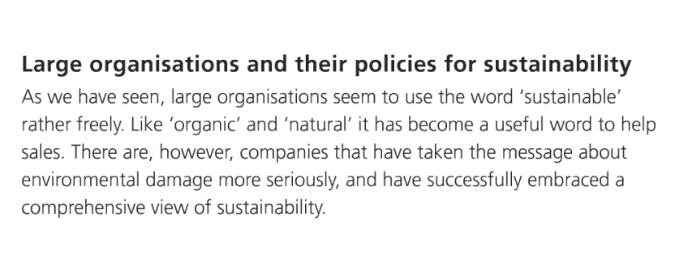
Are large companies really sustainable?

Slide 5
How do companies try to act sustainably?
Use examples of sustainable companies on the weebly
Name of company | Description of product | Socially sustainable? | Environmentally sustainable? | Economically sustainable?

Slide 6
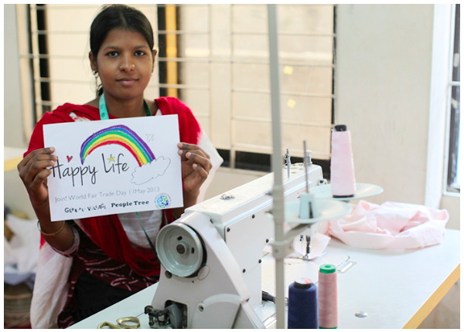
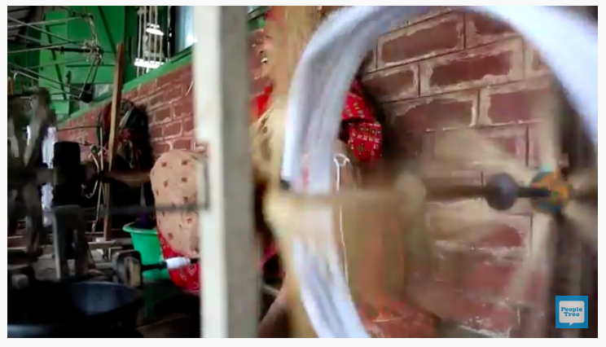
Fair trade: People Tree Bangladesh
http://blog.peopletree.co.uk/fair-trade-fashion-in-banglades/
https://www.peopletree.co.uk/about-us/who-makes-our-products/swallows

Slide 7
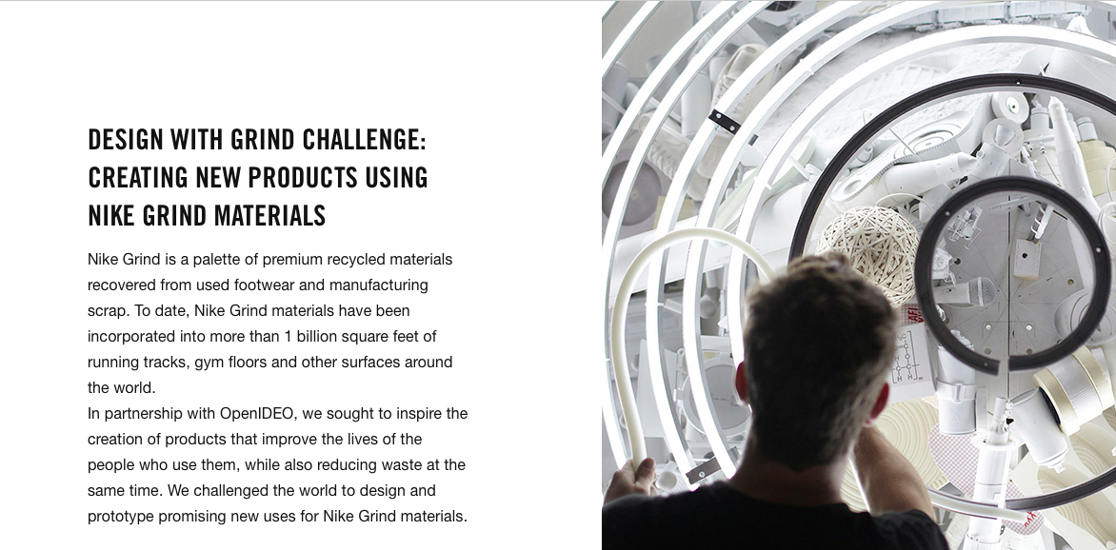
https://www.youtube.com/watch?time_continue=105&v=AaV9nGyY-9A

Slide 8
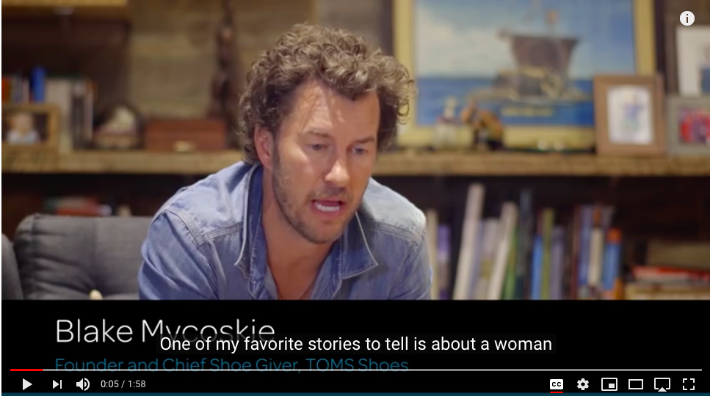
Why is TOMS sustainable?

Slide 9
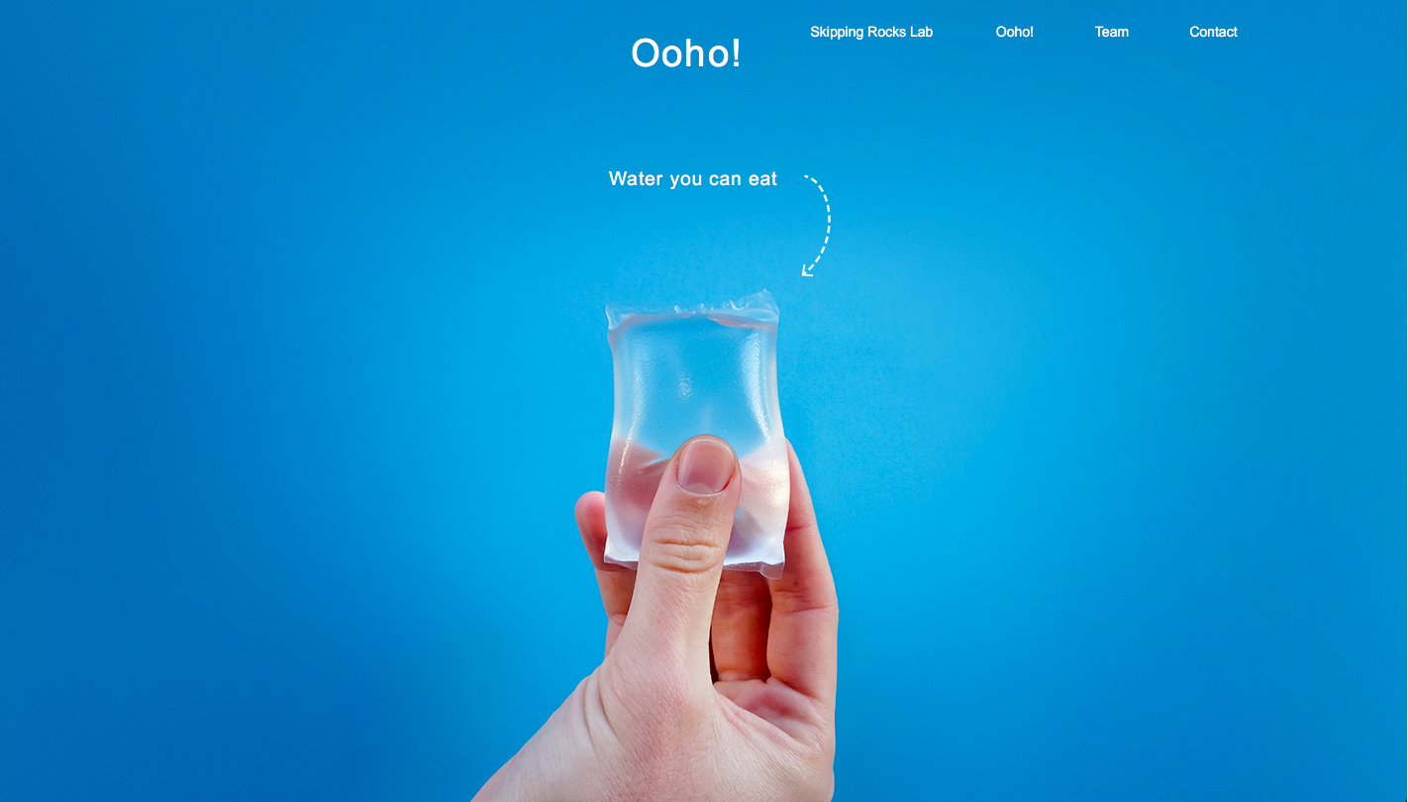
the ooho! edible water bubble gets set to replace plastic bottles
Is This Edible Blob The New Water Bottle?
This edible water bottle is how you will drink in the future
Ooho
These tiny edible water bottles are almost completely pointless

Slide 10
What is a SWOT analysis?
SWOT stands for 'strengths, weaknesses, opportunities, and threats’.
A SWOT analysis is useful because it helps an organization to determine where they stand in the market and whether or not they hold a competitive advantage over competitors.

Slide 11
Example SWOT

Slide 12
SWOT analysis guide

Slide 13
Task: Do a practice SWOT analysis for the Ooho

Slide 14
Your task- design a sustainable product
In teams of 2-3, you must design an innovative and sustainable product that you think will make money.

Slide 15
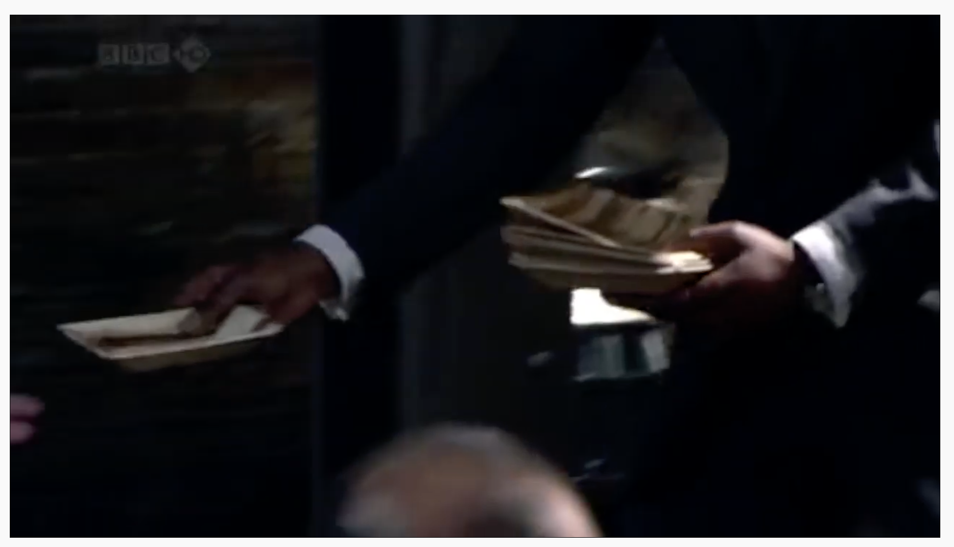
An example of a sustainable product pitched on Dragons Den
https://www.youtube.com/watch?v=1ZtnPPZBhUk&t=81s
While watching consider:
What is good about the product?
How do you think it is related a the SDG?
What was good about the pitch?
What aspects of the pitch could be improved and how?
What makes a successful pitch?
How will you use the ideas from today in your pitch?

Slide 16
What you need to include in your presentation….
What is your company name/logo?
What is the product?
How is it manufactured? How is that sustainable?
Where will it be sold? Who will it be sold to?
Design the packaging, how will this be sustainable?
Consider the lifespan of the product – is it a novelty item that will only be popular for a short period, or could it have longevity?
Can you refer to the sustainable development goals and the circular economy when describing your product?
Produce either a drawing of the product, or the actual product
Produce a costing sheet, including the cost of market research, materials, packaging, distribution, and marketing, as well as the recommended retail price
Identify your target audience
Conduct market research to persuade the Dragons that people will want your product
To what extent is the company socially, economically and environmentally sustainable?
To prepare for your pitch, you should conduct a SWOT analysis for your company identifying your strengths, weaknesses, opportunities and threats.

Slide 17
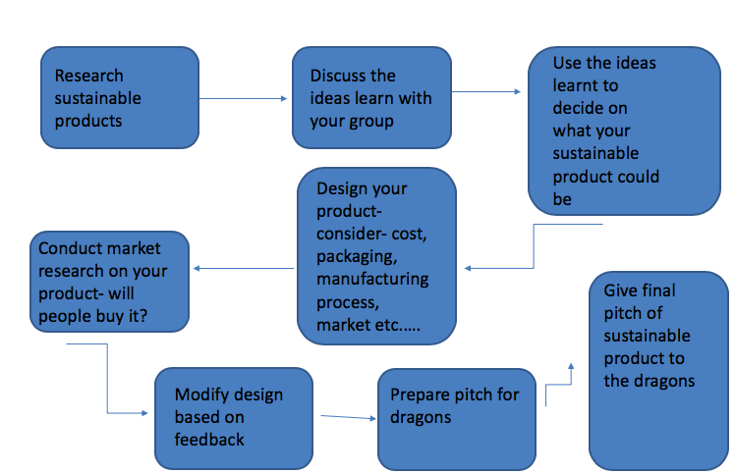
The design process

Slide 18
Heat for class: In lessons W/B 3rd May
Year 9 final (winner of each heat so a representative from each class): May 13^{th.}

Slide 19
Final assessment- week of 17th May
Answer this exam style question: "With use of examples explain how companies have made their operations more sustainable (7)" Introduction: •Definition of Sustainable development/corporate social responsibility •Outline of why it is important for companies to have sustainable policies •Outline the ways in which companies might aim to be more sustainable e.g. the social, economic and environmental aspects
Main part: - Explain the policies of two companies including why they are sustainable. Target: try and make their sustainable practices different -Extension (L7/6)- can you link this to how sustainability may be different at different levels of development and can you link this to the SDGs?
Conclusion: -In what different ways do companies aim to be sustainable? -To what extent can companies achieve sustainability?

