Slide 1
How could help meet Global Goal 11 and 12?
Year 9: Is Development a good thing?

Slide 2
What has already been achieved globally by students to solve the goals?
https://www.youtube.com/watch?v=-cEUhHTlcDU

Slide 3
Why these goals?
Nord Anglia classroom focus
We need to solve these goals in Houston!

Slide 4
What is the aim of goal 11?

Slide 5
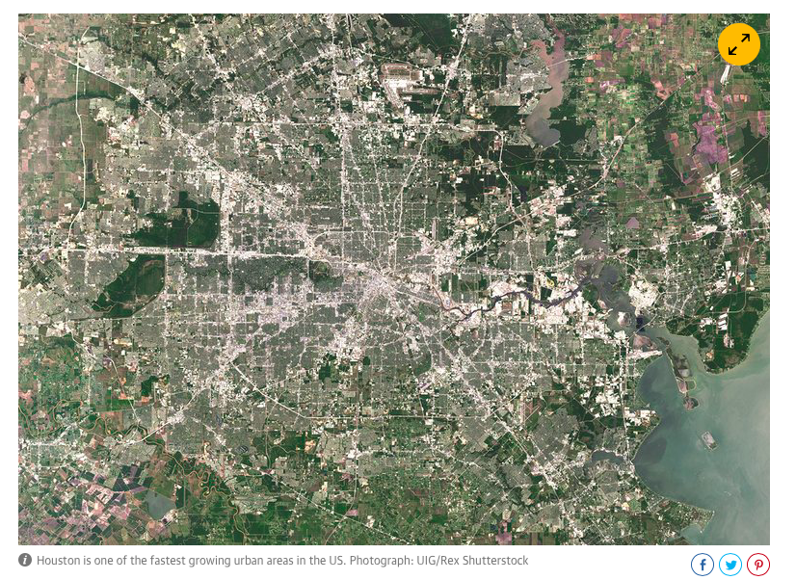
Discuss:
Year 9: Is Development a good thing?
What are the issues of the rapid development of Houston?

Slide 6
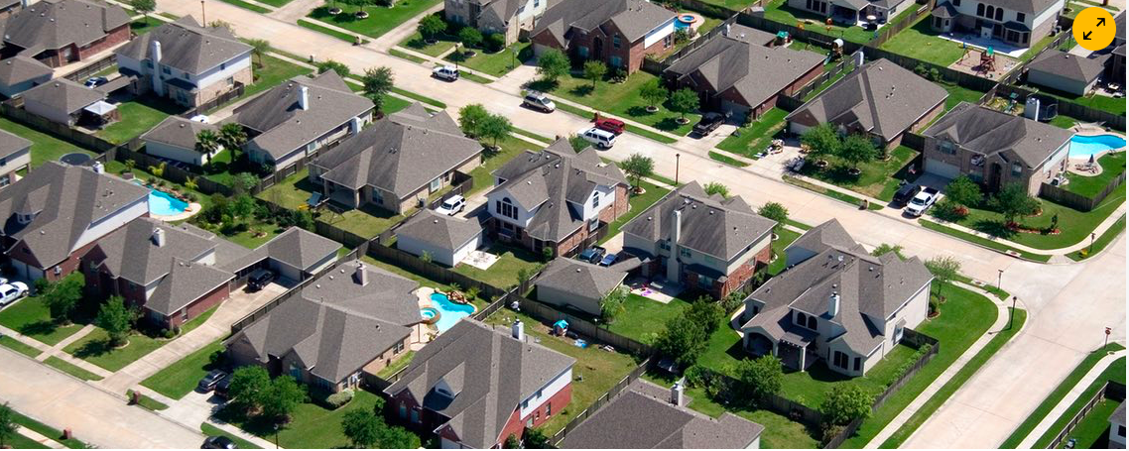
Urban sprawl in Houston

Slide 7
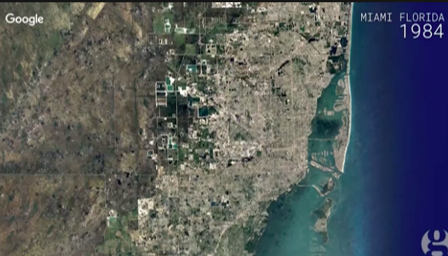
Google timelapse shows changing earth
https://www.theguardian.com/environment/video/2016/dec/05/evolving-earth-captured-by-google-timelapse-video

Slide 8
Key term: urban sprawl

Slide 9
Questions:
Describe the pattern shown on this graph (4)- Describe obvious pattern, use data, identify annomalies
Explain why this pattern may have happened (4)

Slide 10
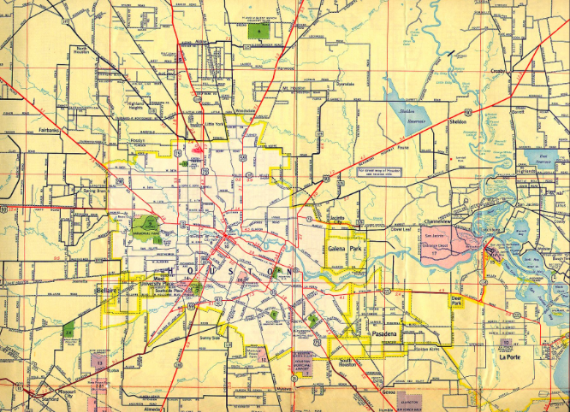
Houston in 1955

Slide 11
Houston today

Slide 12
Urban sprawl

Slide 13
The links between Urban sprawl and the effects of Hurricane Harvey?
Houston is the largest U.S. city to have no zoning laws, part of a hands-off approach to urban planning that may have contributed to catastrophic flooding from Hurricane Harvey and left thousands of residents in harm’s way. Growth that is virtually unchecked, including in flood-prone areas, has diminished the land’s already-limited natural ability to absorb water, according to environmentalists and experts in land use and natural disasters. And the city’s drainage system — a network of reservoirs, bayous and, as a last resort, roads that hold and drain water — was not designed to handle the massive storms that are increasingly common. The impermeable surfaces — asphalt and concrete — reduced the area’s ability to absorb excess water.

Slide 14
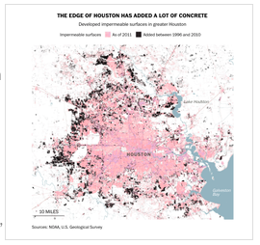
Extra reading:
URBAN SPRAWL IN SPOTLIGHT AFTER HISTORIC HOUSTON FLOODS
BOOMING HOUSTON BUILT OVER LAND MEANT FOR FLOOD PROJECTS
WASHINGTON POST: HOUSTON’S ‘WILD WEST’ GROWTH
THE GUARDIAN: AS FLOOD WATERS RISE, IS URBAN SPRAWL AS MUCH TO BLAME AS CLIMATE CHANGE?

Slide 15
How can we develop more sustainable cities?

Slide 16
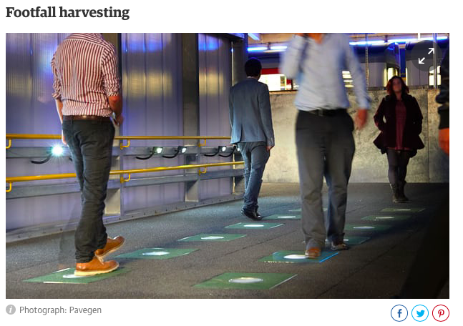
Ten quirky ideas for making our cities more sustainable
https://www.theguardian.com/sustainable-business/2015/apr/16/ten-quirky-ideas-for-making-our-cities-more-sustainable
https://www.fastcompany.com/3016816/the-10-cities-that-are-leading-the-way-in-urban-sustainability

Slide 17
Think- pair- share
What has already been done to try and make Houston more sustainable?

Slide 18
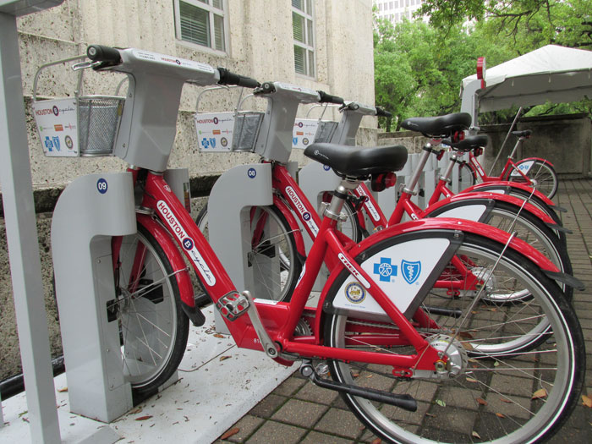
B-Cycle, Houston
B-Cycle, Houston:
http://www.youtube.com/watch?v=_isWKKs5kHY
http://www.youtube.com/watch?v=7JUDUlZV5Vk

Slide 19
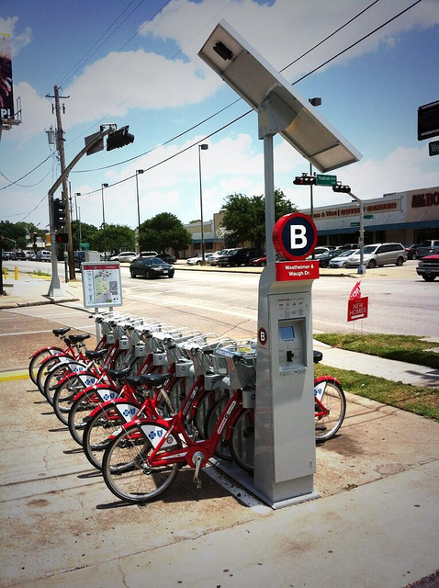
Houston B-Cycle
Houston B-cycle is a bicycle sharing system owned and operated by Houston Bike Share a non-profit organisation.
The program launched May 2012 with just 18 bikes at 3 stations.
May 2013, Houston B-cycle expanded from 3 to 25 stations and 215 bikes.
The program aims to expand to 1,000 bikes at 100 stations by the end of 2017 to include the Texas Medical Center and local universities, as well as additional neighborhoods such as Houston Heights, Midtown and Montrose.

Slide 20
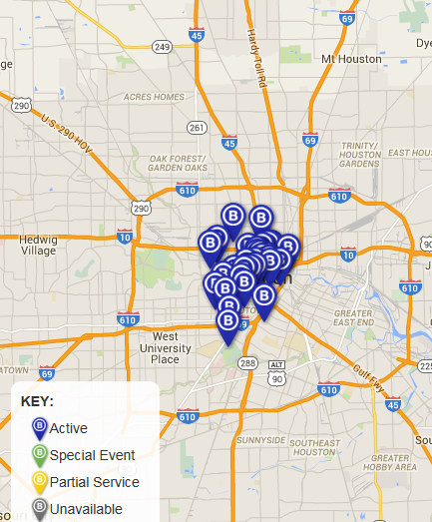
Map of B-Cycles in Houston
Why are the B-cycles located here?

Slide 21
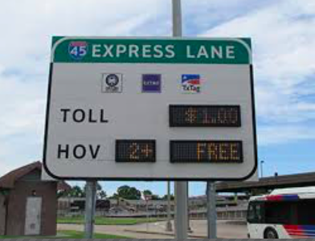
HOV lane

Slide 22
How could we make Houston more sustainable?
What has already been done?
What are the limitations?
Which ideas have we already explored that could work in Houston?

Slide 23
Task: Design a sustainable idea that could make Houston more sustainable
Success criteria:
Explain how your scheme will work
Which issue is it solving? How will this help to solve it?
Include an annotated diagram- the annotations should explain how the different deisgn deatures will work.
Explain which part of the city it may be found?
Who will use it?
How is it sustainable?

