Slide 1
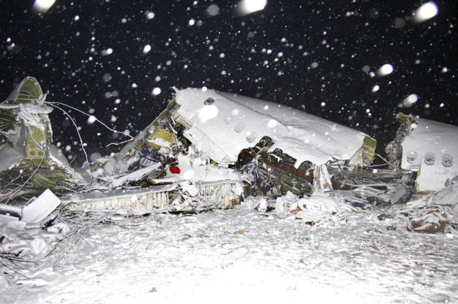
Could you survive in an extreme environment?

Slide 2
Could you survive in an extreme environment?
You and your companions have just survived the crash of a small plane. Both the pilot and co-pilot were killed in the crash. It is mid-January , and you are in Northern Canada. The daily temperature is 25 below zero, and the night time temperature is 40 below zero. There is snow on the ground, and the countryside is wooded with several creeks criss-crossing the area. The nearest town is 20 miles away. You are all dressed in city clothes appropriate for a business meeting. Your group of survivors managed to salvage the following items….

Slide 3
Your items
It is mid-January , and you are in Northern Canada. The daily temperature is 25 below zero, and the night time temperature is 40 below zero. There is snow on the ground, and the countryside is wooded with several creeks criss-crossing the area. The nearest town is 20 miles away. You are all dressed in city clothes appropriate for a business meeting.
A ball of steel wool
A small ax
A loaded .45-caliber pistol
Can of Crisco shortening
Newspapers (one per person)
Cigarette lighter (without fluid)
Extra shirt and pants for each survivor
20 x 20 ft. piece of heavy-duty canvas
A sectional air map made of plastic
One quart of 100-proof whiskey
A compass
Family-size chocolate bars (one per person) Your task as a group is to list the above 12 items in order of importance for your survival. List the uses for each. You MUST come to agreement as a group.

