Slide 1
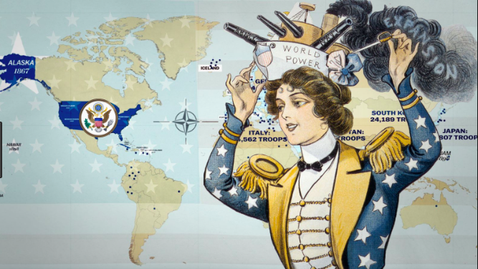
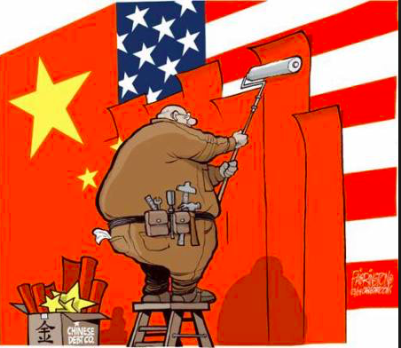
Superpowers
Key question: How does global POWER and influence vary spatially?

Slide 2
What: Global superpowers: How does global POWER and influence vary spatially?
Why: Powerful countries can, directly and indirectly, exert their influence on other places.
How: Through the study of the USA and China as ‘superpowers’

Slide 3
Key terms
Superpower | The term global superpower was used originally to describe the ability of the USA, USSR and the British empire to project power and influence anywhere on Earth to become a dominant worldwide force.
Hard power | This means getting your own way by using force. Invasions, war and conflict are very blunt instruments. Economic power can be used as a form of hard power: sanctions and trade barriers can cause great harm to other states.
Soft power | The political scientist Joseph Nye coined the term ‘soft power’ to mean the power of persuasion. Some countries are able to make others follow their lead by making their policies attractive. A country’s culture (arts, music, cinema) may be viewed favourably by people in other countries. International aid is another soft power strategy.
Do you know what these terms mean?
Click to reveal the definitions

Slide 4
Key terms
Americanisation | The imposition and adoption of US cultural traits and values at a global scale. Media giant Disney has exported its stories of superheroes and princesses globally. Western festivals of Hallowe’en and Christmas feature prominently in its films.
Global hegemony | A powerful state which can influence outcomes and shape global norms without reverting to hard-power tactics alone, such as military force. Instead, control is exercised and reproduced using soft strategies including diplomacy, aid and the work of the media and educational institutions. The USA is regarded widely as being a global hegemon in the post-1945 era.
Do you know what these terms mean?
Click to reveal the definitions

Slide 5
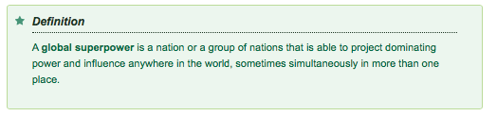


Slide 6
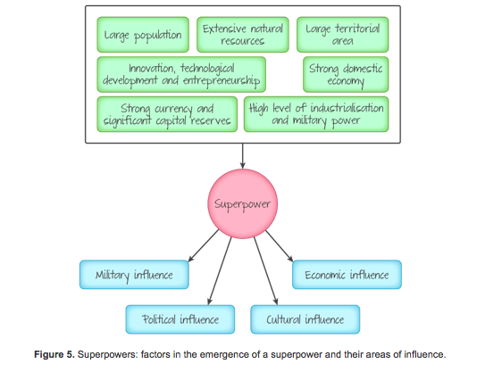
Characteristics of a superpower

Slide 7
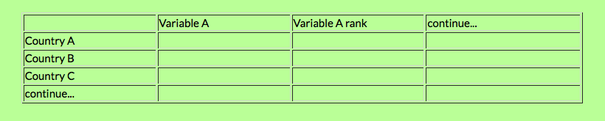
Developing your own superpower index
List countries that are possible superpowers as a column in a spreadsheet.
What values/variables could be measured to show how 'powerful' a country is?
Work as a class to collect the data, add it to the spreadsheet, rank it, create a points system and then decide which are the top two superpowers.

Slide 8
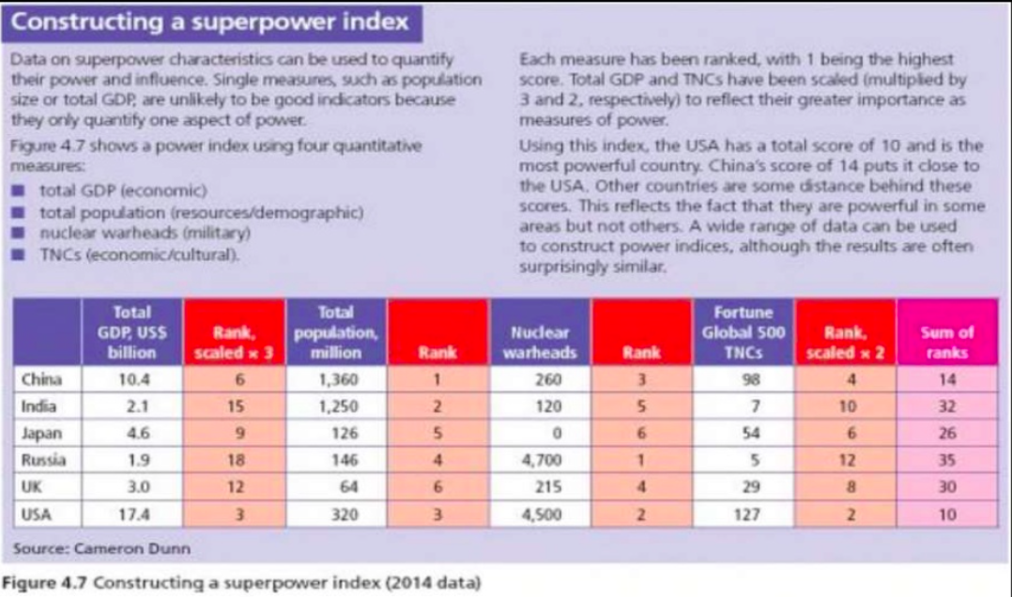

Slide 9
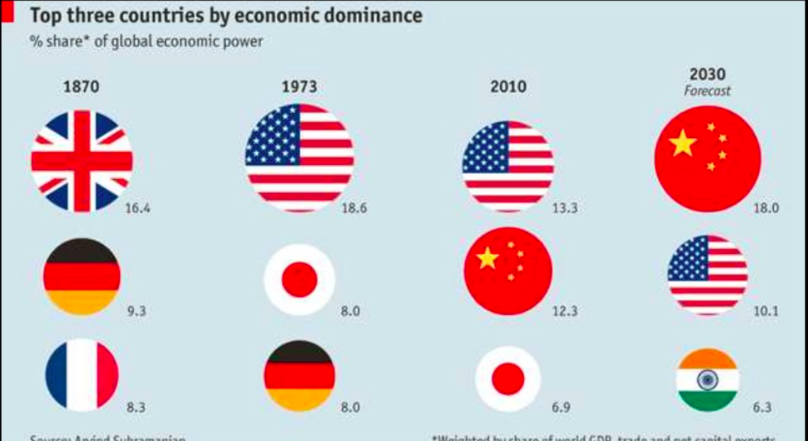
The changing Superpowers

Slide 10
A brief history of the superpowers
1914–1945: the rise of the USA and the USSR
World War 1 (1914–1918) inflicted tremendous damage on the economies of Europe. The great European powers, notably Great Britain, declined while the USA and the emerging USSR became increasingly powerful, industrially and militarily. World War 2 (1939–1945) intensified the rise of the USA and the USSR, which extended its influence over Eastern Europe directly as a result of the war.
Through the late 1940s until the early 1990s these two major superpowers engaged in a Cold War which saw a conventional and nuclear arms race with both countries spending vast amounts of money on their militaries. They also competed in the political sphere, allying with various nations around the world. The USSR consolidated its influence and domination over Eastern Europe in the Warsaw Pact group of nations while the USA became a hugely influential member of the North Atlantic Treaty Organization (NATO).
Watch: The Cold war in 9 minutes

Slide 11
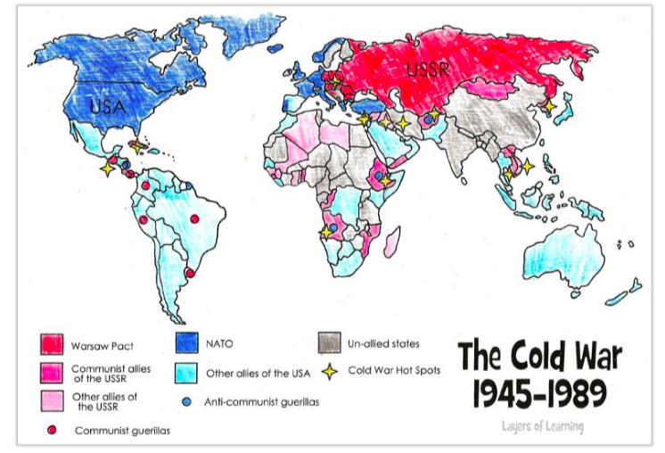

Slide 12
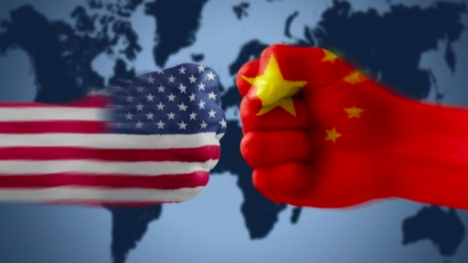
Case studies: USA v China
Success criteria: Use the range of resources on the Weebly to answer this HL essay question…
Using examples, analyse how and why established superpowers are being overtaken by emerging superpowers. (12)
1. Make notes on USA as
A military Superpower
An economic Superpower
A technological Superpower
A cultural Superpower
2. Make notes on how China is gaining power as a Superpower

Slide 13
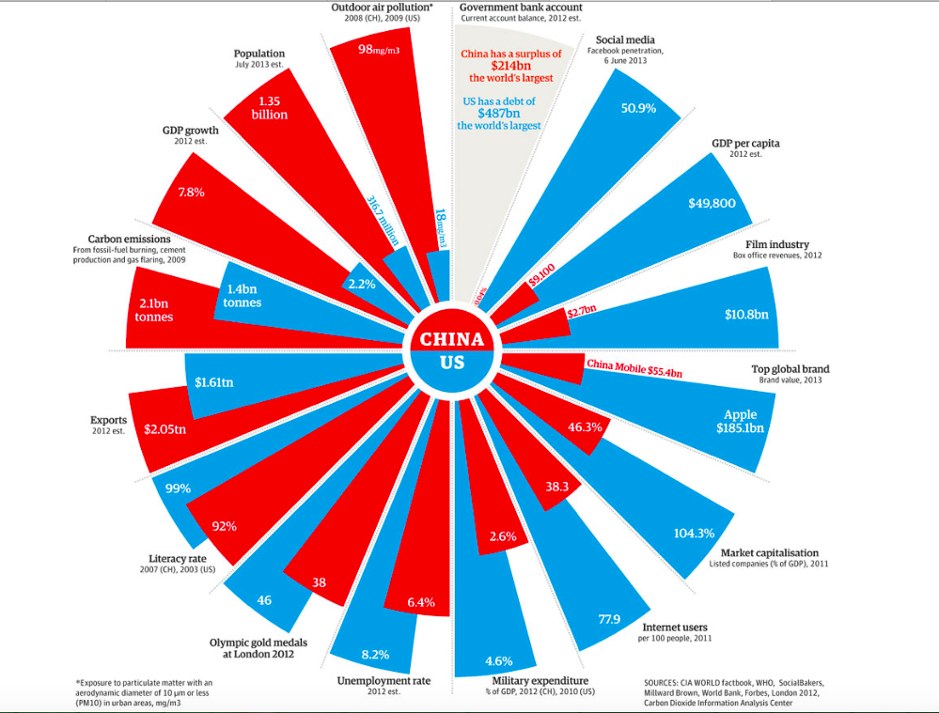

Slide 14
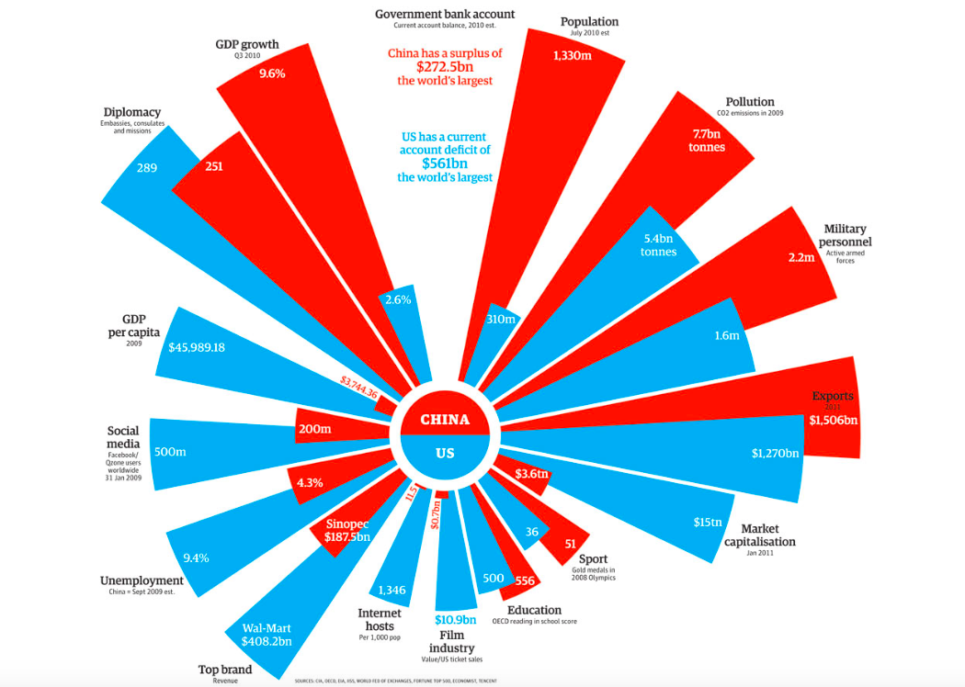

Slide 15
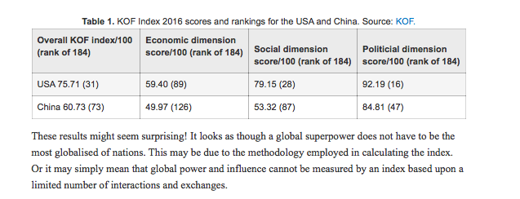

Slide 16
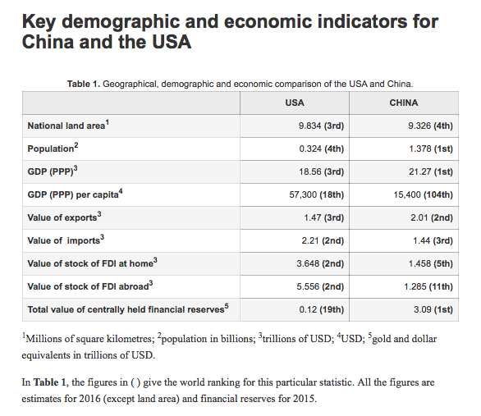

Slide 17
The USA as a Superpower
Watch the video that charts the United States of America's rise to become the current largest global superpower.
​You should focus on the time period post WW2 and paying attention to the formation of the United Nations & Breton Woods Agreement (World Bank & IMF) as well as NATO. 6:60 onward is excellent for post Cold War information.
Task – Watching the VOX video complete some note taking that explains how the USA in involved with the following four organisiations and how they may have helped the country to attain superpower status.

Slide 18
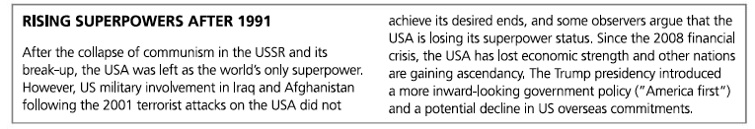

Slide 19
What makes the USA a superpower?
The British empire was a colonial power, alongside France, Spain, Portugal and other European states. Between approximately 1500 and 1900, these leading powers built global empires. One result was the diffusion of European languages, religions, laws, customs, arts and sports on a global scale.
In contrast to the direct rule of the British in the 1800s, the USA has dominated world affairs since 1945 mainly by using indirect forms of influence or neocolonial strategies. Unlike every superpower before it, the USA has not built an empire by colonising other nations. Instead, it has used soft power mechanisms, such as media, aid and diplomacy, to spread its norms, culture and power. Much of American influence has been attributed to ‘Hollywood, Harvard, Microsoft and Michael Jordan’.
Hodder & Stoughton © 2017

Slide 20
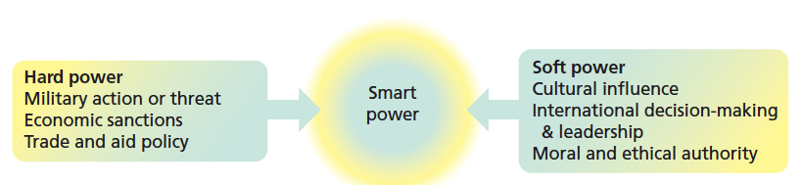
The USA: a smart power?
The USA is such a successful superpower that some people have even described it as a hyperpower.
The following four slides outline different aspects of US power.
Combined, they amount to what some people describe as smart power.

Slide 21
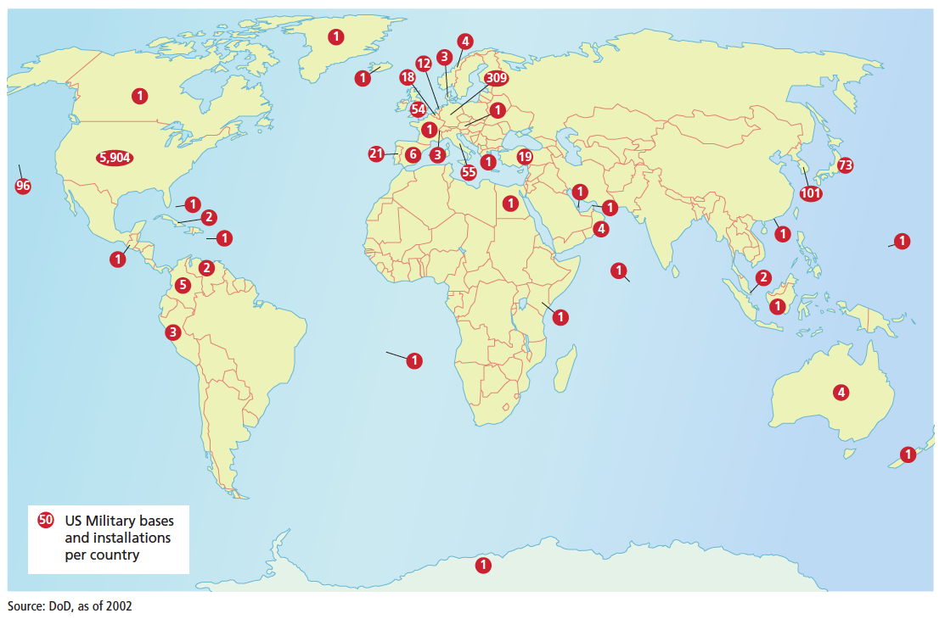
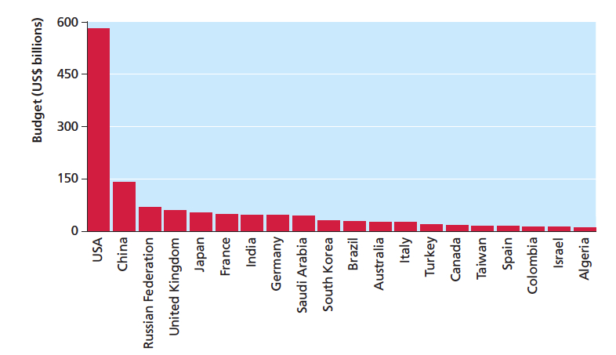
US military power
The USA has used a combination of overt military power and covert intelligence operations to intervene in the affairs of almost 50 states since 1945 according to William Blum, a former US State Department official.
The USA’s reach is truly global.
The USA outspends other countries on military funding by a considerable margin, including China and Russia.

Slide 22
US political power
The USA was the main architect of the global economic system created at the end of the Second World War, and the principles which inform it.
The USA continues to have disproportionate influence over these important intergovernmental organisations, which are based in Washington DC.
Over time, the free market philosophy which institutions like the World Bank and International Monetary Fund promote has become known as the Washington consensus.
To date, all World Bank presidents have been US citizens. The USA has a greater influence over International Monetary Fund (IMF) policy than any other state.
Hodder & Stoughton © 2017

Slide 23
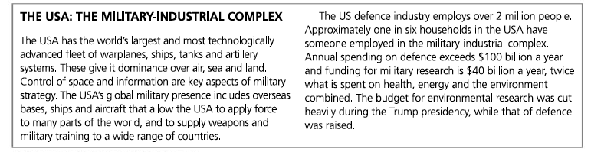

Slide 24
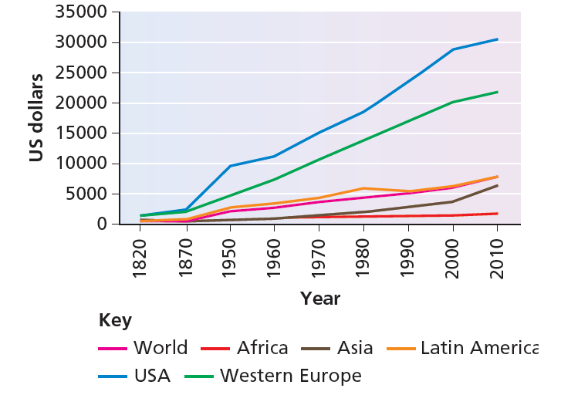
US economic power
The 320 million people who live in the USA (less than one-twentieth of the world’s population) own more than 40% of global personal wealth.
Of the 500 largest global TNCs, one quarter were US-owned in 2015.
The graph shows GDP per capita growth in selected countries and world regions over time: the USA has benefited greatly from the ‘new world order’ it has created.
Hodder & Stoughton © 2017

Slide 25
US soft power
US cultural influence is so strong that terms like Americanisation and McDonaldisation are widely used to describe the way American food, fashion and media have shaped global culture. Brands like Disney, Marvel and McDonald’s are enjoyed by people in many different countries.
The USA is also a major donor of foreign aid. This helps it to build regional and global political alliances.
Hodder & Stoughton © 2017

Slide 26
What next for the USA?
Until very recently, the USA benefited most from globalisation by being able to regulate the terms of its own global interactions with other countries and TNCs in ways that returned significant economic and political rewards. For this reason, conventional wisdom used to be that globalisation and 'Americanisation' were one and the same thing. Indeed, until recently, the USA was widely seen as being the world’s unchallenged ‘hyperpower’ meaning that it was dominant in all aspects of power.
Since the Global Financial Crisis of 2008, however, it has become harder to sustain a unipolar view of the world with the USA as an unopposed global hegemon.
China is increasingly viewed as rivalling the USA in many ways. China became the world’s largest economy in 2014 and exerts great influence over the global economic system through its sheer size.
Other emerging economies including India and Indonesia play an increasingly important global role.
Russia has reasserted its global influence militarily by seizing Crimea and offering support to the ruling regime in Syria. Under the leadership of Vladimir Putin, Russia is expanding its sphere of influence again.

Slide 27
President Trump: what next?
Critics say this amounts to an anti-globalisation agenda. It could end the USA’s role as a true global hegemon working to support the global status quo.
President Trump has portrayed himself as:
A political isolationist This means he may be less keen to see the USA involved in wars or peacekeeping operations. Under his leadership, the USA may play a less active international role in relation to global issues such as climate change. He has suggested the USA’s role in NATO may lessen. He has proposed building a wall along the US–Mexican border.
An economic protectionist This means he may put high taxes on imported goods. He has also said he will place a 35% tax on products which US companies manufacture in other countries (which will encourage TNCs to ‘reshore’ their relations). He has also made a commitment to renegotiate or withdraw from NAFTA, and does not support the Trans-Pacific Partnership (TPP).

Slide 28
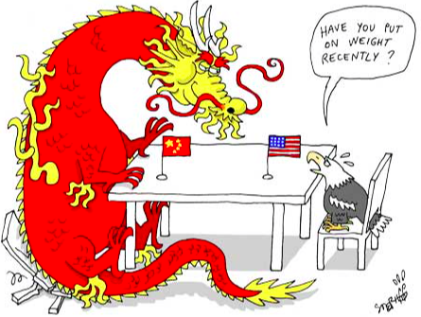
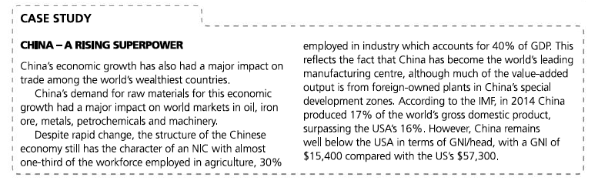
China as a potential Superpower
China because of the size of it’s economy, the size of it’s population and it’s increasing military influence is seen as a potential future superpower.

Slide 29
More to think about…..
The UK declined as a superpower after the Second World War. To what extent might the proposed 2019 Brexit further diminish the powers of the UK?

Slide 30
Assessment
Using examples, analyse how and why established superpowers are being overtaken by emerging superpowers. (12)
​
​"With great power comes great responsibility". Discuss this statement and relate it to the economic, geopolitical and cultural influence of global superpowers. [16]

