Slide 1
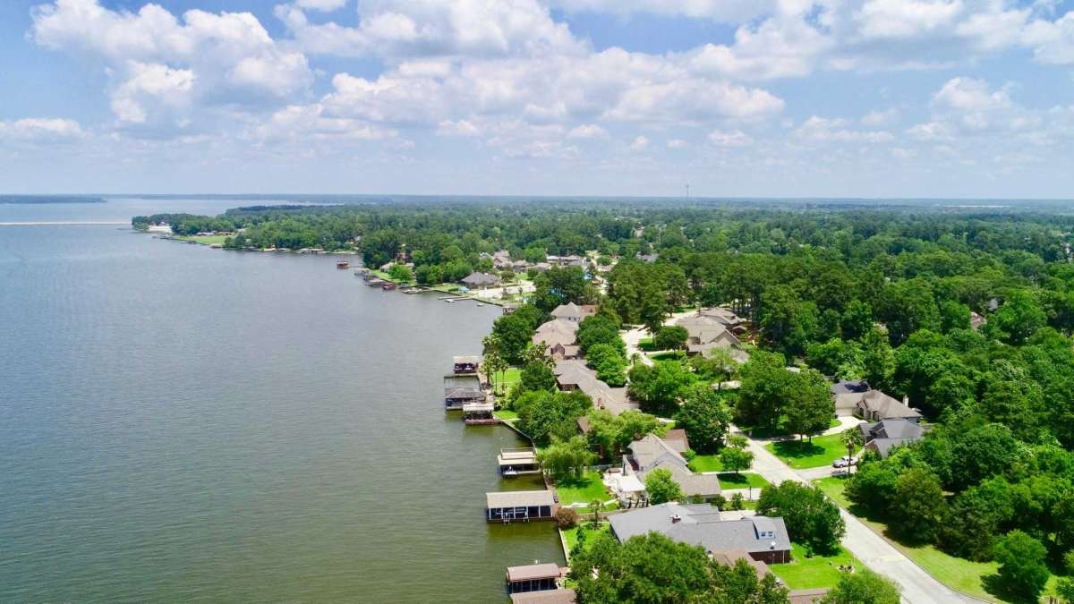
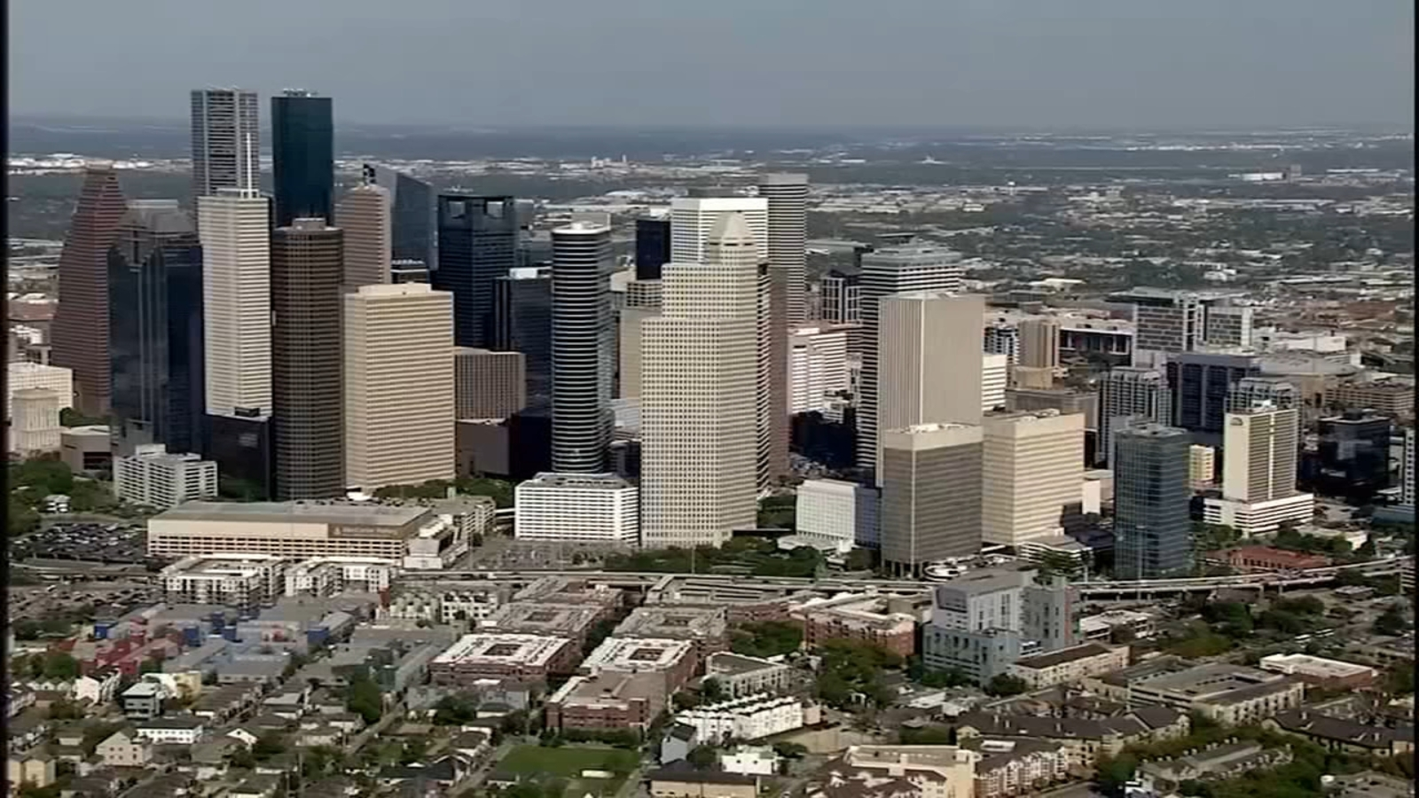
Where would you rather live?

Slide 2
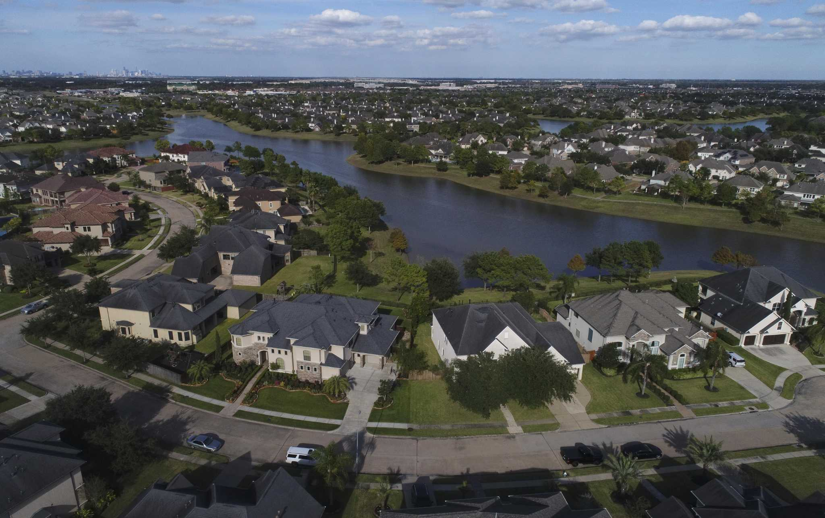
Title - Surburbanisation and Counter-Urbanisation
Lesson Outcomes:
Be able to confidently tell the difference between suburbanisation and counter-urbanisation
Be able to describe what suburbanisation is and why it is occurring
Be able to describe what counter-urbanisation is and why its occurring

Slide 3
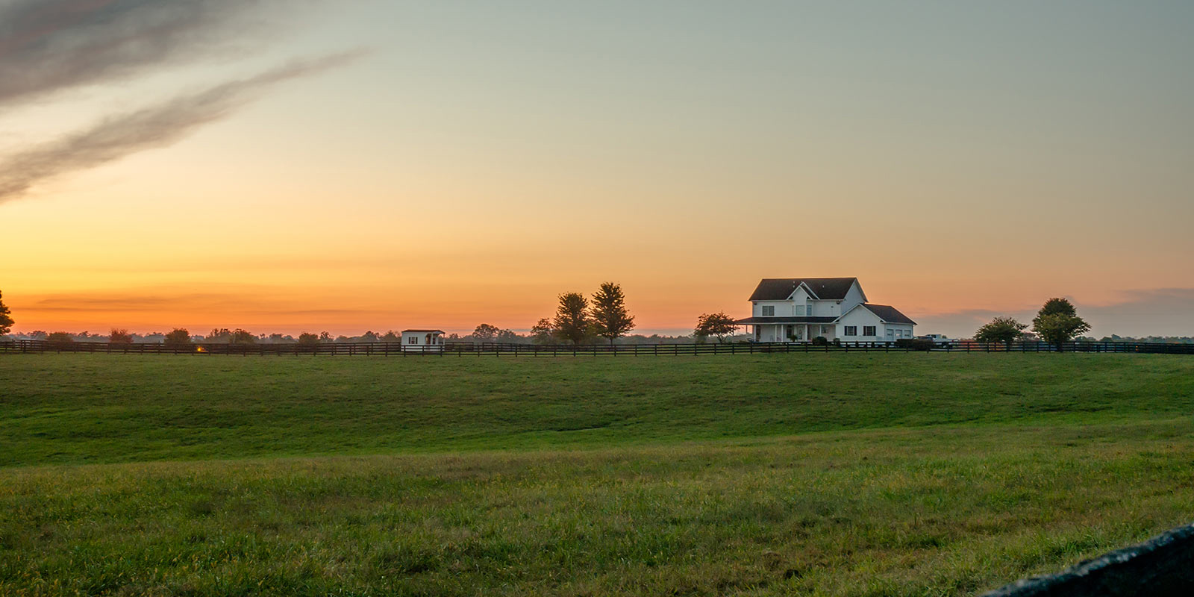
What’s the difference between suburbanisation and counter urbanisation?
Keyword definitions – What do you think they mean?:
Suburbanisation This is where the suburbs on the outer edge of the settlement grow outwards as new houses and services are built to accommodate more people.
Counter-urbanisation The moving of people from cities/urban areas to a more rural setting.
People moving from central Houston to a new house in Katy
People moving from central Houston to a rural, farming town, 2 hours outside of Houston
Challenge – Class the statements and images as either examples of suburbanisation or counterurbanisation.
Extra Challenge – give reasons why this is happening
People moving from central Houston to the outskirts of the city.
Notes:
https://kinder.rice.edu/urbanedge/2020/10/05/rapid-urbanization-houston-how-it-happened-flooding-climate-change

Slide 4
What’s the difference between suburbanisation and counter urbanisation?
Keyword definitions – What do you think they mean?:
Suburbanisation This is where the suburbs on the outer edge of the settlement grow outwards as new houses and services are built to accommodate more people.
Counter-urbanisation The moving of people from cities/urban areas to a more rural setting.
People moving from central Houston to a new apartment in Katy
People moving from central Houston to a rural, farming town, 2 hours outside of Houston
Challenge – Class the statements and images as either examples of suburbanisation or counterurbanisation.
Extra Challenge – give reasons why this is happening
People moving from central Houston to the outskirts of the city.
Notes:
https://kinder.rice.edu/urbanedge/2020/10/05/rapid-urbanization-houston-how-it-happened-flooding-climate-change

Slide 5
Title - Surburbanisation and Counter-Urbanisation
Lesson Outcomes:
Be able to confidently tell the difference between suburbanisation and counter-urbanisation
Be able to describe what suburbanisation is and why it is occurring
Be able to describe what counter-urbanisation is and why its occurring

Slide 6
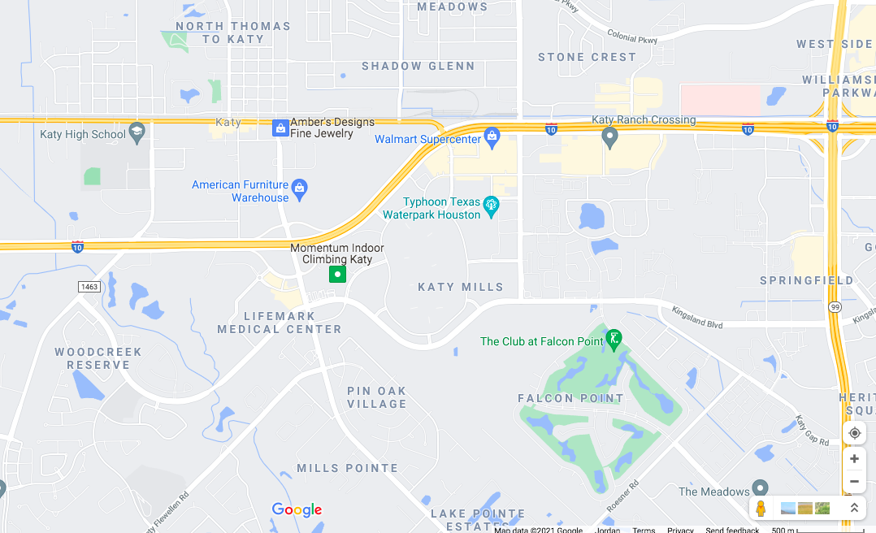
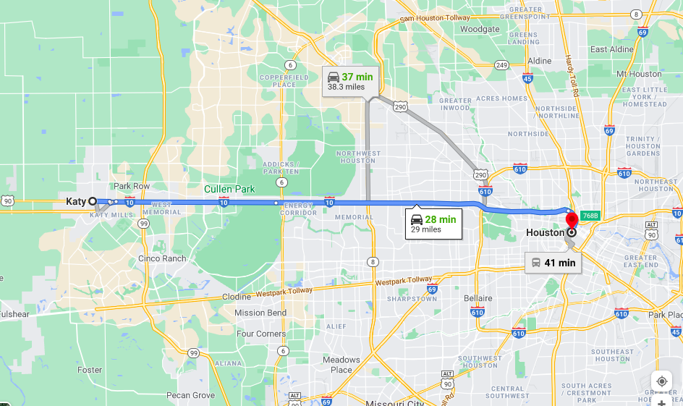
What is causing sub-urbanisation?
Suburbanisation This is where the suburbs on the outer edge of the settlement grow outwards as new houses and services are built to accommodate more people.
Katy- an urban settlement on the outskirts of Houston
N
Challenge: Study the maps and facts about Katy. Give four reasons why sub-urbanisation is occurring in the Houston Metropolitan area. Tip: Think of push and pull factors. 5 mins
Nearby schools
Local shops
Leisure Activities
Golf club
House prices are thousands of Dollars cheaper than similar places closer to Houston’s Downtown
Extra Challenge: Open the interactive crime map. Describe the general distribution of crime grades. Find Katy and give reasons why this might be a pull factor for people living closer to Houston.
I-10 main road leading to Houston, only 30 miles away.
Notes:
https://crimegrade.org/safest-places-in-houston-tx-metro/

Slide 7
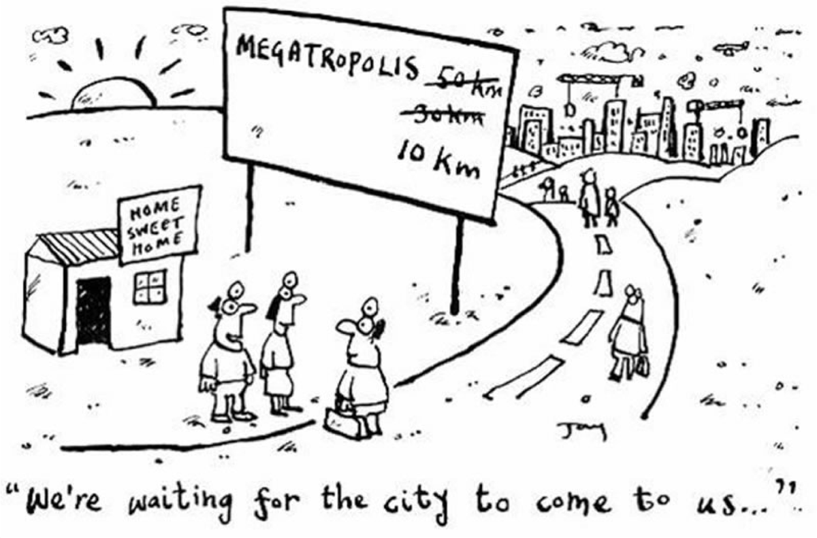
Challenge 2, Either:
Annotate the cartoon with ideas linked to how it is showing suburbanisation
Annotate the satellite images with ideas linked to how it is showing suburbanisation

Slide 8
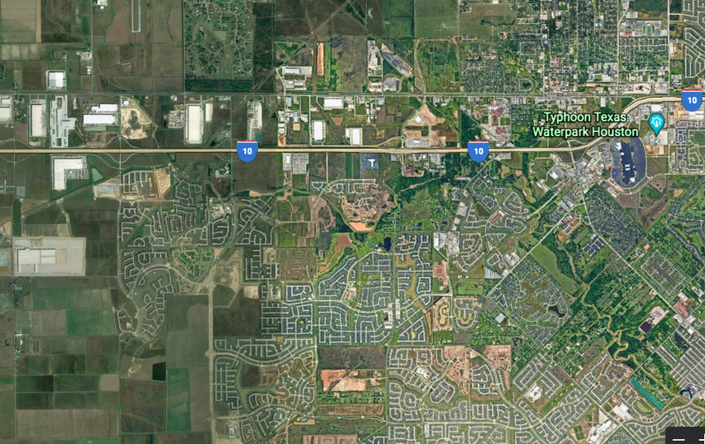
Image 1
Image 2
Image 1 takes in central Houston and its suburbs towards the west. Image 2 is a neigbourhood in Katy.

Slide 9
Image 1
Image 2
Image 1 takes in central Houston and its suburbs towards the west. Image 2 is a neigbourhood in Katy.

Slide 11
What are the effects of sub-urbanisation?
Suburbanisation This is where the suburbs on the outer edge of the settlement grow outwards as new houses and services are built to accommodate more people.
Increase in housing prices when city grows outward.
More services such as a post office, schools, medical offices are built.
Increase in noise and air pollution.
Challenge: Below are speech bubbles with the effects of sub-urbanisation. Colour code them to show the economic, environmental and social effects differently. Create a key to show this. 10 mins
Crowded villages, towns etc.
Large shopping centres are built so more jobs are created.
Derelict buildings and barns are put to use.
Key
 | Economic effect
 | Environmental effect
 | Social effect
Some green spaces are built on because of the demand for houses.
More sales by small shops and stores.
More competition for school places

Slide 12
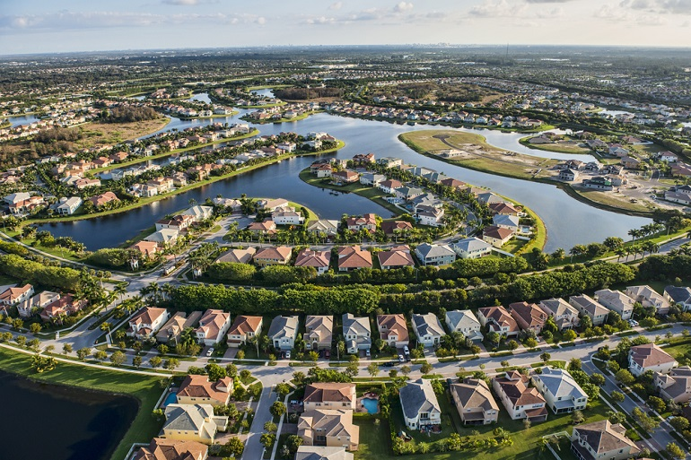
Title - Surburbanisation and Counter-Urbanisation
Lesson Outcomes:
Be able to confidently tell the difference between suburbanisation and counter-urbanisation
Be able to describe what suburbanisation is and why it is occuring
Be able to describe what counter-urbanisation is and why its occuring

Slide 13
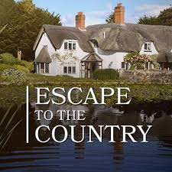
So, what is counter-urbanisation and why is it happening? Thoughts?
Counter Urbanisation – When people move from denser urban areas to more rural settings.
Escape to the country is a British TV show about people wanting to move from an urban area to a more rural setting. What does the title of this TV show suggest about life in rural areas compared to urban?
Challenge 1 – Watch the video about the American couple living in London and write down all the push and pull factors that are mentioned in the video. You can do this is a table, bullet points, spider diagram etc. Up to you.
Notes:
https://www.youtube.com/watch?v=Gq4DWn3dK90

Slide 14
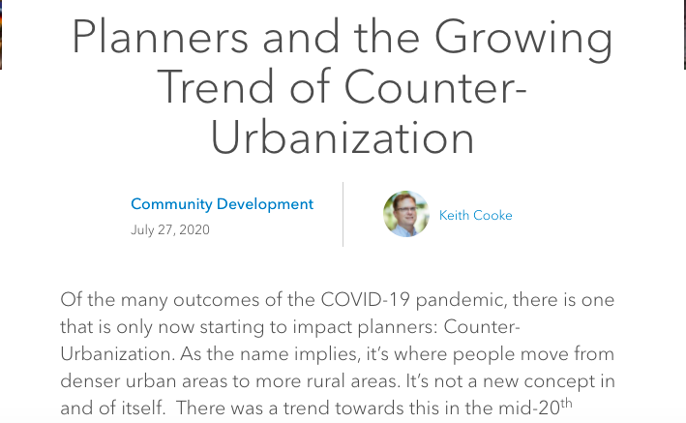
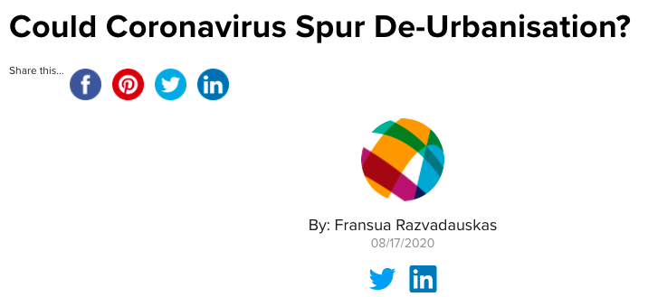
What impact do you think the Covid pandemic has had on rates of counter urbanization in some HICs?

