Slide 1
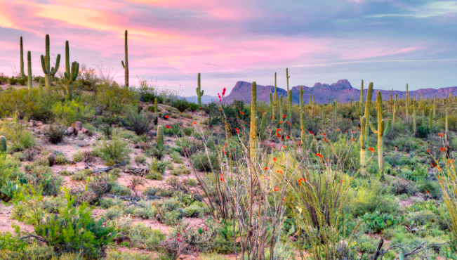
The Sonoran Desert
Desert case study

Slide 2
For a named area of hot desert explain the characteristics of the ecosystem (7)

Slide 4
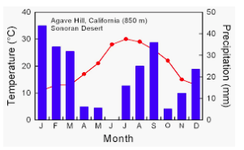
Climate graph for Sonoran desert
Example question: Describe the climate of the Sonoran desert (4)

Slide 5
The Sonoran Desert, Arizona, USA
The Sonoran Desert is one of North America's largest and hottest deserts. It is also one of the wettest, with over 300 mm of rain falling in some places. It is located in the south-west of the USA, straddling the lower states of Arizona and California and stretching south into Mexico. The Sonoran Desert is stunningly beautiful and is home to a great diversity of flora and fauna including the saguaro cactus. The USA is able to respond differently to the challenges and opportunities of a desert environment compared with poorer countries such as India (Thar Desert) or the African desert bordering the Sahara Desert. Money enables many of the physical difficulties to be overcome. The physical extremes of the climate can be overcome to some extent by using air conditioning for vehicles, houses, workplaces and shopping centres. With plentiful supplies of relatively cheap energy, this is perfectly possible in the USA. Water can be relatively easily piped into the area for irrigating crops, to supply drinking water and for filling swimming pools and watering golf courses, The clear, clean atmosphere and open spaces form an attraction to short-term holidaymakers and long-term migrants. A recent trend in the Sonoran desert has been retirement migration, where people decide to retire to newly built housing complexes with swimming pools and golf courses.

Slide 6
Describe the characteristics

Slide 9
Saguaro cactus

Slide 10
Prickly pear

Slide 11
Palo verde
Loses leaves in dry season
Green bark allows for photosynthesis without leaves

Slide 12
Management in the Sonaran desert- Water conservation
Xeriscaping is the process of landscaping or gardening that reduces or eliminates the need for supplemental water from irrigation.

Slide 13
For a named are of hot desert explain the characteristics of the ecosystem (7)

