Slide 2
Objectives
The importance of social entrepreneurship approaches for human development:
the work of microfinance organizations and their networks
alternative trading networks such as “Fairtrade”
TNC corporate social responsibility frameworks and global agreements

Slide 3
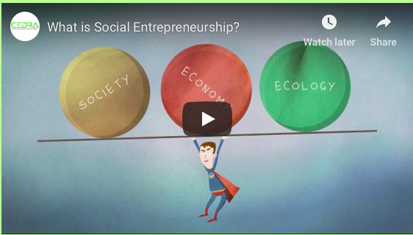

Slide 4
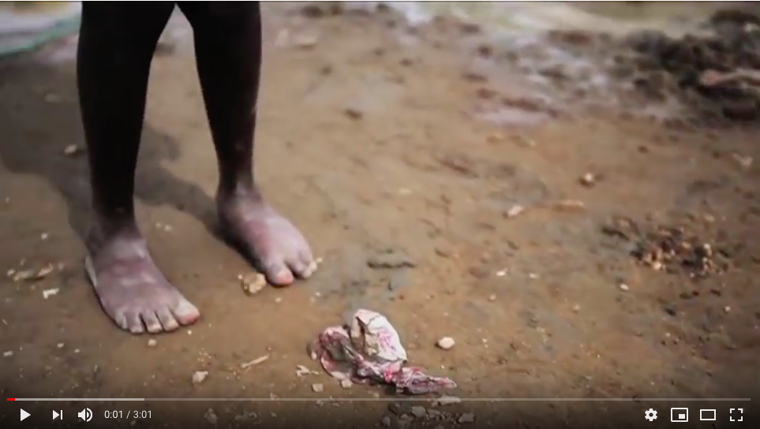
Social entrepreneurship definition:
Example:
Social entrepreneurs are entrepreneurs who use market-based ideas and practices to create “social value,” the enhanced well-being of individuals, communities, and the environment. Unlike ordinary business entrepreneurs who base their decisions solely on financial returns, social entrepreneurs incorporate the objective of creating social value into their founding business models.

Slide 5
Corporate Social Responsibility
Definition: Recognizing that companies should behave in moral and ethical ways towards people and places as part of their business model.

Slide 6
An example of why this is needed: The Rana Plaza Factory Disaster

Slide 7
Why is CSR needed? The Rana Plaza disaster
https://www.youtube.com/watch?v=9Fkhzdc4ybw
https://www.newsweek.com/world-environment-day-how-rana-plaza-disaster-changed-fashion-forever-957141
https://www.theguardian.com/global-development/2018/apr/24/bangladeshi-police-target-garment-workers-union-rana-plaza-five-years-on
https://www.nytimes.com/2018/04/24/style/survivors-of-rana-plaza-disaster.html
http://www.bbc.com/news/world-asia-22476774
What was the Rana Plaza disaster?
Why did it happen?
How have firms tried to improve CSR since this- has the CSR been implemented effectively?

Slide 9
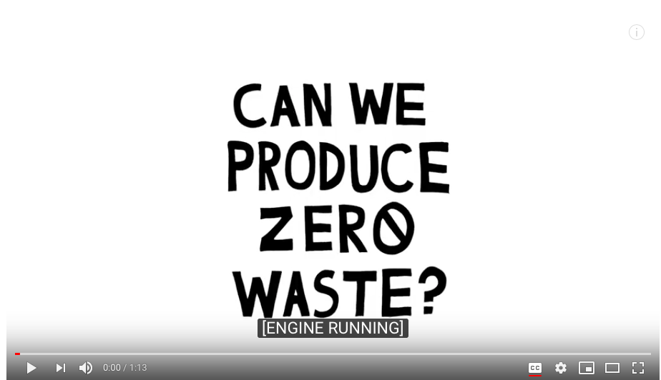
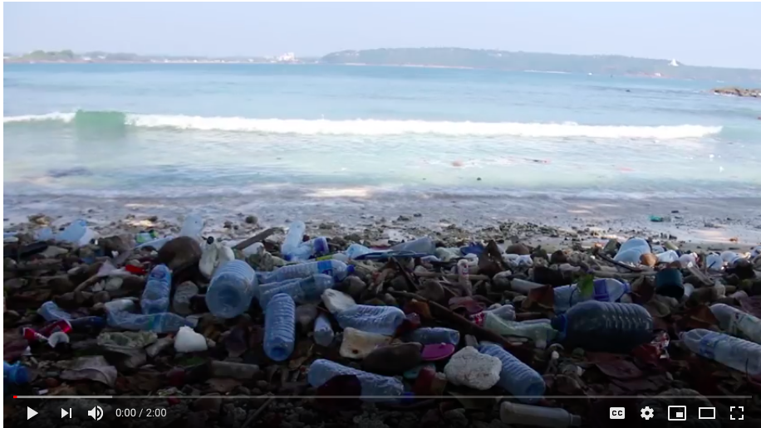
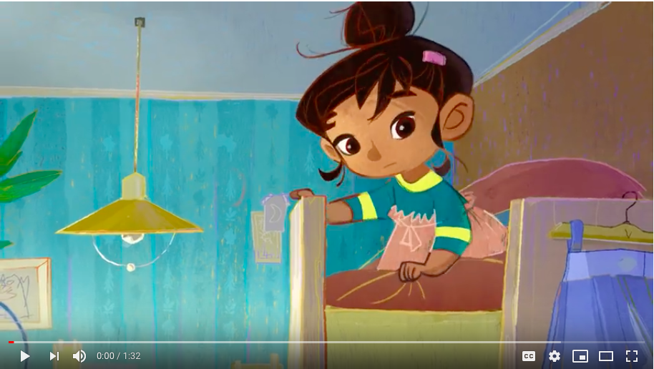
Corporate responsibility examples

Slide 10
Key questions corporate social responsibility
What is it?
How is it an important approach for closing the development gap?
What are the drawbacks?
Resources:
Study guide p50-52
IB textbook p580-581

Slide 11
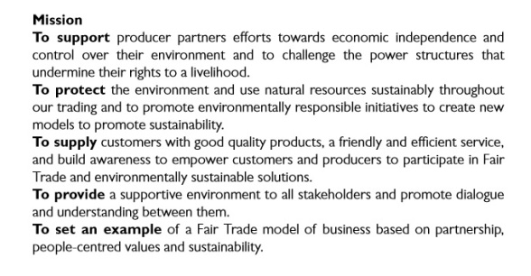
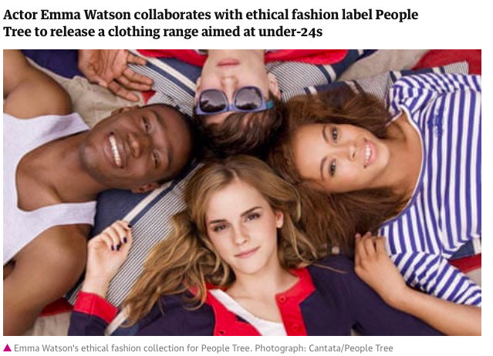
Solution: Fair trade fashion- People Tree
https://www.peopletree.co.uk
Guardian: Emma Watson launches ethical fashion range with People Tree

Slide 12
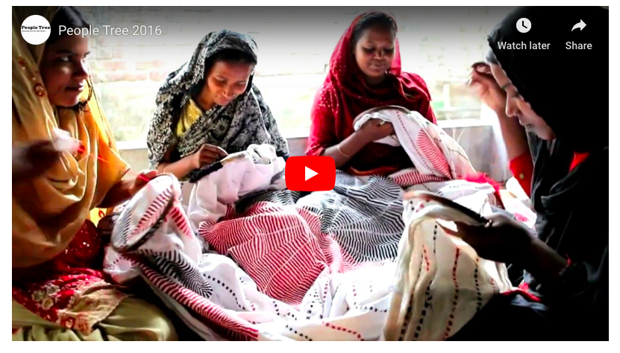

Slide 14
Fairtrade ‘not benefitting the poor’

Slide 15
Fairtrade key questions
What is fairtrade?
How is fairtrade an example of an alternative trading network?
How does fairtrade bring benefits to marginalized people?
What are the drawbacks of fairtrade?
Resources:
Study guide p49-50
IB Textbook p579-580

Slide 16
Exam question
“All forms of social entrepreneurship are well meaning but flawed.” Discuss this statement [16]

