Slide 1
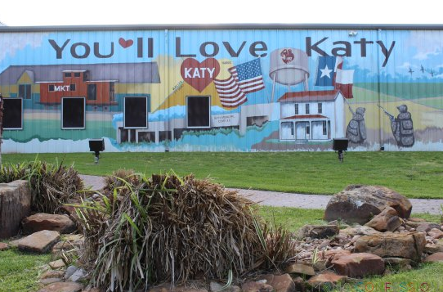
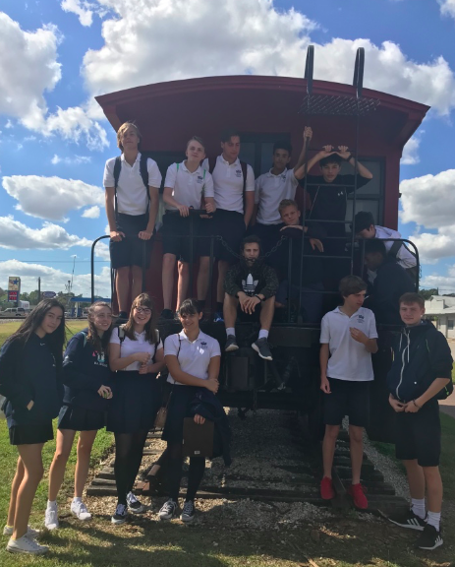
Overview of visited sites in Katy

Slide 2
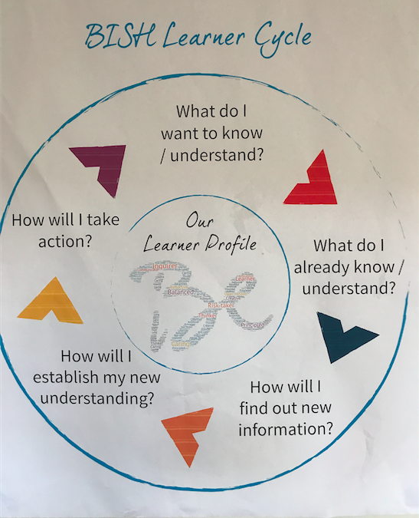

Slide 3
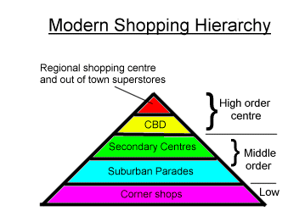
Historically, the ‘Downtown would have been Old Town Katy. Katy has now expended rapidly with many Master planned communities such as Cinco Ranch and so new ‘central areas’ such La Centerra have been constructed.
Katy Mills
Old Town Katy? La Centerra?
HEB/ Whole Foods?
In Katy this would be things such as garages or Walgreens etc

Slide 4
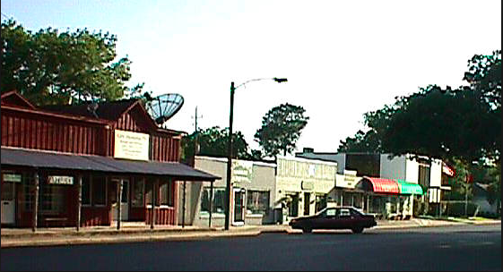
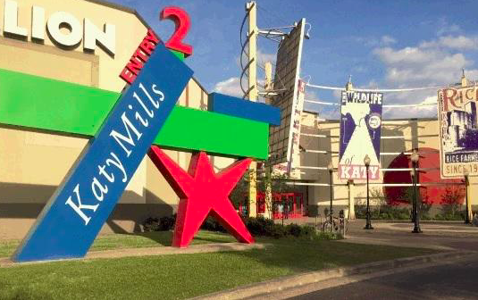
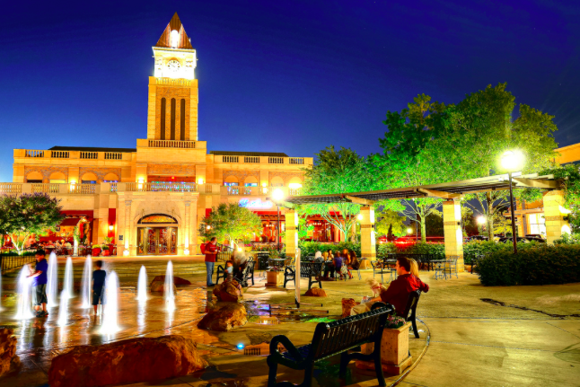
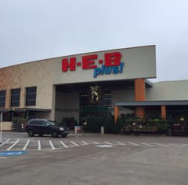
Sites

Slide 5
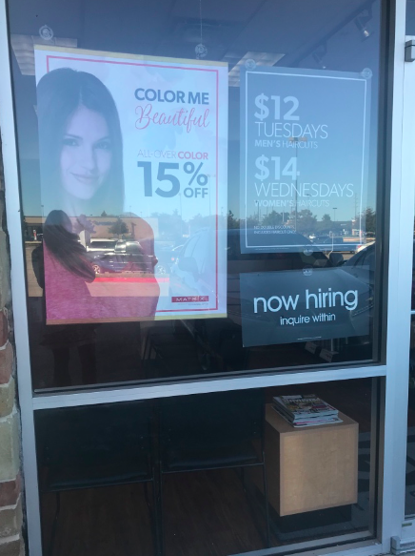
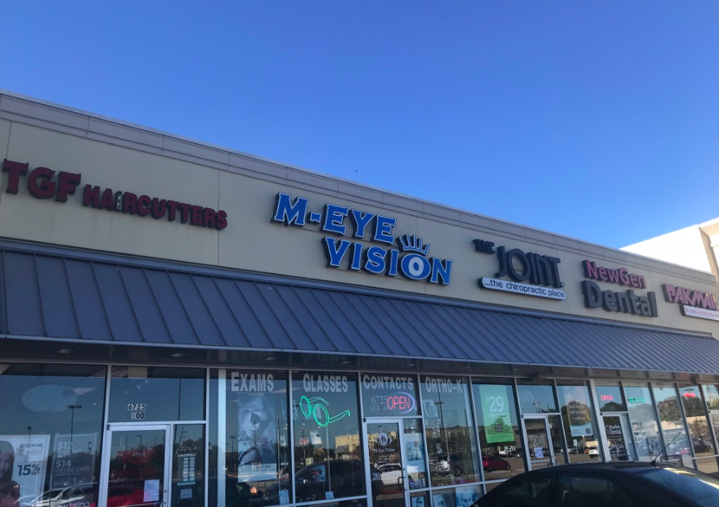
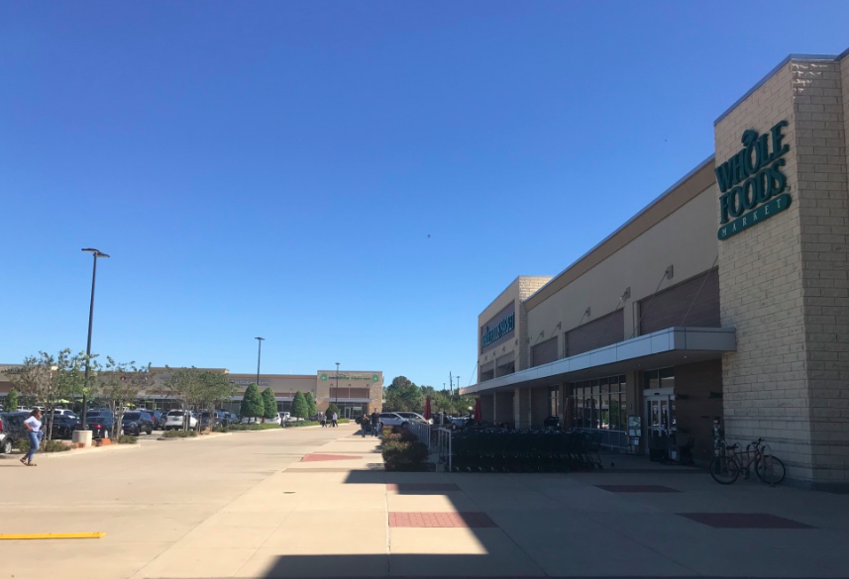
Site 1: Grand Parkway shopping centre (Whole Foods and HEB)
Many Low order services (hair dressers, nails etc)- probably hoping to obtain some of the trade from HEB
HEB- large local supermarket chain- ‘Plus’ means has more services such as toys
Low cost hair cuts
Whole Foods: High End, Specialist supermarket
Wealthy catchment area- Cinco Ranch
2 anchor supermarkets- many stores have located here because of these;Services i.e. banks, Nail salons and department style stores, world market, and low order restaurants

Slide 6
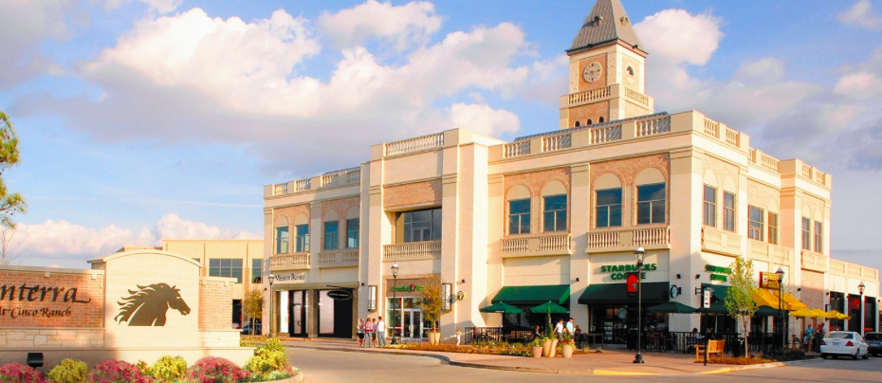
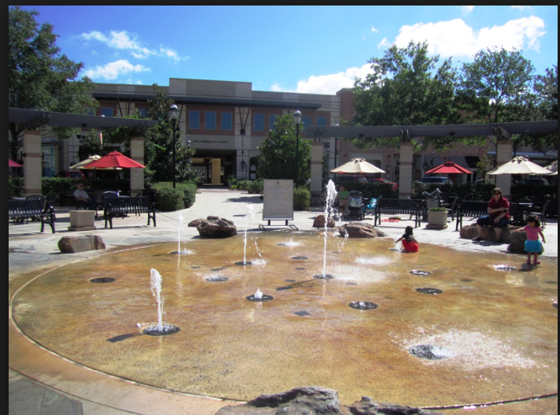
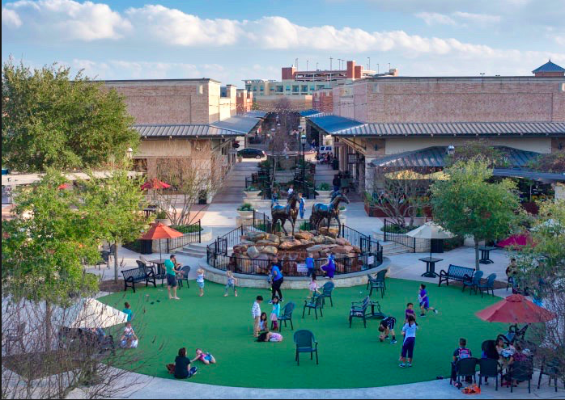
Site 2: La Centerra
Created to meet the demographics of the area- wealthy with families
A range of restaurants, shops and services
Landscaping such as lakes, village greens, and faux European architecture.
A range of activities held in the area to attract visitors such as family days and seasonal activities.

Slide 7
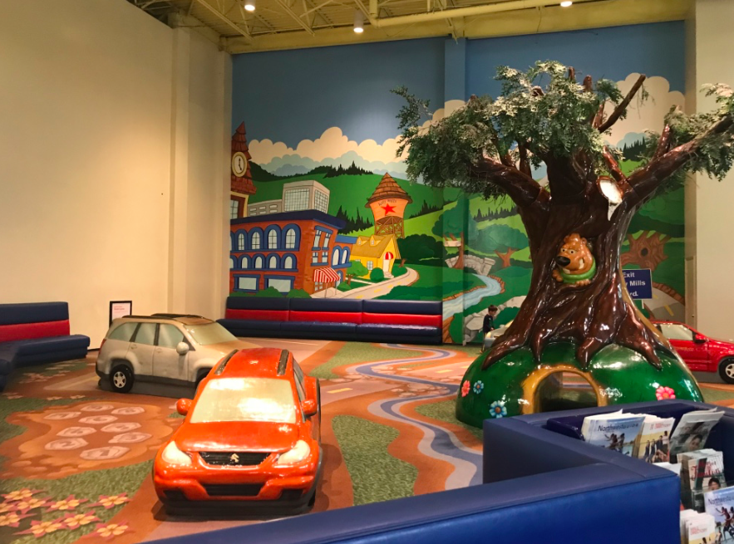
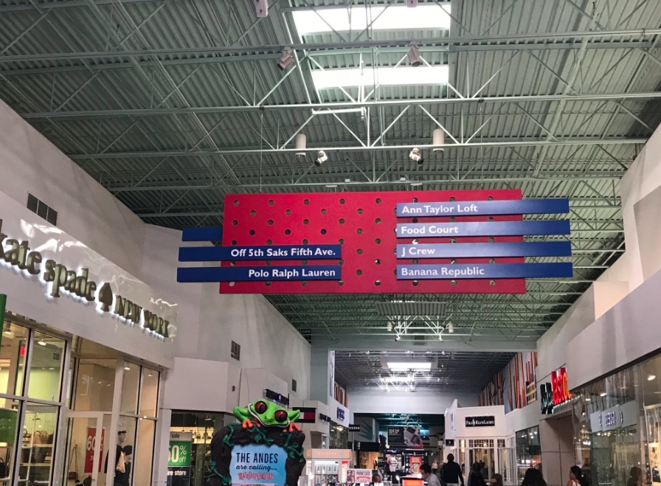
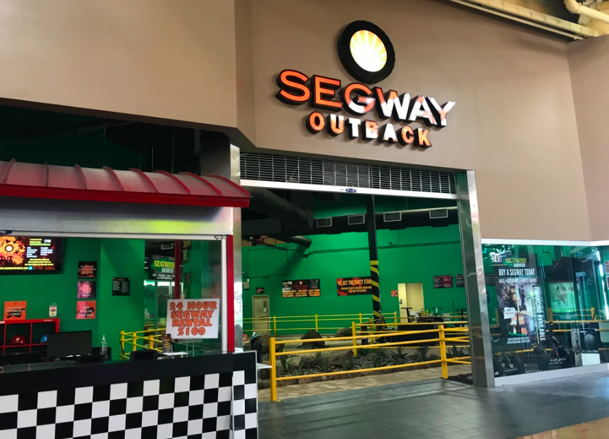
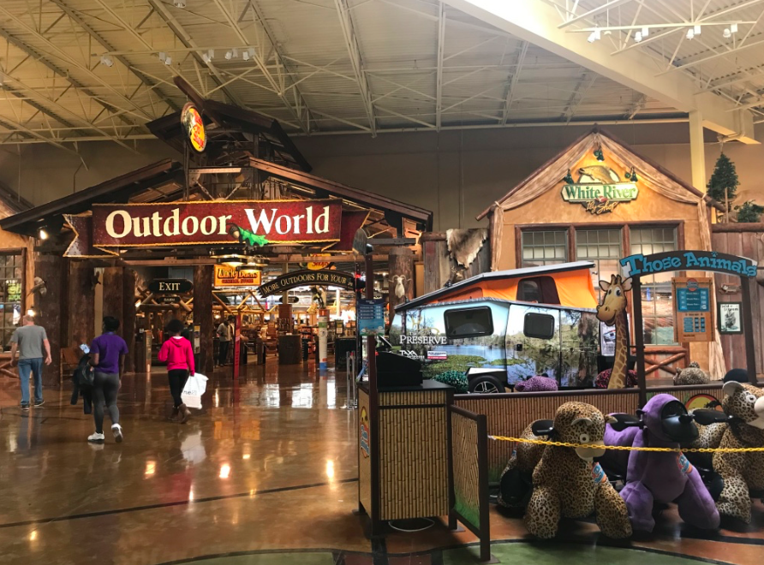
Site 3: Katy Mills
Mix of high end stores (but outlet)- mainly high order goods
Range of additional leisure activities such as playgrounds, amusements, cinemas etc

Slide 8
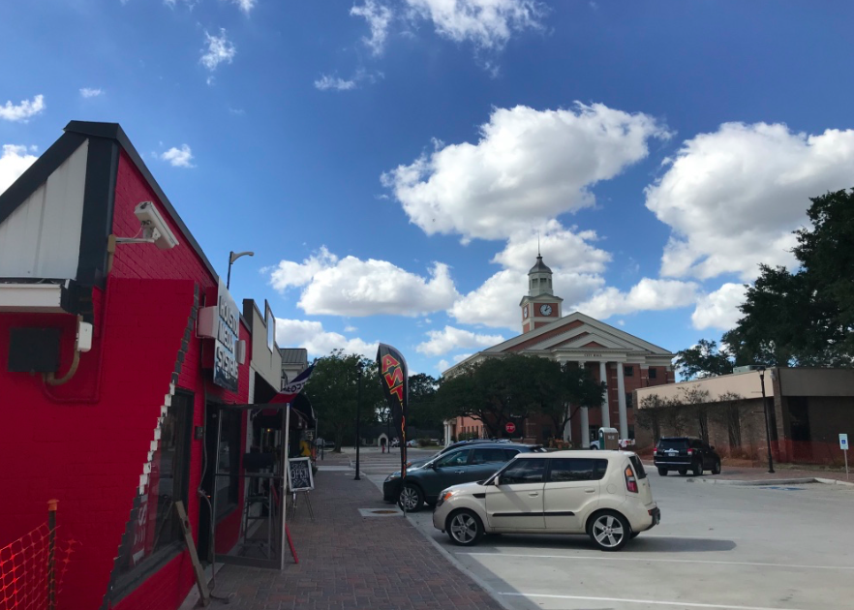
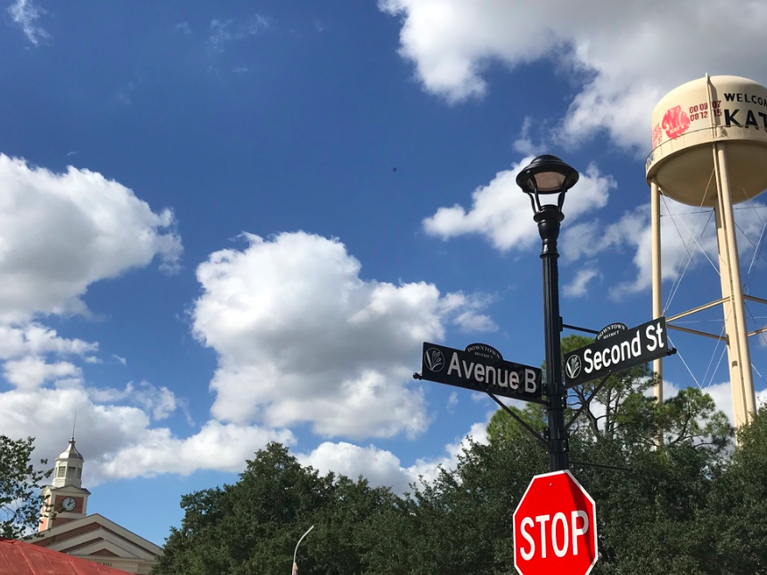
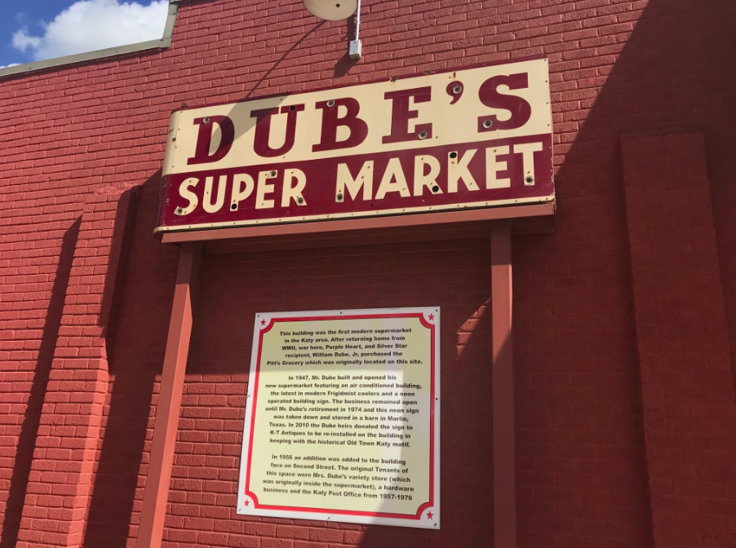
Site 4: Old Town Katy
Original Downtown of the city when it was a distinct settlement
Commercial Hub of Katy with City Hall etc
Old town feel- tried to maintain that look with architecture
Large amount of antiques stores
Flooded during Harvey
Very much local, independent stores

