Slide 1
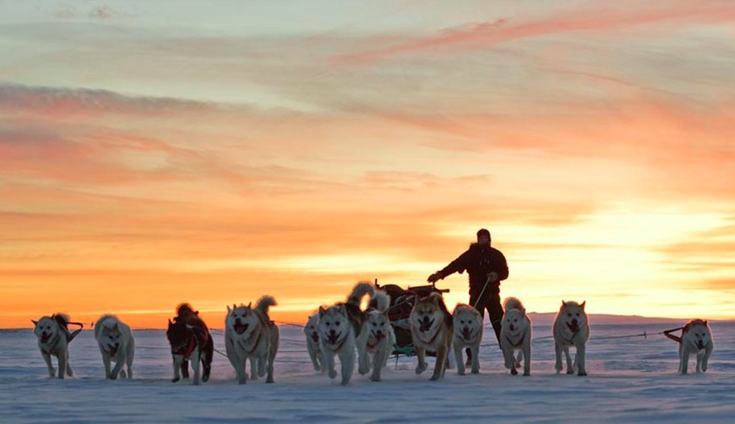
Surviving in an Extreme Environment
The Sirius Patrol

Slide 2
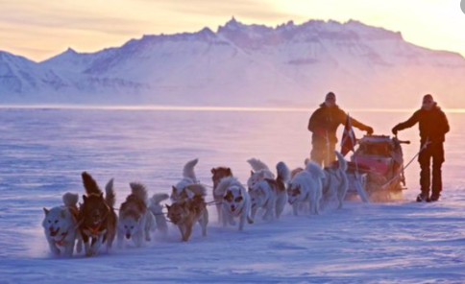
What: The Sirius Patrol Why: To understand how people survive in Extreme Environment (The Greenland National Park) How: To understand what the environment is like in Greenland and research what the Sirius patrol do and be ready to interview one of their former members.

Slide 3
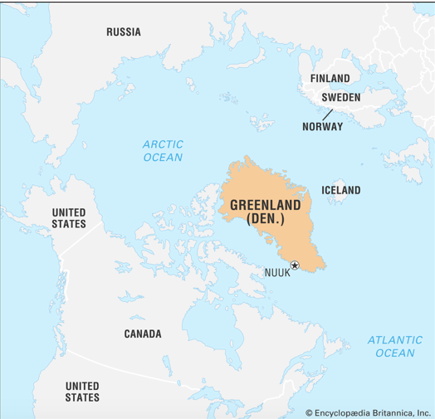
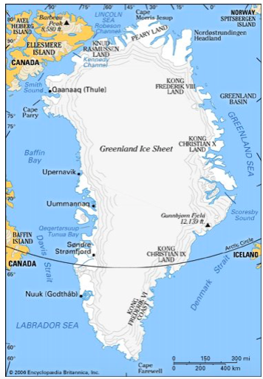
Where: Greenland
Although Greenland remains a part of the Kingdom of Denmark, the island’s home-rule government is responsible for most domestic affairs. The Greenlandic people are primarily Inuit (Eskimo). The capital of Greenland is Nuuk (Godthåb).
Greenland, the world’s largest island. More than three times the size of the U.S. state of Texas, Greenland extends about 1,660 miles (2,670 km) from north to south and more than 650 miles (1,050 km) from east to west at its widest point. Two-thirds of the island lies within the Arctic Circle, and the island’s northern extremity extends to within less than 500 miles (800 km) of the North Pole.

Slide 4
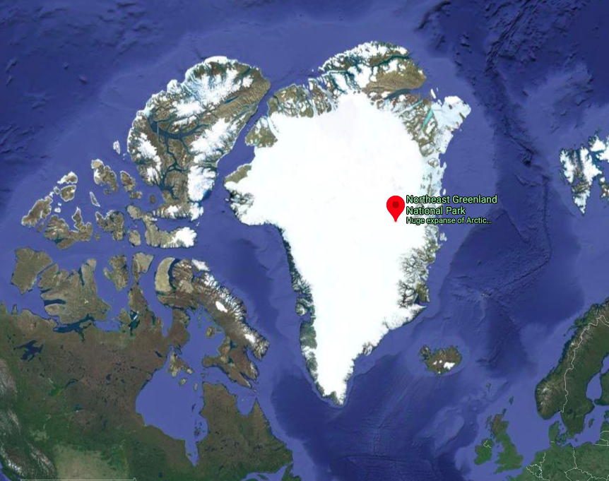
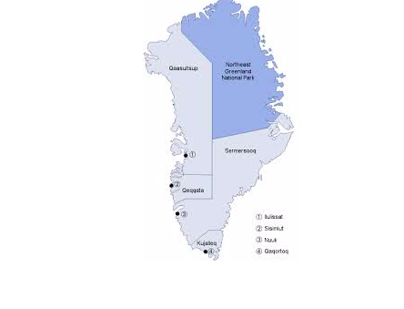
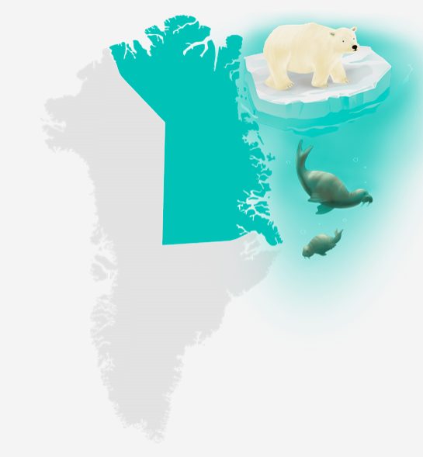
Where: The Greenland National Park
Covering an area of 972,000 square kilometres (approx. size of France and Spain combined), Greenland’s National Park is the world’s largest. The coastline is 18,000 km in total and includes both the highest parts of the Northern Hemisphere’s largest ice cap and the world’s northernmost area of land.

Slide 5
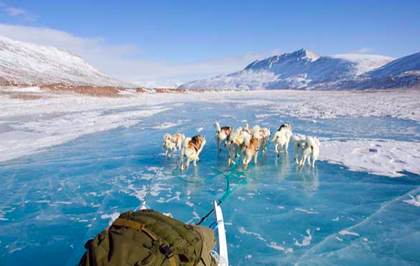
The only people who live permanently in the vast area are a small group of people totalling approx. 40 people over five settlements – the staff at weather and monitoring stations.

Slide 6
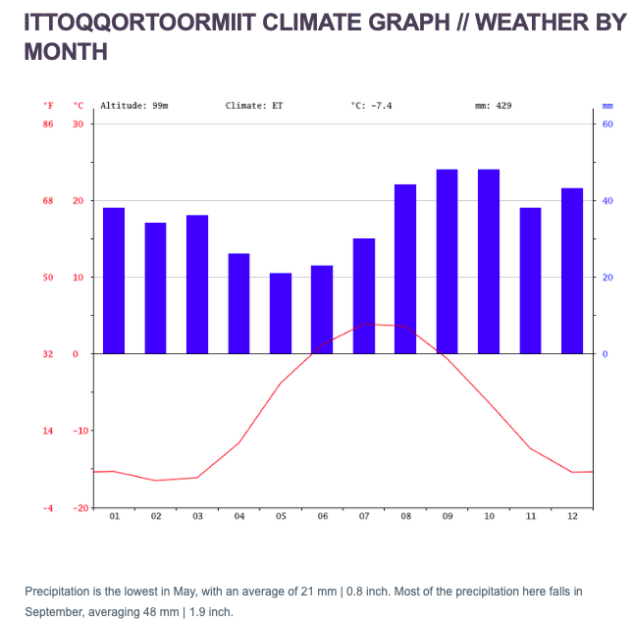
The climate in Greenland National Park

Slide 7
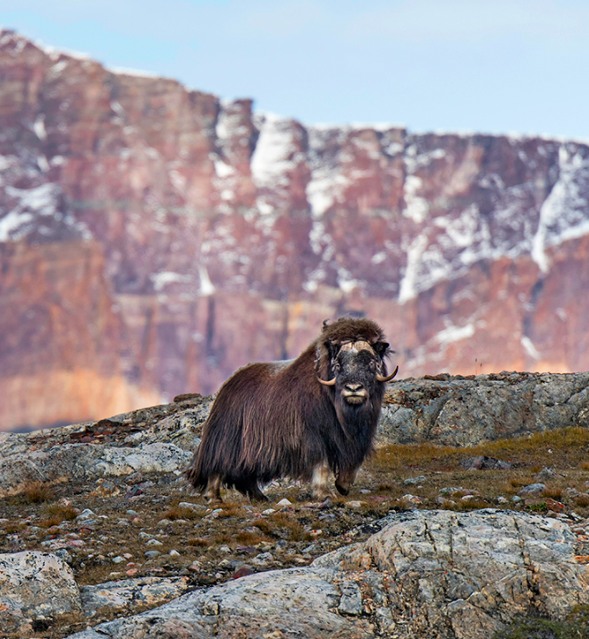
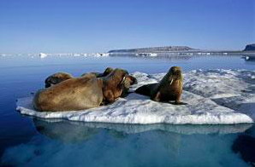
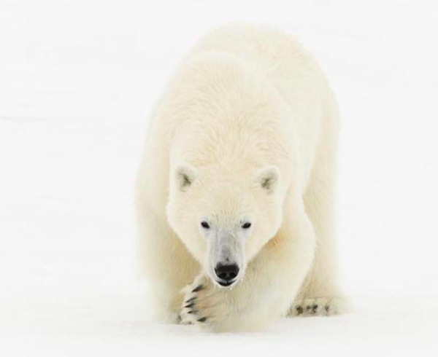
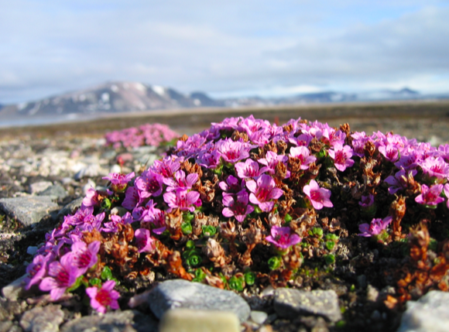
The wildlife
There’s more animals than people
The park’s huge interior is home to a wide range of wildlife: polar bear, reindeer, arctic fox, walrus, musk oxen, and a staggering number of birds including barnacle geese, common eiders, snowy owls, ptarmigans, ravens, and the white-tailed eagle. And the bordering ocean contains an abundance of humpback, minke, beluga, and fin whales, plus ringed seals, bearded seals, harp seals, and hooded seals.
The two northernmost flowers in the world flourish here
Life finds a way—even in Arctic temps and rocky terrain! A mere 434 miles from the North Pole, on Peary Land, an entirely ice-free peninsula located at the most northern tip of the park, you’ll find two tiny flowering plants making a cozy home: Saxifraga oppositifolia (purple saxifrage) and Papaver radicatum.
https://www.expeditions.com/blog/greenland-national-park-by-the-numbers/

Slide 8
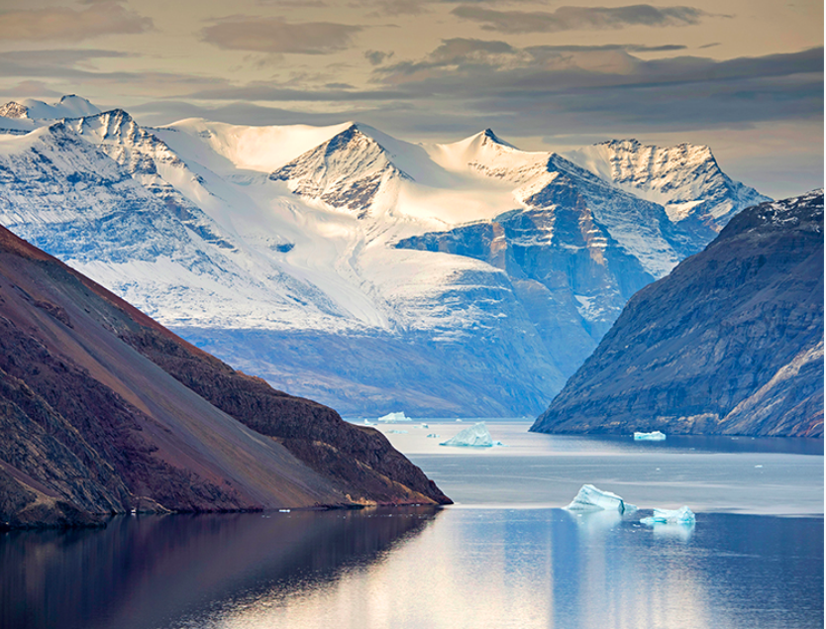
Task 1: Create a Fact-file about the Greenland National Park
Area Total:
Population:
Average summer temperature:
Average winter temperature:
What is the environment like:
Describe how this is an Extreme Environment:

Slide 9
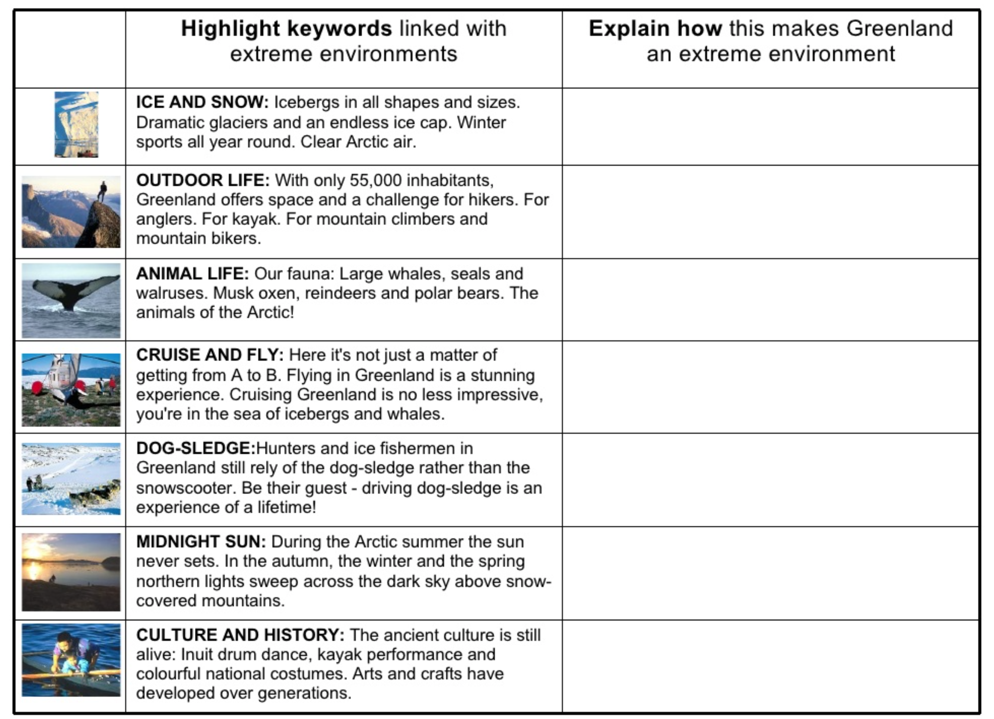
Evidence that Greenland is an extreme environment

Slide 10
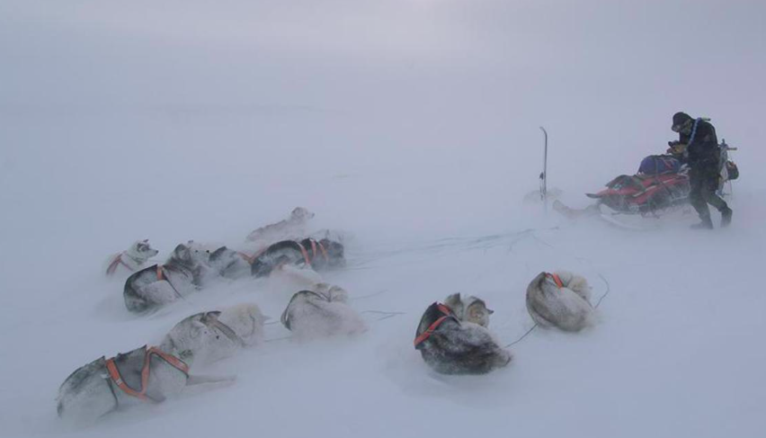
Who: The Sirius Patrol
The Sirius Patrol has its main base at Daneborg in Northeast Greenland. The Patrol is responsible for monitoring the area by dogsled and sailing. The patrol enforces Danish sovereignty in the Arctic wilderness of northern and eastern Greenland. They also have to control expeditions and conservation regulations in the national park. The weather stations at Station North and in Denmark’s Harbour are also staffed. The main task of the staff in Denmark’s Harbour is to launch a weather balloon twice a day with measuring instruments.

Slide 11
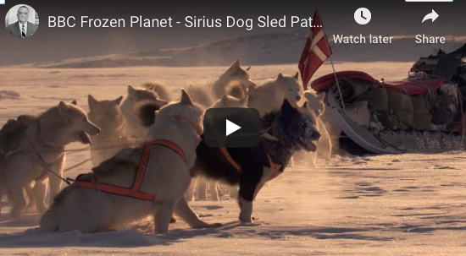
What and Why: Do the Sirius Patrol do?
Task 2: Watch either the frozen planet video clip, and/ or the article embedded on the Weebly ‘The world’s most unusual military unit’
Make notes on:
What the Sirius Patrol do
Why do they do this?
What difficulties may they face?
Things to include:
Climatic research including the impact of climate change
Environmental preservation
Defence
Tourism
Resources

Slide 12
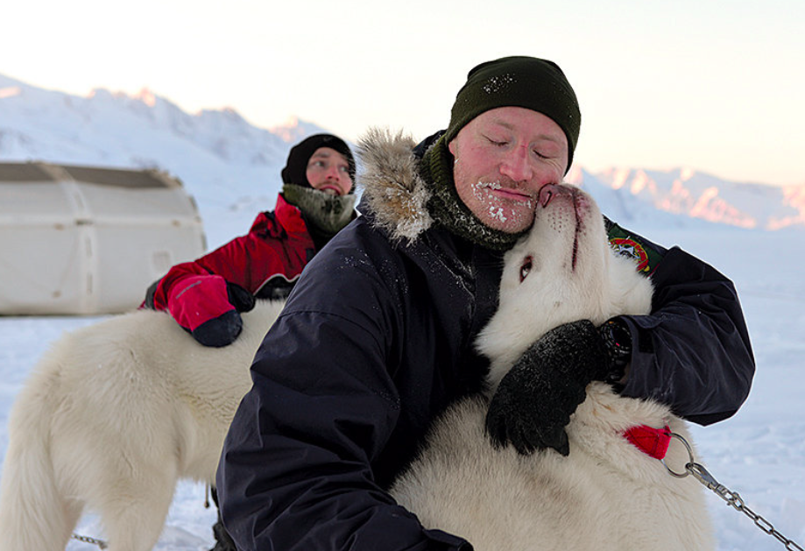
Anders Kjærgaard
We are extremely lucky to have a live link up with Anders Kjærgaard who was part of the Sirius Patrol on Thursday June 3^{rd.} .
He will be giving us a overview of his life and work with the Sirius Patrol and you have the opportunity to ask him questions about his experiences.
Task 3: Write 1 or 2 questions for Anders about his time with the Sirius patrol ready for the presentation on the 3rd June.
Send to Mrs. Bennett by Friday 28th May so I can pass them on on advance.

Slide 13
Blog/Diary Entry/ video or written news report or presentation for your family- your choice
What: Based on your learning about the Sirius Patrol from your research and the live interview with Anders Kjærgaard imagine you are part of the Sirius patrol or you have spent some time with the Sirius Patrol.
How: Blog/Diary Entry/ video or written news report or PPT presentation for your family or Infographic- your choice
Success criteria/ things you could include:
What is the environment like?
How is it different from home?
What tasks do you perform?
Why are these tasks performed?
What is your daily routine?
What do you like?
What do you dislike?
What might be interesting to tell people who have never have been here?

