Slide 1
Singapore population policies
Mary, Abril, Janire, Max, and Caelan.

Slide 2
Pronatalist policy.
Tring to increase birth rate. You cannot force people to have children, so you have to offer incentives.
-Such as money, extended maternity leave and paternity leave and pay, free or subsidized child care, healthcare and education.

Slide 3
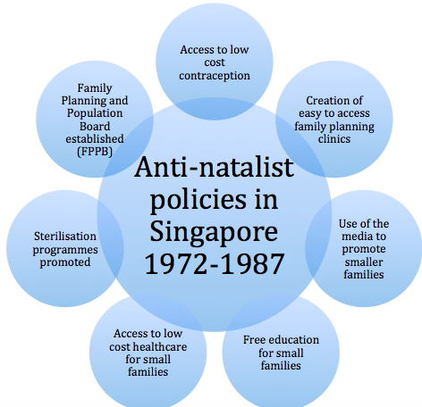
Where this started
Anti-natalist policies 1972-1987: "Stop at Two"

Slide 4
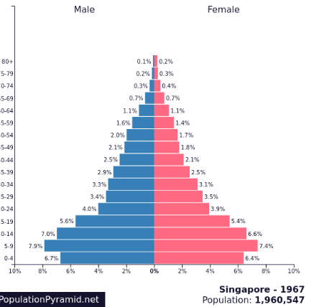
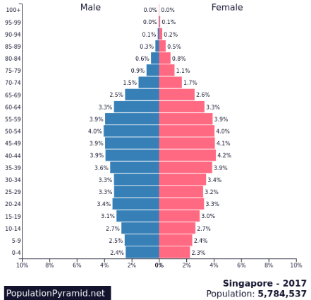
The problem at hand

Slide 5
Case study

Slide 6
Marriage and parenthood packages.
Making it faster and easier to get housing to support early marriage or birth, providing support for contraception and delivery costs, further defraying child raising costs including healthcare costs. Middle-income Singaporean households enjoy $24,000 in Baby bonus cash. And all of these offers are worth $198,000 until both the children turn 13.
The size of Singapore is 710.2 km², so less area means that space is at a premium and housing is expensive. Bigger houses offered as a result of having more children are truly valued as a result.
Slogan changed from ‘stop at two’ to ‘have 3 if you can afford it’. This policy was only aimed at the more affluent educated people as they want to maintain their status in the world economy (5th highest GDP in the world)
1966-1982, Singapore had an anti-natalist policy, but the policy worked too well therefore a Pronatalist policy had to be introduced in 2001.

Slide 7
Problems for the protagonist policy
Lifestyle choice – Some people choose to remain single, get married older or have fewer children. Average age of marriage increases over 2008 to 2012: males from 29.8 to 30.1 and for females, from 27.3 to 28. Fertility rates (per female) have increased from 1.15 to 1.29, however this is nowhere near the replacement rate they would like.
Financial consideration – there is a high cost of living in Singapore. Parents want higher standards for children therefore work longer and have fewer children.
Abortion is common – 1 in 4 pregnancies are terminated, divorces are rising and number of childless couples is 6% and rising.
Social barrier – Highly educated women tend to have more difficulty with finding suitable spouses. A solution for this would be the Romanticizing Singapore scheme

Slide 8
Romanticizing singapore scheme:
Social barrier – Highly educated women tend to have more difficulty with finding suitable spouses.
State sponsored matchmaking events
Rock climbing for couples
Love boat river race
Private sponsors have made their own contributions including spa packages and tango parties
Weekend getaways like a love boat cruise
Pizza hut offering a 3-course ‘love meal’ including a heart shaped pizza.

Slide 9
Other ways to boost population:
Importing foreigners can boost population size and sustain economic growth
However Large number of foreigners. Only 74% of singapore is Singaporeans and the government wants the cultural mix to stay the same, so foreigners are subject to ‘stop at two’ policy. This could create a wide culture or conflict.

