Slide 1
Singapore
Pro-natalist Policy
LO: to explain why Singapore wanted to encourage population growth and how they did it

Slide 2
Pro natalist policy
A policy that tries to increase birth rates. You can not force people to have children, so you have to offer incentives e.g. free education.

Slide 3
Pro-natalist Policies
You can not physically force people to have children, so pro-natalist policies normally work by offering several incentives.
Incentives may include:
Money
Extended maternity and paternity leave and pay (maternity leave is time off work given to the mother after she has given birth, paternity leave is time off given to the partner after the mother has given birth - in most countries paternity leave is very short (maybe 2 weeks and often unpaid)
Free or subsidised childcare
Free or subsidised education and healthcare

Slide 4
Population pyramid for Singapore- what does this tell us?

Slide 5
The policy…..
Why did they decided they needed more babies….?
What did they do (what were the incentives?….?
Who did it involve…..?
Was it successful? ….?

Slide 6
“To sustain growth and vitality in our economy, we need a growing population in Singapore with talents in every field.”
Said by Senior Minister Mr Goh Chok Tong on August 19th, 2006

Slide 7
NIC (newly industrialised country)
Independence in 1963 and since, the citizens’ standard of living risen dramatically.
It is the 5th wealthiest country in the world in terms of GDP per capita.
710.2 km2 – London is 2.4 times the size of signapore

Slide 9
Anti Natal
The population doubled from 1947 to 1970.
The Anti-natalist policy 1966-1982
Government only wanted them to have 2 children
Policy worked too well

Slide 10
How did they solve it?
They introduced a pro-natalist policy to promote having babies. In 2001.
The slogan switched from ‘stop at two’ to ‘have three, if you can afford it’
Their target was to increase the population by 40% over 40 years

Slide 11
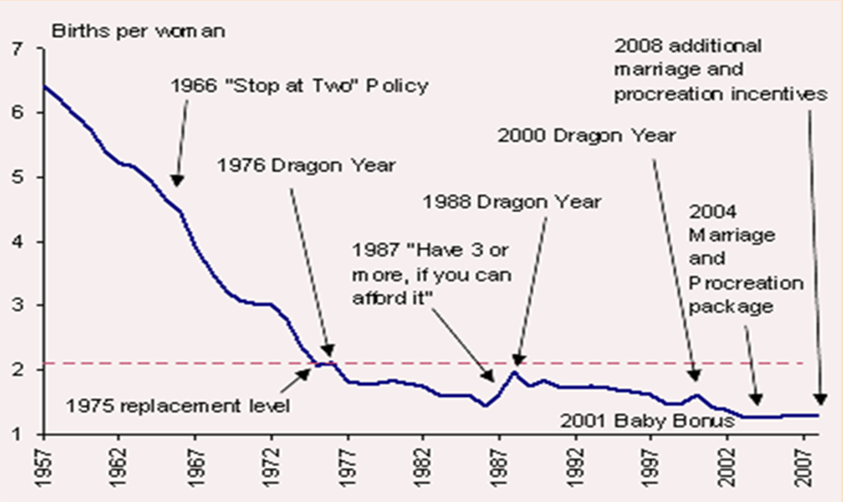

Slide 12
Techniques they used to convince people to have more babies
2 children = $10,000
And then tax relief on third child
Increase maternity leave from 8 weeks to 12.
Shorter work so singles got together.
Cheap nurseries
Preferential access to the best schools
Spacious apartments

Slide 14
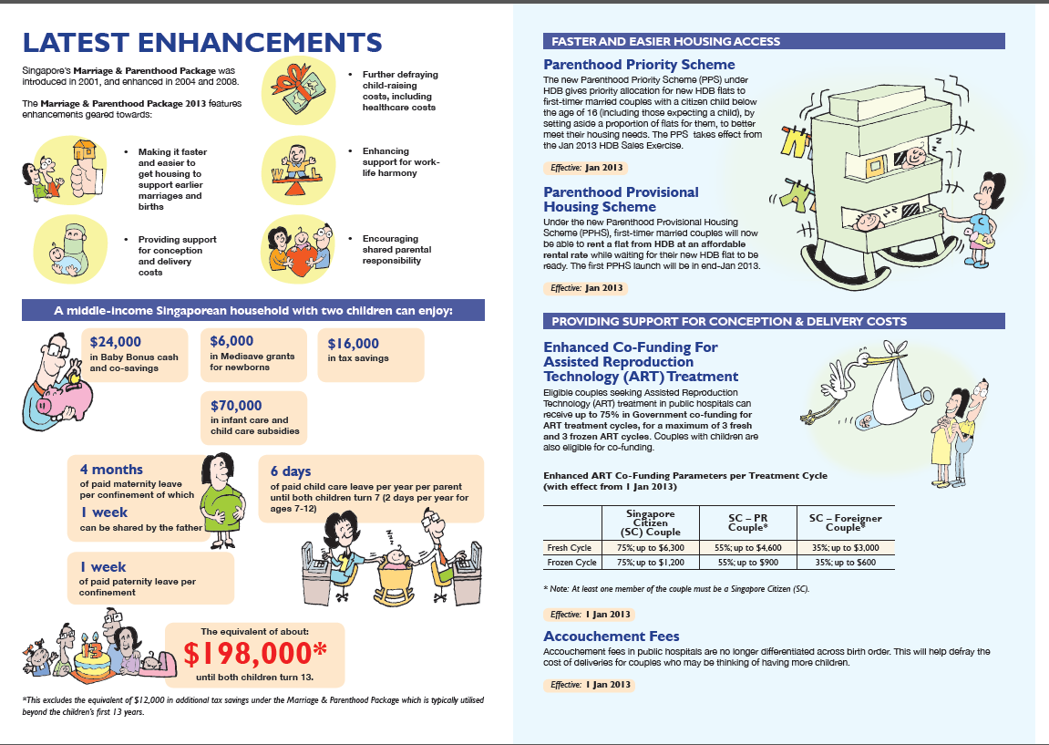

Slide 15
Problem 1
Social Barrier:
The highly educated women tend to have more difficulty with finding more suitable spouses.

Slide 16
Romancing Singapore!
state-sponsored matchmaking events
rock climbing for couples,
a love boat river race,
vertical marathon called “lovers’ challenge” in which couples run up a 43-storey office tower.
Private sponsors have made their own contributions:
tango parties
spa packages
Weekend getaways like a “love boat cruise” to a luxury resort with sex counselors, fertility seminars, therapeutic massages and a host of aphrodisiacs from which to choose.
Even Pizza Hut offers a three-course “love meal”
including a heart-shaped pizza.

Slide 17
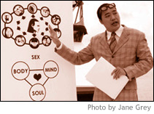

Slide 18
Problem 2
Life style choice:
Some people choose to remain single, get married older or have fewer children.

Slide 21
Romancing Singapore!
state-sponsored matchmaking events
rock climbing for couples,
a love boat river race,
vertical marathon called “lovers’ challenge” in which couples run up a 43-storey office tower.
Private sponsors have made their own contributions:
tango parties
spa packages
Weekend getaways like a “love boat cruise” to a luxury resort with sex counselors, fertility seminars, therapeutic massages and a host of aphrodisiacs from which to choose.
Even Pizza Hut offers a three-course “love meal”
including a heart-shaped pizza.

Slide 23
Problem 3
Financial Consideration:
High cost of living
Parents want higher standards for children therefore they work longer and have fewer babies.

Slide 24
Explaining key features of the policy:
To overcome worker shortages, the Singapore government has encouraged immigration, but it is also trying to increase the population through raising birth rates. The government is doing this in a number of ways:
It has increased maternity leave and it will cover the cost of maternity leave for the first four babies. This incentive means that parents do not have to worry about the security of their work if they decide to have children which is important due to the high status of women in Singapore and their desire for successful careers.
The government is also increasing child benefits paid to families. For example, the government will pay money into a special bank account. By doing this, families do not need to worry about the costs of having children and can instead focus upon the benefits of family life. As an HIC the cost of living is very expensive.
The government has also sponsored dating organizations to encourage people to get married earlier and start having children as people are too busy to date due to busy careers.

Slide 25
Other problems, slowing population growth
Abortion is common – ¼ pregnancies are terminated
Divorce rates are rising
Family values are strained
Number of childless couples is 6% and rising

Slide 26
Were there other ways to boost Singapore’s population?
Singapore has experienced that importing foreigners can boost population size and sustain economic growth- but it is only encouraging graduates.
It already has a large amount of foreigners, only 74% are Singaporeans- the government wants the current cultural mix to stay the same- ‘foreigners’ are still subject to the ‘Stop at two’ policy
It could create a wide culture or conflict.

Slide 28
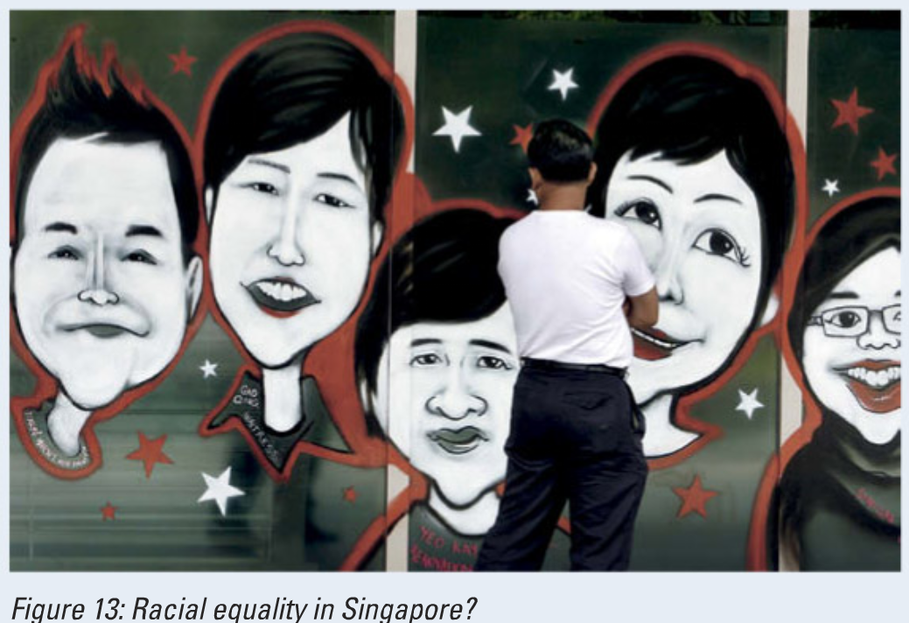

Slide 30
The policy…..
Write a bullet point summary of the main points from the Singapore case study
Include:
Why did they decided they needed more babies….?
What did they do (what were the incentives?….?
Who did it involve…..?
Was it successful? ….?

