Slide 1
Settlement Patterns
Objective:
To be able to recognise the physical shape of settlements and to be able to explain why they look like that.
To practice using OS maps

Slide 2
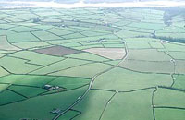
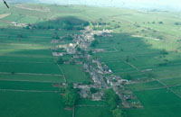
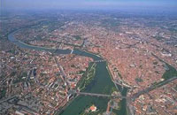
Settlement Patterns
Dispersed
Linear
Nucleated
What would influence the development of these settlement patterns?

Slide 3
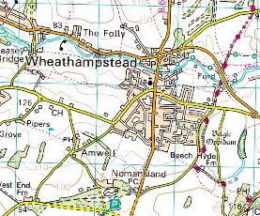
Nucleated, Linear or Dispersed?
Why?

Slide 4
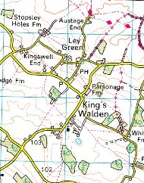
Nucleated, Linear or Dispersed?
Why?

Slide 5
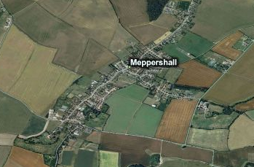
Nucleated, Linear or Dispearsed?
Why?

Slide 6
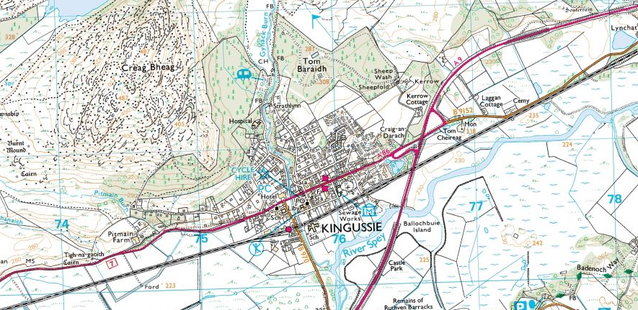
Nucleated, Linear or Dispersed?
Why?

Slide 7
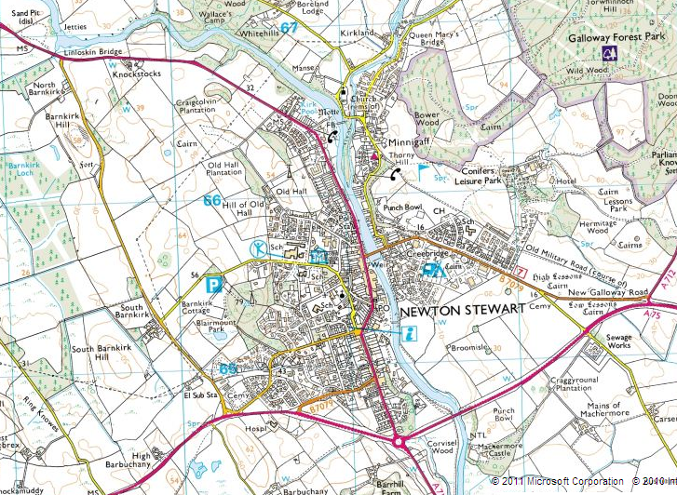
Nucleated, Linear or Dispersed?
Why?

Slide 8
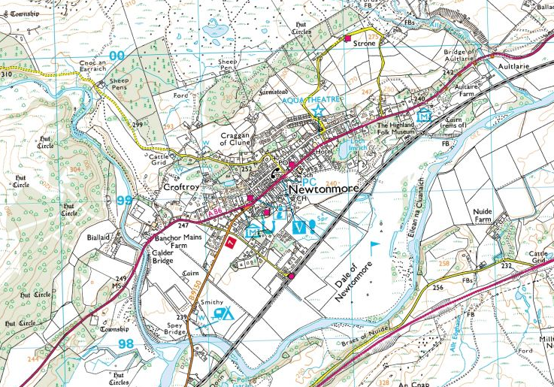
Nucleated, Linear or Dispersed?
Why?

Slide 9
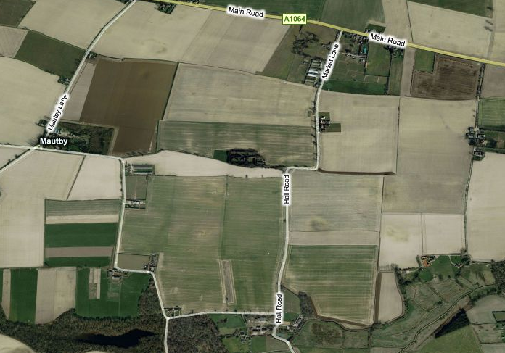
Nucleated, Linear or Dispersed?
Why?

Slide 10
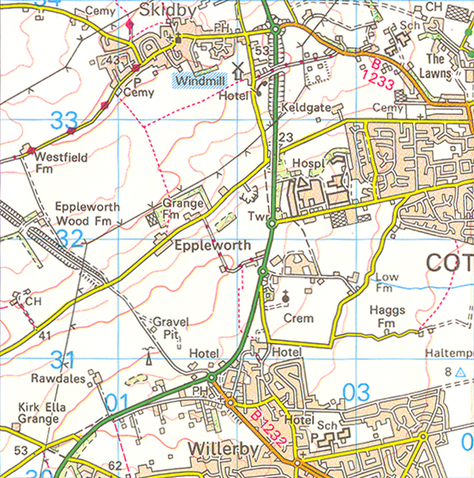
Ordnance survey
Ordnance Survey (OS) is Britain’s national mapping agency.
They produce most of the commonly used maps and map data for the British Isles.
What map features tell you what the land is like?
N
What map features would help you navigate?
1km
Scale 1:50 000
Notes:
Map credit: Reproduced by permission of Ordnance Survey on behalf of HMSO.
© Crown Copyright 2008. All rights reserved. Ordnance Survey Licence number 1000 46271.

Slide 11
Ordnance survey
OS maps contain:
symbols and place names
contour lines and spot heights
a scale
grid references and grid lines
orientation
N
1km
Scale 1:50 000
Notes:
Map credit: Reproduced by permission of Ordnance Survey on behalf of HMSO.
© Crown Copyright 2008. All rights reserved. Ordnance Survey Licence number 1000 46271.

Slide 12
Settlement Patterns and Hierarchy
Using your OS map find as many examples of settlement patterns as you can and fill in the table below.
Village Name
Grid Reference
Settlement Pattern
Reason
Use both the paper and digital versions of the OS maps
Online login: deanna.thompson@bishouston.org
Geography
Choose a location in the UK you would like to look at (it is better if it is rural).

Slide 13
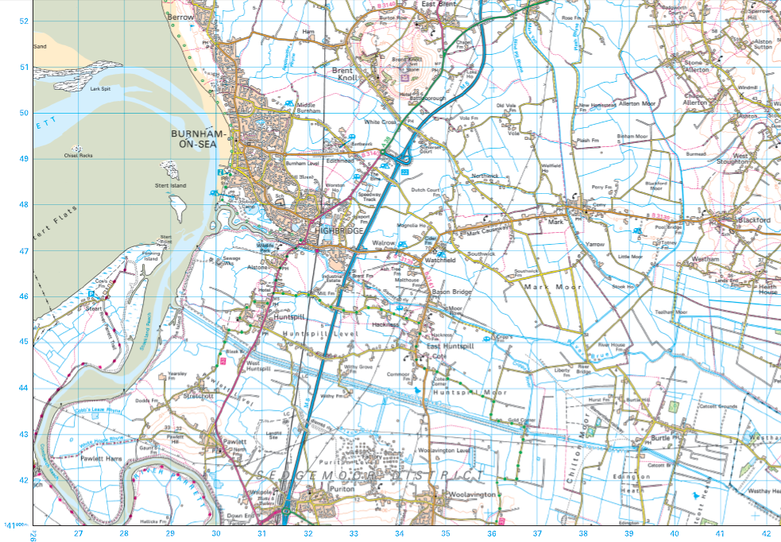
Map skills using Burnham on Sea Map
Initial general observations of the map

Slide 14
Steep hill
Very straight/ linear road network
Main settlement
Mud
M5-major road
Extensive drainage network
Generally flat land
A lot of farm land…could be allowed to flood

Slide 15
Questions using Burhnam map
Name a linear, dispersed and nucleated settlement (3)
What is the 4 figure grid reference of Pawlett (1)
What is the 4 figure grid reference of Alston Sutton (1)
Where would you place the following settlements on the settlement hierarchy and why?
Burhnam (1+1)
Mark (1+1)
Vole Farm (1+1)
Extension:
5. Describe the distribution of settlements on the map (4)
6. Explain why this distribution may have occured (4)

Slide 16
Questions using Exeter map
Name a linear, dispersed and nucleated settlement (3)
What is the 4 figure grid reference of Broadclyst (1)
What is the 4 figure grid reference of Lympstone (1)
Where would you place the following settlements on the settlement hierarchy and why (use evidence from the map?
Exeter (1+2)
Exmouth (1+2)
Otterton (1+2)
Extension:
5. Describe the distribution of settlements on the map (4)
6. Explain why this distribution may have occured (4)

Slide 17
Questions using Purbeck map
Name a linear, dispersed and nucleated settlement (3)
What is the 4 figure grid reference of Shipton Gorge (1)
What is the 4 figure grid reference of Uplolders(1)
Where would you place the following settlements on the settlement hierarchy and why (use evidence from the map?
Dorchester (1+2)
Shipton Gorge (1+2)
Westfleet farm (1+2)
Extension:
5. Describe the distribution of settlements on the map (4)
6. Explain why this distribution may have occured (4)

Slide 18
Questions using Ben Nevis map
Name a linear, dispersed and nucleated settlement (3)
What is the 4 figure grid reference of Roybridge (1)
What is the 4 figure grid reference of Tullock (1)
Where would you place the following settlements on the settlement hierarchy and why?
Fort William (1+2)
Spearn Bridge(1+2)
Annat Farm
Extension:
5. Describe the distribution of settlements on the map (4)
6. Explain why this distribution may have occured (4)

Slide 19
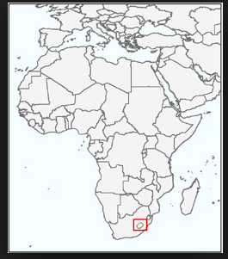
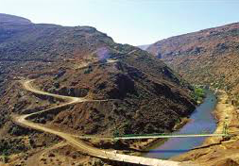
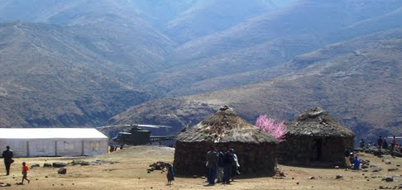
Rural Settlement- Tsoelike Valley, Lesotho
Task: Read page 47-48 of textbook. Answer al questions in box 5 in detail
Extension: Use this link to play with the activities based on this case study: https://quizlet.com/106861926/settlement-in-the-tsolike-valley-lesotho-ledc-flash-cards/
What factors have influenced the settlement pattern in this area?

