Slide 1
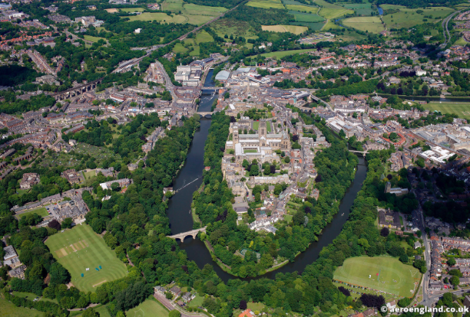
Introduction to settlements
Objective: To be able to explain how physical factors (relief, soil, water supply) and other factors such as accessibility, agricultural land-use, influence the sites and patterns of settlements.

Slide 2
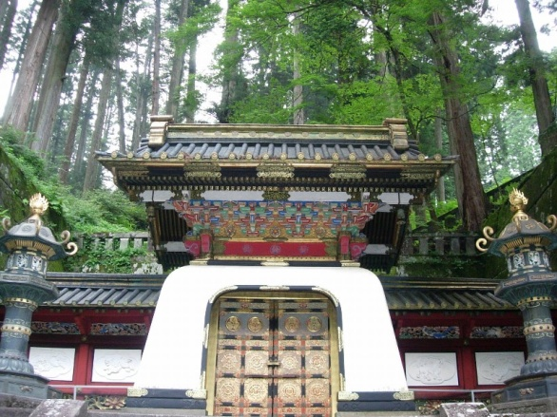
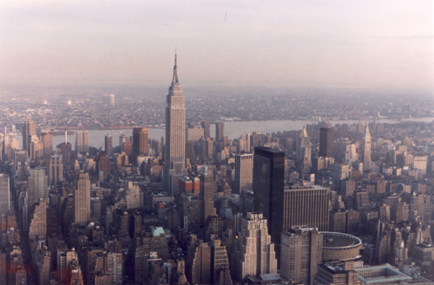
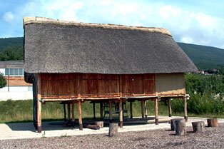
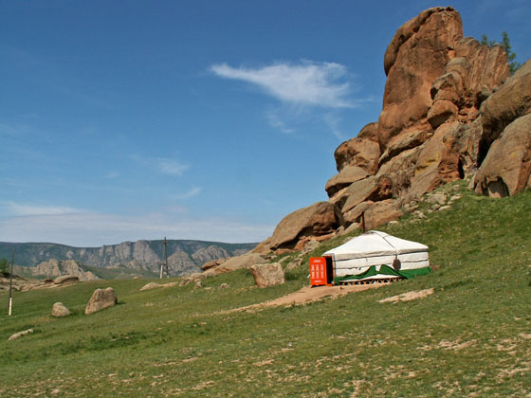
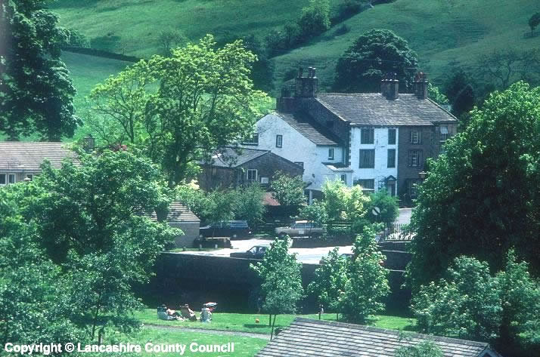
What do all these photos have in common?
They are all places where people live (settlements)!

Slide 3
Settlement
Settlement - A place where people live. A settlement can range from one isolated building to a capital city with over 20 million people like Mexico City.

Slide 4
What is a settlement?
Settlement site: The physical land on which a settlement is built.
Settlement situation: The location of a settlement in relation to other places.

Slide 5
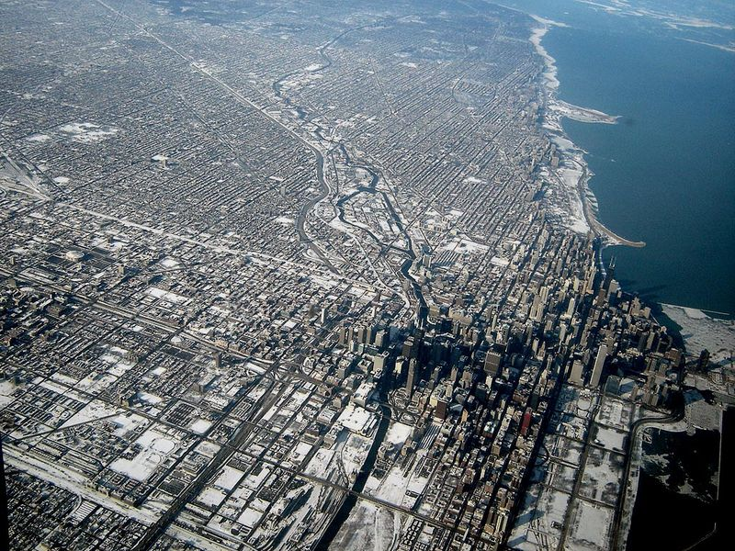

Slide 6
Starter
Key words
Early settler- someone who created the first places where people live.
Natural- Things that are not man made e.g. trees
Settlement- a place where people live e.g. town, city, village.
You are an early settler before the times of nice homes with running water and heating.
What natural factors would influence where you would build your settlement?
Think!
There is no running water, bricks, internet, electricity etc.
Where are you going to get water from?
Where are you going to get heat for cooking and keeping warm?
Where are you going to get building materials?
What does the land need to be like to build on?
How are you going to get food?
Forests (trees) for fire wood.
Natural factors influencing settlement site.

Slide 7



Natural site factors
Extension; Which of these is not important today and why?
The site is the actual place where a settlement such as a village or town grew up.
Building materials
Needed wood or stone. Useful to be near a wood or rocky hill side.
Shelter
A south facing slope will have more sun and protection from the wind. Trees can also provide protection.
Protection
Good views from the hill top give you warning if you are about to be attacked.
Water
Needed for drinking, cooking and washing. Too much can cause flooding.
Wood
Need for fires to keep warm and to cook on.
Rivers
Easy to cross either on foot or by a bridge.
Flat land
Easier to build on, grow crops and travel to other towns.
Notes:
Question- Would any of these not be relevant today? What would people be looking for now, when choosing somewhere to live?

Slide 8
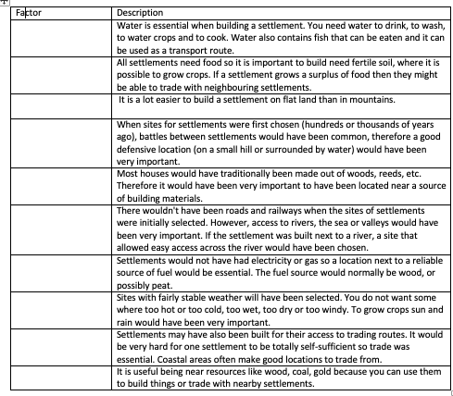
Write in the appropriate factor name next to the description below.

Slide 9
1
2
3
4
5
6
7
8
9
Positive or negative site factor

Slide 10
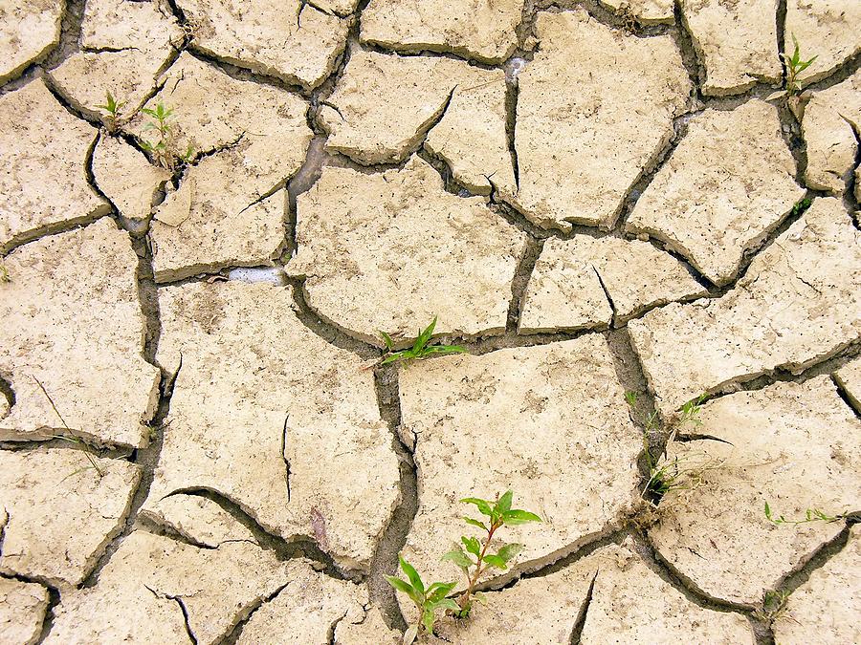
1
The soil is hard and dry.

Slide 11
2
There is a river nearby.

Slide 12
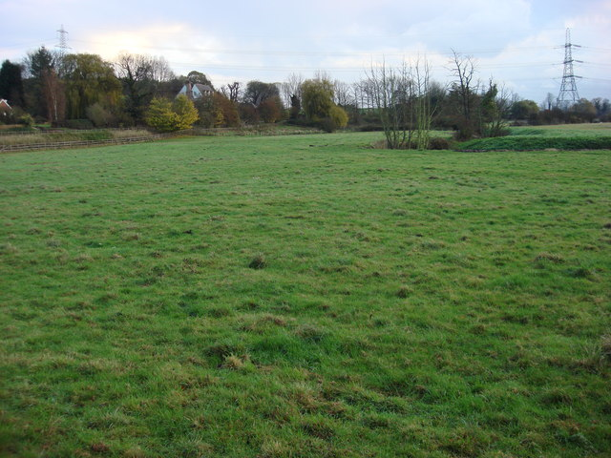
3
The ground is very flat

Slide 13
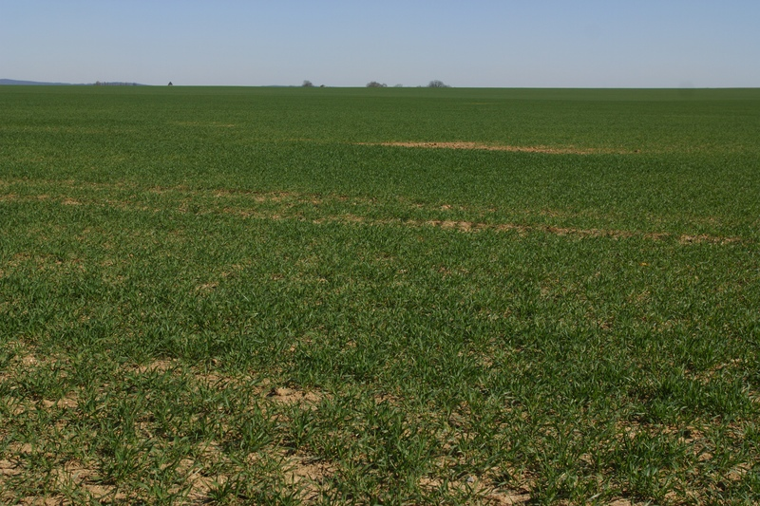
4
The area is very open there are no trees.

Slide 14
5
There are hills

Slide 15
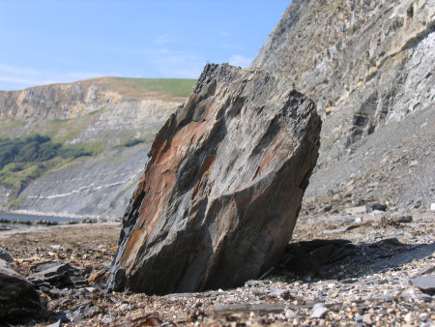
6
The area is very rocky.

Slide 16
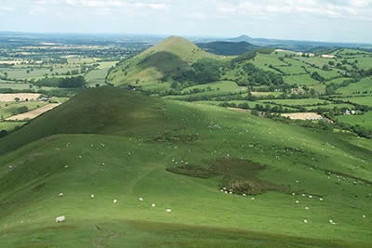
7
The land is not very flat.

Slide 17
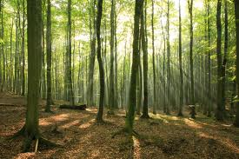
8
There is a forest nearby

Slide 18

9
The hills are south facing towards the sun.

Slide 19
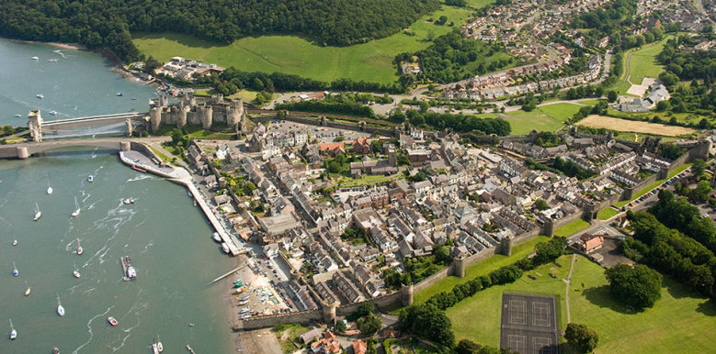
Annotate these images to explain why they were chosen as a site for a settlement

Slide 20
Example exam question: Suggest reasons why Durham was chosen as a site for a settlement (5)

