Slide 1
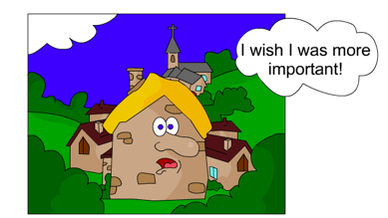
Settlements and service provision

Slide 2
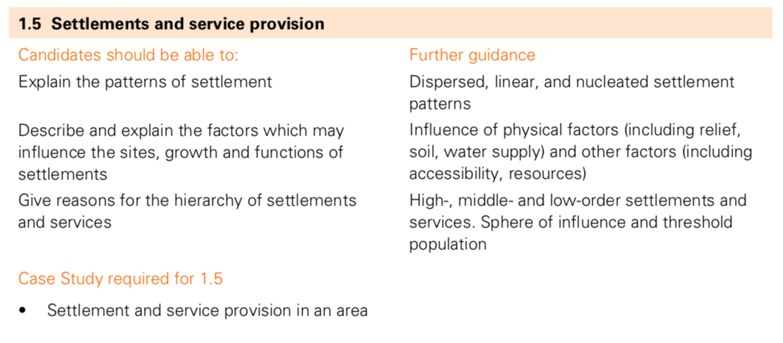

Slide 3
What is the function of a settlement?
The function of a settlement relates to its economic and social development and refers to its main activities.
mining town
tourist resort
residential
market town
settlement
functions
administration
cultural/religious
commercial
port
manufacturing
route centre

Slide 4
What is the function of…
Houston
Galveston

Slide 5
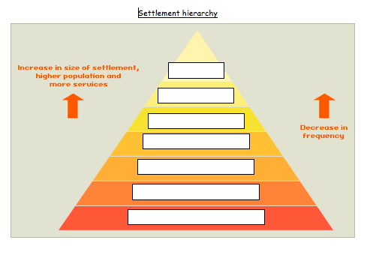
a. Look up any words below you are not familiar with.
b. Write the following words down onto the settlement hierarchy in the correct place in the pyramid.
Hamlet
Isolated dwelling
Conurbation
Large town
City
Village
Small town

Slide 6
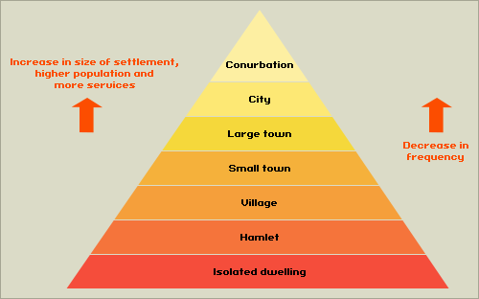
Settlement Hierarchy
Task
Write out a definition for all of the terms in bold.
Low order services
High order services
Range
Threshold population
Sphere of influence
Dormitory settlements

Slide 7
Starter:What am I?
Convenience goods or services such as milk or bread.
Comparison goods or services such as TVs and laptops.
How far someone is willing to travel for a particular good or service.
The number of people needed to sustain a service.
The area surrounding a settlement that is effected by the settlements activities.
Anomalous settlements with a high number of residents but not many services.
Low order goods/ services
High order goods/ services
Range
Threshold population
Sphere of influence
Dormitory settlements

Slide 8
More shops and services in larger settlements
The number of shops and services in a settlement depends upon the threshold population, which is the minimum number of people required by a shop/service to make a profit. Shops and services are classified according to their threshold population:
classification
frequency of use
maximum distance customer prepared to travel
example and estimate of threshold population
convenience (low order)
very often
short
general store –200 people.
comparison (middle order)
fairly often
reasonable – even the next town
bank – 15 000 people
specialist (high order)
not often
can be quite far
department store – 350 000 people

Slide 13
Task - Hypothesis
1. The number of services that a settlement provides increases with settlement size. 2. Larger settlements and conurbations have a much larger sphere of influence than smaller ones.
3. Services such as department stores selling high order goods have a higher threshold than those selling low order goods such as newsagents.

Slide 14
Task
The number of services that a settlement provides increases with settlement size. Small settlements will only provide low-order services such as a post offices, doctors and newsagents. Large towns, cities and conurbations will provide low and high-order services such as leisure centres, chain stores and hospitals. Larger settlements and conurbations have a much larger sphere of influence than smaller ones.
This means they attract people from a wider area because of the facilities they offer. Cities such as Paris have a global sphere of influence, whereas a small hamlet or village may only have a sphere of influence of a couple of kilometres. Services such as department stores selling high order goods have a higher threshold than those selling low order goods such as newsagents.
This means they need a higher number of people to support them and make them profitable, therefore they will only be found in larger settlements. It also means that there are fewer big department stores than small newsagents.

Slide 15
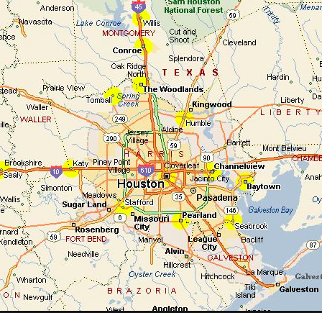
What services are available at each of these settlements?
Houston?
Brookshire?
Katy?
Galveston?

Slide 16
For one named settlement which you have studied, describe and explain the service provision (7)
Houston has a population of 2 million people (the 4th biggest in the USA). Because of it being a conurbation it can offer a range of high order services. In the centre it has one of the biggest theatre districts in the USA (located in the centre of the city because of good accessibility). The centre also has sporting arenas for basketball, baseball and football. Houston is home to one of the world’s best medical centres with hospitals such as the world famous MD Anderson cancer centre. The high number of hospitals leads to an agglomeration of services. This draws in patients from all over the USA and globe (very high sphere of influence). The city holds over 40 colleges and universities. There are 2 major airports- George Bush has connections to the globe. The city has low order services to meet the needs of the population all over the city.

Slide 17
For a named area you have studied, describe the hierarchy of service provision (7)
Houston has a population of 2 million people (the 4th biggest in the USA). Because of it being a conurbation it can offer a range of high order services. This means that it is top of the hierarchy with many high order shops and services such as universities, a world-class medical centre, theatres and sporting venues. Katy is a town on the Western edge of Houston with a population of about 20,000. It is a 30 minute drive from Houston so many of it’s population use the services in Houston. Within Katy there are many high schools and it has its own out-of-town shopping centre- Katy Mills. Brookshire is a large village about 10 miles west of Katy. It only has services to meet the needs of the local population such as local shops and schools. Galveston is 60 miles south of Houston and one of its main functions is tourism. Because of this it has more services than would be expected for a population of 50,000 such as many museums, water parks and restaurants.

