Slide 1
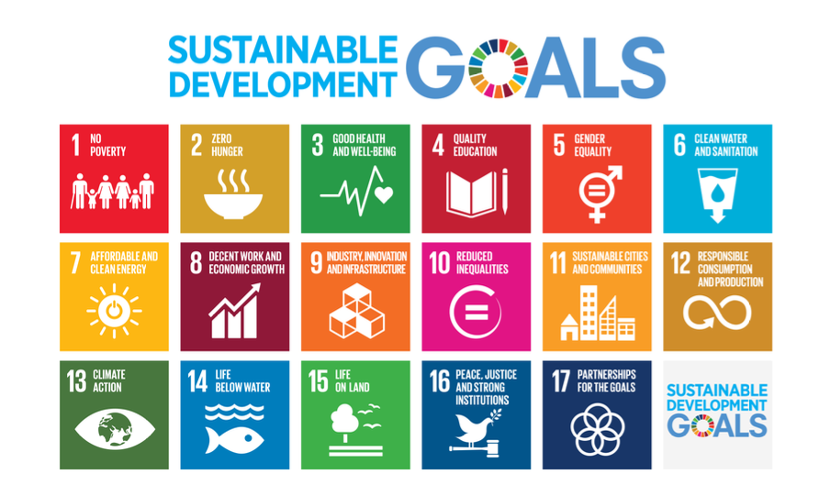
Resource stewardship

Slide 2
Learning objectives:
Resource stewardship strategies, including: • the role of the UN Sustainable Development Goals and progress made toward meeting them Synthesis, evaluation and skills opportunities ​ Different perspectives on global resource use and the likely effectiveness of management actions at varying scales

Slide 4
The global commons
The global commons refers to areas of the world that lie out of reach of any nation state. The United Nations Environmental Programme state four global commons…name them

Slide 5
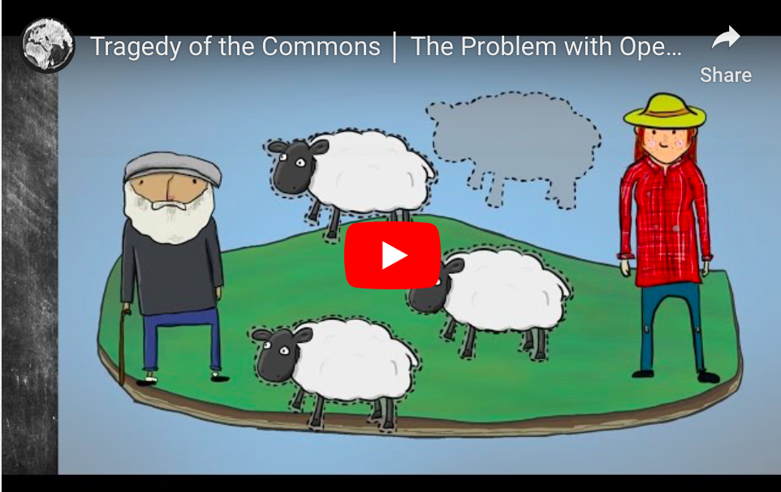
The tragedy of the commons
Watch the animation explaining Garrett Hardin's model called 'The Tragedy of the Commons’
Make notes on:
How the Tragedy of the Commons and over exploitation takes place
Why this model may be useful for increased resource stewardship
Can you think of real examples of the Tragedy of the Commons

Slide 6
Resource stewardship
Resource stewardship is the responsible planning and management of resources

Slide 7
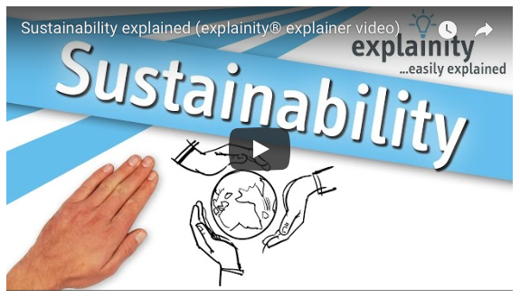

Slide 8
Why?
Enquiry question: What is the role of the UN Sustainable Development Goals and how is progress made toward meeting them?

Slide 9
The aim of this task is: To be able to discuss the role of the UN Sustainable Development Goals as resource stewardship strategies and progress made toward meeting them You will focus on SDGs linked to food, energy and water.

Slide 10
How?
Use the embedded sheet on the Weebly to consider the role of the SDGs in helping achieve resource stewardship.
Use the resources on the weebly and kognity: 3.3.7 SDGs 6 and 7
SDGs 12 and 13

Slide 11
Exam practice
For a named Sustainable Development Goal explain how one of its targets can be viewed as a resource stewardship approach. (4)

Slide 13
Essay practice
“By the end of the 21st century there will be too many people and not enough resources left.”
To what extent do you agree with this statement? (10)

