Slide 1
Year 9 Sustainable development Goals workbook

Slide 2
List what you think are the biggest problems in the world

Slide 3
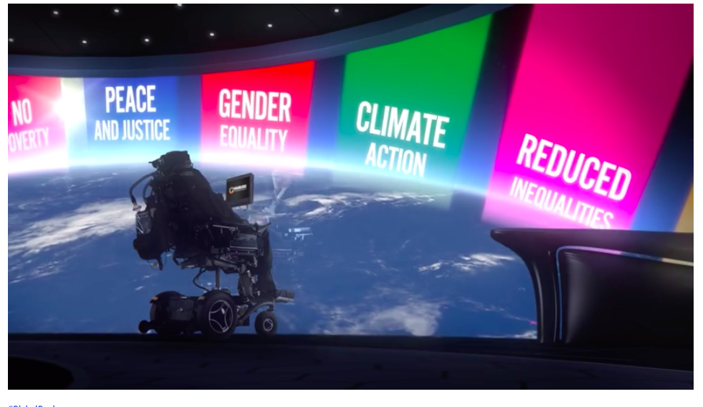
Video links for introduction
https://www.youtube.com/watch?time_continue=48&v=RTRdtrsL9jg
https://www.youtube.com/watch?time_continue=2&v=DdLqiTvFwJk&feature=emb_logo

Slide 5
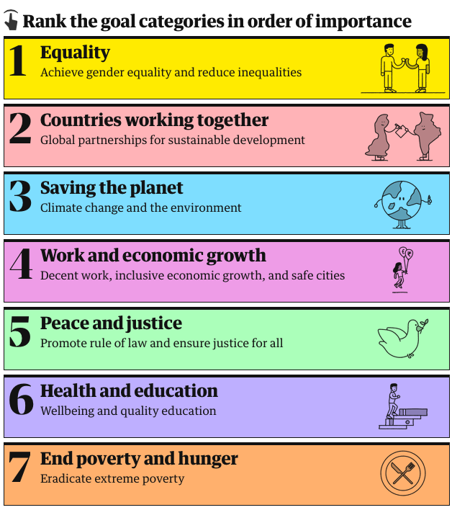
You can do this online here

Slide 6
Rank the importance of the goals
To help you with deciding which goal is most important use the comic strip resources and this website: https://www.theguardian.com/global-development/ng-interactive/2020/jan/15/environment-inequality-hunger-which-global-problems-would-you-fix-first
And this virtual book: https://issuu.com/unpublications/docs/sdg_yak_en
Most important
Least important important

Slide 7
Which goal I have picked as the most important and why
Justify here:

Slide 8
**Your Name** Supports Goal **
Your photo – with caption.
What has been done since 2000
What is there to do by the time I’m **enter age in 2030 here**

Slide 9
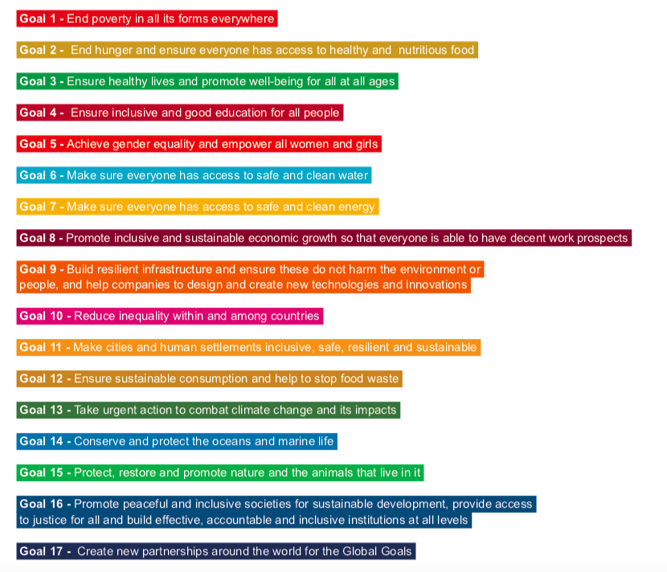
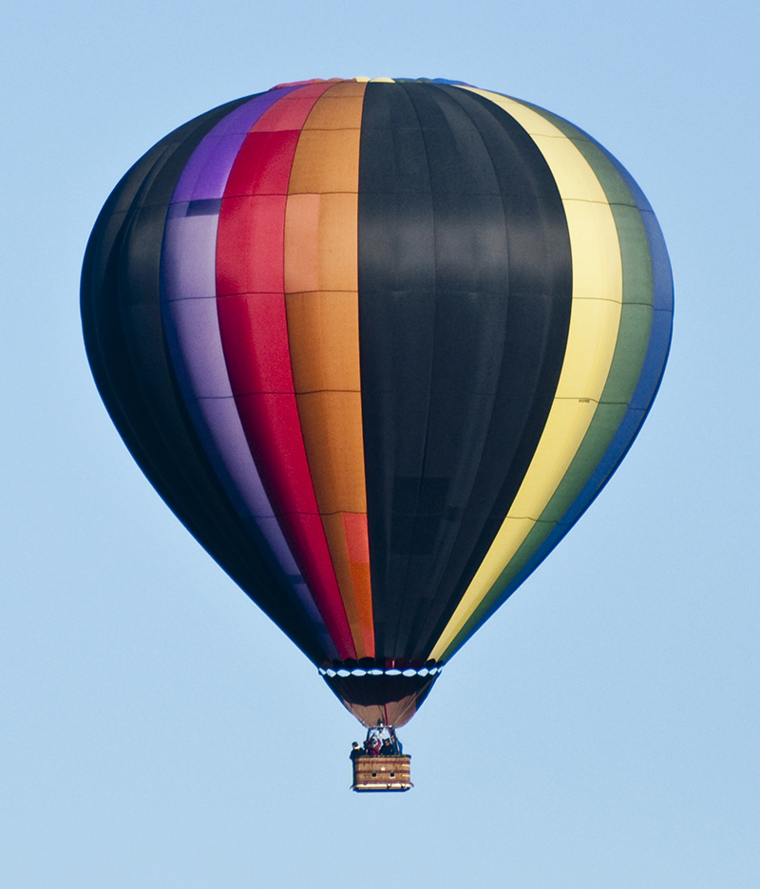
Balloon debate
You are going to have a 'hot air balloon' style debate. A hot-air balloon debate is a debate in which a number of speakers attempt to win the approval of an audience. The audience is invited to imagine that the speakers are flying in a hot-air balloon which is sinking and that someone must be thrown out if everyone is not to die.
Each speaker has to make the case why they should not be thrown out of the balloon to save the remainder.
In this case the debate is about which of the SGGs is the most important.
You will represent one of the SDGs. You will write an oral presentation explaining why your goal is the most important and therefore why it should be sorted out first.
Your presentation should complete the following sentences:
I am representing ...
My SDG is about ...
The reasons why this goal is so important are…
My SDG links has links with goals ? ? because….
The progress towards my goal so far is…
Work that needs to be done includes…
We will know that my SDG is complete when ...
My SDG should be dealt with first because ...
https://www.globalgoals.org
.

Slide 10
Reflection

Slide 11
Some resources that could help you
Websites:
https://www.theguardian.com/global-development/ng-interactive/2020/jan/15/environment-inequality-hunger-which-global-problems-would-you-fix-first
https://www.undp.org/content/undp/en/home/sustainable-development-goals.html
https://unstats.un.org/sdgs/report/2018/overview/
Virtual SDG book:
https://issuu.com/unpublications/docs/sdg_yak_en

