Slide 1
Sand dunes
Objective: To find out how and where sand dunes are formed.

Slide 2
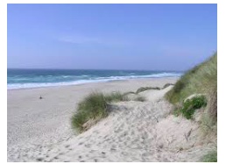
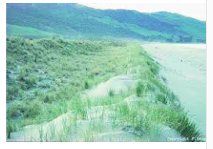
Look at these images of Sand Dunes. How do you think the dunes were formed? Can you see differences in the shape of the dunes in the different images? Does the vegetation seem to change in the various photographs?

Slide 3
https://www.youtube.com/watch?v=gKU1K8n6jYM
What are Sand Dunes?
1. What is a sand dune?
2. How do they form?
3. What conditions are required for their formation?

Slide 4
What are Sand Dunes?
ACTIVATE
Be READY TO LEARN
Think like a Geographer
Sand dunes are large heaps of sand that form on the dry backshore of a sandy beach.
Form a sand dune to form, it needs:
A large flat beach,
A large supply of sand,
A large tidal range, so there is time for the sand to dry,
An onshore wind to move sand to the back of the beach,
An obstacle such as drift wood for the due to form against.
LO: To explore the characteristics and formation of the deposition landforms; sand dunes.

Slide 5
How do they form?

Slide 6
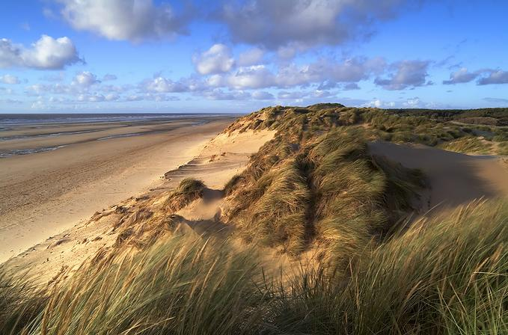
Characteristics of Dunes
ACTIVATE
Be READY TO LEARN
Think like a Geographer
Unstable, steep slip slope (lee slope) on sheltered side
Gentle slope on windward side
Embryo Dune
Berm
Slack
Crests
LO: To explore the characteristics and formation of the deposition landforms; sand dunes.

Slide 7
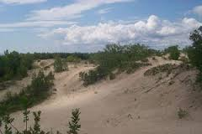
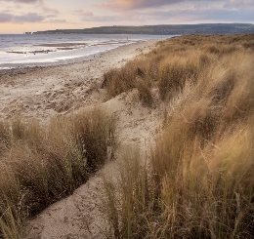
The Formation of Sand Dunes
ACTIVATE
Be READY TO LEARN
Think like a Geographer
Embryo dunes form around deposited obstacles such as pieces of wood or rocks.
These develop and become stabilised by vegetation to form fore dunes and tall yellow dunes. Marram grass has adapted to the windy, exposed conditions and has long roots to find water. These roots help bind the sand together and stabilise the dunes.
In time, rotting vegetation adds organic matter to the sand making it more fertile. A much greater range of plants colonise these ‘back’ dunes.
Wind can form depressions in the sand called dune slacks, in which ponds may form.
Dune Succession
LO: To explore the characteristics and formation of the deposition landforms; sand dunes.

Slide 8
Sand Dune Succession
ACTIVATE
Be READY TO LEARN
Think like a Geographer
Embryo dunes are only a few metres high whereas mature dunes maybe up to 15 metres high.
Size of sand dunes increases inland as long-rooted marram grass binds the sand together. It’s long roots help build up the height of the dunes.
Dunes closest to the beach have a yellow sandy colour and not much vegetation, whereas dunes at the back are grey and less sand like.
Inland the dunes become increasingly colonised by vegetation.
Each line of dunes is separated by a trough called a slack. Slacks are formed by the removal of sediment from the leeward base of one line of dunes and up the windward side of the next line. Sometimes slacks are eroded so much that they reach down to the water table, resulting in the formation of ponds.
LO: To explore the characteristics and formation of the deposition landforms; sand dunes.

Slide 9
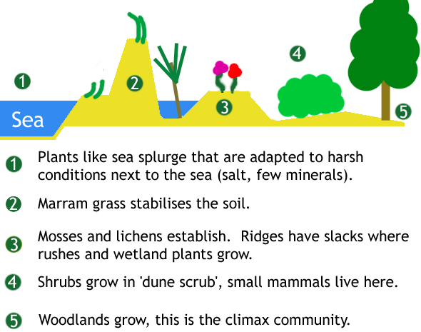
Dune development
Key term: sand dune succession: How the type and density of vegetation changes on dunes with distance from the shore line
Read through page 159 and 161 of the textbook and complete questions in box 5 and 6

Slide 10
Characteristics of Dunes
DEMONSTRATE
Be READY TO LEARN
Think like a Geographer
Identify the characteristics of sand dunes. Add the characteristics in the correct places.
Slack
Gentle slope on windward side
Embryo Dune
Unstable, steep slip slope (lee face) on sheltered side
Crests
Berm
LO: To explore the characteristics and formation of the deposition landforms; sand dunes.

Slide 11
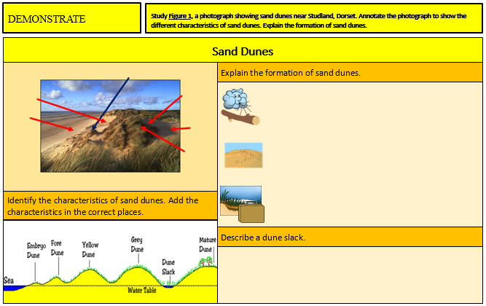
Complete the worksheet describing what a dune slack is and how sand dunes are formed.
DEMONSTRATE
Be READY TO LEARN
Think like a Geographer
LO: To explore the characteristics and formation of the deposition landforms; sand dunes.

Slide 12
Study Figure 2, a photograph showing sand dunes near Studland, Dorset.
CONSOLIDATE
Be READY TO LEARN
Think like a Geographer
Explain how the sand dunes in Figure 2 formed. (3)
SUCCESS CRITERIA:
Start from the beginning of the formation process – what does wind cause?
What happens to trapped sand? What type of dunes are formed first?
What happens to the sand?
Where do sand dunes end? What type of dune?
Figure 2
LO: To explore the characteristics and formation of the deposition landforms; sand dunes.

Slide 13
Study Figure 2, a photograph showing sand dunes near Studland, Dorset.
CONSOLIDATE
Be READY TO LEARN
Think like a Geographer
Explain how the sand dunes in Figure 2 formed. (3)
MODEL ANSWER:
Sand blowing up the beach was trapped by obstacles (1). The trapped sand was colonised by vegetation, forming embryo dunes (1). The embryo dunes grew and migrated inland, forming mature dunes (1).
Figure 2
LO: To explore the characteristics and formation of the deposition landforms; sand dunes.

Slide 14
Examples of exam question
Explain the conditions required for the development of sand dunes (3)
Explain how dunes may change (sand dune succession) with distance from the coast (4)
Explain how and why sand dunes may be protected (4)
Explain the formation of coastal sand dunes (7)

Slide 15
Mark scheme: Explain the formation of coastal sand dunes (7)
Level 1 [1–3 marks]
Statements including limited detail which explain the formation and/or development of coastal
sand dunes.
Level 2 [4–6 marks]
More developed statements which explain the formation and/or development of coastal sand
dunes.
Level 3 [7 marks]
More developed statements which explain the formation and development of coastal sand
dunes. Comprehensive and accurate statements.
Content Guide:
Answers are likely to refer to;
• Movement of sand by wind,
• Wind deposition,
• Accumulation around an object,
• Growth of marram grass,
• Dune succession/colonization by vegetation etc. [7]

