Slide 1
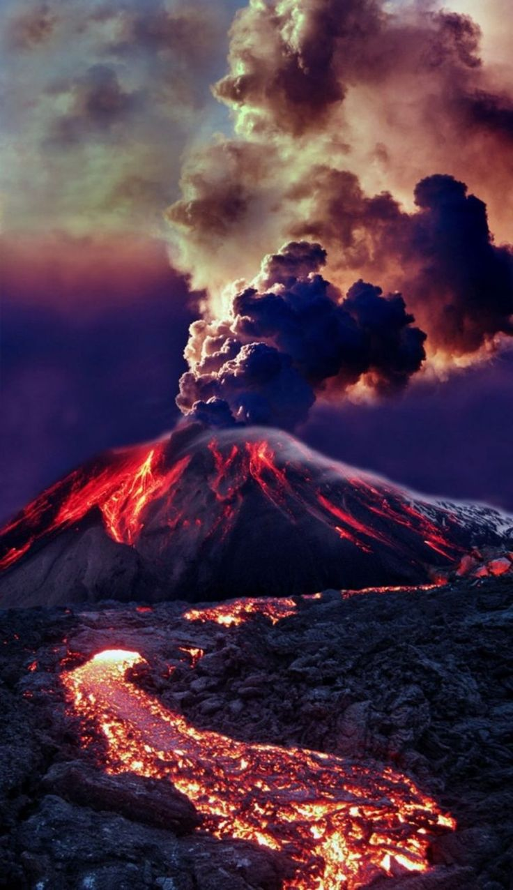
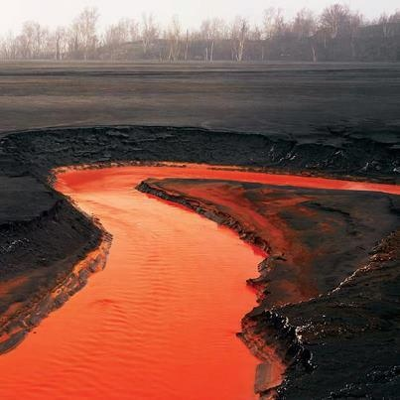
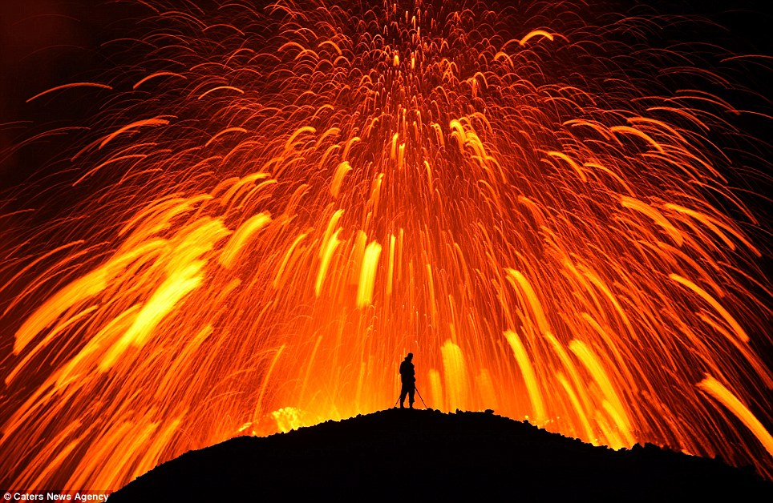
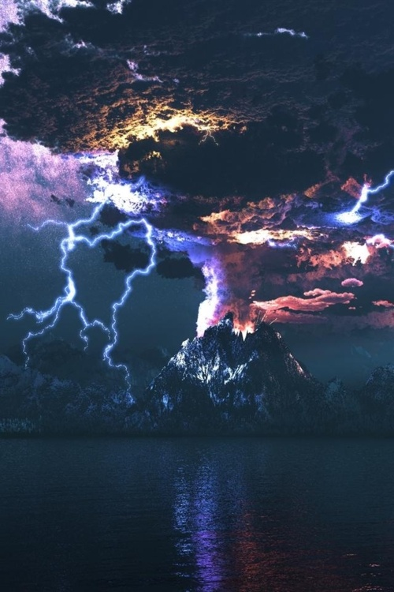
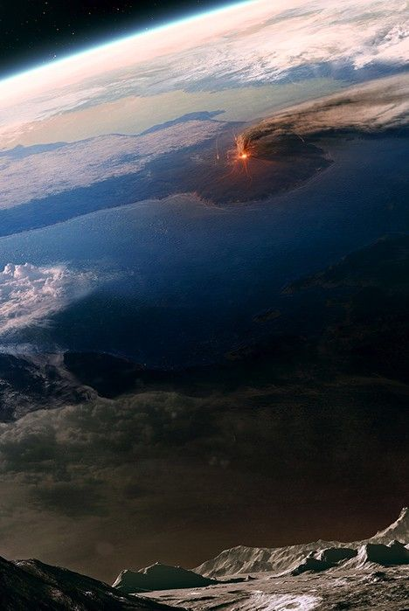
LO: Reviewing plate Tectonics and Volcanoes
.

Slide 2
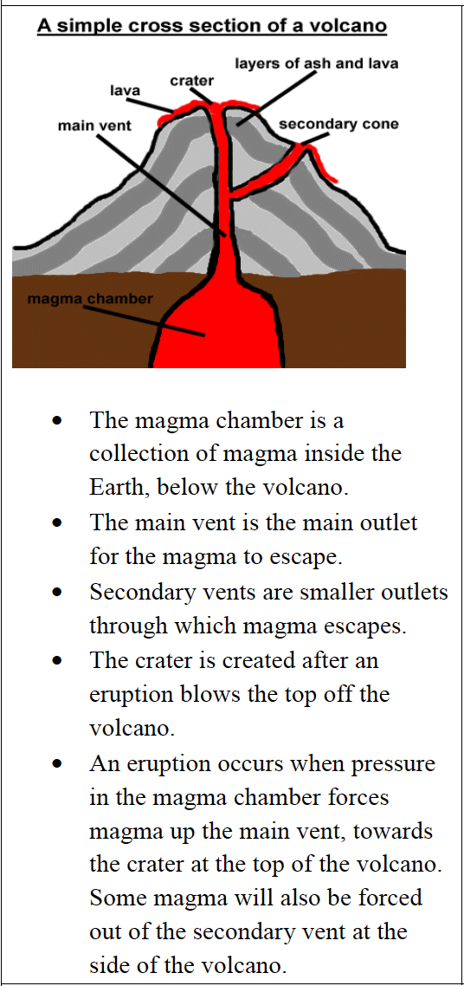
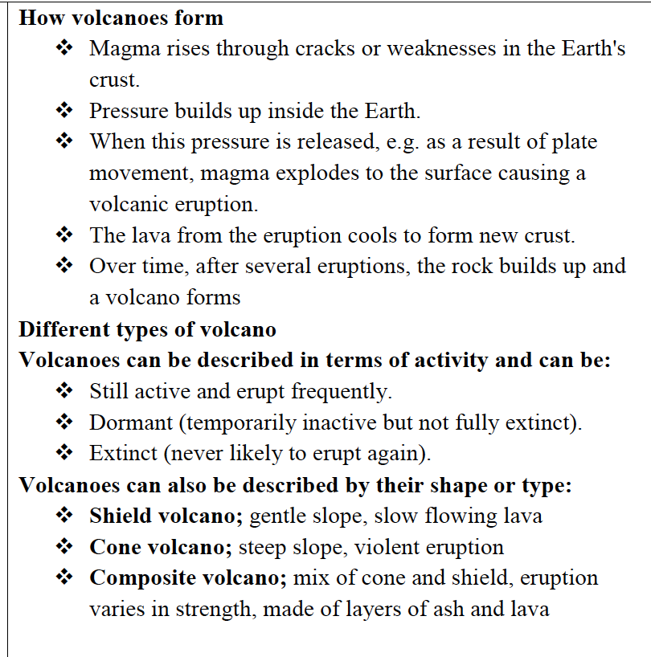

Slide 3
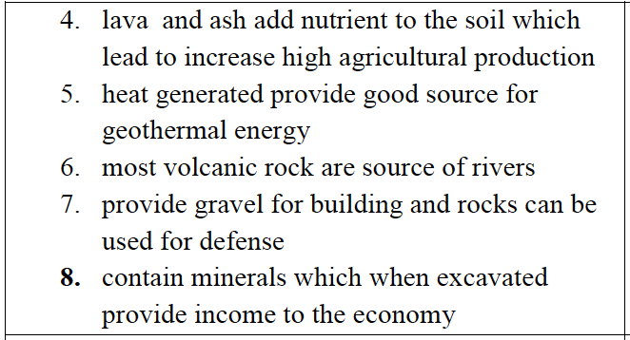
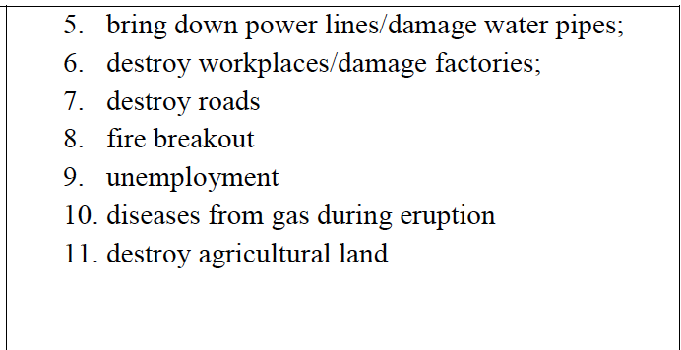
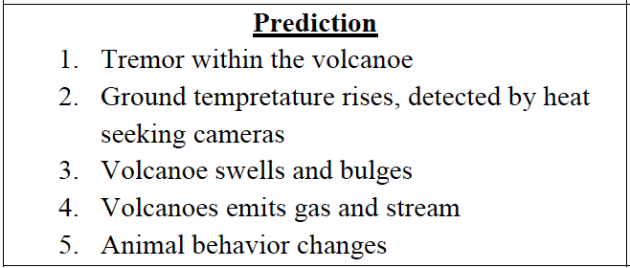
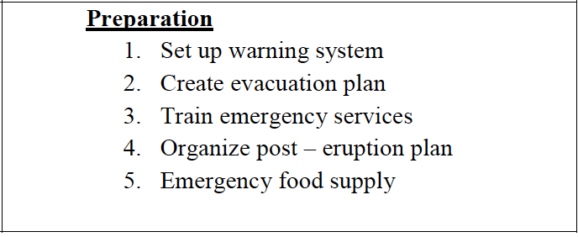

Slide 4
Volcanoes in the USA

Slide 5
What happened at Mount Saint Helens?
https://youtu.be/VNGUdObDoLk
Watch the Video and take notes on what happened.
https://youtu.be/AYla6q3is6w

Slide 6
What are hot spots and super volcanoes?
https://youtu.be/bYv6V5EJAKc
https://youtu.be/CpOKkRIyg7E

Slide 7
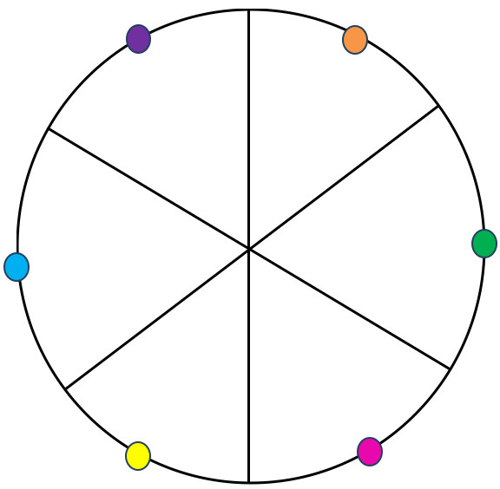
You are going to select a question and try to answer it.
Choose a colour.
You will have 5 minutes to answer the question.
No talking or asking anyone for help.

Slide 8
Outline reasons why people live near volcanoes.
What are the effects of volcanoes?
What type of Plate Boundaries cause Volcanoes?
Name as many types of Volcanoes as you can?
What are hot spots and super volcanoes?.
Describe the types of volcanoes there are and give examples

Slide 9
You are going to select a question and try to answer it.
Choose a colour.
You will have 5 minutes to answer the question.
No talking or asking anyone for help.

Slide 10
Outline reasons why people live near volcanoes.
What are the effects of volcanoes?
What type of Plate Boundaries cause Volcanoes?
Name as many types of Volcanoes as you can?
What are hot spots and super volcanoes?.
Describe the types of volcanoes there are and give examples

