Slide 1
Reason:
Aims:
Understand that the use of reason is a way to extend our knowledge from known facts
Be able to distinguish from inductive and deductive arguments – in both cases to evaluate the strengths and weaknesses of the arguments
To be able to apply 15 fallacious (false) reasons

Slide 2
Reason
“A way to extend our knowledge from known facts”

Slide 3
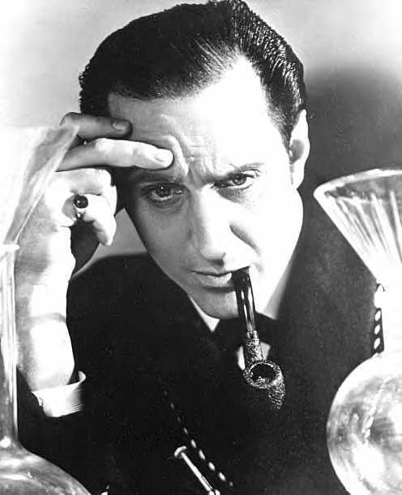
Reasoning
According to the fictional English detective Sherlock Holmes, “crime is common, but logic is rare.” Holmes prided himself on his skills of deduction. In one mystery, the theft of a racehorse, Holmes solves the crime based on the fact that the watchdog didn’t bark in the night. His reasoning goes like this:
Watchdogs bark at strangers.
The watchdog did not bark at the thief.
Therefore the thief was not a stranger.

Slide 4
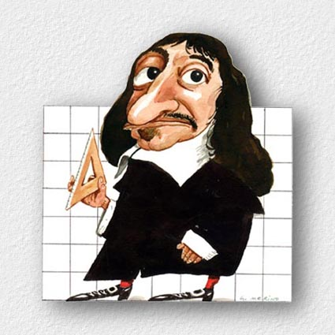
Rationalists
One of the great attractions of reasoning is that it seems to give us certainty.
Given the assumption, which in logic are called premises, the conclusion has to follow.
It is perhaps not surprising that there is a school of philosophy called rationalism, in which reason is the most important source of knowledge.
The central tenet of rationalism is that we can discover important truths about reality through reason alone.

Slide 5
Deductive and Inductive Reasoning
Philosophers distinguish at least two types of reasoning

Slide 6
Deductive Reasoning
Premise A: I am either a schnoodlepopper or a birshteinwaller, or both.
Premise B: I am not a schnoodlepopper.
Conclusion: Therefore I am a …..
Premise A: All humans are mortal.
Premise B: I am human.
Conclusion: Therefore I am .

Slide 7
Inductive Reasoning
Does not involve certainty in the same way
Premise A: metal A, metal B, and metal C all expand when heated
Premise B: D is a metal
Conclusion: Metal D will expand when heated
Premise A: You buy a car from a second hand car dealer
Premise B: The wheels fall off
Conclusion: You should never buy a car from this car dealer again

Slide 8
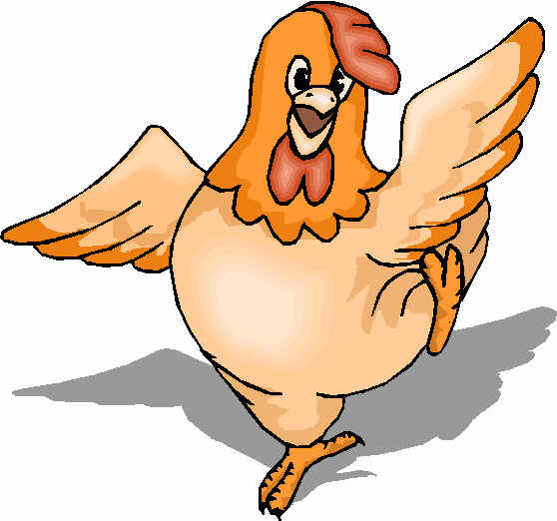
The Problem of induction
Consider the chicken who is fed every day by the farmer. Being a philosophical sort of chicken, after a few weeks it applies induction and comes out to greet the farmer each morning, expecting food. One day…
The farmer wrings its neck!

Slide 9
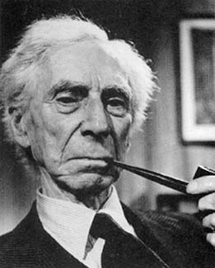
Bertrand Russell's response..
‘More refined views as to the problems of induction would have been useful to the chicken.’

Slide 10
How refined are our views of induction?
What would the world be like if induction ceased to be reliable?
Are we going to have a shock one day if we rely on induction?
How can we justify the use of induction? Here are two possibilities:
‘It has always worked before.’
‘It is probably correct.’
Neither of these are good justifications as they are circular arguments.
What do you think this means?

Slide 11
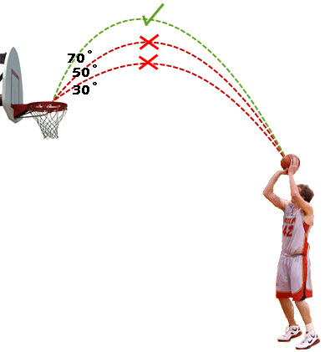
The Problem of Induction?
x | o | x | x | x
x | o | x | o | o
x | o | o | o | x
o | o | x | o | o

Slide 12
Can you…
Explain what ‘reasoning’ is?
Explain whether the Sherlock Holmes example at the beginning of the lesson was inductive or deductive reasoning?
Give an example of deductive reasoning…
Give an example of inductive reasoning…
Explain when you use them in real life in one of your IB Subjects (areas of knowledge)…
Badly
To good effect!

