Slide 1
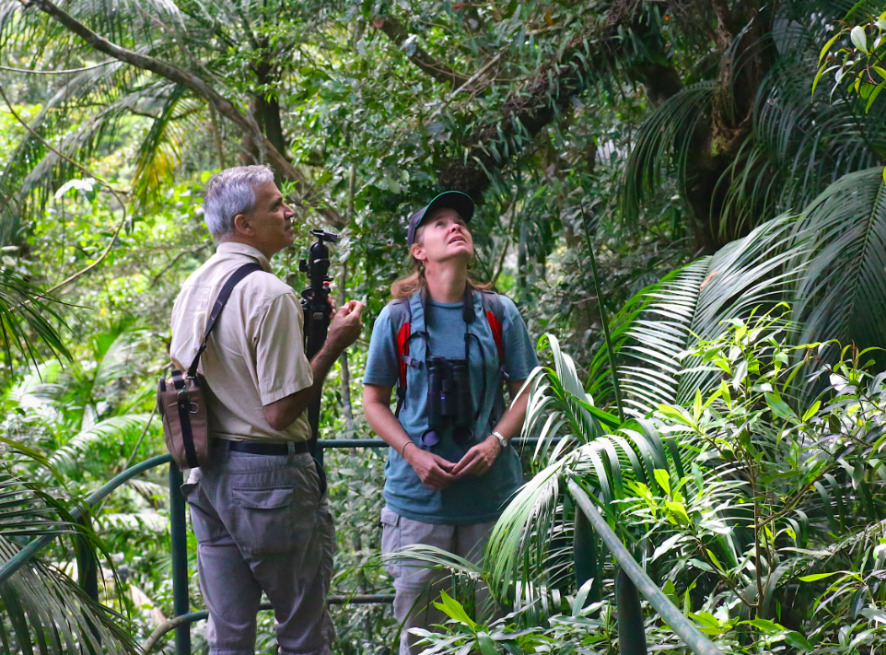
Can deforestation in Brazil be managed?
Sustainable development: Development that meets the needs of today without compromising future generations needs
Lesson objectives-
What: To evaluate the range of ways in which tropical rainforests can be managed
Why: To evaluate the sustainability of a range of schemes

Slide 2
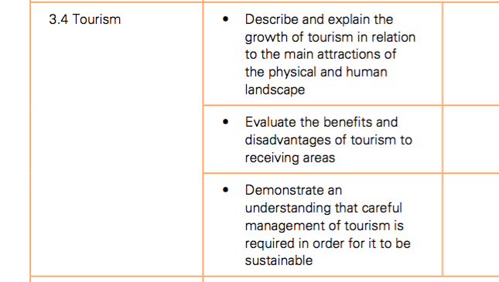
Links to paper 3: Economic development section of the course

Slide 3
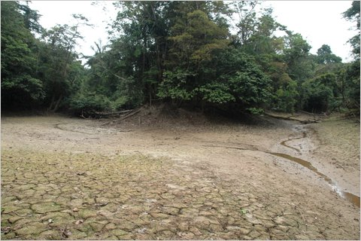
Starter
Using what you have learnt last lesson answer one of the levelled questions below. Bullet point your answer.
Figure 1- Impact of deforestation in the Amazon
Easy (Grades 1-3)
Describe the impact(s) of deforestation shown in figure 1. (2 marks)
Medium (Grades 4-6)
Explain a global impact of deforestation shown in figure 1. (4 marks)
Hard (Grades 7-9)
Explain a local impact of deforestation that can lead to global consequences. (6 marks)

Slide 4
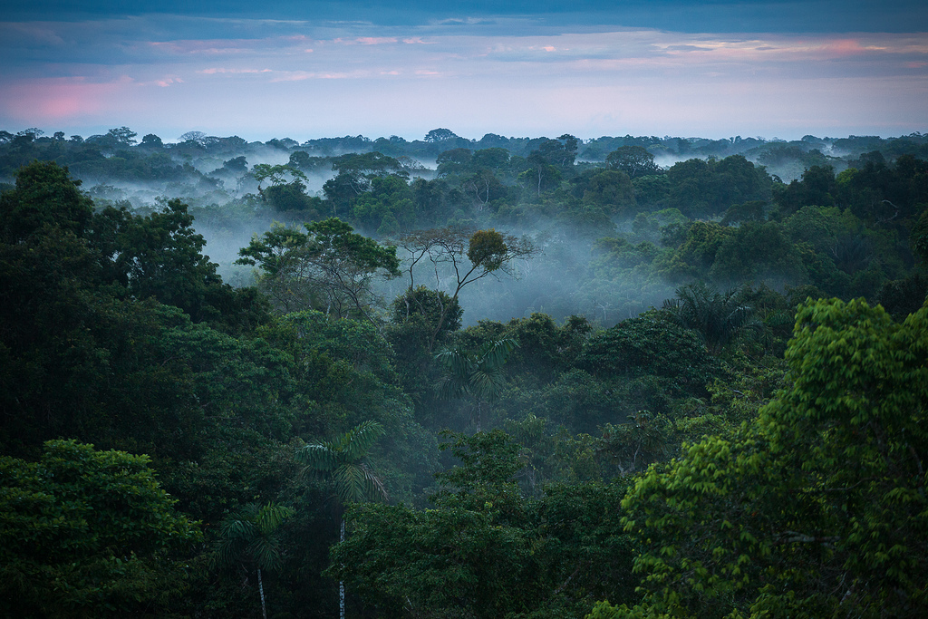
Why are tropical rainforests important?
Resources
Tropical rainforest trees provide valuable hardwoods as well as nuts, fruit and rubber.
Biodiversity
Tropical rainforests contain half of the plants and animals around the world. They are home to thousands of different species. Some plants may become extinct before they have even been discovered.
Water
Rainforests are important sources for clean water- 20 per cent of the world’s fresh water comes from the Amazon basin.
Medicine
Around 25% of all medicines come from rainforest plants. More than 2000 tropical forest plants have anti-cancer properties.
People
Indigenous tribes live in harmony in the world’s rainforests making use of the forest’s resources without causing any long term harm.
Climate change
Rainforests absorb and store carbon dioxide, a gas that is partly responsible for climate change.
Climate
Known as the lungs of the world, 28 per cent of the world oxygen comes from the rainforests. They prevent the climate from becoming too hot and dry
Extension
In groups of 7 swap the information from your homework to produce a small mind map about why we should protect the rainforest.
Explain which reasons is the most and least significant. Do any reasons link together?
Grades 1-3
Describe the reasons why tropical rainforests should be protected from deforestation.
Grades 4-6
Explain the reasons why rainforests should be protected from deforestation.
Grades 7-9
Make links between the reasons why rainforests should be protected from deforestation.

Slide 5
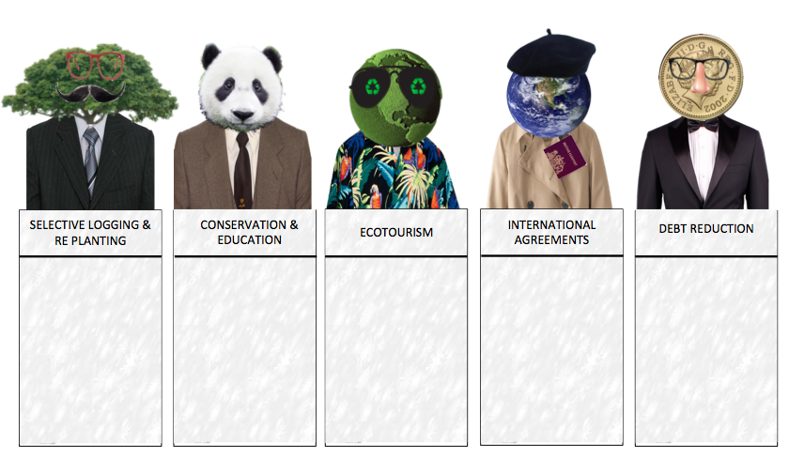
How can the tropical rainforest be protected sustainably?
Literacy
Can you use these key terms:
Logging
Biodiversity
Conservation
Ecotourism
Debt relief
Debt for nature swaps
International
Selective logging
GradesV
Describe the strategies used to manage deforestation in the rainforest in detail.
Rainforest management strategy | Description of the strategy | Advantages of the strategy | Disadvantages of the strategy
Selective logging
Conservation and education
Ecotourism
Grade B
Give at least two advantages and two disadvantages of each of the strategies used.
A*
Evaluate the sustainability of each of the strategies used to protect the rainforest.
Comlete the table to evaluate the different methods of rainforest management. Add an extra ‘sustainability’ column to challenge! Who will you ‘take out’?

Slide 6
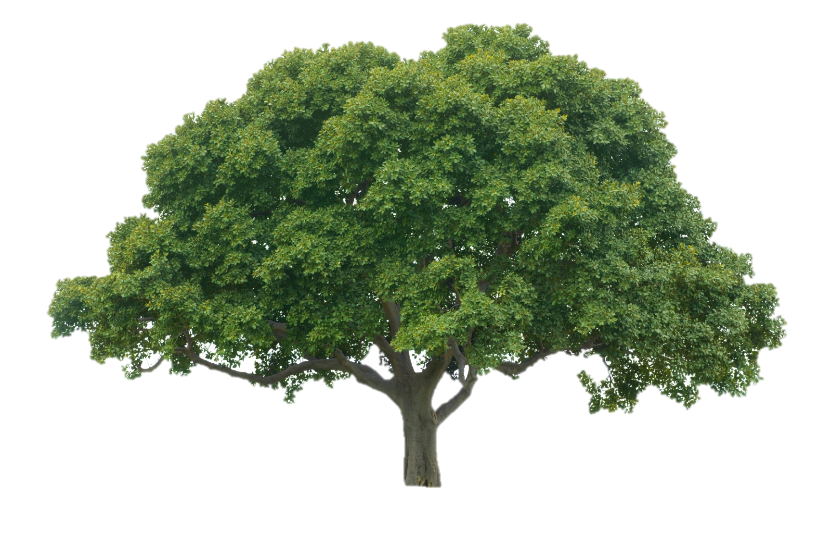
How can the tropical rainforest be protected sustainably?
Rainforest management strategy | Description of the strategy | Advantages of the strategy | Disadvantages of the strategy | To what extent is the scheme sustainable?
Selective logging
Conservation and education
Ecotourism
International agreements
Debt reduction

Slide 7
Contestant 1
The most damaging form of deforestation is clear felling. All trees big and small are chopped down in the area being cleared. This completely destroys the ecosystem. A more sustainable approach is selective logging. This involves only felling trees when they are fully grown, and letting younger trees mature and continue protecting the ground from erosion. It involves a cycle lasting between 30 and 40 years.
A project in brazil has shown that it is possible to recreate a forest cover almost like the original. This is done by collecting seeds from remaining patches of primary forest, growing the seeds into saplings in nurseries and then planting the saplings back in the deforested areas.
SELECTIVE LOGGING & RE PLANTING
COMPLETE YOUR SHEET
Sustainable
Unsustainable

Slide 8
Contestant 2
Rainforests can be preserved in conservation areas, such as national parks or nature reserves. These areas can be used for education, scientific research and tourism. Recently large international businesses have supported conservation projects in exchange for carrying out scientific research or the provision of raw materials.
Charities (NGOs) such as the WWF and Fauna and Flora are also interested in helping protecting the tropical rainforest. They promote the conservation message through education programmes, provide training for conservation workers, and buy up threatened areas and create nature reserves.
A biosphere reserve is a way of protecting part of the rainforest by leaving it untouched except for research and plant breeding. The protected core area is surrounded by a buffer zone in which only certain activities are allowed. A lodge can be built within to educate tourists.
CONSERVATION & EDUCATION
COMPLETE YOUR SHEET
Sustainable
Unsustainable

Slide 9
Contestant 3
Countries like Costa Rica, Belize and Malaysia have promoted their forests for ecotourism. Scenery, wildlife, remoteness and culture are the main attractions. Ecotourism aims to introduce people to the natural world, to benefit local communities and protect the environment for the future. Through income generated by ecotourism, local people and governments benefit from retaining and protecting their rainforest trees. This is a more sustainable option than cutting them down for short- term profit. Ecotourism is small scale and local (controlled by local people, employing local people and using local produce). Its profits stay in the local community. It tries to minimise the consumption of non renewable resource too.
ECOTOURISM
COMPLETE YOUR SHEET
Sustainable
Unsustainable

Slide 10
Contestant 4
Rainforests are now understood to be of global importance. They absorb carbon dioxide from the atmosphere, releasing oxygen and maintaining levels of humidity. International agreements have been made to protect the resources and biodiversity of rainforest.
The international tropical timber agreement (2006) restricts the trade in hardwoods. The very high prices gained from trading hardwoods has encouraged a large amount of illegal felling. This agreement restricts the trade of hardwood to sustainable managed forest and all timber has to be marked with a registration number.
The CITIES treaty blocks the illegal trade in rare and endangered animals and plants.
INTERNATIONAL AGREEMENTS
COMPLETE YOUR SHEET
Sustainable
Unsustainable

Slide 11
Contestant 5
Some countries have borrowed money from overseas aid in the form of loans to fund developments. To pay off these debts some have raised money from massive deforestation programmes.
Most countries with tropical rainforests are NEEs or LICs. Schemes known as debt for nature swaps are sometimes arranged. In 2010 for example the USA signed an agreement to convert a Brazilian debt of £13.5 million into a fund to protect large areas of tropical rainforest. These swaps are all part of what is know more widely as debt reduction, where some high-income countries (HICs) agree to write off the debts of some poor LICs.
DEBT REDUCTION
COMPLETE YOUR SHEET
Sustainable
Unsustainable

Slide 12
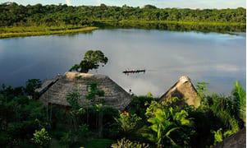
A Biosphere reserve: The Yasuni National Park, Ecuador
Conserving the resource
https://www.youtube.com/watch?time_continue=17&v=D0UGQCREe7I
Use the resources to answer the following questions:
Why should this area be protected?
How is this area aiming to conserve the natural environment?
How does the protection help the local people?
Is the management sustainable?
What are the threats to this area?
The Napo Wildlife Centre
Link to Yasuni National Park website
http://www.laselvajunglelodge.com/html/yasuni-national-park.html
Sustainable
Unsustainable

Slide 13
Using the resource in a sustainable way
Sustainable logging
https://www.youtube.com/watch?v=uRbcfTZmLbk
How can forestry be made more sustainable?
Why is this approach needed?
Heli-logging
Sustainable
Unsustainable

Slide 14
Starter
Decide where you stand on the decision line in relation to the statement. Be prepared to justify!
Yes
Maybe
“All development in the Rainforest should be stopped”
No
Yes!
Maybe?
No!
Why is it the best way?
What are the most influential reasons?
What should we worry most about?
What is making you unsure?
What would it take for you to make a decision?
What are both sides of the argument?
Why not?
What is a better way?
Which negatives particularly outweigh the positives?
What are the advantages of development in the tropical rainforest?
What are the disadvantages of development in the tropical rainforest?
What are the conditions like in the tropical rainforest?
What examples can you use to illustrate the advantages and disadvantages?
How can you decide?

Slide 15
Exam questions…
Level 1
You demonstrate limited knowledge of managing tropical rainforests sustainably.
You demonstrate a limited ability to use key terms.
Level 2
You demonstrate a clear knowledge of managing tropical rainforests sustainably.
You are able to use some place specific detail.
You are able to use key terms correctly.
Describe two ways that the tropical rainforest can be managed sustainably.
(4 marks)
Evaluate the sustainability of one method used to manage deforestation in the tropical rainforest.
(6 marks)
For a named area which you have studied, describe attempts to maintain, conserve or improve the natural environment
(7 marks)
Level 3
You demonstrate detailed knowledge of managing tropical rainforests sustainably.
You are able to use place specific detail thoroughly.
You are able to use key terms consistently correctly.
Advice
Use examples
Use key terminology
Make links between points
Use point, example, explain, link to structure your answer
Key words
International
Biosphere reserve
Resource
Logging
Ecotourism
Conservation
Debt reduction
NGO’s
Sustainable

