Slide 1
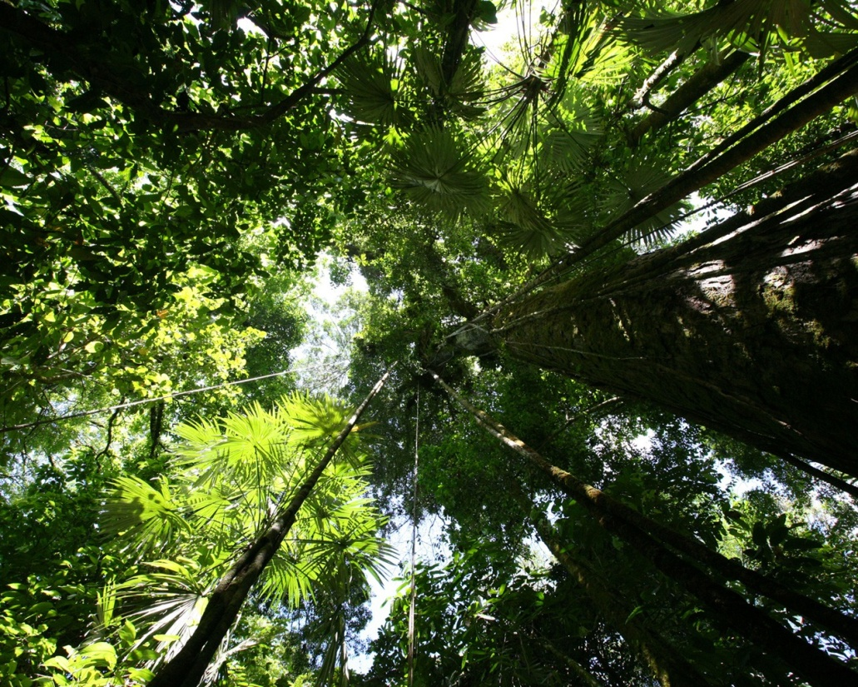
The Rainforest Ecosystem

Slide 2
Learning objectives:
To describe the characteristics of the tropical rainforest
Develop the skill of drawing an analysing a climate graph for a tropical rainforest
Explain how the rainforest ecosystem works including the layers of the rainforest
Explain how plants and animals are adapted to the tropical rainforest ecosystem

Slide 3
What can we learn from your Seesaw projects from last week?
The physical characteristics of the biome i.e. location (use a map), climate, weather, flora, fauna.
Please go on and comment on the relevant projects – think about including 2 positives and 1 WBI (Would be better if…)

Slide 4
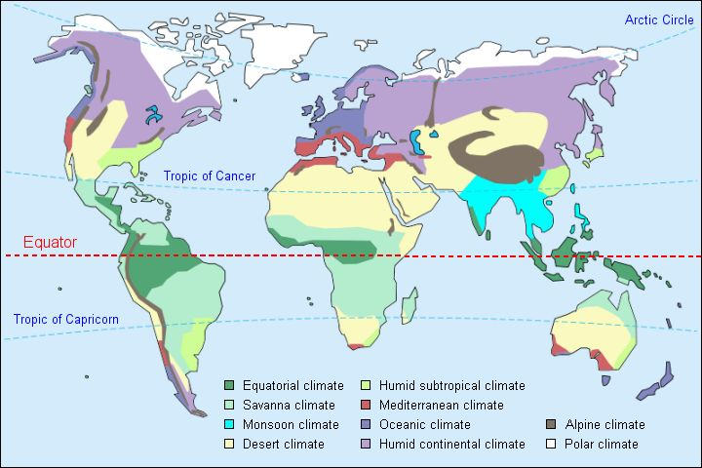
Describe the global distribution of tropical rainforests (3)

Slide 5
A Rainforest Country or not? Using your completed world map with all the rainforests marked on decide which countries have tropical rainforests.
To describe where tropical rainforests are found.
To illustrate the location of tropical rainforests
Brazil
Thailand
Sudan
Cameroon
Indonesia
Chile
United Kingdom
Madagascar
Angola
Cambodia
Cuba
Japan
Brazil
Thailand
Sudan
Cameroon
Indonesia
Chile
United Kingdom
Madagascar
Angola
Cambodia
Cuba
Japan
(RED = YES)

Slide 6
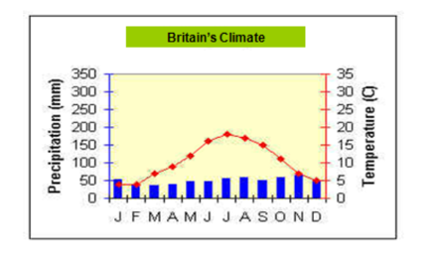
Drawing a climate graph
Climate graph for tropical rainforest
Temperature in degrees centigrade- drawn as a line graph
Precipitation in mm- drawn as a bar graph
What a climate graph should look like

Slide 7
Now analyse your graph
Describe the climate shown in the graph
Refer to temperature and rainfall throughout the year
Think about whether there is a specific pattern of weather during the year
Use figures from the graph to illustrate
Use key words e.g. temperature range
Key words:
Temperature range – the difference between the lowest and highest temperature.

Slide 8
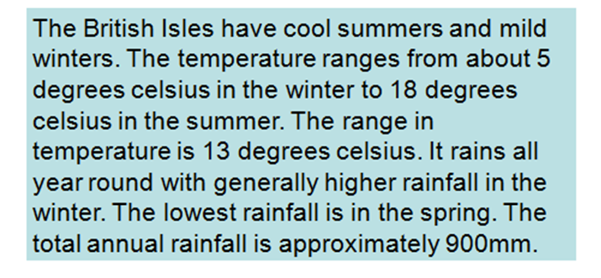
Model answer

Slide 9
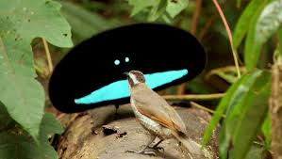
Watch the planet earth DVD
Watch the BBC Planet Earth Jungles DVD using the worksheet to help your structure your notes
https://vimeo.com/122463253

Slide 10
Worksheet for documentary here: http://bshyear8geography.wikispaces.com/file/view/igcse_planet_earth_jungles.pdf/276548628/igcse_planet_earth_jungles.pdf

Slide 11
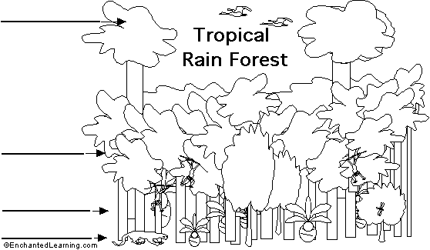
Structure of Tropical
Rainforests

Slide 12
EMERGENT TREES
Structure of Tropical
Rainforests
CANOPY
UNDER-CANOPY
FOREST FLOOR

Slide 13
Adaptation
“Something that is changed or changes to become suitable to a new or special situation.”
Think
Pair
Share

Slide 14
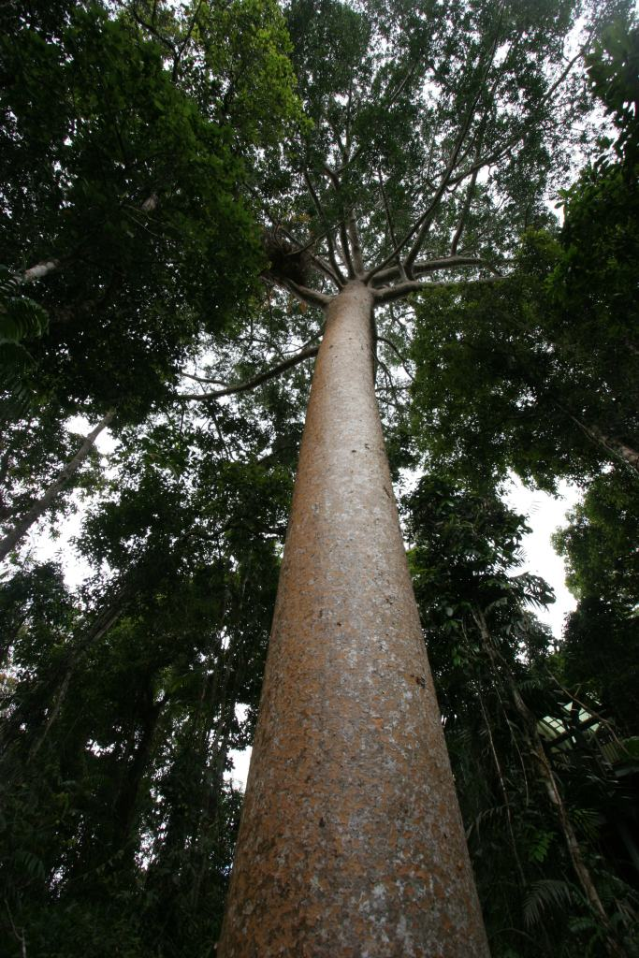
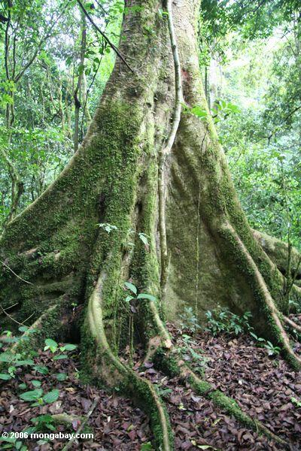
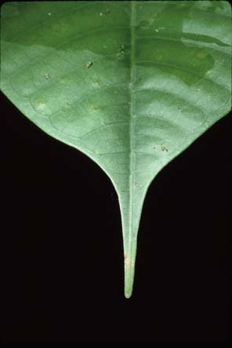
TRF Trees

Slide 15
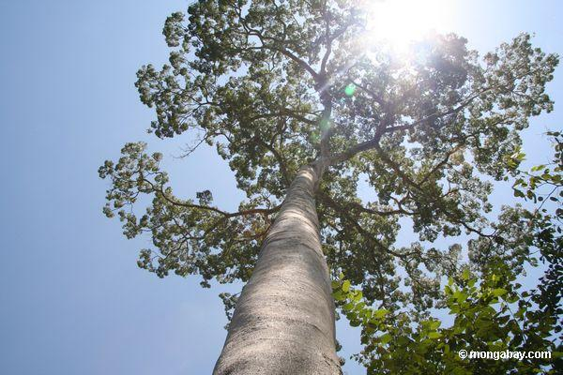
A Rainforest Tree
Why are they so special?
Trees are branchless.
Trunks are tall and thin.
Trees are evergreen.
Leaves are waxy and have drip tips.
Some trees have large buttress roots.
Creeping lianas climb high into the canopy, dropping their roots down to the ground.
Epiphytes are plants that grow in the branches of trees – they use the tree for support, not for food.

Slide 16
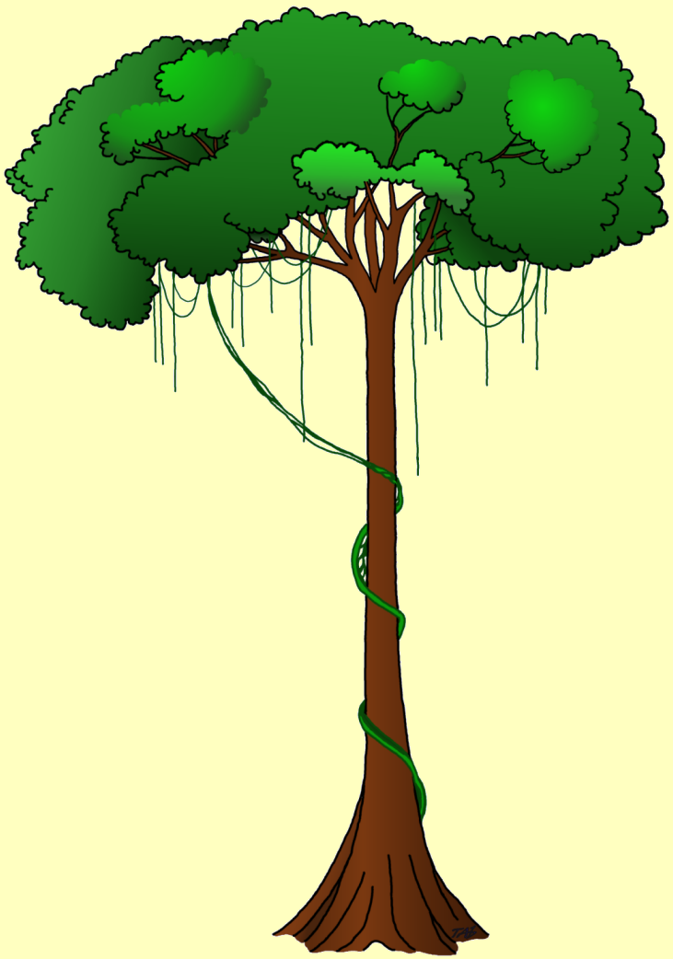
Strong scent of fruits attracts
animals, which feed on the
fruit and assist in dispersal
of the seeds
Thick, waxy surface of
leaves protects against
hot sun, heavy rain,
and strong winds
Strong scent and bright
colours of flowers
attract insects which
assist in pollination
Aerial roots of
epiphytes absorb
moisture from the
air
Tall straight trunks
no side branches
Thin, smooth bark
Shallow spreading
root system
Buttress roots

Slide 17
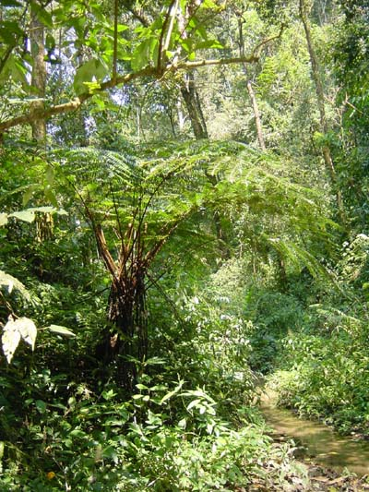
How have plants adapted to the conditions of the rainforest?
Thick vines loop around the tree trunks to reach sunlight.
Air plants perch up high on branches.
Ferns adapt to life in the shade.
Roots grow close to the surface to get nutrients.

Slide 18
Rainforest plants
And the enormous the number of different species of plants grow in
rainforests, with many species occurring only in one particular region.
Unlike other forests, rain forests have an abundance of :
Epiphytes plants which live above the ground growing on
tree trunks and branches, Example orchids,
ferns, mosses
Climbing plants including large woody climbers called lianas
which are rooted in the soil and usually reach the
canopy. The climbers twist around the tree trunks,
and loop from one tree to another in the canopy,
binding the trees together.

Slide 19
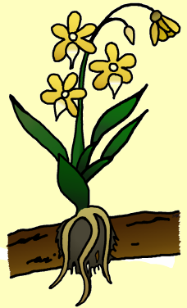
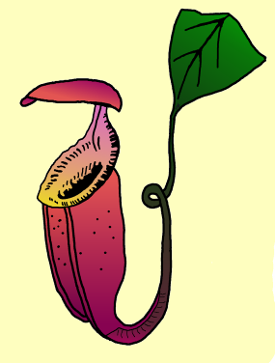
Pitcher plant - a carnivorous plant.
Parasitic plant
slippery rim
tendril
Orchid - sun-loving roots
attached themselves to
branches and absorb nutrients
Insects falling into the
pitcher are digested, and nutrients which are released are absorbed by the plant.

Slide 20
Can you find any adaptations on the animals shown on the following slides?

Slide 21
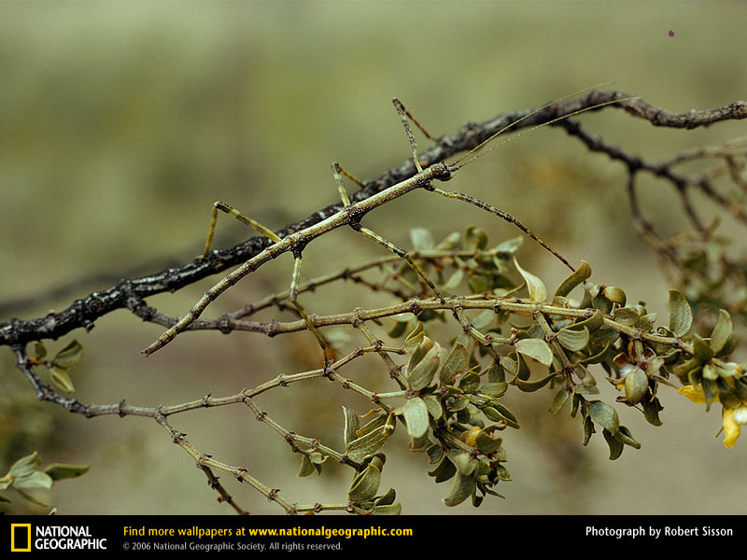
Stick Insect

Slide 22
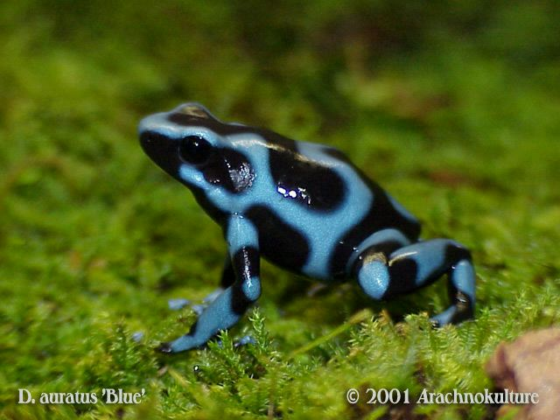
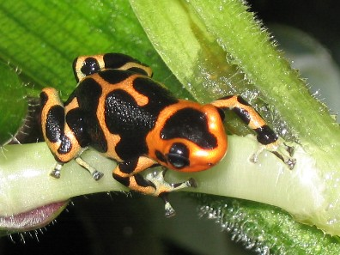
Poison Arrow Tree Frog
Mimic Poison Arrow Tree Frog

Slide 23
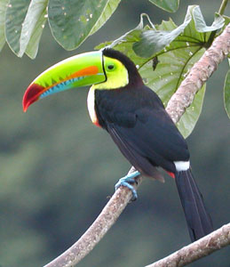
Toucans

Slide 24
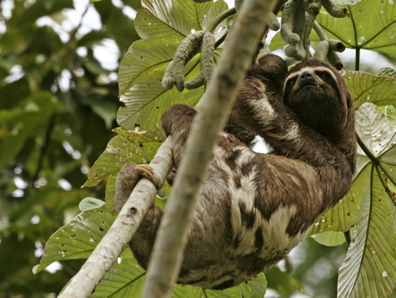
Three-toed Sloth

Slide 25
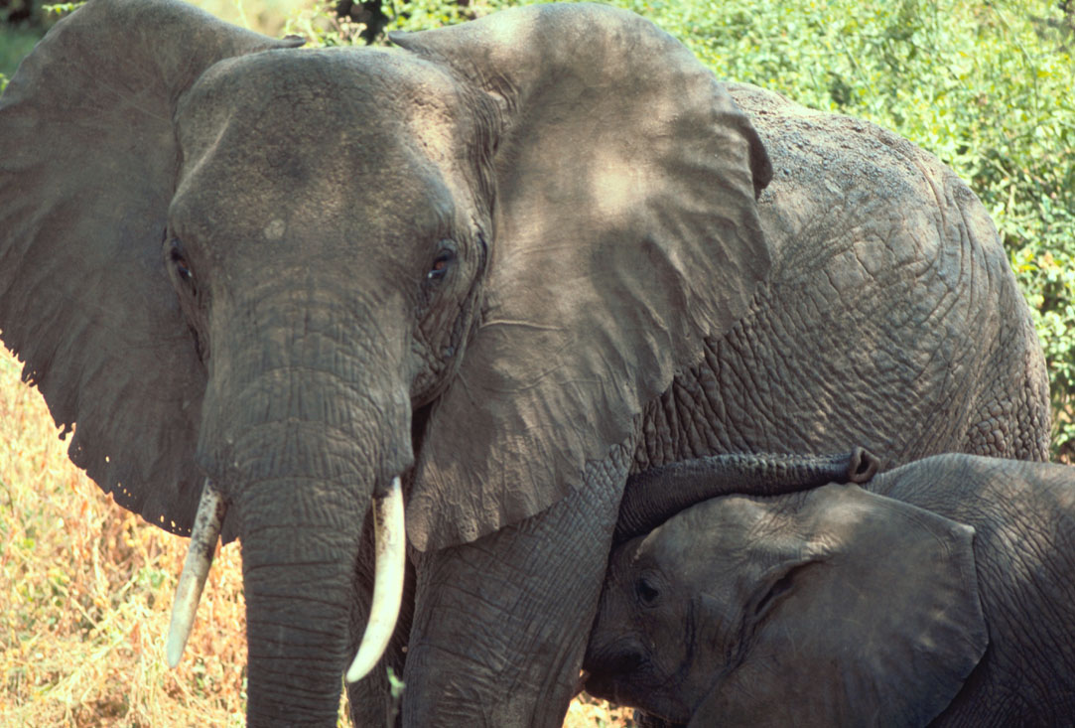
African Forest Elephant

Slide 26
Imagine that a new species of plant or animal has been discovered in the rainforest…. Your task is to design the plant or animal and suggest the adaptations they might have to suit the rainforest environment

Slide 27
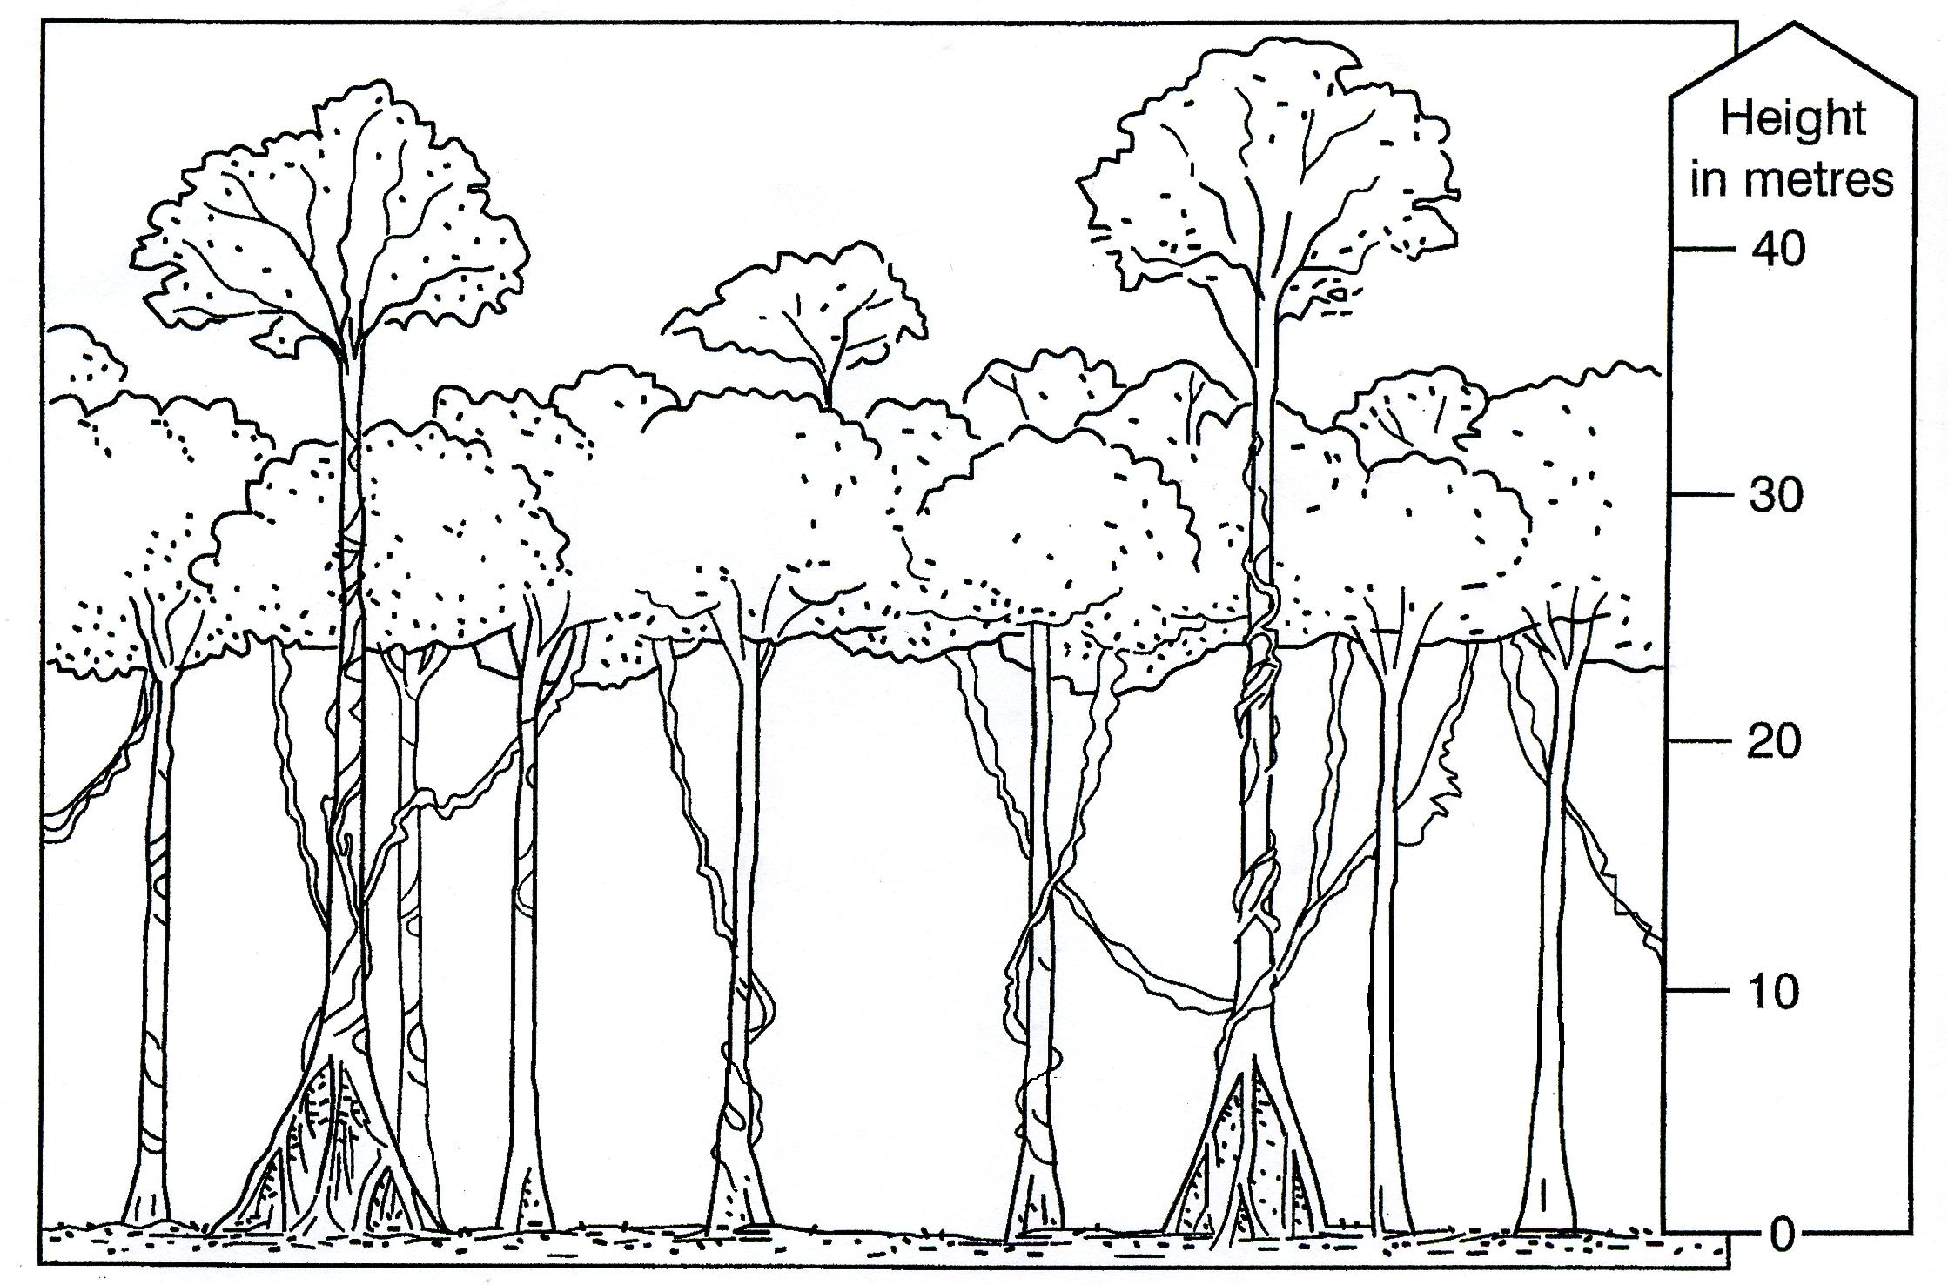
Decide what part of the rainforest your animal will live in

Slide 28
Imagine a new species of plant or animal has been discovered in the rainforest.
Draw an annotated sketch of your plant/animal.
Things to think about...
Use at least 3 adaptations for the plant/animal
Describe your plant/animal, giving reasons for its adaptations linked to the conditions within the forest
Give your plant/animal a name
Describe your plant/animal’s environment and the layer of the rainforest that it lives in
Put your plant/animal in a food chain, using other species from the rainforest.

Slide 29
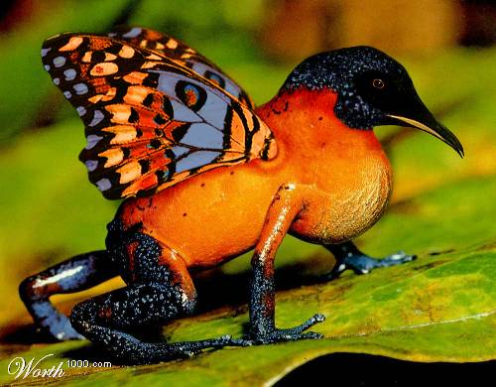
Example: Butterhummingfrog
This is a butterhummingfrog. It lives in the Brazilian rainforest. It cannot fly, but uses its wings to attract insects and butterflies to eat. It has a pointed beak to drink nectar from flowers. It likes to live in dark, moist environments like a pond or stream. Its toes have suction cup pads to help in climbing and clinging to leaves and branches.

Slide 31
Choose your own biome
Find out:
The physical characteristics of the biome i.e. location (use a map), climate, weather, flora, fauna
Explain why it has these characteristics
Draw a climate graph for the biome

Slide 32
Biomes to choose from
Desert
Tundra
Savanna
Boreal Forest/Coniferous Forest/ Taiga
Deciduous Forest/Temperate Forest
Mediterranean
Alpine
Chaparral
Temperate grassland

