Slide 1
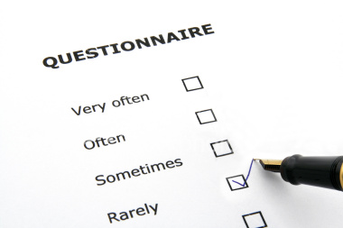
Questionnaires
CONNECT:
1. When you start to answer a questionnaire about something, what are the first questions usually about and why?
Lesson Aims:
1. Do you know what a questionnaire is?
2. Describe the types of question you know
3. Questionnaires are useful tools for sociologists. Do you:
Strongly agree, agree, neither agree nor disagree, disagree, strongly disagree
5 mins

Slide 2
Getting started…Lets look at the lesson aims
5 mins
Do you know what a questionnaire is?
Describe the types of question you know
Questionnaires are useful tools for sociologists. Do you:
Strongly agree, agree, neither agree nor disagree, disagree, strongly disagree
MATCH THE LESSON AIMS TO THE TYPE OF QUESTIONNAIRE QUESTION
Open:
Respondents can answer however they like- often in lengthy answers
Closed:
A limited number of possible answers are given and the respondents have to choose from the options given to them
Scaled (or Graded):
Respondents are asked how much they agree with questions and can record their responses on a scale of say 1-6.

Slide 3
For each of the question types copy the definition and give your own example
5 mins
OPEN- Respondents can answer however they like- often in lengthy answers
CLOSED- A limited number of possible answers are given and the respondents have to choose from the options given to them
SCALED (GRADED) - Respondents are asked how much they agree with questions and can record their responses on a scale of say 1-6.

Slide 4
2 New Key Words
3 mins
Validity and Reliability
Does anyone know what these words mean?
How do they relate to sociological research?

Slide 5
Validity describes...
Data that gives a true picture of what is being studied.
For example, you are studying whether girls in this school achieve more than boys. You would know your research was valid if…
5 mins

Slide 6
Reliability describes...
Data that can be repeated and consistently comes up with the same results.
For example, you are studying which age groups are most fearful of crime. You would know your data was reliable if…
5 mins

Slide 7
If a study has ‘x’ it has measured what it set out to measure
X is…
Validity
Reliability

Slide 8
If a study is reliable…
You could run the same procedure again and get the same results
It tests what it set out to test
It can be generalised to the rest of the population
‘a’ and ‘c’

Slide 9
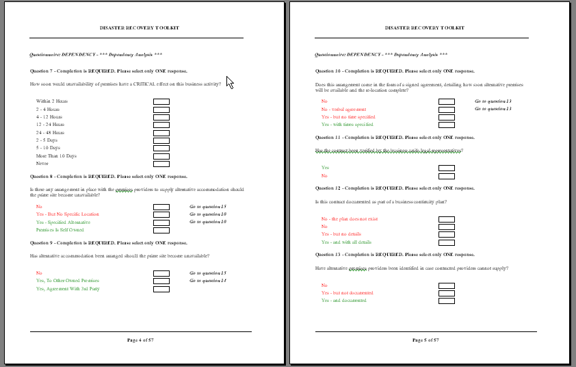
We will now use these 2 new key words in the next task which looks at the strengths and weaknesses of using questionnaires . TASK: Make a table of Advantages and Disadvantages of questionnaires and copy each statement into the correct side of the table
15 mins

Slide 10
Strengths and Weaknesses of questionnaires
1. The researcher has decided what to ask and may choose a biased set of questions
3. People can take their time to think of appropriate answers
2. Response rates vary depending on the way the questionnaire is distributed
6. Respondents might rush through the questions especially if it is a long questionnaire
4. They produce reliable data
5. They can reach a large sample
7. Questions may be misunderstood and the respondent cannot ask for an explanation
8. They are a quick way to collect a lot of data
11 They are relatively cheap to produce
10. If closed questions are asked the researcher has decided on the range of possible answers
9. Responses may lack validity

Slide 11
+/- of questionnaires... EXTENSION POINTS
12. It is possible to cross-reference data from different questions, for example, you can do an analysis by gender and age if you asked those questions
13. Open questions take a long time to analyse
14. If you ask a question you are supposed to analyse the data. You can collect too much data
15. They can be designed on a computer and are read by a computer and computer packages can help to organise the data
16. They produce quantitative data that can be easily converted into statistics

Slide 12
Pilot study
Why might you use one for questionnaires?

Slide 13
Pilot study! Ask your questions to the person sat next to you Then answer these 2 questions… 1. Does this ‘pilot study’ make you want to change the way you asked your question? 2. Why might this be important for sociologists?

Slide 14
Have you met the lesson aims?
Be prepared to feedback whether you have met the lesson aims and how!!
Lesson Aims:
1. Do you know what a questionnaire is?
2. Describe the types of question you know
3. Questionnaires are useful tools for sociologists. Do you:
Strongly agree, agree, neither agree nor disagree, disagree, strongly disagree

