Slide 1
Protest as a means of bringing about change.
What: Exploration of violent and non-violent protest and their effects.
Why: In order to tackle the problem of Climate emergency we must understand what actions are available to us to become effective change makers.
How: By studying case studies from past historical protests and evaluating their effectiveness.
Notes:
Starter – what do all these people have in common?

Slide 2
Starter:
Why do people protest?
Protest
Power?
Money?
Equality
In your breakout room discuss what makes people protest.
Share your ideas with the rest of the class.

Slide 3
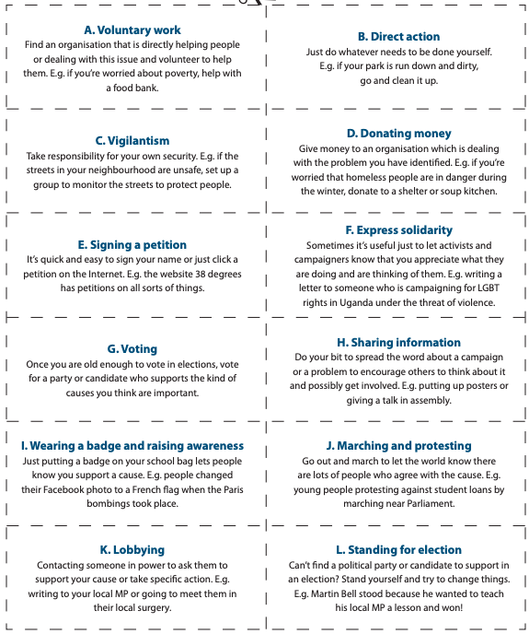
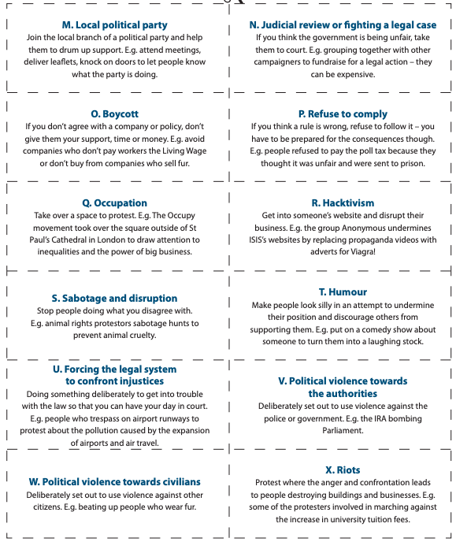
Below are 24 actions that you can take to try and bring about change on a local, national or global level..
Read each one carefully and decide if each action is legal or illegal. Plot them on the chart below.

Slide 4
Taking action to create change
“Citizens in a democracy are free to undertake any actions to bring about change so long as they are within the law.”
Illegal
Legal

Slide 5
What would you do?
Scenario card 1 – Women’s Rights
Campaign objectives
The suffragettes operated in the UK in the late 1800s and early 1900s. At this time there was a democratic system of government but women were not allowed to vote. Their objective was to force the government to give women the vote as soon as possible.
What tactics should they reject? Why?

Slide 6
What would you do?
Scenario card 2 – Animal Rights
Campaign objectives
The Animal Liberation Front exists to end abuse and cruelty to animals. In this campaign they want to put an end to fur farming. Think about what a member of this network might choose as the most effective form of action.
What tactics should they reject? Why?

Slide 7
What would you do?
Scenario card 3 – Anti-fascists
Campaign objectives
The Anti-fascist Network exists to make sure that far-right and racist campaigners are always challenged and demonstrate that the number of people against such ideas is greater than the number of them. Their ultimate goal is to make sure the far right cannot build a power base in local communities. Think about what a member of this network might choose as the most effective form of action.
What tactics should they reject? Why?

Slide 8
Historical Case Studies – What methods of protest are effective in bringing about change?
YOUR TASK:
You have been provided with a list of violent and a list of non-violent protests that have occurred in the past.
You should select one event from each list.
You should research each event and create a summary of the event that answers the following questions;
What are the protesters demanding? What change do they want to occur?
What happened? What methods/actions do they use to make their protest?
Were they successful? What were the consequences of the action?

Slide 9
Historical Case Studies
Non- Violent Action
Violent Action
The Salt March (India) 1930
The Montgomery Bus Boycott (USA) - 1955
The Selma to Montgomery March (USA) 1965
The Monday Demonstrations in Leipzig (Germany) 1989
Tiananmen Square Protest (China) 1989
The Singing Revolution (Estonia) 1987 - 1991
The Storming of the Bastille (France) 1789
The Easter Rising (Ireland) 1916
Emily Davison – Suffragette (UK) 1913
The Sharpeville Massacre (South Africa) 1960
Kent State Massacre (USA) 1970
The Detroit Riots (USA) 1967

Slide 10
Time to share and discuss
You will be allocated a breakout room of 3-4 people.
In your group share your presentations.
Share your non-violent protests – when you have all shared ask the following questions.
Do they have anything in common?
Do they use similar methods?
Are they all successful?
2. Repeat the process for your Violent Protests.

Slide 11
Can breaking the law or using violence ever be justified?
Using the Padlet on the Weebly add your opinion on the question above.
Notes:
Pupils write down ideas on post-its and then stick them on the whiteboard.

Slide 12
Evaluation Can breaking the law or using violence ever be justified?
Now that you have explored a range of actions that people can use to bring about change and have researched and discussed several case studies you should answer the question above.
You should;
Use no more than 200 words
Offer a balanced response – agree and disagree
Use specific examples

