Slide 1
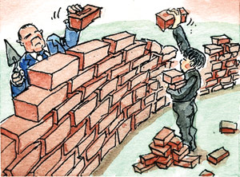
Protectionism: The Trade Barrier Game

Slide 2
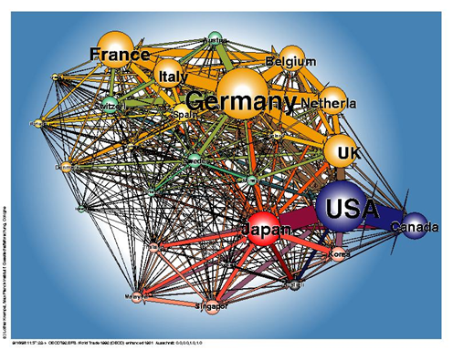

Slide 3
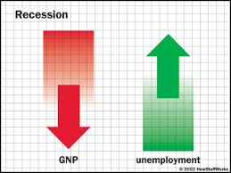
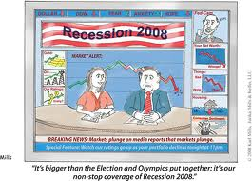
The Scenario
You represent the government of a country in trade negotiations with two of your main trading partners during a time of recession.

Slide 4
The Rules
You will take part in 6 rounds of negotiation. During each round you must decide in private whether you wish to have free trade with your neighbours or impose a measure of protection.
If you select protection you will increase the revenue you generate for that round through increased taxes and higher sales of home produced products, but beware retaliation is sure to follow and your exports may suffer as a consequence.

Slide 5
The Rules
After each round you must make a decision F for Free Trade or P for Protection.
Do this in private.
Reveal your decision at the same time as your neighbours.

Slide 6
The Game – the details
At the beginning of each round an event card will be passed between the 3 countries there should be no communication between countries at all-no listening in!!
Each country is assumed to be able to continue free trade, the status quo at the beginning of the game or take a protectionist measure
They should slide the chosen card forwards
On the cue ‘reveal’ reveal you card to all countries and work out how it has affected your trade balance
A note of your score will be made
At this stage you are able to tell other countries whether you intend to keep your protective measure in force at the beginning of the next round or remove it
Draw the next event card

Slide 7
Trade combination | Trade decision | Country’s X ($m)
FFF | F | 800
FFP | F P | 200 1400
FPP | F P | -400 1000
PPP | P+3 P+2 P+1 P P-1 P-2 P-3 | 1000 800 700 600 200 -400 -800
Round | Country A | Country B | Country C
1
2
3
4
5
6
Total

Slide 8
And the winner is….
The country that has the healthiest trade balance on current account over 6 rounds.
Or is it?
How did your group do compared to the other groups in the class?
If other groups were better off as a whole, how did they achieve this?
How realistic do you think this game is?

