Slide 1
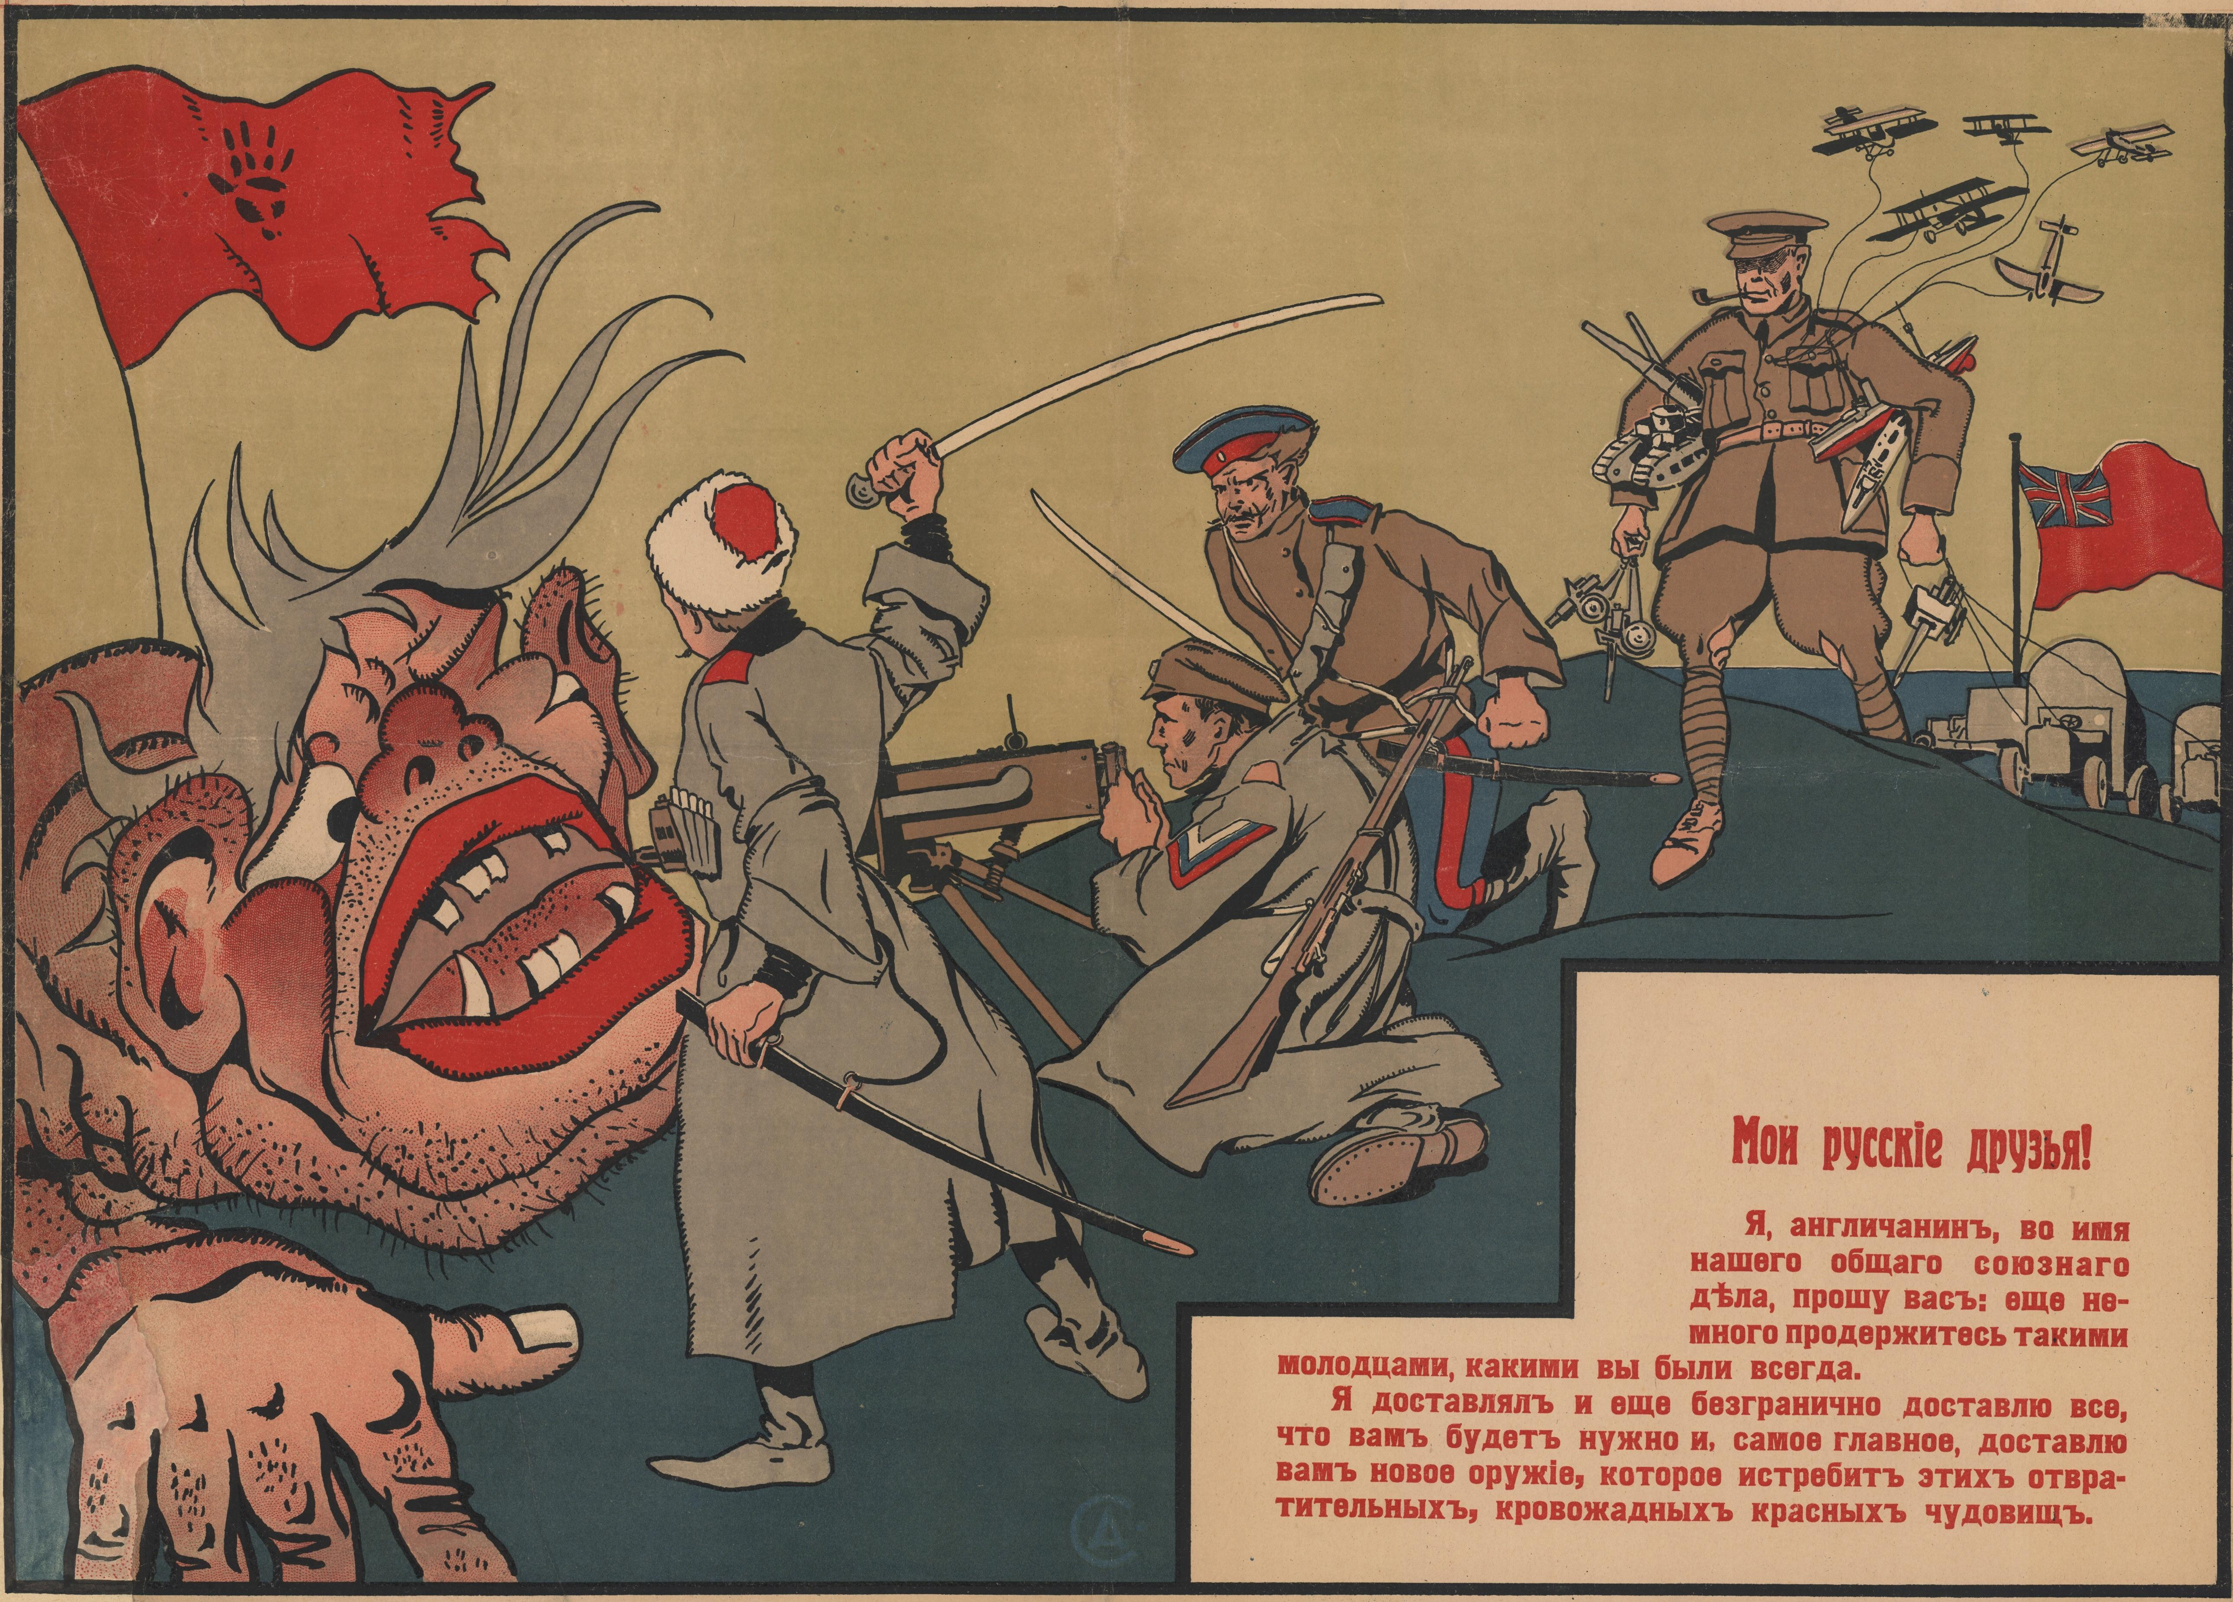
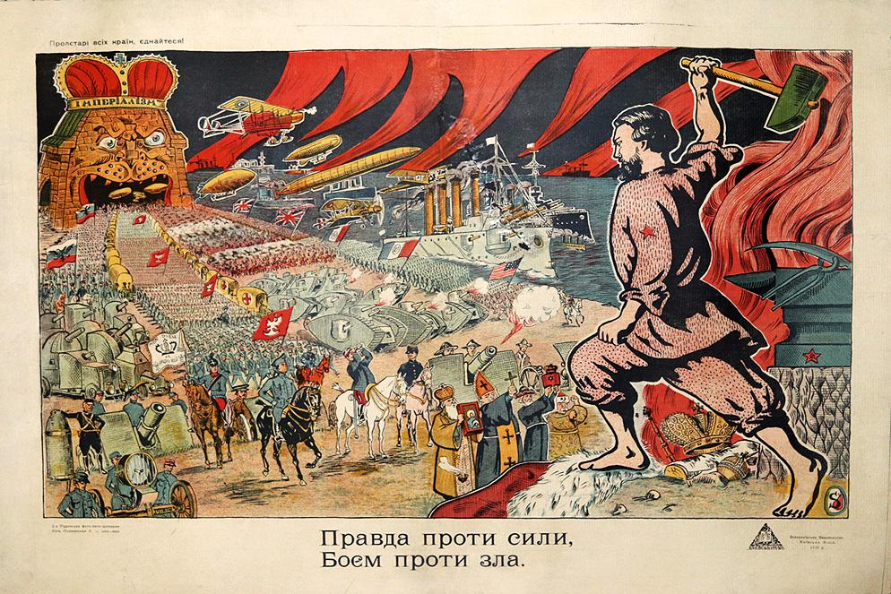
PROPAGANDA POSTERS
THE SUMMER OF 1918 SAW THE START OF A TERRIBLE CIVIL WAR IN RUSSIA.
ON ONE SIDE THE RED – THE COMMUNISTS. ON THE OTHER SIDE WERE THE WHITES. THE OPPONENTS OF THE NEW COMMUNIST GOVERNMENT
BOTH SIDES PRODUCED PROPAGANDA POSTERS LIKE THESE IN ORDER TO WIN SUPPORT

Slide 2
WHAT IS PROPAGANDA?
The purpose of propaganda is to persuade people to think, believe, or do something by appealing to their emotions or by using misleading or biased information. It can be used to influence opinions, shape public opinion, and bring about behavioral changes.

Slide 3
HOW DOES PROPAGANDA WORK?
1. Bandwagon: Encourages people to join in a movement or idea because everyone else is doing it. This is often seen in advertising and political campaigns.
2. Glittering Generalities: Uses emotionally charged words and phrases to evoke a favorable response from the audience. It relies on unstated and often vague promises and the appeal of patriotism and similar emotional triggers.
3. Transfer: Uses symbols and associations to attach an idea or feeling to something else. It is commonly used in advertising and politics.
4. Testimonial: Uses a celebrity or spokesman to affirm the benefits of a product or idea.
5.Name-calling: Uses a negative term to discredit an opponent or opposing idea or viewpoint.
6. Plain Folks: Appeals to ordinary people by using common language that they can easily identify with.
7. Card Stacking: Selectively omits or distorts information to make one side of an issue look better than the other.
8. Fear: Uses fear or a threat of harm to influence a person to take a certain action.

Slide 4
IS IT RED OR WHITE PROPAGANDA?
What message is the poster trying to put over?
1.
2.
3.

Slide 5
IS IT RED OR WHITE PROPAGANDA?
What message is the poster trying to put over?
1.
2.
3.
Translation: DID YOU VOLUNTEER?

Slide 6
IS IT RED OR WHITE PROPAGANDA?
What message is the poster trying to put over?
1.
2.
3.

Slide 7
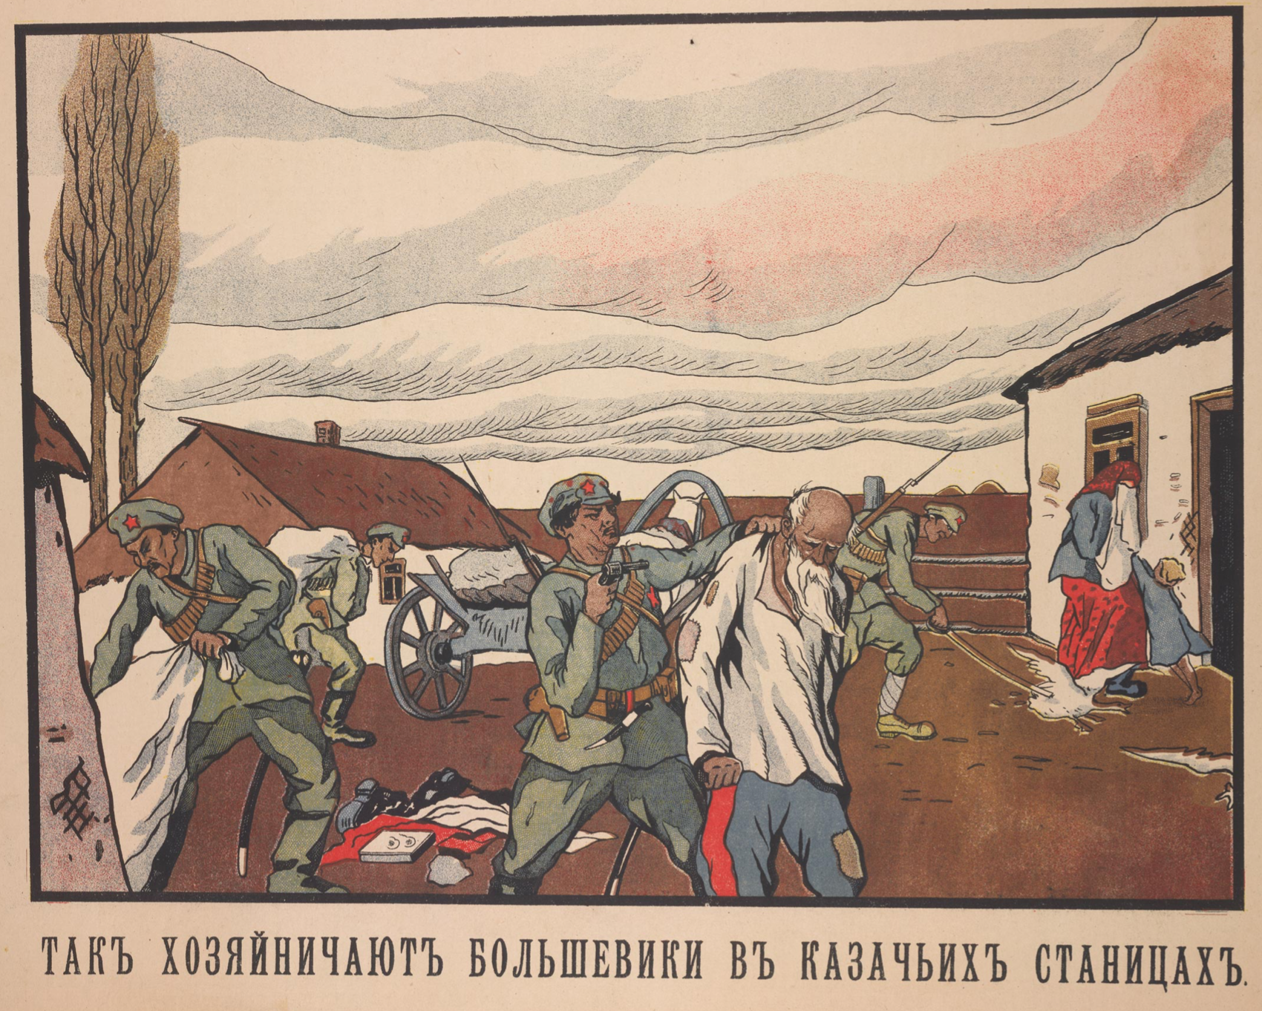
IS IT RED OR WHITE PROPAGANDA?
What message is the poster trying to put over?
1.
2.
3.

Slide 8
LOOK THROUGH YOUR SPIDER DIAGRAM AND DECIDE WHAT SIDE OF THE CIVIL-WAR YOU WOULD LIKE TO CREATE A PROPAGANDA POSTER FOR…
THINGS TO CONSIDER:
WHAT SIDE WILL YOU SUPPORT?
WHAT MESSAGE WILL YOUR POSTER FOCUS ON?
HOW WILL YOU COMMUNICATE YOUR MESSAGE TO YOUR AUDIENCE?
COMPLETE A QUICK DRAFT OF YOUR IDEA AND THEN CREATE THE FINAL PIECE ON A4 PAPER.

