Slide 1
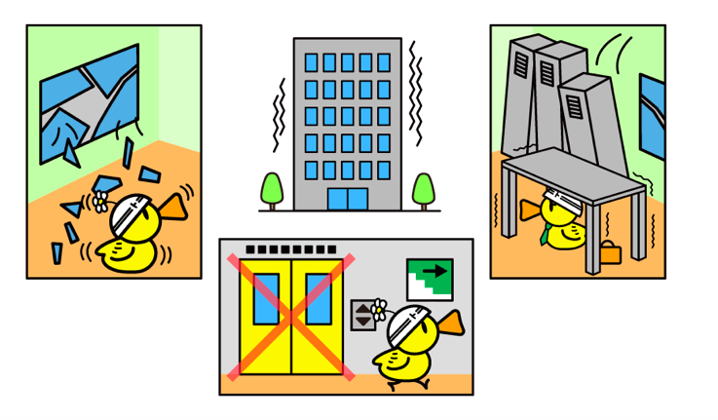
What: How can a country prepare for an earthquake?
Why: To understand how the risk of earthquakes can be reduced
How: By looking at earthquake preparation, prediction and protection
Final essay question: “Was the Haiti 2010 Earthquake a bigger disaster than the Japanese Earthquake of 2011?”
https://www.nippon.com/en/guide-to-japan/gu016001/being-prepared-for-an-earthquake.html

Slide 2
The different ways of reducing the effects of earthquakes can be classified according to whether they involve:
Prediction:
Attempts to forecast an event, where and when it will happen, based on current knowledge.
Protection :
Constructing buildings so that they are safe to live in and will not collapse. Tsunami walls in Japan.
Preparation:
Organising activities and drills so that people know what to do in the event of an earthquake.

Slide 3
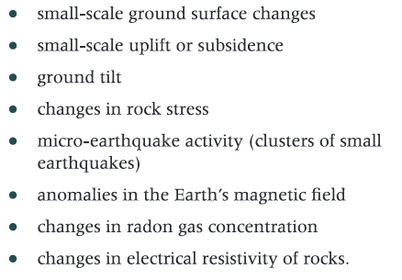
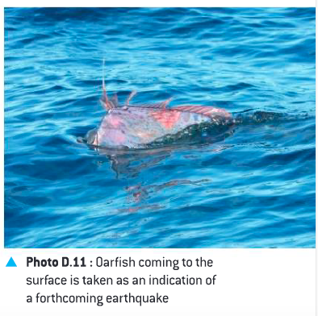
Earthquake prediction
Animal behavior
In Japanese folklore dead oarfish are a sign that an earthquake is supposed to happen- in 2011 20 washed up on the beaches where Tohoku earthquake and tsunami caused the most damage- could be because of the carbon dioxide released by the earthquake or electrically charged ions to be released by the water.
In 1975, the day before a 7.3 earthquake stuck the city of Haicheng city officials evacuated the city based on strange animal behavior such as hibernating snakes coming out of hiding months early.
The most difficult hazard to predict ….

Slide 4
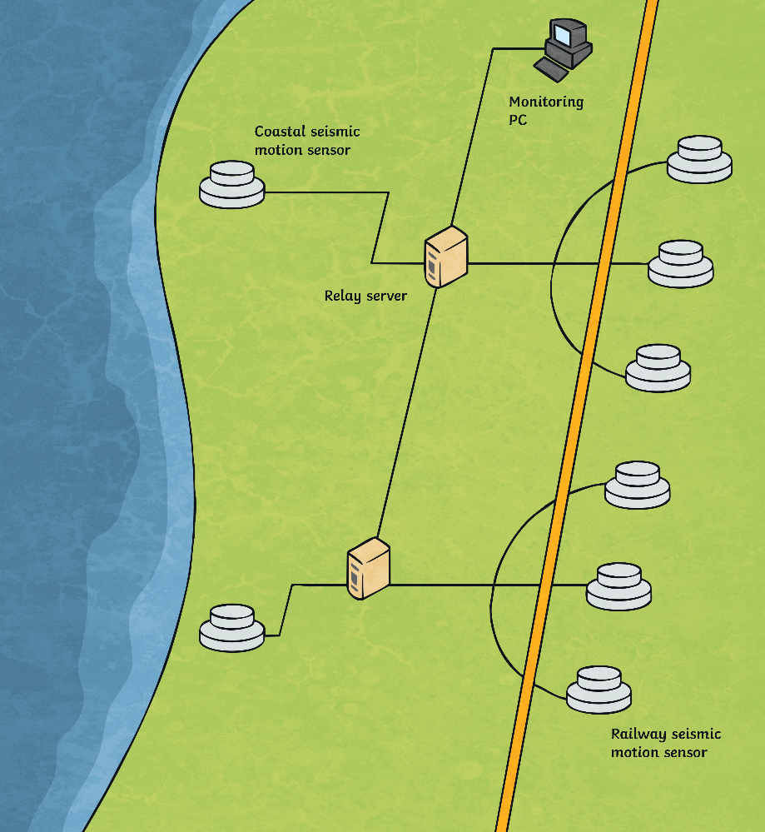
Prediction/ protection in Japan
Urgent Earthquake Detection and Alarm System
The Urgent Earthquake Detection and Alarm System (UrEDAS) is a system designed for Japan Railways. Motion sensors are used to detect the beginning of an earthquake, registering small seismic waves.
When seismic waves are detected, power to the train line system is automatically cut off, bringing trains to a stop.

Slide 5
Preparation

Slide 6
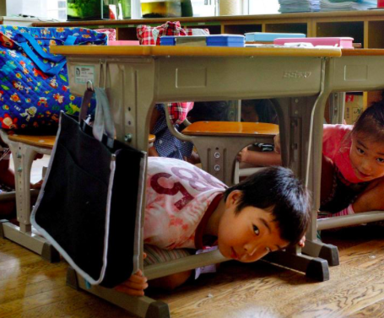
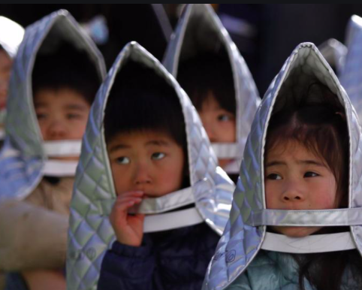
Earthquake drills Japan
Japan Earthquake Drill On Disaster Prevention Day. Japanese authorities have staged a drill based on the scenario of a mega earthquake striking the country on Saturday, national Disaster Prevention Day. The date September 1st commemorates the 1923 Great Kanto Earthquake, which left more than 100,000 people dead in and around Tokyo.
https://www.youtube.com/watch?v=fze5s1SlqB8&feature=emb_rel_err

Slide 7
Earthquake emergency kit in Japan
https://www.bbc.com/news/world-asia-pacific-12759840

Slide 8
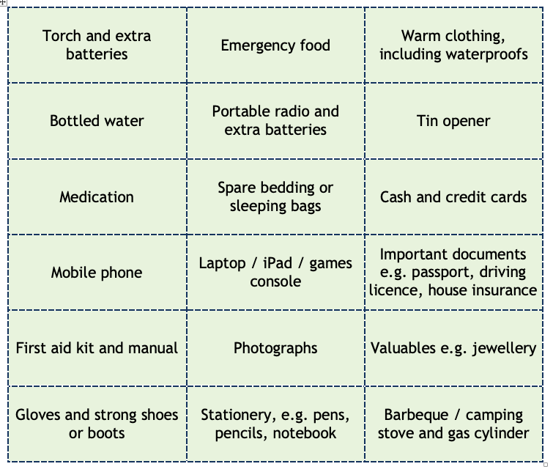
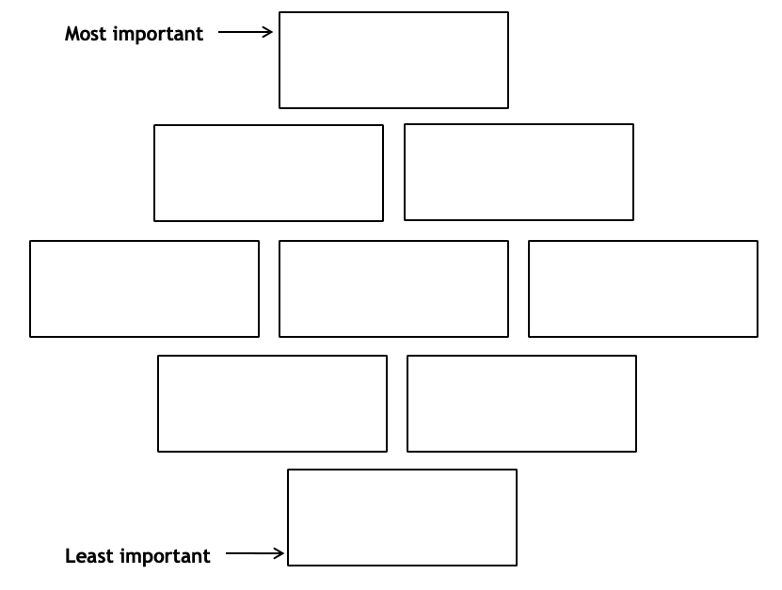
What would you put in your emergency grab bag?
Pick the one item that you think is the most important. Now pick the eight next most important items.
‘Diamond rank’ all nine items on the chart below. The most important item needs to go in the top box and so on.
Make sure you are able to justify your top choice.

Slide 9
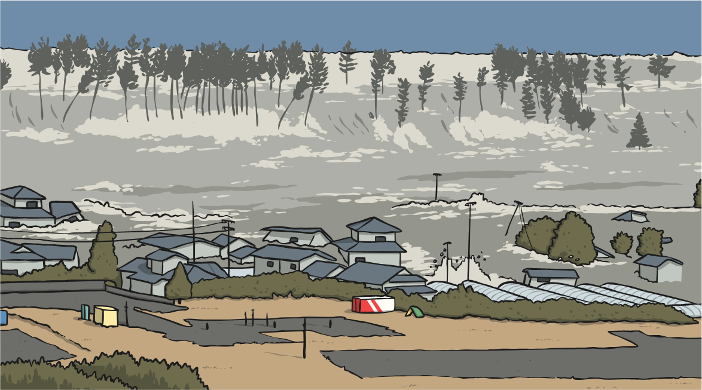
Protection against Tsunamis
Protection
A severe earthquake can trigger a tsunami. A tsunami is a large wave caused by a sudden movement of the ocean floor, such as the shock of the seismic activity from an earthquake.
A tsunami can be devastating to life, property and nature. As Japan is extremely susceptible to earthquakes, it has implemented strategies to minimise the damage that tsunamis could cause.

Slide 10
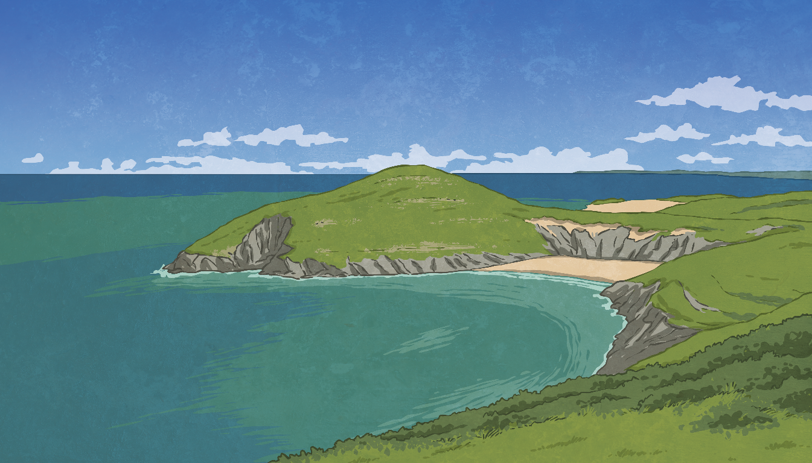
Protection against Tsunamis
Seawall
Thick, high concrete walls have been constructed along on Japan’s coastline where a tsunami might strike the coast. Seawalls have been proven to protect the coastlines from damage and coastlines.
Coastal Forests
Forests along the Japanese coastlines have shown to reduce the destruction and damage caused by a tsunami by absorbing the energy of the wave.

Slide 11
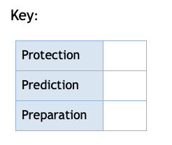
1. Sort the information above into the 3 categories: Protection, prediction and preparation
2. Not all countries can afford to prepare for earthquakes.
Use the boxes above to write a paragraph describing how poorer countries would prepare differently to richer countries.
Can you explain the differences (say why)?

