Slide 1
Case study of a national sports league: The English Football League

Slide 2
LO: Factors affecting the geography of a national sports league, including the location of its hierarchy of teams and the distribution of supporters Case study of one national sports league

Slide 3
Key terms
Hierarchy: Placing things in an order of importance. Usually in Geography it refers to placing settlements in an order of importance. Here it will refer to placing football leagues and football teams in an order of importance. Sphere of influence: The area people will travel from to access a service. Here it will be the area that people travel from to support a football team.

Slide 4
What factors would influence you to support a particular sports team?

Slide 5
Part 1 - Global Factors Affecting Participation

Slide 6
2016 Questions

Slide 7
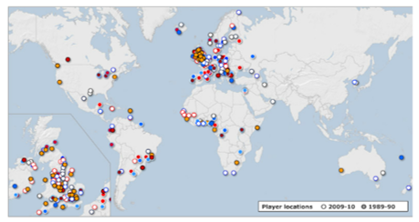
English premier league: global participation
Study the BBC interactive article carefully. You are going to be working as a group to determine the global participation spread of players in the Premier League. There were three prominent teams in the Premier League back in 2009. They were Manchester United FC and Arsenal FC, Chelsea FC. Each of these teams were successful and qualified for the UEFA Champions League, won cups and made millions of $'s in profits. i. Using the Task 1 worksheet, complete the commentary for both maps of English Premier League participant players for 1989 and 2009.
ii. Using your own knowledge and discussing with your group, try to construct flow arrows that explain why certain nationalities of players can participate in the Premier League competition.

Slide 8
Origins of football
England is the origin of nearly all first accounts of features of football and its roots in England can be found in Medieval times.
When the Football Association was founded in 1863 blue collar workers found they could earn more playing football than working in factories. The game has therefore had a more traditionally working class following.
However, sociologists state that times are changing and the children of blue collar workers who have grown up supporting a team, however, they have become white collar workers themselves. Therefore the social class of people watching football in England has diversified.
Extra reading: Guardian: 'It’s only working for the white kids': American soccer's diversity problem’

Slide 9
Barclays Premier League
The Barclays Premier League (also known as the English Premier League, The premiership, The Premier League and the FA Premier League) was established in 1992. It replaced League One which was formed in 1888.
The Premier League has 20 teams, with three teams being relegated and promoted each year. This makes it different to many leagues (NHL, NBA, Super 15's) which operate franchise systems with no relegation or promotion.
Because the Premier League is the only level 1 league in England, it is obviously at the top of the hierarchy in terms of English football. The league season consists of each team playing each other home and away (38 matches in total). There are no play-offs, the team to finish at the top of the league are crowned champions. The top four team qualify for the lucrative European competition, the Champions League.
The Premier League is the most watched league in the world, watched by half a billion in 202 countries. It is also the world's richest league generating about $3 billion in income during the 2009/10 season.
Since 2004 the Premier League has been sponsored by Barclays, so that it why it is often referred to as the Barclays Premier League. The television revenue for the Barclays Premier League is huge, rights for 2010-2013 were sold for $2.7 billion. Extra revenue came for selling overseas rights, highlight rights and internet rights.

Slide 10
‍Measuring Hierarchy
The Barclay's Premier League is the only level one league in England so it is top of the hierarchy in terms of football leagues.
The Barclays Premier League is often considered to be the number one league in the world as well, because of its viewing figures, average attendances and income generation.
In terms of the football team at top of the hierarchy, things get a little bit more complicated. The current champions are Leicester City (anomaly). However, if we look at different measures then Manchester United, Manchester City or Liverpool could appear at the top of the hierarchy. Biggest Stadium: Manchester United (Old Trafford) Average Attendance: Manchester United Most Premier League Titles: Manchester United Current Champions: Leicester City 2015-16/Chelsea 2014/15 Most FA Cup titles: Manchester United Most Champions League Titles: Liverpool Highest Wage Bill: Chelsea and Manchester City Richest Club: Manchester United

Slide 11
Looking at the list of Premier League clubs below, a city needs a population of about 250,000 to support a Premier League football club. Wigan, Norwich and Swansea all noticeable exceptions. There are also some big cities in England that don't have Premier League football teams; Derby, Nottingham are a couple, but even more noticeable are Sheffield (535,000), Leeds (770,000) and Bristol (420,000).
TEAM | CITY | ‍CITY POPULATION | STADIUM NAME | STADIUM CAPACITY
Aston Villa | Birmingham | 1 million | Villa Park | 42,000
Norwich City | Norwich | 132,000 | Carrow Road | 26,000
West Bromwich Albion | Birmingham | 1 million | The Hawthorns | 28,000
Reading | Reading | 232,000 | Madejski Stadium | 24,000
Manchester City | Manchester | 500,000 | City of Manchester | 47,000
Manchester United | Manchester | 500,000 | Old Trafford | 75,000
West Ham | London | 7.5 million | Upton Park | 35,000
Newcastle United | Newcastle | 260,000 | St James Park | 52,000
Sunderland | Sunderland | 280,000 | Stadium of Light | 49,000
Stoke City | Stoke | 250,000 | Britannia Stadium | 28,000
Wigan Athletic | Wigan | 81,000 | JJB Stadium | 25,000
Fulham | London | 7.5 million | Craven Cottage | 25,000
Swansea City | Swansea | 228,000 | Liberty Stadium | 20,500
Tottenham Hotspurs | London | 7.5 million | White Hart Lane | 36,000
Arsenal | London | 7.5 million | Emirates | 60,000
Chelsea | London | 7.5 million | Stamford Bridge | 42,000
OPR | London | 7.5 million | Loftus Road | 19,000
Southampton | Southampton | 239,000 | St Mary's Stadium | 32,000
Liverpool | Liverpool | 435,000 | Anfield | 45,000
Everton | Liverpool | 435,000 | Goodison Park | 40,000

Slide 12
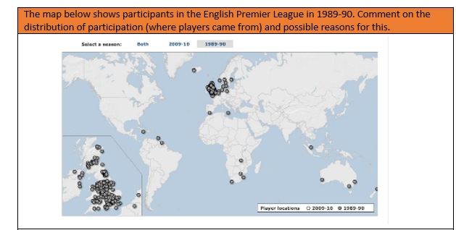
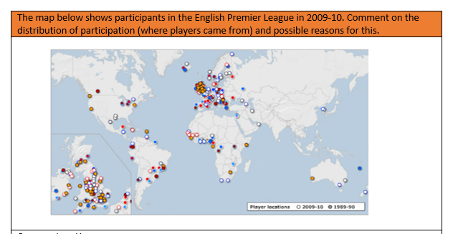

Slide 13
Political Factors limiting participation in the Premier League
Click here to access a news article on the UK Work Permit system and how it affects players wishing to participate in the league. Outline the rules for players who are from outside of the EU.
Click here to access a 2014 news article on the limiting of non-UK players in Premier League teams and promoting home grown players. Make notes on why this system has been introduced, how it links to the English National Football team and the effects that it is likely to have.

Slide 14
Economic factors affecting participation in the Premier League
There has been massive inward investment into four of the top football clubs in the English Premier League in recent years. Premier League clubs have been bought by foreign investors. Three examples are set out below:
Chelsea Football Club (London) - Roman Abramovich (Russia). Wealth $11.3 billion & 53rd wealthiest person on earth
Manchester City - Sheikh Mansour (United Arab Emirates). Wealth $4.3 billion with family fortune of $1 trillion!
Manchester United - Glazier brothers (USA). Wealth $4 billion.
Check out the following articles to find out how much each club has spent to achieve success in the Premier League. Make notes on these three clubs including levels of spending from the graphs below. Manchester City FC - Link here Chelsea FC - Link here Manchester Utd FC - Link here

Slide 15
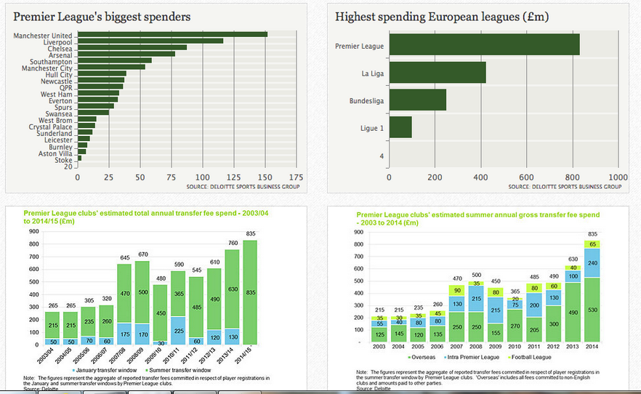

Slide 16
The Globalisation of Sport
Factors affecting spectators
Drag the timer bar to 5:33. Make notes on International Sports People from both the slide and the narrator. https://www.youtube.com/watch?time_continue=470&v=X6QEvM_d9xg
Spectator participation The majority of revenue for football clubs is generated not through fans who go to see live games, but those who watch matches live on television in different parts of the world. Click here to read the Independent newspaper article from 2010 on the money generated through TV broadcasting.

Slide 17
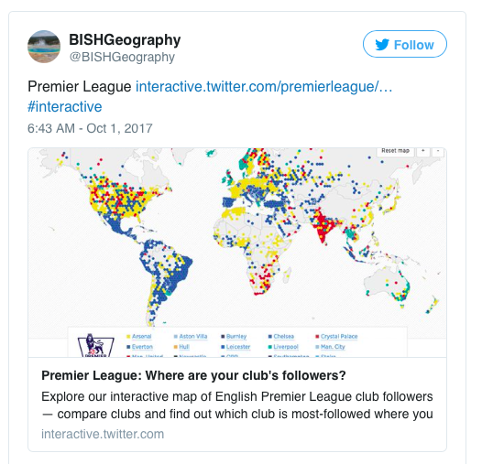
The global spread of the supporters of the premier league
Refer to the 2 embedded tweets on the weebly page:
Task 1: Look at the embedded 'map of the premier league' tweet below. Describe the pattern shown: - Which clubs are the most followed overall? - Which countries have concentrations from particular clubs? - Which areas of the world have fewer supporters?
Task 2: Why has the pattern occurred? Read the tweet below and explain some of the reasons for this pattern.

Slide 18
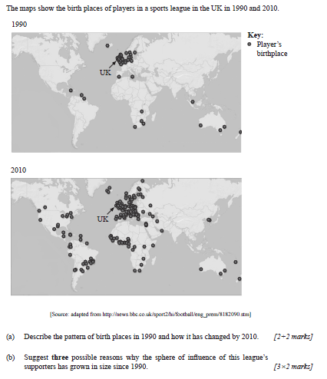
Past exam questions Nov 2011:
Sphere of influence: The area that people are drawn from to support a service. Here it will be the area that supporters are drawn from to support a football team.

Slide 19
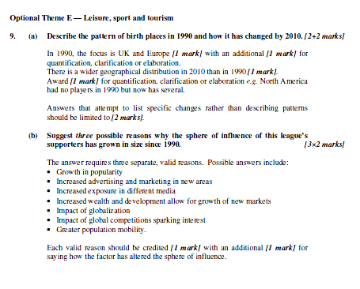
Markscheme

Slide 20
‍Manchester United - Top of the Hierarchy?
Manchester United has the biggest stadium, the highest income, the most FA cups, the most league titles and the most global fans. Because of this it is often considered to be the number one club in England - top of the hierarchy. Manchester United was formed in 1878 but was not an original founding member of the football league. Originally called Newton Heath it changed its name to Manchester United in 1902 and moved to Old Trafford in 1910. Manchester is owned by the American Glazer family and is estimated to be worth about $2 billion making it the most valuable club in the world. The club's worldwide fan base includes more than 200 officially recognised branches of the Manchester United Supporters Club (MUSC), in at least 24 countries. The club takes advantage of this support through its worldwide summer tours. Accountancy firm and sports industry consultants Deloitte estimate that Manchester United has 75 million fans worldwide, while other estimates put this figure closer to 333 million.
Data on Man United Fans from Facebook:
http://www.peakdemand.co.uk/blog/facebook-advertising/manchester-united/
Manchester United is currently sponsored by Aon who are paying about $120 million over 4 years. The clubs brand and trademarks are estimated to be worth about $525 million. Manchester United manages to maintain its number one position through:
Merchandise sales (shirts, mugs, posters, bed spreads, etc.)
Season ticket and match day ticket sales
TV money (Sky)
Transfer market (selling players e.g. Ronaldo to Real Madrid)
Global pre-season tours (usually to Asia) - Japanese gripped by Man United fever - BBC article
International players e.g. Ji-Sung Park of South Korea
Website and supporters club (http://www.manutd.com/)
Winning trophies (prize money)
MUTV (television channel promoting itself)

Slide 21
‍Manchester United – Fact-file
Date Founded: 1878 Stadium: Old Trafford Stadium Capacity: 75,957 Income (2009/10): Turnover of over $460 million Premier League Titles: 12 League Titles (including Premier League): 19 titles Champions League Trophies: 3 FA Cup Victories: 11 Highest Earning Player (salary): Wayne Rooney ($11.6 million a year) Total Wage Bill: About $193 million a year Global Fans: Up to 330 million
Manchester United is world's richest club says Forbes - BBC article
Warning over Premier League wages - BBC article
Manchester United to break 100 million in commercial revenue - Guardian article

Slide 22
Manchester United top of the hierarchy?
Manchester United reports 110.9 million pounds operating profit - BBC article Man United accept 80 million pound Ronaldo bid - BBC article Man United in new shirt sponsor deal - BBC article Manchester United announce details of pre-season tour of North America - Guardian article Do Man Utd really have 659m supporters? - BBC article

Slide 23
Case study of a national sports league
Task: Make a fact-file for a national sport’s league. You can use the example of the English football league or an example for another sport you enjoy
Brief introduction: Why is it an important sport for the country/who plays?
Explain the organisation and hierarchy of the league.
Explain the relationship between team location and the residence of its supporters.

Slide 24
Exam practice: Nov 2012

Slide 25
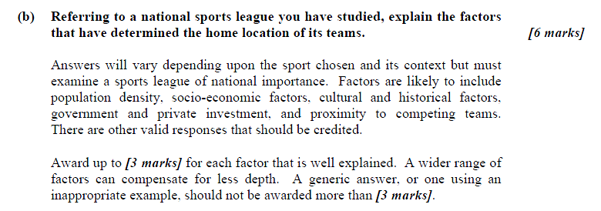

Slide 26
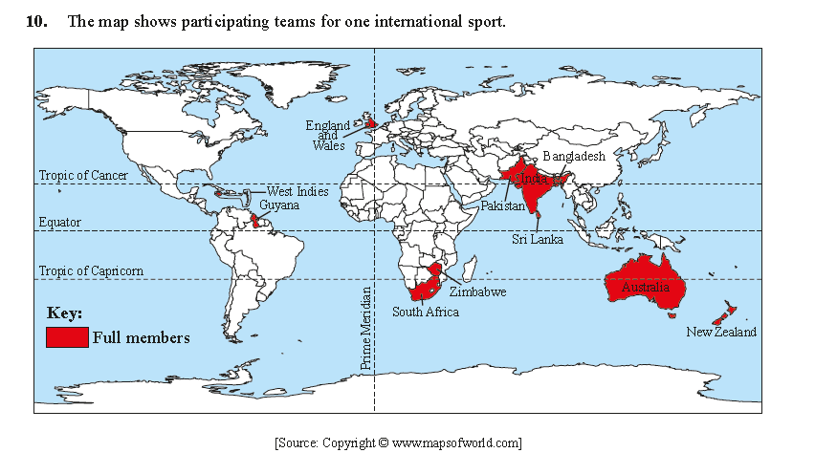
2014 May paper

Slide 27
2016 Questions

